Slide 1
Writing – Plagiarism
What is academic dishonesty?
Skyline Definition of Academic Dishonesty & Plagiarism…

Slide 2
Most common form of academic dishonesty

Slide 3
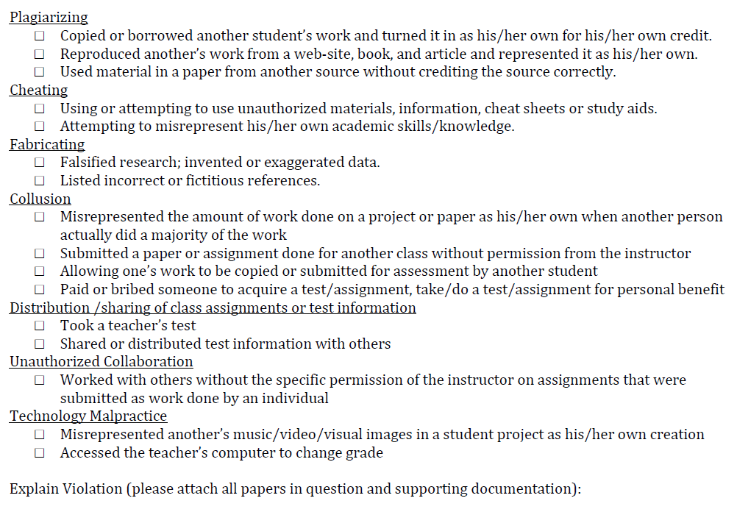

Slide 4
Turnitin.com
This is a great tool for you and teachers
Makes it easier to turn in assignments
Allows you and the teacher to receive/give great feedback
Awesome way to turn in assignments
It also allows me to see what is copied and what is not…

Slide 5
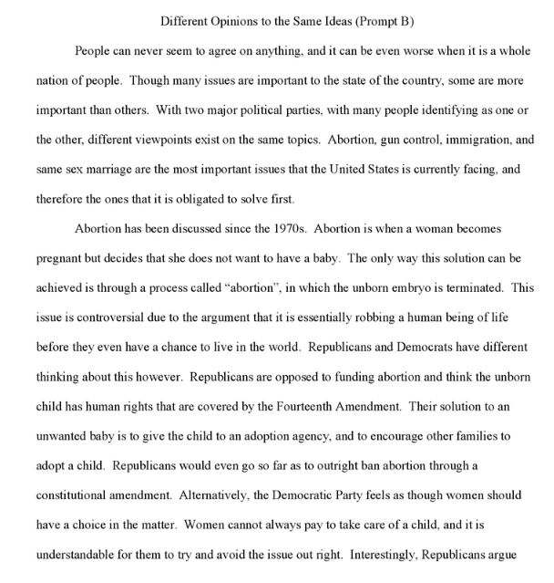
Little or No cited/copied work

Slide 6
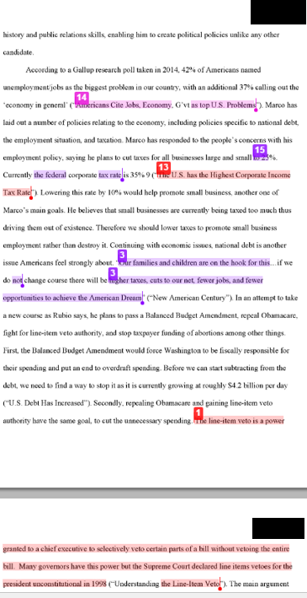
Some cited/copied work

Slide 7
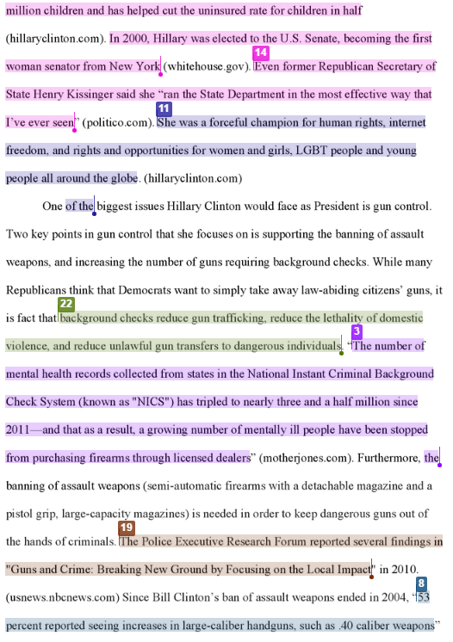
Lots of cited/copied work

Slide 8
What we want to see…

Slide 9
What we don’t want to see…

Slide 10
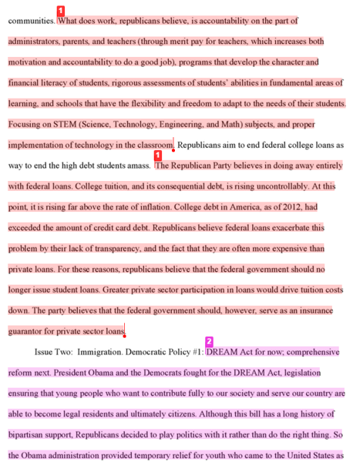
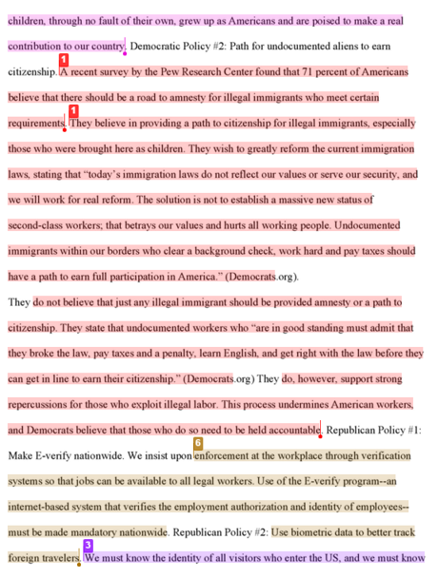
One example of a plagiarized essay

Slide 11
Plagiarism Reminder
Plagiarism is not just copying someone else work. It is also stealing their thoughts and ideas.
We know if you are creating your own thoughts and ideas or if you are taking them from someone else.
Ways to avoid plagiarism
Don’t take other information without citing it in your essay.
Don’t take ideas/thoughts without citing it.
Make sure you are doing proper MLA citations in the essay and proper MLA paraphrasing in your essay.

Slide 12
Writing – Citations Direct Quote
If you cite a direct quote you should have quotation marks around it, along with the authors last name and the page number
This is only from a text with a single author.
In the event that you are using a different source than a book with 1 author you may need to cite your source differently
Purdue Owl will set you free

Slide 13
Writing – Citations Paraphrase
If you cite an author and don’t want to use the entire quote you would want to paraphrase
Why would you want to do this?
It is too long
You want to borrow their idea or thought
You want to cite contextual information
You want to use another author’s analysis
you cannot have more than 3 consecutive words from the quote without a direct quote
A paraphrase borrows someone else’s idea, but puts it into your own words
The paraphrase should be followed with the correct in text citation

Slide 14
Writing – Citations Paraphrase
Good paraphrase
Improper paraphrase

Slide 15
Writing - Academic Voice
All numbers under 10 are written out – one, not 1
Any history is written in the past tense
Have you referred to historical people in correct manner
First time talking about them using full name, then just last name on any reference after the first
Do not use contractions and do not use first person
Don’t, didn’t, etc… -- “I”, “me”, “my”, “our” or “we”
Avoid speculations
careful with words: would, could, should, may, might, probably… etc.
Avoid generalizations
careful with words: many, everybody, most, all, people, society… etc.
Avoid asking questions, you are answering a question

Slide 16
Writing - Analysis
Analysis is your words or your borrowed words which develops your argument.
Your analysis should accomplish the following…
Explain your evidence - if needed
Explain why your evidence is proving your argument
Explain how your evidence connects to your argument
You analysis should not…
Restate your evidence
Argue something that isn’t in your thesis/bts
Be someone else's argument (without properly citing it)
We are going to look at examples if proper and improper analysis next week

Slide 17
Writing - Three-level outline
Heading
Research Question
Thesis
Title
I. First Level (body thesis)
A. Second Level (general evidence - cited)
1. Third Level (further specific evidence and/or general analysis – ie: analysis – cited if necessary)
B. Second Level
1. Third Level
2. Third Level
C. Second Level
II. First Level
A. Second Level
1. Third Level
2. Third Level
B. Second Level
1. Third Level
2. Third Level
Every subordinate level must directly support the level above it.

Slide 18
Writing - Three-level outline Example
William Tecumseh Sherman
Mr. Myers
World Studies
7 December 2016
Prompt: Argue what the best high school in Washington state is.
Thesis: Skyline High School is the best high school because it has highly awarded teachers, and it has the strongest academics all of which create the paramount learning institution in Washington state.
Skyline = Domination
I. The teachers at Skyline are the best in Washington state because they are highly awarded and use unique teaching styles to reach their students.
A. “President Obama today named 108 mathematics and science teachers as recipients of the prestigious Presidential Award for Excellence in Mathematics and Science Teaching.” (whitehouse.gov)
1. Ms. Von Bargen was awarded the Presidential Award for Excellence indicating Skyline has teachers who are highly decorated for their practices.
B. “Teachers at Skyline High School participate in the block classroom model bringing together Language Arts and Social Studies.” (Hood)
1. The methodology of English and social studies teachers at Skyline is one where they teach together. This allows the participants in the classroom, both teachers and students, the opportunity to work in a unique environment that deepens their learning in a way that other schools cannot accomplish.
Every subordinate level must directly support the level above it.

Slide 19
What’s Due – Level Three Outline
You will have a typed three level outline. Include the following in your typed outline:
1) Full MLA Heading, Title, Research Question, Thesis at the top of the outline
2) Level One - Roman Numerals: Body Thesis (a complete sentence and be absolutely sure that this sentence directly relates to your thesis)
3) Level Two - Capital Letters: Think Evidence/Support/Facts (and be absolutely sure that the evidence relates to your body thesis)
4) Level Three – Arabic Numbers: General analysis and/or further more specific evidence
Notes:
Outlines do not need to be double spaced
For all researched information – cite the source in your outline as though you are citing in an essay
You may include a works cited page for feedback, however it is not required for this assignment.

Slide 20
Journal Entry 12/12/16
Explain the purpose of a paraphrase
Explain the purpose of analysis
Explain what a BTS’s is supposed to do

Slide 21
Writing – What’s Required in the Essay?
Introduction
Should include a hook – The first sentence, designed to get your reader interested in the essay
Contextual information – Any information your reader needs to know to understand your essay
Remember pretend like your reader knows nothing about what you wrote
Your thesis statement
Create your clear, concise argument

Slide 22
Writing – What’s Required in the Essay?
Body Sections – As many as you need to prove your argument
Each section should include a body thesis statement
Each section should include evidence that supports your argument
Each piece of evidence must be analyzed
You should also include transitional sentences
NOTE* Remember just because you have written a BTS you don’t have to write one paragraph, you can have multiple

Slide 23
Writing – What’s Required in the Essay?
Conclusion
Wrap up any major points you were making in your essay
Remind your reader what your major points were
Restate your thesis
Do not include any questions

Slide 24
Writing - Examples
Read the example that I have provided for you.
Look for the following information
Context
Thesis
Body thesis statements
Evidence
Analysis
Are the elements of a good introduction and conclusion there?
Do the body sections connect to the argument, is the paper proving the thesis?

