Slide 1
Venezuela Debates
What specific action should the U. S. take in regards to Venezuela to produce an important positive effect? What should the U. S. do now?
Find current information/evidence for Wilsonian AND Realpolitik. (will explain this in a minute)
Organize it. You decide what you want to use.
Use it and plan on turning it in on Monday after the Debate/SAC

Slide 2
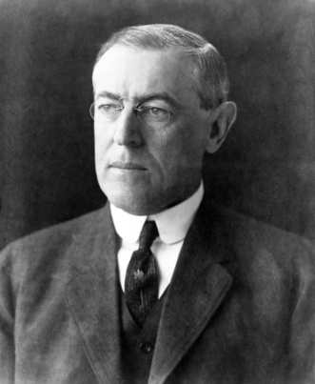
Wilsonian Options
Woodrow Wilson: America is a “Wilsonian” nation. We want to do right.
“We shall fight for the things which we have always carried nearest our hearts—for democracy, for the right of those who submit to authority to have a voice in their own governments, for the rights and liberties of small nations...”

Slide 3
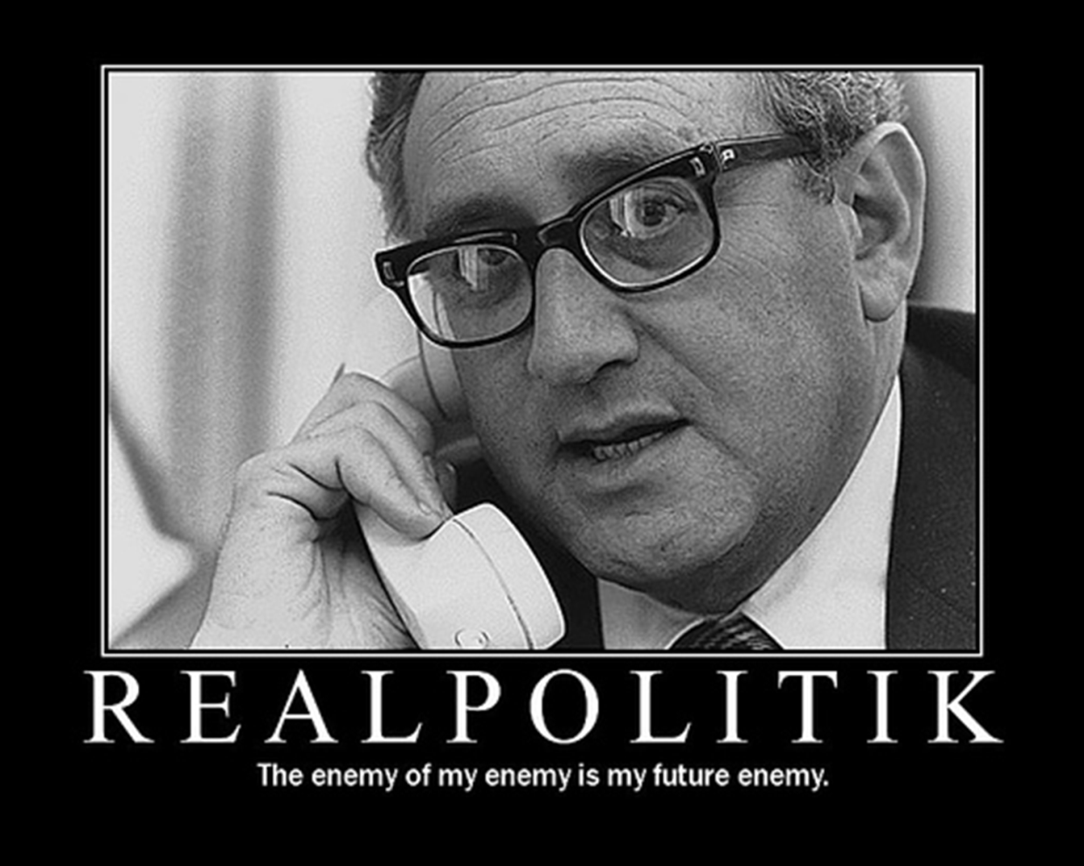
Realpolitik
“Realistic Politics”
politics based on practical and material needs rather than on moral or ethical ideas & objectives

Slide 4
Realpolitik or Wilsonian FP Approach?
Prompt: What specific action should the U. S. take in regards to Venezuela to produce an important positive effect? What should the U. S. do now?

Slide 5
Debate Format
Everyone will have an opportunity to argue both sides & moderate/take notes
One team will be argue the Wilsonian approach, another team will moderate, while the third team will argue the Realpolitik approach
We will then rotate, switch roles, and argue the other side/moderate
Draw a blob
Each team will have 1 minute to prepare their opening arguments, 2 minutes to present their argument, 1 minute to create a rebuttal, and 2 minutes to present their rebuttal – in total each round will take 10 minutes, for a total of
Once everyone has argued both sides and moderated we will debrief as a class

Slide 6
Show groups

Slide 7
Tuesday prep directions
Meet with team mate and plan how to create arguments – I don’t care who does what, but everyone must speak to get full points
Preparation…
Prepare an argument for both a Wilsonian approach & Realpolitik approach
Consider writing a thesis statement & BTS’s for both sides – a thesis is an argument
You must include hard/soft power approaches, you must include evidence of US Foreign Policy goals we have discussed
Think about holes in your arguments (both sides have them) and prepare to attack/defend those holes

Slide 8
During the debate
Moderator Responsibilities
Make sure the debaters are being professional
Keep the clock, remind the teams of how much time is left (I will run a timer for the class, just pay attention to it)
You declare a winner of the debate
Note taker responsibilities
Take notes on both sides arguments
Make sure you get everyone’s names, and who is arguing what
Do a good job, this is what the group is turning in for points at the end, make sure you select note takers who write legibly
Teams of 3 – you have two note takers & one moderator
Debating teams
Jot down basic ideas, so you can prepare a rebuttal, does not have to be formal
Think about ways that you can poke holes in their argument
Be nice, but be aggressive

