Slide 1
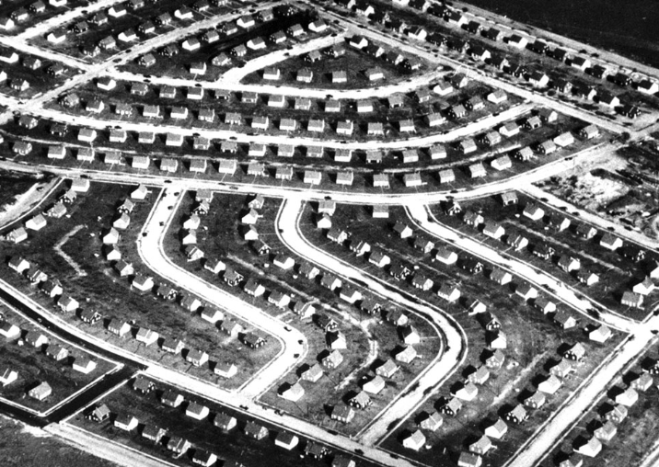
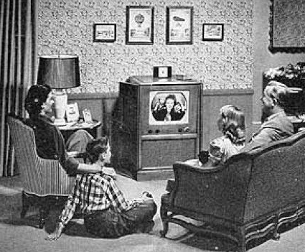
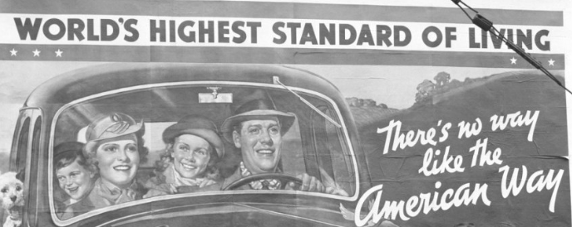
Journal Entry 10/9/18
When you think of the 1950s what type of music do you (or musicians) do you think of?

Slide 2
Unit Intro
This unit will be split in two distinct categories
Non Rock n Roll
Rock n Roll
Non Rock n Roll will consist of –
Soloists (Mostly Crooners)
Rock n Roll –
Rise
Doo Wop
Rockabilly
Both categories will include studies of individual artists

Slide 3
Social Climate 1945-1950s
What do you remember from US history?
WWII just ended
Period of great inflation and prosper in the US (aside from a brief period of deflation right after the war)
Jazz took a dip during the great depression
Blues were popular, but still not super mainstream
Development of housing communities became the norm
Conformity, does this matter?
Teenagers were beginning to emerge as a completely different group of people.
Included a new set of ideas and desires regarding life
Significantly more leisure and money than in previous generations
Emergence of Cold War, and what I would qualify as the beginning of the major division in political ideology

Slide 4
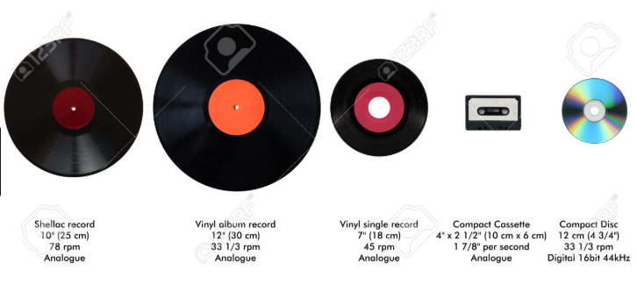
Music in late 1940s – Society
Radio was king
Disc jockeys controlled what was played
Disc jockeys were essentially force fed whatever recording studios gave them
Most songs in the late 40s and early 50s were recorded on 45s
45s or 78s which were records that could hold about 3 minutes of music on one side
Recording companies wanted to keep costs down, and they didn’t believe that people would listen to longer songs.
Artists were heavily discouraged (essentially forced) into recording shorter songs as a result of this

Slide 5
Music in late 1940s – Society
Teenagers after the war were beginning to be targeted by recording companies and ad agencies
First time in history teens had disposable income
Many teens had an allowance or after school jobs
Estimated that people under the age of 21 constituted nearly 1/3 of music sales in the US
Not exclusive to teens, recording industry grossed over $214 million by 1947
First time since 1921 to surpass $200 million
What do you think the impact the youth in the US had on the music industry (outside of sales)?

Slide 6
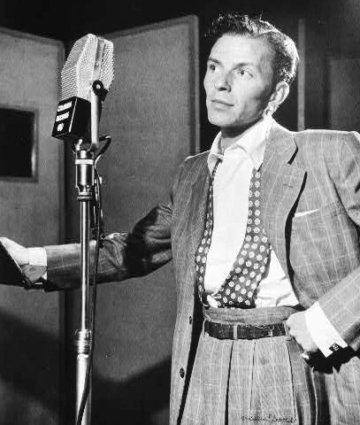
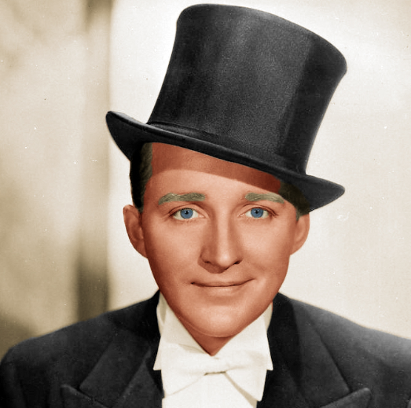
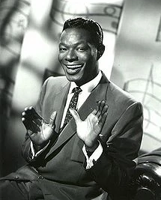
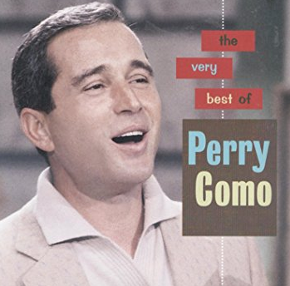
Music in late 1940s – Society
Most pop music between the late 1940s and early 1950s consisted of love songs by crooners (occasionally women) accompanied by a swing jazz band

Slide 7
Music in late 1940s – Society
Why would the US be rooted in what is considered “musical conservatism” during this time frame?
Post war economy expanded rapidly officially ending the Great Depression, men/women were coming home from war, after nearly 20 years of uncertainty and personal sacrifice people simply wanted to settle down
Do you think the Cold War (threat of nuclear war) could have played a role in this?
Families were finally in a place to see the dream produced 20 years before in Gene Austin’s My Blue Heaven

Slide 8
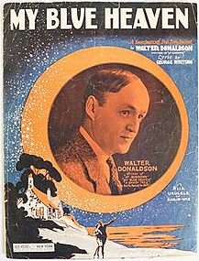
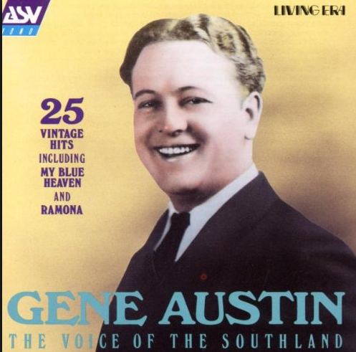
Song Analysis – My Blue Heaven
Listen to the song, and consider how the lyrics represent the following information
A refrain from potentially tumultuously progression
Any other notes on feel and characteristics of the song
Don’t look it up on your phone I will go through the lyrics with you, and we will talk about it.

Slide 9
Song Analysis – My Blue Heaven
Musical composition written by Walter Donaldson, lyrics written by George Whiting in 1924
Published 1927
Originally used in the Ziegfeld Follies
Theatrical review (think vaudeville) in 1928
Became a hit in 1928 when Crooner Gene Austin performed the song
Was on the charts for 26 weeks, number 1 for 13 weeks
Sold over 5 million copies
Look up the lyrics on your phone and answer the following questions
What lyrics highlight a conservative return to what was promised in 1928 in the 1940s
Does the fact that the song was written and released in 1928 mean anything?
What is the mood/tone of this version of the song
Recorded by Paul Whiteman (sung by Bing Crosby) in 1927
Recorded by many other artists, including Fats Domino in 1956
Listen to this version of the song and be prepared to discuss if the new version changes the song

Slide 10
Music in the 40s/50s – Rise of the DJ
Disc Jockey (DJ) – Someone who introduces and plays recorded popular music, especially on the radio or at a disco tech
Idea of top 40 programming became popular during the early 50s for two reasons –
An attempt by radio stations to control the type of music that was being played
A way to make money and create routine amongst the DJs
Top 40
Stems from Todd Storz in Omaha, Nebraska
Watched kids pumping coins in jukeboxes and playing the same songs on repeat, thought he could apply it to radio
Created a list of the top 40 songs, and started playing them on repeat
Within 5 years this was the standard on radio, and to an extent still is today

Slide 11
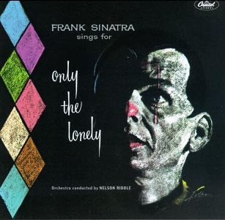
Journal Entry 10/11/18
Song analysis – Once for my Baby (and One More for the Road)
Analyze the lyrics, tone, and mood
Give your personal thoughts as well
Singer: Frank Sinatra
Album: Only the Lonely, released September 1958
Capital Records
Reached number 1 on the Billboard pop album chart
120 weeks on the chart
Album reached gold in 1962
Won the Grammy for the best album cover in 1959

Slide 12
Music in the 40s/50s – Rise of the DJ
The rise of the top 40 DJ led to the Payola
Payola – record companies paid DJs to put their records in heavy rotation
How could Payola be used to control music, and encompasses the idea of a conservative music industry?
Used by old school record execs to control the music being played on the radio in an attempt to keep newer styles of music off the radio
Most execs looked down their noses at a teenage audience, and didn’t exploit this new trend
By late 50s, the practice of payola was under legal scrutiny and essentially ended

Slide 13
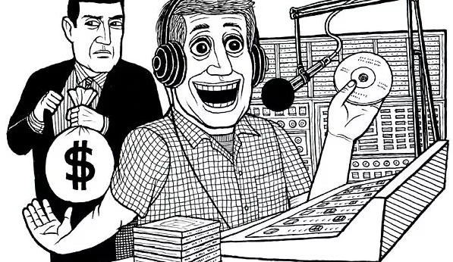
Music in the 40s/50s – Rise of the DJ
As a result of Payola and a rapid turnover of hit songs in the late 40s/early 50s record companies began overproducing records
Most were poorly produced, and poorly written
Record companies in attempts to make money would send as many as 100,000 copies of records with a guarantee for money back for each copy that didn’t sell

Slide 14
Music in the 40s/50s – Technological Advances
Introduction of tape recording
Allowed artists to dub over (called overdubbing) the top of their recordings and create different sound effects
Popularized by Les Paul
1949 introduction of two-track recorder
Allowed artists to record simultaneous inputs from two microphones
Advent of FM radio stations (late 30s) took hold during the 1940s and by 1949 there were nearly as many FM stations as AM stations (700 vs about 900)
FM produces a higher sound quality with a stronger frequency
Advent of television
Led to live music being played and replayed on TV
Created legal issues with paid usage for songs

Slide 15
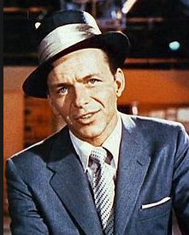
Late 40s & Early 50s - Crooners
Croon(ing) – To hum or sing in a soft, low voice, especially in a sentimental manner
This was only made possible by the advent of the microphone
Previously singers had to have loud powerful voices, but the microphone allowed singers to have a much lower, personal style of singing
Rose to popularity during the 1920s reaching its peak in the mid/late 40s through the early 1950s

Slide 17
Crooner Research
You are going research one of the following crooners
Nat King Cole – Caelin L.
Perry Como – Faith
Bing Cosby – Katelyn R.
Dean Martin – Bice
Tony Bennet – Anthony
Sammy Davis Jr – Luis
Harry Connick Jr – Abby
Johnny Mathis – Emma
Gene Austin – Matt F.
Barry White – Cassie
Cab Calloway – Declan
Louis Prima – Sam
Mel Torme – Noah
Johnny Mercer - LT
Andy Williams – Oss
Robert Goulet - Spencer
Bobby Darin - Jaielyn
Tom Jones – Tyler
Englebert Humperdinck – Alec C.
Pat Boone – Kourtis
Leon Redbone – Manon
Michael Buble - Julia
Desi Arnaz - Keon
Tomorrow we will have a drawing for each crooner on this list.
In your research you will need to find the following information –
Context on the artist
Who they were, where they were from, etc.
The course of their career
Impact of the artist on music
Impact of the artist on American culture
You will need to use a minimum of three sources
You will have the weekend and time in class on Monday to complete this research
We will culminate this little project with a 3 minute presentation to the class on your artist
Note – Frank Sinatra is not on this list, I am doing Frank, you are doing the other singers

Slide 18
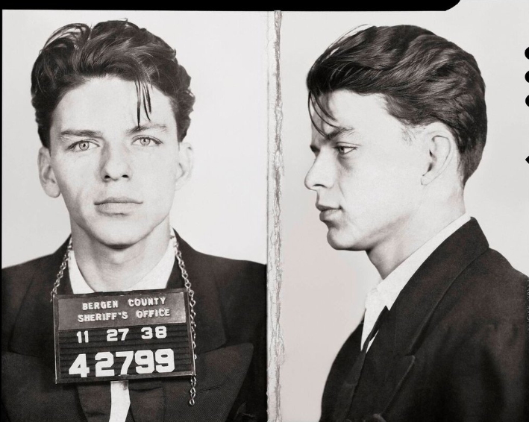
Frank Sinatra
We are going to watch a documentary on Ol’ Blue Eyes
Take notes on the following –
Context – who he was, where he was from, his story, etc.
His impact –
How did Frank impact the music industry?
How did he impact America?

