Slide 1
The Battle of the
Bulge
Kenneth Ruslim,
Ansen Tan,
Amogh Karanth,
Lifan Zeng

Slide 2
Background

Slide 3
Germany's Situation Before the Battle of the Bulge
1,200,000 Germans were either dead, wounded, and missing.
Resources and materials were lost in the previous battles.
Rumanian oil, Finnish and Norwegian nickel, copper, and molybdenum, Swedish high-grade iron ore, Russian manganese, French bauxite, Yugoslavian copper… [etc]

Slide 4
EASTERN FRONT (Russia)
Germany suffered from many defeats in the Eastern Front
They lost control of much of Romania.
Soviet Russia pushed the borders to east Prussia across the Vistula at a number of points, and up to the northern Carpathians.
German troops had to retreat from southern Greece and the Greek islands (except Crete).
German grasp on the Balkans weakened.

Slide 5
WESTERN FRONT
Allied forces began closing in on Germany from the west, threatening their security.
In September of 1944, American troops approached the western border of Germany in the Aachen sector and the British arrived in Holland.

Slide 6
Germany’s Replacement Army
In August, 1944, Germany produced 18 new divisions, 10 panzer brigades and nearly a hundred separate infantry battalions.
In September, Heinrich Himmler created 327 divisions and brigades, of which 31 divisions and 13 brigades were armored
Most of these units did not have the strength of either division or brigade.
By November, twenty-five new divisions, about a thousand artillery pieces, and a score of general headquarters brigades of various types were demanded.

Slide 7
Total War in Germany
Germany lowered the minimum age requirement and increased the maximum age to enlist in the army.
SS Soldiers exploited hospitals to expedite the treatment of wounded soldiers.
Minister Joseph Goebbels-August 24, 1944
New mobilization scheme: Schools and theaters were closed down, a 60-hour week was introduced, holidays were temporarily abolished, most types of publications were suspended (except for Mein Kampf because “standard political works”), small shops closed, and the staffs of governmental bureaus were disposed of.

Slide 8
The Battle
of the
Bulge

Slide 9
Thesis
Hitler's risky attempt to seize Antwerp through an aggressive counter-attack devastated the German military, which allowed for the Allied invasion into Germany's borders.

Slide 10
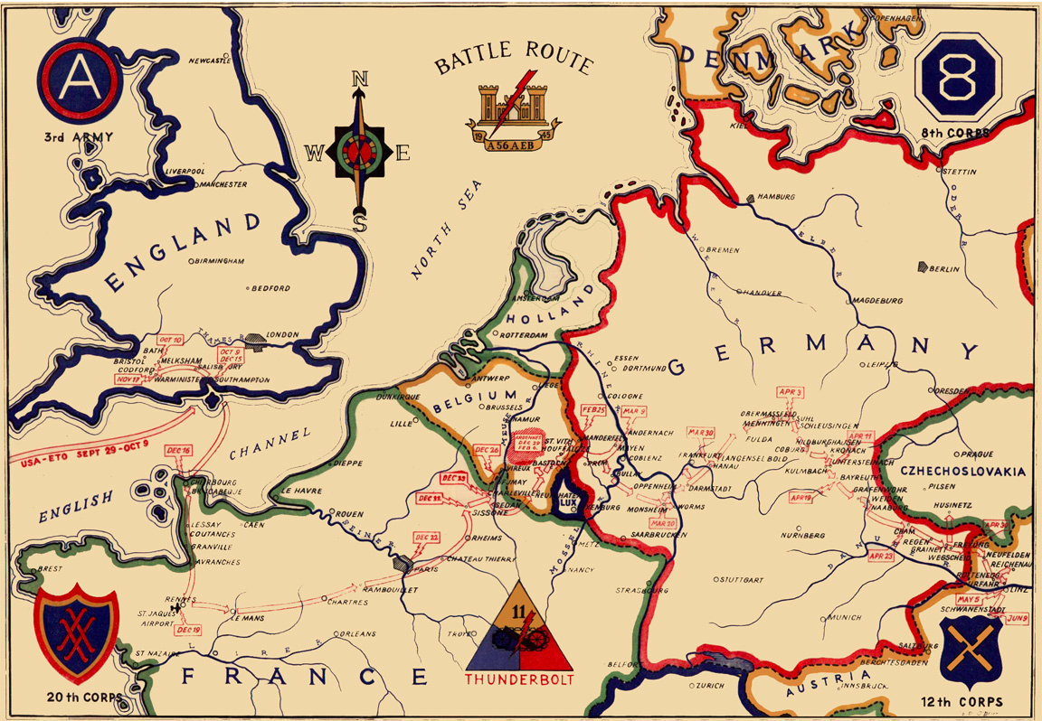

Slide 11
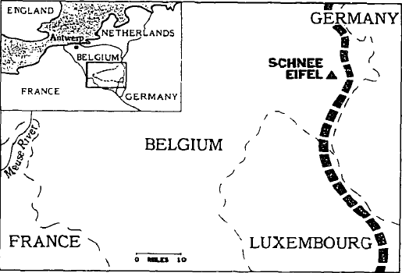
Basic Timeline
Allied front established.
Germans attacked, creating a bulge.
Dec. 16, 1944 - The 80 mile front that divided Germany and the Allies.
Germany pushed back.

Slide 12
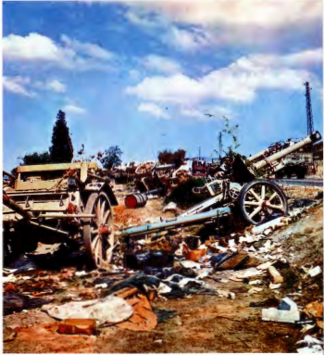
The Allied Front
Following their successful Invasion of Normandy in June of 1944, Allied Forces moved swiftly across France and into Belgium, where the Allied Front was established.

Slide 13
A Major Gamble for Germany
Hitler realized that Germany was in tatters and devised a plan to revive the empire.
Hitler still had full confidence in his military prowess, despite his recent defeats; he believed that he could make up for those defeats.
Planned to defeat the Allies in the west and create a peace treaty with Stalin in the east.
Destroying the approaching Allies was Hitler’s final hope to preserve the Third Reich.

Slide 14
Hitler’s Illusion
Hitler also no longer wanted to continue split-front fighting.
“The war fought on two fronts had been analyzed and solutions had been proposed by the great German military thinkers” (Cole 11).
These German thinkers said it was impossible to fight both fronts given the limited number of supplies and soldiers.
They decided that counter-offensive was the best option.
Notes:
Hitler really liked and wanted to protect the Ruhr industrial area
East Territory < Ruhr Industrial Area
Germany currently is a position where if they were to take Finland or Italy, nothing would happen. Russia also was of no help
The only way was for Germany to get a quick victory capable of bearing immediate diplomatic fruit

Slide 15
Germany’s Economy
German economy was not well suited for long, drawn out wars.
To change this, Reich Minister Albert Speer and his company were given two years to reorganize and expand the German economy before the intense Allied air efforts of 1944
He created a program so successful that Allied destruction and German construction was neck in neck in the third quarter of 1944
Single-engine fighters had risen from 1016 in February to a high point of 3031 in September

Slide 16
Hitler’s Illusion
September 16, 1944, Speer assured Hitler in a briefing that German war stocks could be expected to last through 1945
Hitler’s optimism and the miscalculation led to Hitler’s belief that a counter-offensive would be successful.

Slide 17
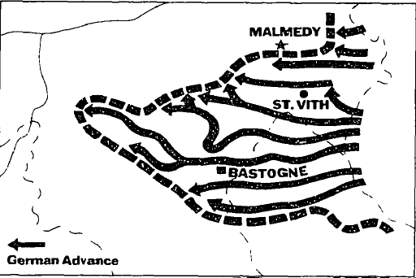
Basic Timeline
Allied front established.
Germans attacked, creating the bulge.
December 16-26, 1944 - Germany launched their assault and created a bulge in the Allied front.
Germany pushed back.

Slide 18
Germany’s Objective
Germany’s primary goal was to traverse through the Ardennes region and divide the Allied Front in order to capture port of Antwerp, Belgium, the Allies’ principle supply port.
The Allied Front consisted of American and British troops.
This did not go as expected for the Germans and became Hitler’s final major offensive attack.

Slide 19
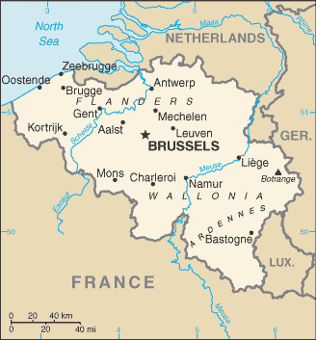
Antwerp
The Ardennes Region

Slide 20
How?
In order to accomplish Hitler’s goal of seizing Antwerp, the Germans concentrated the majority of their offensive powering into one prominent forefront.
Hitler created the Fifth and Sixth Panzer Armies, two tank divisions, to penetrate the Allied Front through the Meuse River and the city of Liège.
The armoured German “spearhead” cracked the Allied Front, creating a deep wedge, thus giving it’s name the Battle of the Bulge

Slide 21
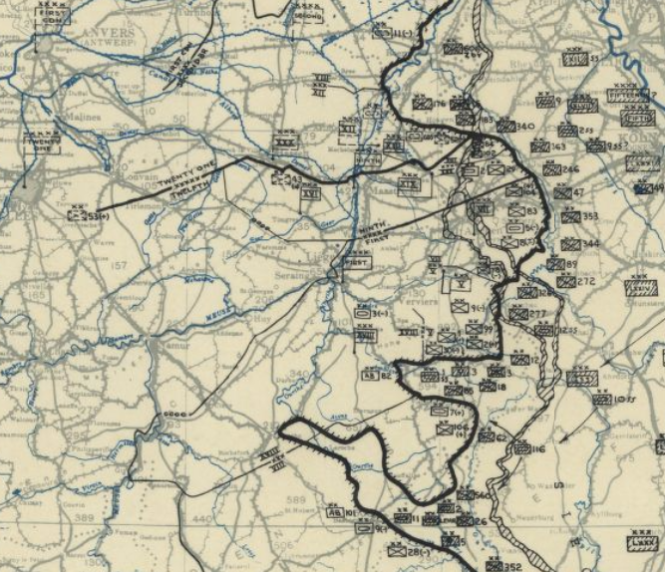
Fifth and Sixth Panzers (December 21, 1944)
Liège, Belgium
Antwerp, Belgium
Meuse River

Slide 22
The German Advantage
Due to the notoriously brutal forecast of the Ardennes region during the winter, the Anglo-American air forces (which were much more powerful that the German air force) were unable to initiate in combat.
The mist and stormy weather above the Ardennes region formed a cloak-like shield that allowed German ground troops and tanks to traverse across the Ardennes with little to no detection from the Allies

Slide 23
Strategies of the Germans
Initial German forces consisted of 200,000 men, 1,000 assault guns and tanks, 1,900 artillery pieces, and 2,000 aircrafts.
Germans used Blitzkrieg in attempt to split the Allied lines and capture their most important supply port.
Unfortunately, plan failed and for the remainder of the war German forces were consistently defensive and continually in retreat.

Slide 24
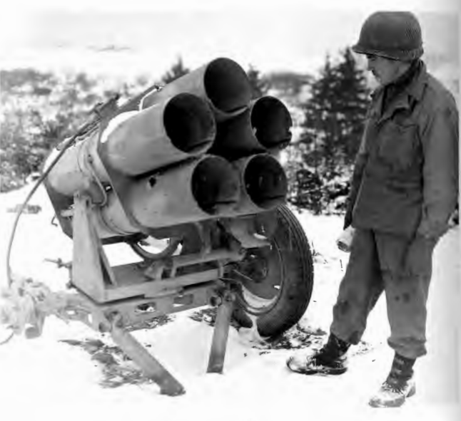
Strategies Cont. - German Weaponry
The German Nebelwerfer was a multiple-launch rocket system that was commonly used during World War II
When fired, a shrilling uproar of sound is produced, which led Allied soldiers to give it the nickname of “Screaming Meemies” (skrēmiNG ˈmēmēz)

Slide 25
Strategies of the Germans Cont.
The Germans secretly planned an intense offensive code named Wacht am Rhein (Watch on the Rhine)
Offensive attack included an airborne assault led by Otto Skorzeny.
Paratroops were to secure and hold key Meuse bridges which included having English-speaking troops dressed in American uniforms and driving American vehicles, was to infiltrate and disrupt the American rear area.

Slide 26
Strategies of the Germans Cont.
Hitler exploited Allied weakness in the Ardennes sector and used the effective element of surprise.
Germans knocked out the telephone lines and launched a surprise attack on the Allies.
Allowed for the bulge in the Allied line.
Germans then advanced to Foy-Notre Dame marking the farthest extent of the German bulge.

Slide 27
The Siege of Bastogne (December 20-27, 1944)
As a part of a larger goal, the apprehending of Bastogne, Belgium was crucial part of the German objective of capturing Antwerp.
By December 21, 1944 the city of Bastogne had been surrounded by German divisions.
After capturing the city of Bastogne the Germans plotted to swerve north in an attempt to obtain Antwerp.

Slide 28
McAuliffe and the 101st Airborne
The city of Bastogne was defended by the 101st Airborne Division, lead by General Anthony Clement "Nuts" McAuliffe
According to those present at the time, when the surrounding Nazi forces sent a letter to McAuliffe giving him a chance to surrender, McAuliffe promptly crumpled the paper exclaiming, “Nuts!”, thus earning him his infamous nickname.

Slide 29
The Redemption of Bastogne
As the weather cleared up, ammunition and supplies were dropped in Bastogne help the 101st Airborne Division.
Despite the constant barrages of the German divisions, McAuliffe and his soldiers held the city of Bastogne for another 4-5 days.
On the 26th of December 1944, General George S. Patton’s 4th Armoured Division broke through the German line of defence, succeeding in freeing Bastogne from their German captors

Slide 30
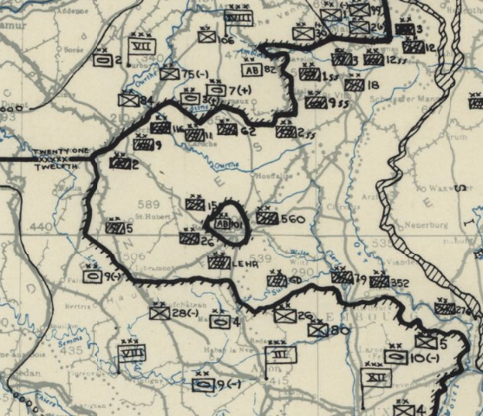
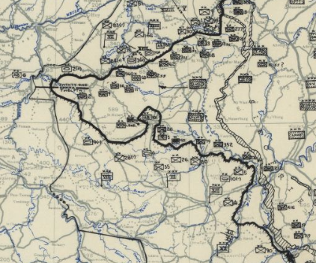
Bastogne December 25, 1944
Bastogne December 27, 1944

Slide 31
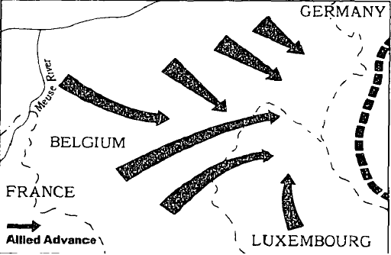
Basic Timeline
Allied front established.
Germans attacked, creating the bulge.
Dec. 27, 1944–Jan. 28, 1945 - Allied forces drove the German forces behind their own borders through their own counterattack.
Germans pushed back.

Slide 32
Allied Counter-Offensive
After the failed Siege of Bastogne the bulge of Germany’s offensive attack was compromised and cease to move any further.
December 27, 1944 marked the initiation of the Allied Counter-Offensive Assault.

Slide 33
Strategies of the Allies
General Eisenhower ordered the 10th Armored Division of George S. Patton's Third U.S. Army and the 7th Armored Division of the Ninth U.S. Army to reinforce the Ardennes line.
This allowed the 99th to hold out against the attack in the North and the 4th to do the same in the South.
Eisenhower was short on troops, so he allowed African American soldiers to fight for the first time, marking the first time the United States desegregated during WWII.

Slide 34
Strategies of the Allies Cont.
Unfortunately for the Allies, the German offensive attack was too much and the were forced to withdraw.
Eisenhower then ordered to turn the entire Third Army from its ongoing westward advance 90° to the north.
Goal was to counter-attack in the Ardennes.
The speed and efficiency of this change in direction is considered to be one of the greatest tactical achievements in the war.

Slide 35
Strategies of the Allies Cont.
The First U.S. Army transformed its position from defense to counter-attack.
By December 22, the weather improved, allowing the Allies to call in air support by flying 1,300 sorties on December 23 and some 2,000 on December 24.
Devastated German supply lines.

Slide 36
Desperate Attempts by Hitler
In an attempt to keep their offensive momentum, Hitler ordered several minor operations on January 1, 1945.
Operation Baseplate was a German aerial assault on allied airfields
Operation North Wind was the last major German attack on the West Front of Europe.
Allied forces recovered from these onslaughts in a matter of days, while these failed operations left Germany crippled for the rest of the war.

Slide 37
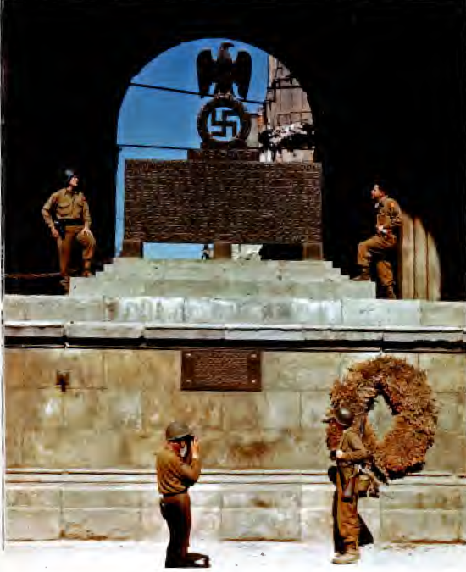
A German Defeat
From December 27, 1944 to January 25, 1945, the Allied forces successfully reduced the German bulge and achieved a crucial victory that devastated Germany’s military state for the remainder of WWII.
They faced many casualties and spent a large amount of resources.
Germany was so low on fuel that they resorted to 50,000 horses to get through the Ardennes.
Notes:
Picture: American troops posing after the successful downfall of Berlin, Germany

Slide 38
Impacts
Immense psychological effect and decrease in morale on German side since this was seen as their final hope.
Last major offensive campaign by Hitler
Allowed for the Allied attack within Germany itself, contributing to Germany’s eventual surrender on May 7, 1945.
Many casualties

Slide 39
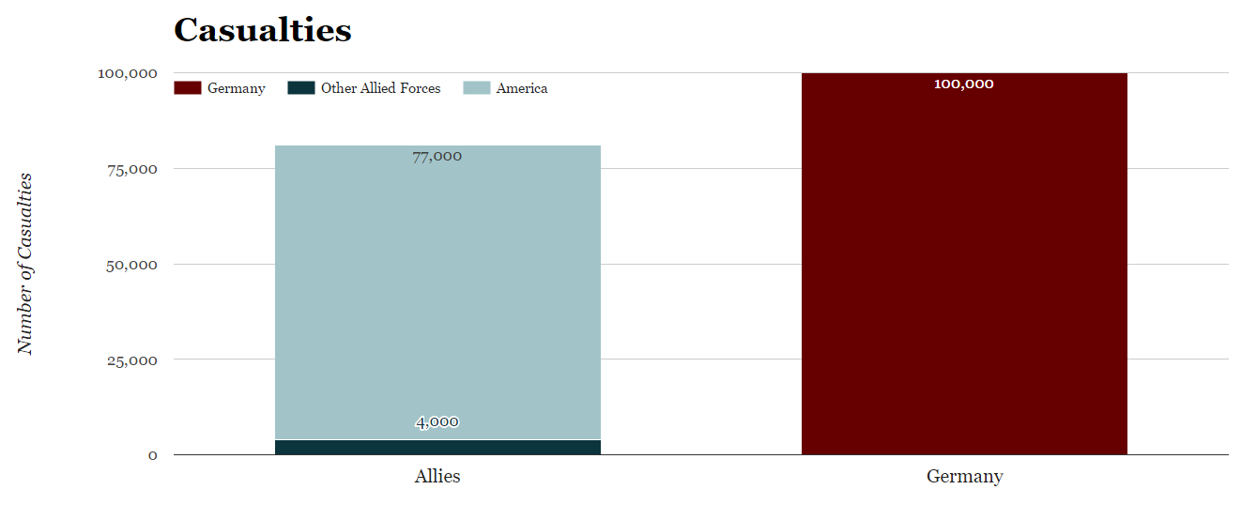
This was the costliest battle ever fought in U.S. history, both in casualties and equipment; a third of the U.S. Army participated in this battle.

Slide 40
Following the Battle of the Bulge, British Prime Minister Winston Churchill stated, "This is undoubtedly the greatest American battle of the war and will, I believe, be regarded as an ever-famous American victory."

Slide 41
Works Cited
Allied Forces. Army Group, 12Th. Engineer Section, and 1St. Headquarters United States Army. Army Group. [December 21, 1944, HQ Twelfth Army Group situation map]. [England?: Twelfth Army Group, 1944] Map. Retrieved from the Library of Congress, <https://www.loc.gov/item/2004630293/>.
Allied Forces. Army Group, 12Th. Engineer Section, and 1St. Headquarters United States Army. Army Group. [December 25, 1944, HQ Twelfth Army Group situation map]. [England?: Twelfth Army Group, 1944] Map. Retrieved from the Library of Congress, <https://www.loc.gov/item/2004630297/>.
Allied Forces. Army Group, 12Th. Engineer Section, and 1St. Headquarters United States Army. Army Group. [December 27, 1944, HQ Twelfth Army Group situation map]. [England?: Twelfth Army Group, 1944] Map. Retrieved from the Library of Congress, <https://www.loc.gov/item/2004630299/>.
"Anthony C. McAuliffe." Britannica Library, Encyclopædia Britannica, 16 Jan. 2009. library.eb.com.ezproxy.kcls.org/levels/referencecenter/article/Anthony-C-McAuliffe/49625. Accessed 25 Apr. 2017.
Axelrod, Alan. “Battle of the Bulge.” Encyclopedia of World War II, Vol. 1, Facts On File, 2013. History Research Center, online.infobase.com/Article/Details/264563?q=battle of bulge. Accessed 2017. (This is the source used for all of the battle strategies)
"Battle of the Bulge." Battle of the Bulge | The U.S. Army. N.p., n.d. Web. 25 Apr. 2017.

Slide 42
Works Cited
"Battle of the Bulge." World History: The Modern Era, ABC-CLIO, 2017, worldhistory.abc-clio.com/Search/Display/309553. Accessed 22 Apr. 2017.
"Battle of the Bulge." World History: The Modern Era, ABC-CLIO, 2017, worldhistory.abc-clio.com/Search/Display/1844608. Accessed 22 Apr. 2017.
“Belgium.” University of Texas Libraries, U.S. Central Intelligence Agency, 2016, www.lib.utexas.edu/maps/cia16/belgium_sm_2016.gif. Accessed 24 Apr. 2017.
Bruning, John R. The Battle of the Bulge: the Photographic History of an American Triumph. Minneapolis, MN, Zenith Press, 2011.
MacDonald, Charles. The Last Offensive. Greenock: 232 Celsius, 2013. Print.
Marshall, S. L. A. Bastogne: The Story of the First Eight Days in Which the 101st Airborne Division Was Closed .. Place of Publication Not Identified: U S Govt. Printing Office, 1988. Print.
Middleton, Drew. “The Battle That Sealed Germany's Fate: Forty Years Later, the Battle of the Bulge Remembered.” New York Times, 1984. Proquest, search.proquest.com.ezproxy.kcls.org/docview/122522564/fulltextPDF/E27653E133484A85PQ/3?accountid=46. Accessed 22 Apr. 2017.

