Slide 1
Welcome to Russia – Here come the Memes

Slide 3
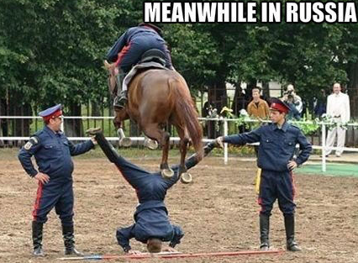

Slide 4
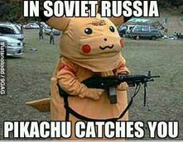

Slide 5
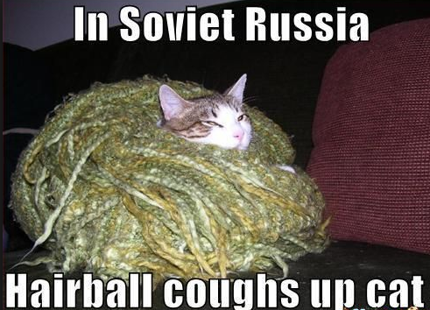

Slide 6
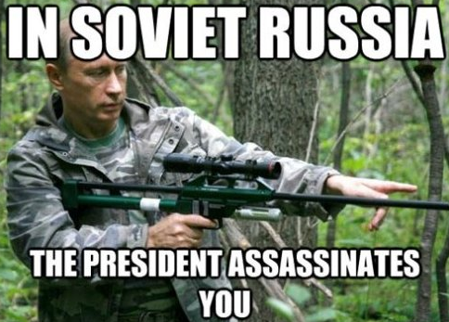

Slide 8
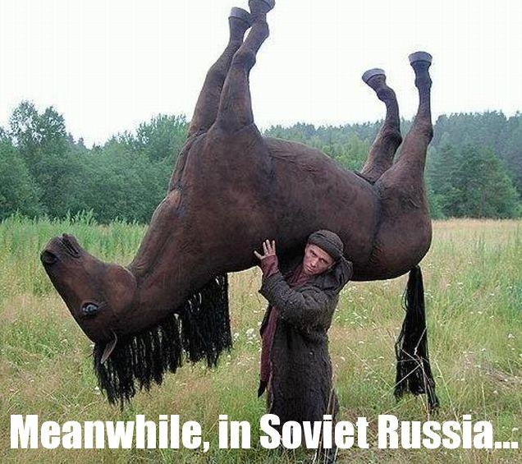

Slide 9
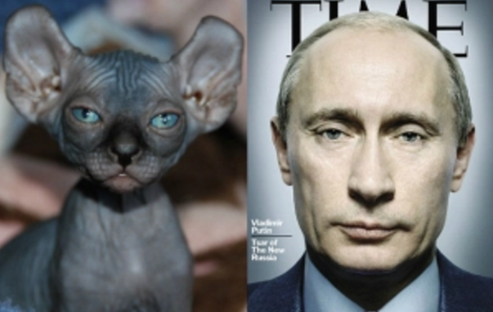
Bald Cats that look like Putin – A real article

Slide 10
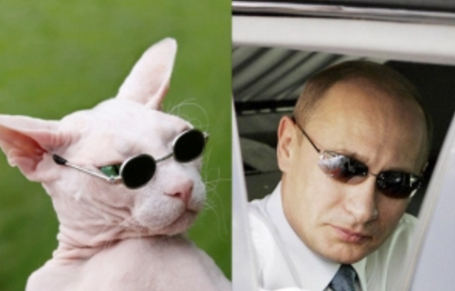

Slide 11
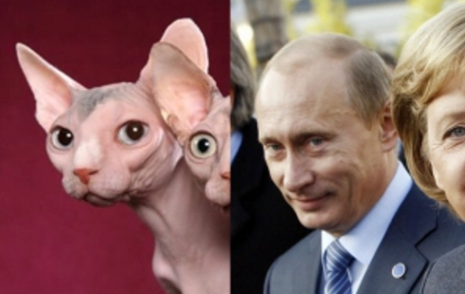

Slide 12
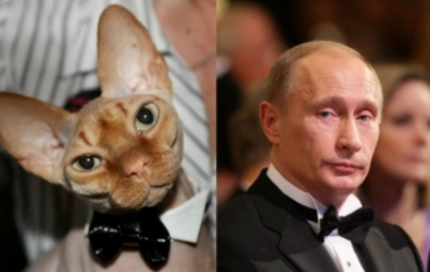

Slide 13
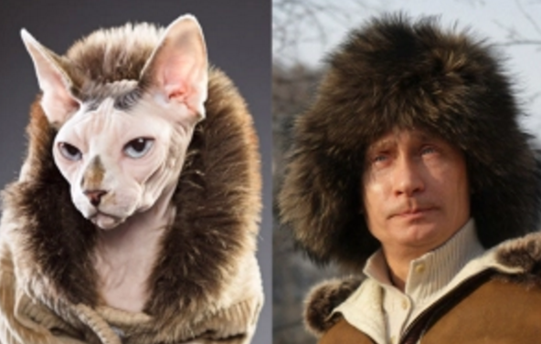

Slide 14
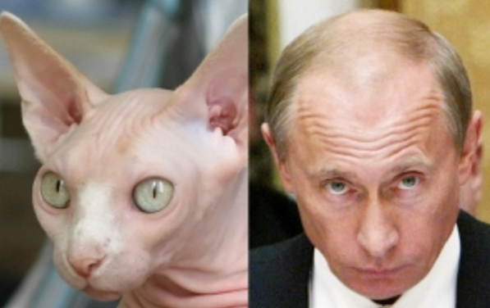

Slide 15
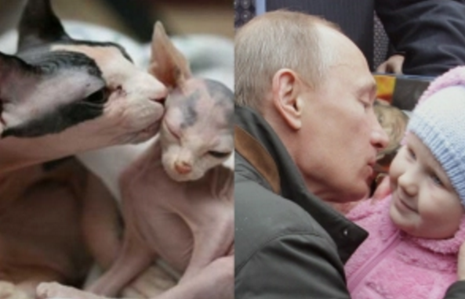

Slide 16
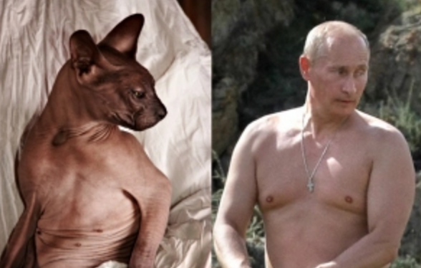

Slide 17
John Stewart on crazy Russia
Dash cam scam

Slide 18
Russia before the Tsars
Kievan Rus or the Kievan Empire – 850-1240
1240-1400 taken over by Mongols, also known as Tatars
1400-1605 The Muscovite Empire
1613-1917 The Romanov Empire
This is where we will start with Ivan the Terrible, Alexander the Great, and Catherine
These are tsars
Caesar

Slide 19
Russia before the Tsars – Kievan Rus
First Russian state is known as Kievan Rus or the Kievan Empire – 850-1240
Rose out of mutual need
Citizens had common goal of survival
Vikings, Scandinavians, Turks, but mostly Vikings (in the north)
Viking conversion to the Rus
Conversion to monotheism (Christianity) from polytheism
Waring society
Major city was Kiev, those who ruled Kiev had control over the rest of the empire
The Kievan Empire was a feudalistic society
Slaves
Smerd class (Serfs)
Empire ultimately falls apart because of the apanage system – division of an estate to a fallen leaders offspring & in their moment of weakness they were attacked by the Mongols
This led to the fall of the Kievan Rus and a broken empire until about 1400

Slide 20
Russian Revolution – Ivan the Terrible
Russia begins to unify under its first tsar – Ivan IV the Terrible – 1530-1584
During the Muscovite Empire
First ruler to take title of tsar, crushed the old ruling nobility known as the Boyars, unifies Russia until the end of his dynasty in 1598
Boyars still exist, but not in the same capacity
Think of it like the crown in the UK after parliament is ECW/Glorious Rev.
Time of Troubles to Michael Romanov
1598-1613 is a period of time where there is a resurgence in the old assembly of nobility
Lots of bickering, fighting between powers
Literally known as the time of anarchy because there are so many people vying for power
Eventually Romanov is elected as tsar by the Zemsky Sabor (National Assembly)
This starts the Romanov Dynasty which lasts until 1917
Notes:
Ivan the Terrible actually did very good things for Russian society, his actual name meant Ivan the Awesome or Great. He was labeled as being awesomely terrible or Greatly terrible because the killed his son

Slide 21
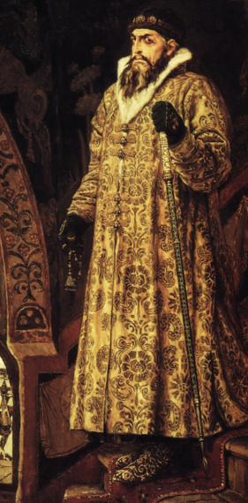

Slide 22
Russian Revolution – Tsarist Society
Russian Society under the tsars
Society is built around aristocracy and ruling class (absolutism)
Tsar claimed to be divinely ordained
Tsar essentially keeps the Boyars (aristocracy) in check during Romanov Empire
Russia is behind the rest of Europe during the Renaissance and Industrial Revolution, and relatively cut off (not completely, have some trade and are Christian)

Slide 23
Russian Revolution – Peter the Great
Read the section on Peter the “Great” – 1672-1725
Why was Peter the Great an innovator?
Why was Peter the Great a lunatic?
Other notable information regarding crazy Pete – I think he is hilarious
He loved war games
Would literally kill his friends in their “playful” war games
Loved the navy – Had a full size naval ship built (Shtandart) on Lake Lagoda just to play boat with
Had St. Petersburg built because he didn’t like Moscow, his father died there (killed by Pete the Great’s aunt in front of Pete the Great)
Built on land that was frozen most of the year and a marsh the rest of the year
Forced his nobility to go there, they literally froze to death because he just wanted a castle there
crazy Pete just liked it there more than Moscow (named it after himself), would do anything to maintain a presence there
Somewhat tactical because it is a port city on the river Neva & on the Baltic Sea

Slide 24
Russian Revolution – Peter the Great
Had an older brother (Ivan the V) who should have been tsar
However, he was mentally/physically disabled, both sat on the crown for posterity purposes
Pete & Ivan’s sister (Sophia) had a special window/door she would open on the back of his throne and tell him what to say
Ivan died very young (about 30) and then Pete was able to take over and rule on his own, sent his sister to a convent after Ivan’s death
Wanted to modernize Russia, but did it in a really weird way…
After the passing of his brother he went on a tour of Europe, in “disguise”, to learn about “modernity”
Except, he is almost 7’ tall, traveled with an entourage, and had a heavy Slavic accent
He didn’t fool anybody, but he expected everyone to act like they didn’t know who he was
On the bright side crazy Pete expands Russia, improves their economy, created a strong army/navy, and created alliances (also enemies) all over Europe

Slide 25
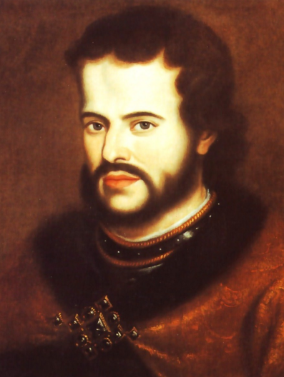
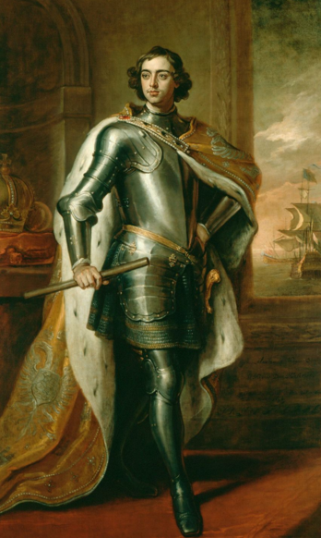
Ivan V
Peter the Great

Slide 26
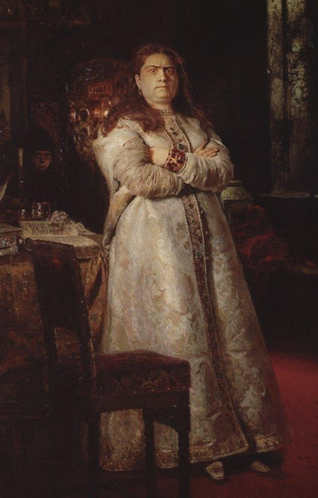
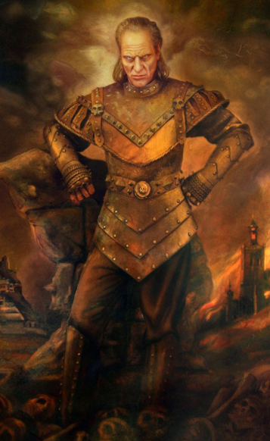
Sophia
Vigo the Destroyer?

Slide 27
Russian Revolution – Catherine the Great
Catherine the Great (1762-1796) attempted to modernize Russia
After crazy Pete died they went through a series of tsars who are inept and essentially worthless
Literally controlled by palace guards
CTG doesn’t really modernize Russia she ends up strengthening the ruling class, dividing Russia, and taxing the Smerd class
Makes it terrible for the peasants
Essentially she talked a big game, but she was greedy, and expanded territory even further
Poland to the west, Balkans in the south

