Slide 1
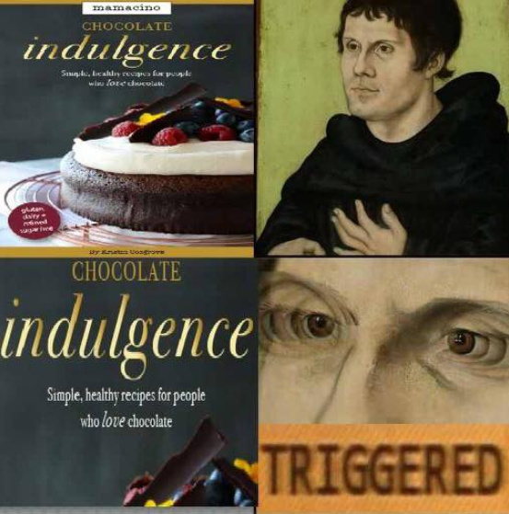
Journal Entry
Two thesis statements
Argue the largest issue Martin Luther had with the Catholic Church.
Argue the biggest cause of the Reformation

Slide 2
Luther Reading Packet
Using the Luther Reading Packet –
You and your table group will use the packet of primary and secondary source information to get a clear handle on Martin Luther.
To do this you will need to begin by investigating Luther’s ideas and actions (think direct quote/very specific paraphrase) in the following areas:
society, women, salvation, role of the clergy, role of the Prince/state.
Once you have aggregated this information you need to display it in comparison to the Catholic Church.
You may have to return to your notes or do more research to figure it out. (Note: be sure to look at the Catholic Church’s position back in the day, not now.)
Then you will need to find a way to display a clear comparison between the two—think t-chart.

Slide 3
Differences between Catholics and Protestants
Luther/Protestants believe that salvation is through the love of God, and a personal relationship with God.
Luther/Protestants believe that salvation is not earned through indulgences, relics, or any other earthly means.
Luther/Protestants believe that humans are not saved through their good works but through faith in the promises of God
This is made possible by the sacrifice of Jesus on the cross
Luther/Protestants also believe that God’s grace is not given through sacraments (confession)
Luther struggled with his ability to truly confess all of his sins
Luther Protestants believe in three sacraments (Communion, Penance, Baptism)
Catholics believe in seven (Baptism, Confirmation, Communion, Confession, Marriage/Holy Orders, Extreme Unction)
Marriage/Holy Orders – either traditional marriage or Holy Orders (marrying the church)
Extreme Unction – last rites
Notes:
Sacrament – Christian rite (ceremony) of particular importance

Slide 4
Spread of the Reformation
The spread and change of the church does not end in Germany with Luther.
Lutheranism in Scandinavia
Zwingli’s Reformation
Anabaptists
Henry VIII
Calvinism

Slide 5
Lutheranism in Scandinavia
Background –
In 1397 century Denmark, Norway, and Sweden are all unified through the Union of Kalmar
Over the course of the next 120 years the union disintegrates
In 1520 Christian II of Denmark is overthrown by Swedish Baron Gustav Vasa – A Lutheran
By 1530 Vasa makes Lutheranism the official state religion
Christian II also loses his control of Denmark and is replaced by his uncle, Frederick I
Frederick (King from 1523-1533) is a supporter of Lutheranism, eventually succeeded by Christian III
Christian III
Installs Lutheranism as the state religion of Denmark
Responsible for the spread Lutheranism to Norway
By the 1540s Lutheranism is securely spread throughout Scandinavia

Slide 6
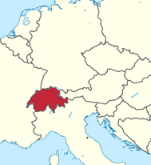
Lutheranism Spreads – Continental Movement
After Lutheranism spreads to Scandinavia it takes on another form and spreads south…
Protestant Reform in Switzerland

Slide 7
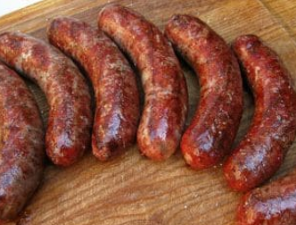
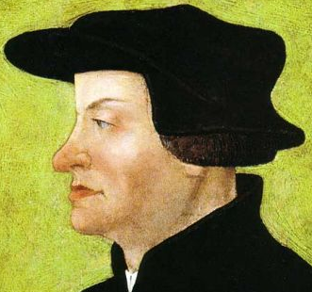
Ulrich Zwingli – The Great Sausage Affair
1522 - Sparked reformation in Zurich
Defended the right of a Christian eating sausage during Lent on a Friday
Lent – period of 40 days leading up Easter
Signify your preparation for the coming of Easter
Not supposed to eat meat on Fridays during Lent, signifies the sacrifice of Jesus
Sparks Zwingli to begin the reformation in Switzerland

Slide 8
Zwinglian Reformation – Protestant reform in Switzerland
Switzerland (technically under Holy Roman Empire) is comprised of 13 Cantons
Virtually independent by the end of the 15th century
Cantons are made up of six forest cantons, and 7 urban cantons
Urban include Zurich, Bern, and Basel
Ulrich Zwingli – a product of the forest cantons, son of a peasant eventually becomes priest in Zurich in 1518
Humanist
Spreads the Gospels (same stories as Luther)
Creates a debate over whether or not Zwingli can preach the Gospels in the Zurich city council in 1523
Council rules that Zwingli can continue teaching the Gospels

Slide 9
Zwinglian Reformation – Protestant reform in Switzerland
By 1529 Zwingli’s reformation moved from Zurich to Bern and Basel
Zwingli attempts to create alliance between his preaching and Luther
Cannot agree, have dispute over the meaning of the Communion and dislike each other because of this
The Catholic forest cantons and the Protestant city cantons eventually battle over the state religion in the cantons in 1531
Zurich’s army is routed
Zwingli is fatally wounded in battle
After the death of Zwingli Luther is quoted to say Zwingli “got what he deserved”

Slide 10
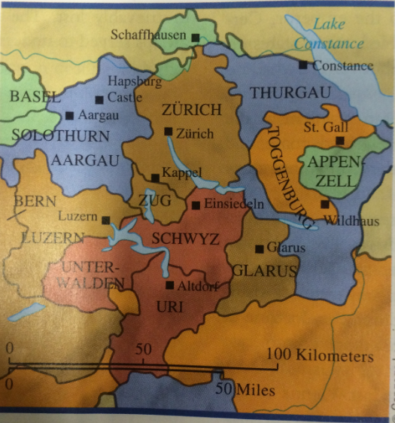
map

Slide 11
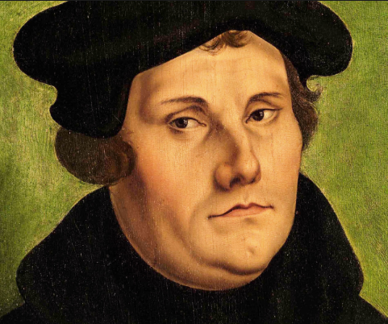
Journal Entry 10/1/18
Read Debates about the Eucharist on my website and answer the following question
Was Luther an agent of positive change?
Use your Luther reading packet to answer this question along with any other information you have learned.
Also consider the following…The Peasant War
His treatment of Jews
His connection to kings & nobility

Slide 12
Radical Reform - Anabaptists
Anabaptists – Radical Reformers
Didn’t believe in baptism as a baby/child, believed that you chose to become baptized
Believed that all members of the church were equal, although there were few women who preached
Called themselves Christians
Read and focused mostly on the New Testament Gospels
Believed in total separation of church and state
Considered dangerous radicals

Slide 13
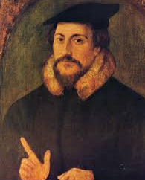
John Calvin & Calvinism
On your phones research Calvinism -
Who was Calvin (give me some context)
What did Calvin believe
What does Calvinism become?

Slide 14
Journal Entry 10/2/18
Two questions -
Who was John Calvin?
What does Calvinism eventually morph into?

Slide 15
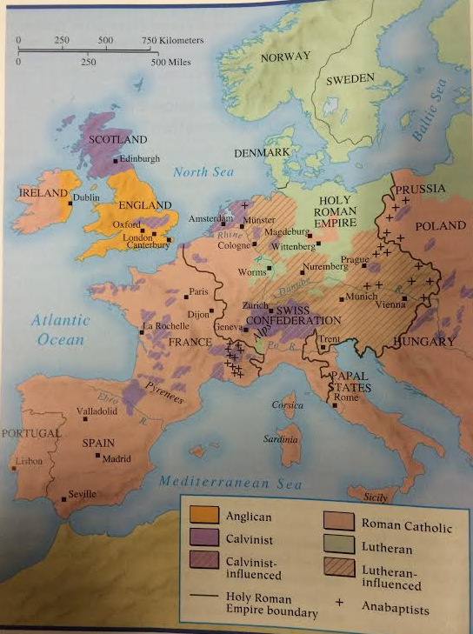

Slide 16
Connecting Question Luther’s Impact
Discuss and explain the following question…
Did Luther reform a culture and people or did he merely reorganize the power structure in Europe?
Defend your answer with evidence.

Slide 17
Counter Reformation
Define the Counter Reformation.
Explain what it was
What the goals of the church were
How the Church went about the Counter Reformation

Slide 18
Counter Reformation
Extremist – Wars of Religion
Give me background on the following…
Hugenots
Valois
Bourbon
Guise
Explain how and why all of these groups meet and what the outcome was
How was this extremist?
Who was Philip II, what did he want, how did he attempt to achieve his goals?
How was he an extremist?

Slide 19
Reformation – Cuius Regio
Cuius Regio
“He whose territory” it was had the right to impose faith (Catholic or Lutheran) on his subjects, free from outside interference
If you were a ruler during the 16th century how would you have used cuius regio in order to rule over your people?
Why do you think that certain leaders chose Catholicism over Protestantism and visa versa?

