Slide 1
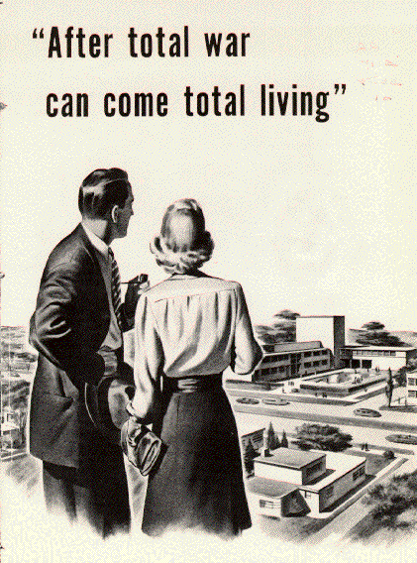
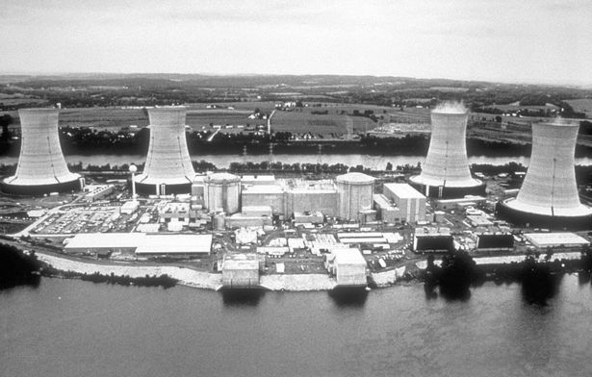
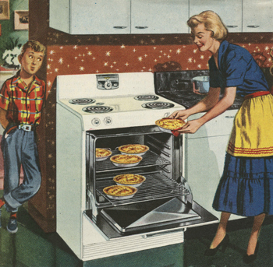
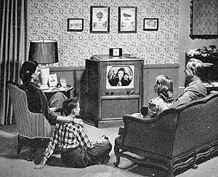
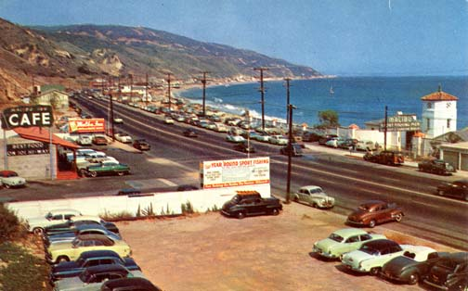
Welcome to Tomorrow
Welcome to the Future

Slide 2
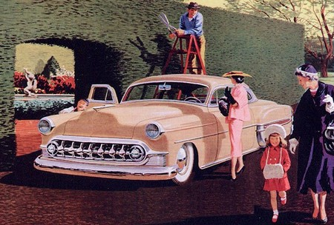
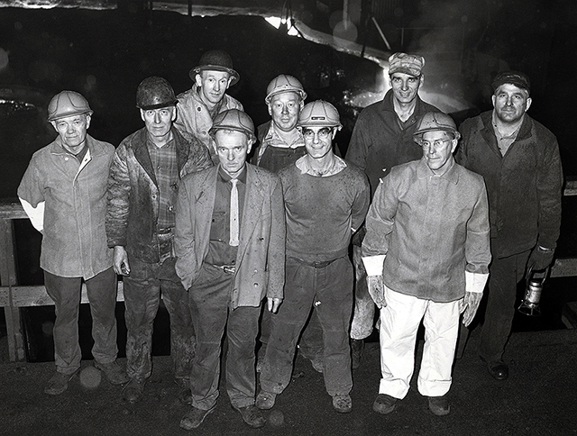
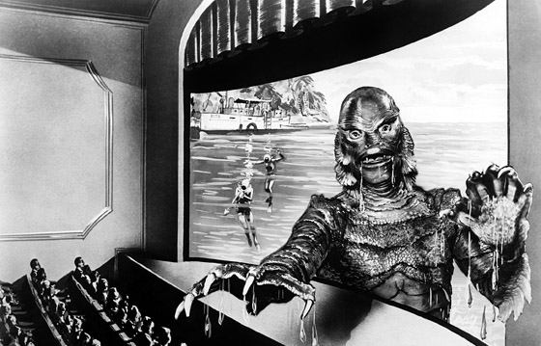
Greatest in History
Prosperity
Employment
Family
Energy
Popular Culture
Music ,Movies Comics
Production
Power
Next???

Slide 3
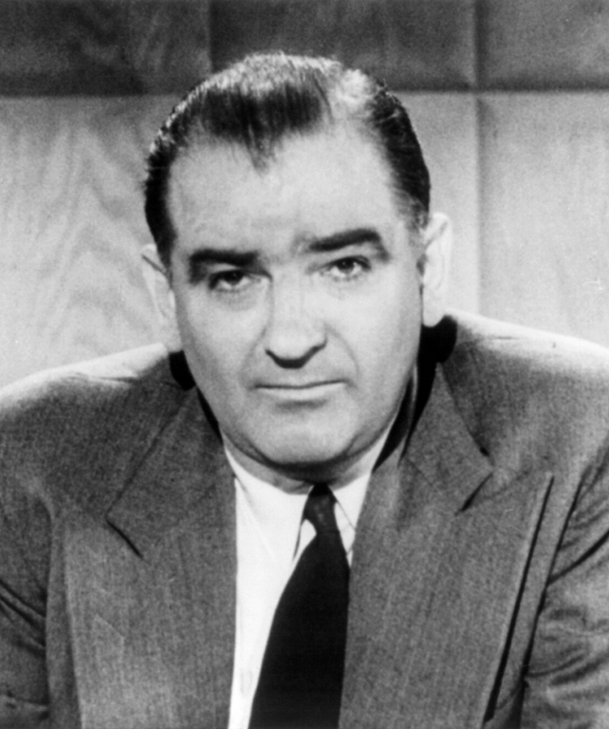
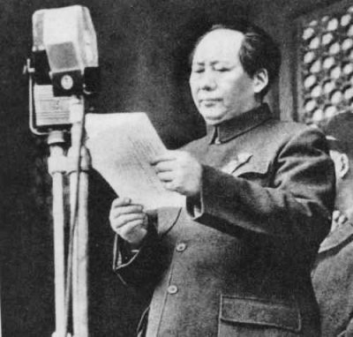
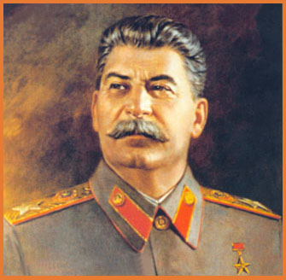
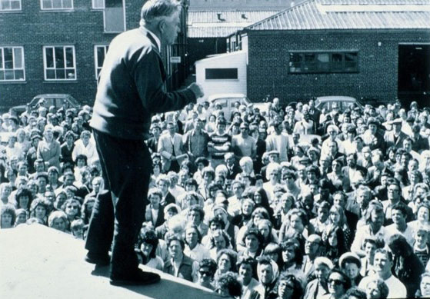
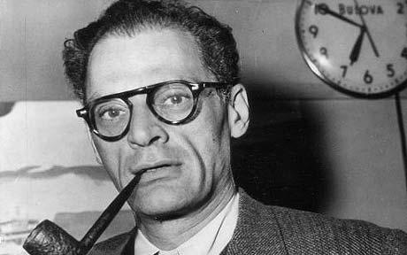
Be Careful
Soviet Invasion
American Communists

Slide 4
The goal of this task
It’s easy for me to tell you why McCarthyism is wrong, or why it was bad, but that’s only half the story.
I want you to look at it and answer a few key questions?
What compelled people to follow McCarthy?
Why did he receive so much power?
Why were people who opposed him vilified and shunned?

Slide 5
Research Tips
Website
Look up McCarthyism, become familiar with it
Look up the House Committee on Un-American Activities
HUAC…don’t ask
Formulate an argument that aligns with McCarthy’s ideals, related to your topic.
How would a McCarthy supporter view your topic?
Pro –McCarthy folks need to try to keep the status quo
Anti-McCarthy folks are not necessarily communist, but don’t fear it either

Slide 6
Topic | Pro-McCarthy | Pro-McCarthy | Pro-McCarthy | Anti-McCarthy | Anti-McCarthy | Anti-McCarthy
Gender Roles | Camille | Stephen |  | Maddie C. | Abi S.
Religion | Sarah | Taya |  | Natalie | Maddy P
Education | Peter | Zach |  | Lauren | Brandon
National Security | Abbie R. | Danika |  | Sarah | Casey
Media | Bella M. | Kevin |  | Alex | Ben
Ethics/Morals | Hannah | Nick |  | Olivia | Taylor
Government | Liam | Bella D. |  | Ana | Jon
Topic | Pro-McCarthy | Pro-McCarthy | Pro-McCarthy | Anti-McCarthy | Anti-McCarthy | Anti-McCarthy
Gender Roles | Melissa | Makennan |  | Tara | Mag
Religion | Eric | Horn |  | Mitchell | Kevin
Education | Sean | Bryan |  | Tanner | Isaiah
National Security | Megan | Alexa |  | Sidney | Ke’ala
Media | Jonah | Alicia |  | Emily | Meg
Ethics/Morals | Sam | Michael |  | Keara | Hennedy
Government | Harel | Alex |  | Colin | Taylor

Slide 7
What you need to do
Research McCarthyism
Take notes on important aspects of McCarthyism
Using your own powers of analysis, you should figure out what threats were posed by supporting McCarthyism, and also, why people may have bought in.
Start at the Issues and Controversies in American History website…
Feel free to do outside research, but you won’t get far searching “Pro-McCarthyism Gender Roles” in The Google

Slide 8
Topic | Pro-McCarthy | Pro-McCarthy | Anti-McCarthy | Anti-McCarthy
Gender Roles | Matt | Ela | Anthony | Destiny
Religion | Katie | Marie | Tony | Leila
Education | Jack | Luis | Bobby
National Security | Lucy |  | Kendell
Media | Ben |  | Manny
Ethics/Morals | Jayna |  | Ryan
Government | Dustin |  | Brendan

