Slide 1
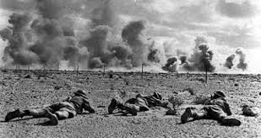
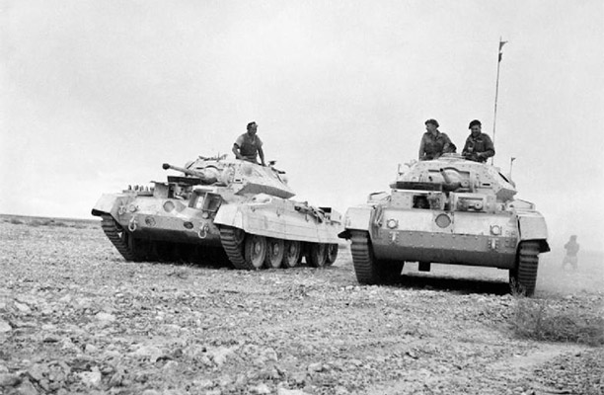
Battle of El-Alamein & Operation Torch
Carson and Dora Burek, T. Fung, Archit Gubiligari, Sandeep Singh Sidhu

Slide 2
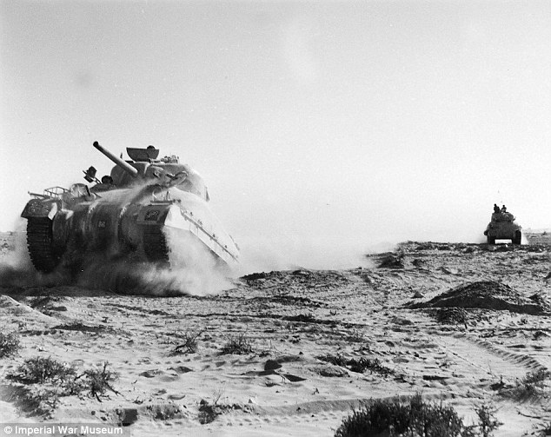
Background on Battles of El Alamein
Both battles of El Alamein took place near of Alexandria, Egypt
They were a German effort to save the Italian campaign against the British
1st Battle (May 1942): Hitler sent Afrika Corps under command of German general Erwin Rommel who pushed the British to the Egyptian frontier, but was stopped at El Alamein due to lack of supplies
2nd battle (October 1942): On October 23, the British army, led by General Montgomery, launched a counteroffensive
Rommel responded by laying a large minefield, but returned to Germany
British had more resources, launched an artillery barrage, penetrating the German defenses.
Rommel returned to Africa with a counteroffensive, which failed, and withdrew from the battle November 3, 1942

Slide 3
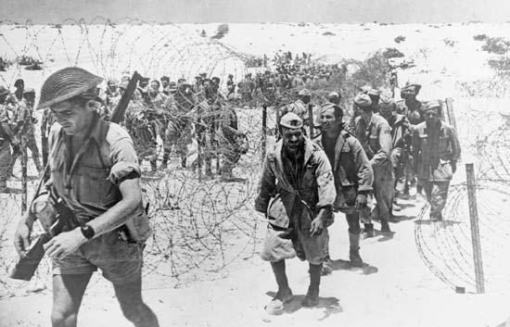
Thesis for the Battles of El Alamein
The Battles of El Alamein contributed to one of the first Allied victories in the North African campaign between the British Empire and the German-Italian army, which eventually led to the Axis Powers’ downfall in North
Africa.

Slide 4
Timeline of the First Battle of El Alamein
30th June - Axis Troops reach El Alamein, Egypt
10th July - Australia captures Tel el Eisa and South African Troops captured Tel el Makh Khad
13th July- Germans drive Australians out of Tel el Eisa
15th July - New Zealand captures Ruweisat Ridge
27th July- German counterattack and led to the end of the First Battle of El Alamein
1942

Slide 5
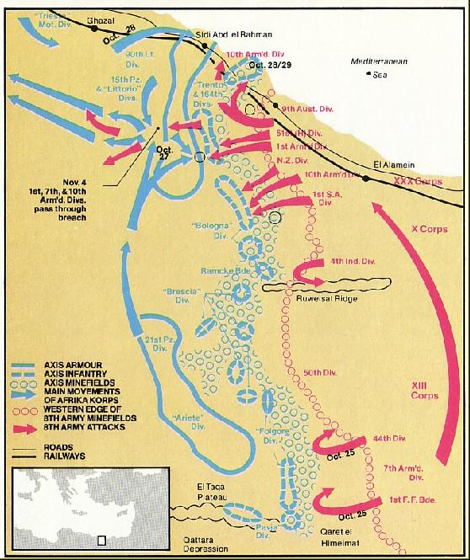
Map of First Battle of El Alamein

Slide 6
Timeline of the Second Battle of El Alamein
23rd October - Allied begin their attack on Germans
26th October - Axix begin a series of counterattacks
1st November - Operation Supercharge (break last of German defenses) failed
4th November - Germans retreat disobeying Hitler’s direct order to “stand and die”
1942

Slide 7
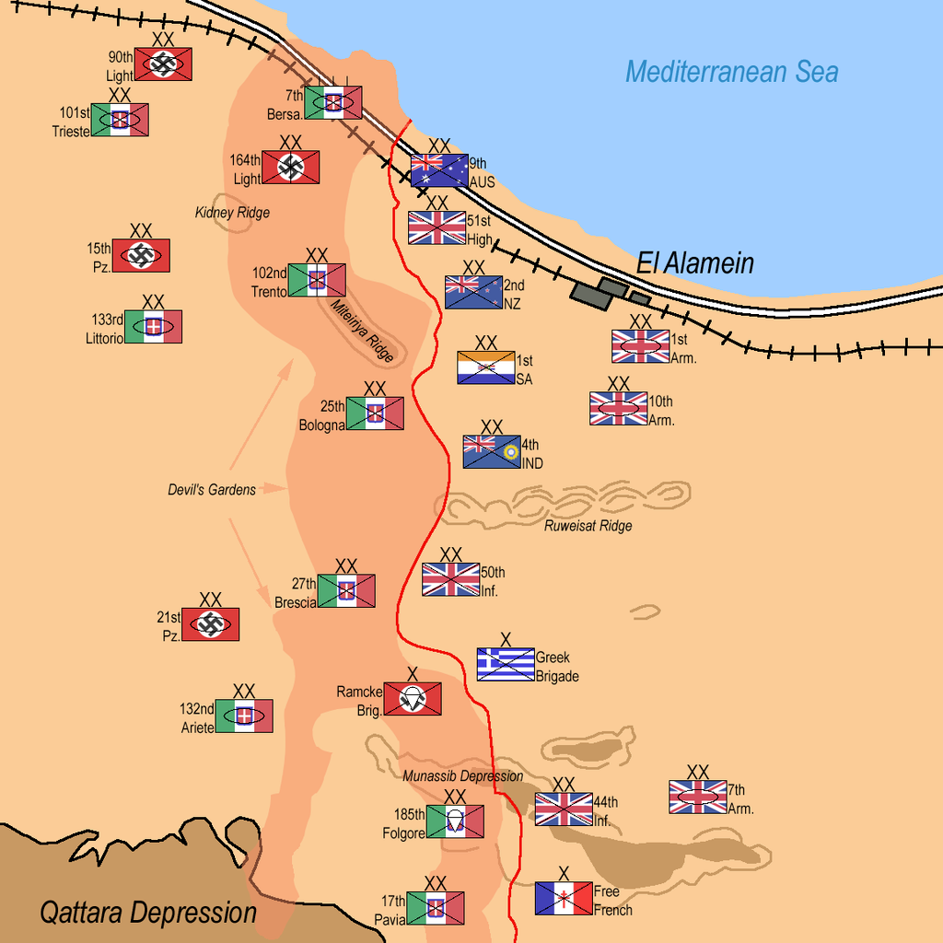
Map of Second Battle of El Alamein

Slide 8
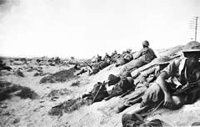
Strategies of the First Battle of El Alamein
Germans attacked El Alamein earlier than expected, catching the Allies without sufficient supplies.
However, the position of El Alamein prevented the Germans from attacking from the south flank due to the Qattara Depression and forced them to attack directly from the west. They also used anti tank mines to force the Germans to attack through a specific area.
The Germans planned on attacking from the west then cut north to push them back east
During the invasion, the Axis forces were held back by sandstorms and positioned themselves wrong, causing them to run into Allied forces which pushed them back.
Limited supplies of the Axis forced them to stop and put them on the defensive.

Slide 9
Strategies of the Second Battle of El Alamein
The Allies have double the troops of the Axis by the end of October and were ready to attack
They first had engineers clear out the mines, then poured tanks and infantry though the mine line with air support
Used a main attack in coastal area assisted by a push further south.
Eventually forced Rommel to go into full retreat by beginning of November

Slide 10
Weaponry of Battle of El Alamein
Axis Forces:
Panzer 2/3/4 + Italian tanks
antitank-Mines
Bombers/Fighter planes
Infantry
Artillery (cannons + anti-tank guns)
Allied Forces:
Lee/Stuart/Sherman/Crusader tanks
Anti-tank Mines
bomber/fighter planes
Infantry
Artillery (cannons anti-tank guns)
Radio intercepting technology

Slide 11
Impacts of the First Battle of El Alamein
The battle was a stalemate between the Allies and the Axis Powers.
The Axis Powers suffered from 96,000+ casualties, 70 tanks, and about 500 aircrafts.
The Allies suffered from 150,000 casualties, 179 tanks, 1,000+ artillery pieces, and over 1,500 planes.
The perseverance displayed by the Allies persuaded the French to start aiding the Allies in the North African campaign.

Slide 12
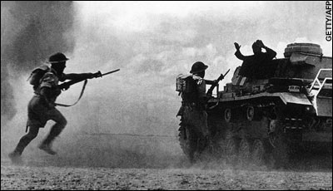
Impacts of the Second Battle of El Alamein
The British gained Kidney Ridge and other vital locations.
The Axis suffered from 30,542 casualties, 500 tanks, 254 guns, and 84 aircraft vehicles.
The Allies suffered from 13,560 casualties, 332-500 tanks, 111 guns, 97 aircraft vehicles.
Turning point for the Allies: First Victory and shed light on Germany’s weaknesses.

Slide 13
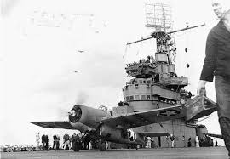
Background on Operation Torch
Operation Torch was code name for the British-American air force landings directed by Dwight D Eisenhower in French Morocco and Algeria
Operation Torch was the first step in conquering all of Axis-occupied North Africa
Operation Torch consisted of three air force landings: at Casablanca, Morocco and at Oran and Algiers, Algeria which took place early on November 8, 1942
650 warships oversaw the landings of 65,000 troops
Algiers surrendered immediately while Oran and Casablanca fell on November 10
The landings of Operation Torch gave way to the rest of the North African Campaign

Slide 14
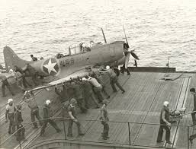
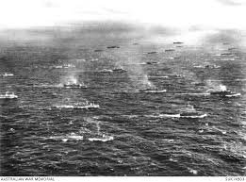
Thesis for Operation Torch
The three air force landings executed by the Allies in Operation Torch resulted in the Ally invasion of Tunisia, which marked the end of the North African Campaign.

Slide 15
Timeline of Operation Torch
8th November - Allied forces land on three different shores of North Africa
9th November - French surrender Oran to British forces
10^{h} November - Allies easily take over Casablanca with an important US air strike
11th November - French Admiral Jean Durlan commands a ceasefire
12th November- Operation ends with the successful capture of North Africa
1942

Slide 16
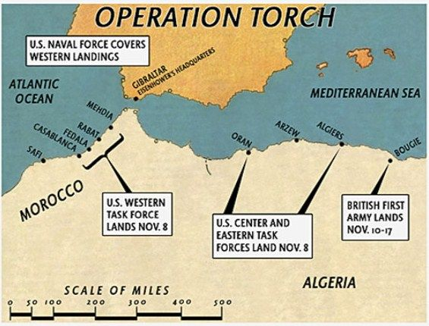
Map of Operation Torch

Slide 17
Strategies in Operation Torch
Operation Torch used a three pronged attack, with landing sites in Oran and Algiers, in Algeria, and at Casablanca, Morocco.
It was the Allies' first experiment with coordinating the Allied forces under one supreme commander (Eisenhower).
Hitler responded by sending two German regiments to Tunisia; followed by other German and also Italian reinforcements, including tank units.
In May 1943 the campaign for North Africa ended with the surrender of 250,000 Axis troops.

Slide 18
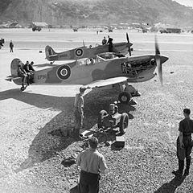
Impacts of Operation Torch
Successful invasion of North Africa by American-British forces.
Major victory for the Allies.
First major air assault carried out by the US in WWII.
Allies suffered from 1,200+ casualties and many resources were used up.
The Axis suffered from 3,343+ casualties and lost a lot of confidence as a result of this defeat.

Slide 19
Works Cited
Axelrod, Alan. “Operation Torch.” Encyclopedia of World War II, Vol. 2, Facts On File, 2013. History Research Center, online.infobase.com/Article/Details/265040?q=operation torch. Accessed 2017.
Battle of El Alamein. Digital image. AWM Encyclopedia. N.p., n.d. Web. 24 Apr. 2017.
Battleships. Digital image. Blogger. N.p., n.d. Web. 24 Apr. 2017.
Biesinger, Joseph A. “Battles of El Alamein.” Germany, Facts On File, 2006. History Research Center, online.infobase.com/Article/Details/267168?q=battle of el alamein. Accessed 2017
Chen, C. Peter. "First Battle of El Alamein." WW2DB. N.p., n.d. Web. 24 Apr. 2017. <http://ww2db.com/battle_spec.php?battle_id=264.>.
Frame, Arthur T. “Operation Torch.” Encyclopedia of American Military History, Vol. 3, Facts On File, 2003. History Research Center, online.infobase.com/Article/Details/204189?q=operation torch. Accessed 2017
Map of Battle of El Alamein. Digital image. Wikimedia. N.p., n.d. Web. 24 Apr. 2017
Operation Torch Map. Digital image. History Through Gaming. N.p., n.d. Web. 24 Apr. 2017
Soldiers. Digital image. Brittanica. N.p., n.d. Web. 24 Apr. 2017.
Stacy, Robert. “Battles of El Alamein.” Encyclopedia of the Early 20th Century (1900 to 1950), Facts On File, 2016. History Research Center, online.infobase.com/Article/Details/246127?q=second battle of el alamein. Accessed 2017.
"BBC - History - World Wars: Second Battle of El Alamein." BBC News. BBC, n.d. Web. 24 Apr. 2017. <http://www.bbc.co.uk/history/worldwars/wwtwo/ff5_second_alamein.shtml>.

