Slide 1
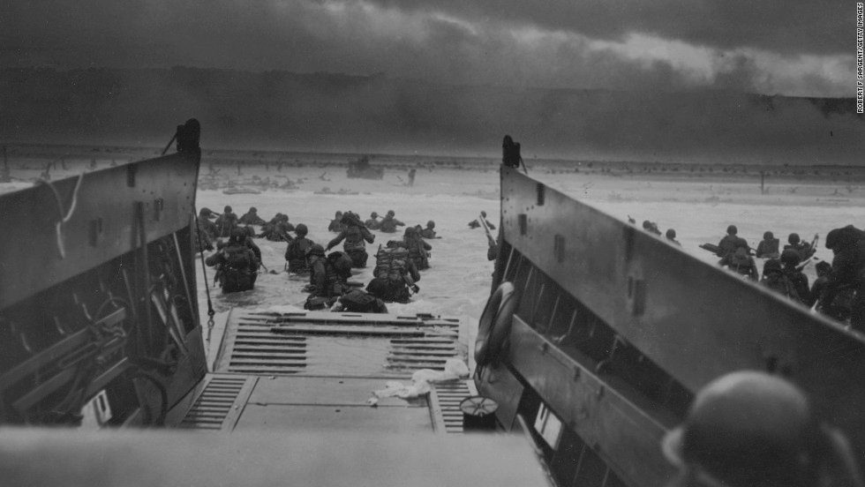
Operation Overlord
Gene Wang, John Froman, Kellen Hoke, and Isaiah Chang

Slide 2
Thesis:
Operation Overlord’s element of surprise allowed the Allies to establish a foothold in Europe, proving that D-Day was the greatest turning point in the liberation of Europe.
Notes:
isaiah

Slide 3
Overview
Operation Overlord commenced on June 6, 1944 in Normandy, France and ended on August 15, 1944 with the liberation of France
The starting date is commonly known as D-Day and the Normandy invasion
Largest Amphibious naval landing in military history
Allied operation that launched the successful invasion of German-Occupied Western Europe
Notes:
kellen

Slide 4
Basic Battle Information
Where: Normandy, France
When: June 6, 1944-August 25, 1944
Who: Twelve Allied powers contributed to the attack
The majority of troops who landed on the D-Day beaches were from the United Kingdom, Canada and the U.S.
Some minor Allied powers such as Australia and Belgium still sent a few divisions of troops
VS.
German forces who occupied France had set up defenses along the coast, but did not know when or where the impending invasion would commence
Notes:
kellen

Slide 5
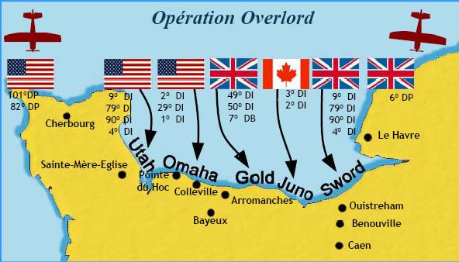

Slide 6
Operation Logistics
“Scheduling, timing, and coordinating the Neptune phase of Operation Overlord proved to be extraordinarily intricate” (Axelrod)
Utah Beach - U.S. 4th Infantry
Omaha Beach - U.S. 1st Infantry
Gold Beach - British 50th Infantry
Sword Beach - British 3rd Infantry
Juno Beach - Canadian 3rd Infantry
Allies landed around 156,000 troops on D-Day
73,000 American
83,000 British and Canadian
By June 11th, the Allies had landed 326,547 troops, 54,186 vehicles and 104,428 tons of supplies in Normandy

Slide 7
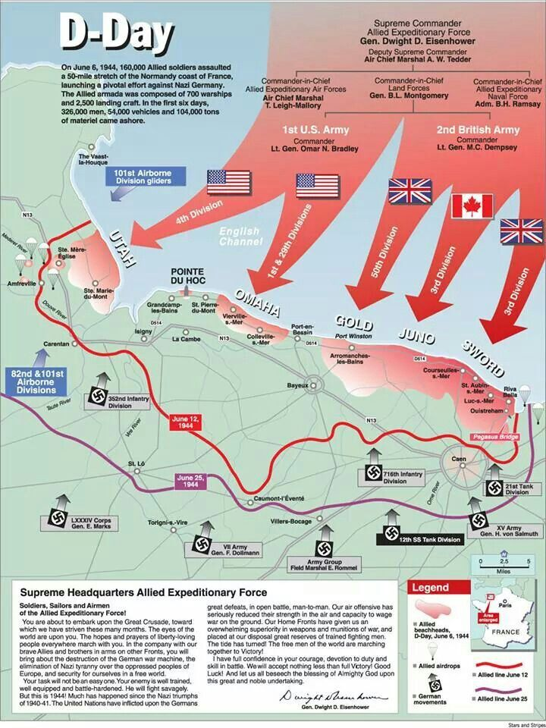

Slide 8
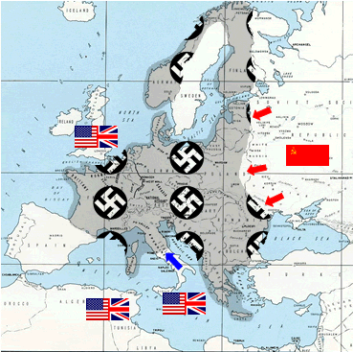

Slide 9
Timeline of Events
The Allies struggled to regain a foothold in Europe during 1942-1943
Allies invaded Africa during this time
Casablanca Conference in early 1943
Roosevelt and Churchill attended
Churchill wanted to push into Sicily and then Italy
Americans wanted to invade France
Churchill won the argument and they proceeded north into Sicily

Slide 10
Timeline of Events (continued)
Allies still had some success in Italy, but were still unsatisfied
Wanted a stronger presence in Europe and to help France
Tehran Conference in late 1943
Roosevelt, Churchill, and Stalin attended
Agreed to launch a Allied invasion on the occupied northern French coastline
Dwight D. Eisenhower (U.S. general) was put in charge of Operation Overlord

Slide 11
Timeline of Events (continued)
Operation Overlord started on June 6, 1944
Allied troops landed in Normandy, France
The Allied troops destroyed German coastal defenses through very bloody battles
More troops arrived in the coming months, creating a key foothold in Europe, allowing for a turning point in the war
On August 25, 1944, France was liberated and the Allies continued their push towards Germany
War (Europe) ended with German surrender on May 8, 1945

Slide 12
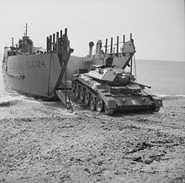
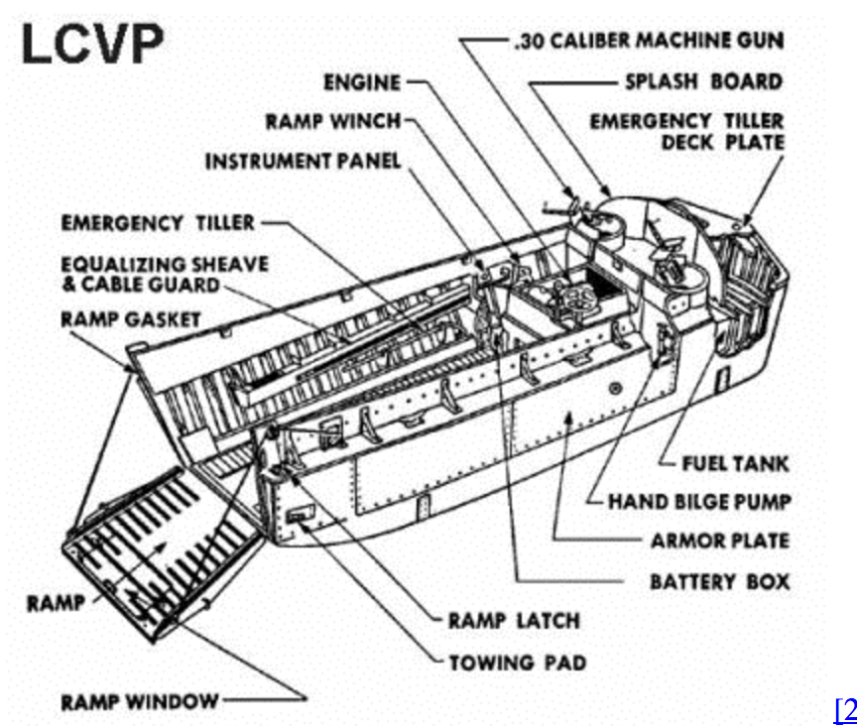
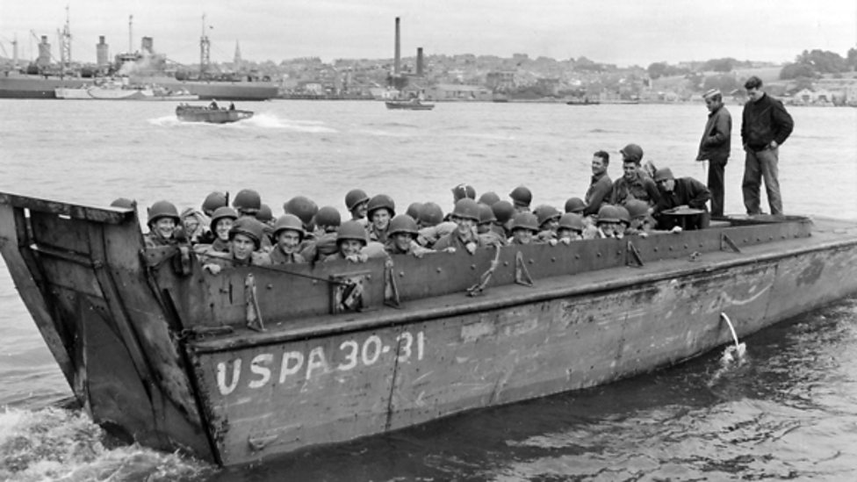
In the soldiers’ boots… (Allied Invaders)---DISADVANTAGE
Soldiers were armed with rifles and small, sidearm weapons
Tanks, but in limited numbers
Allied forces used LVCP (Landing Craft, Vehicle and Personnel) Higgins landing craft to transport troops to the beaches
Made by Andrew Higgins, and irishmen living in louisiana
Felt that there would be a need for thousands of small boats some point in the war and developed the LVCP

Slide 13
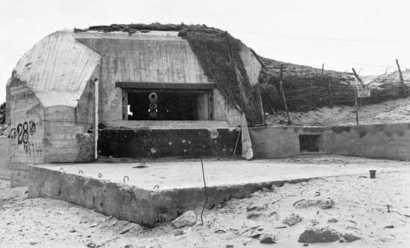
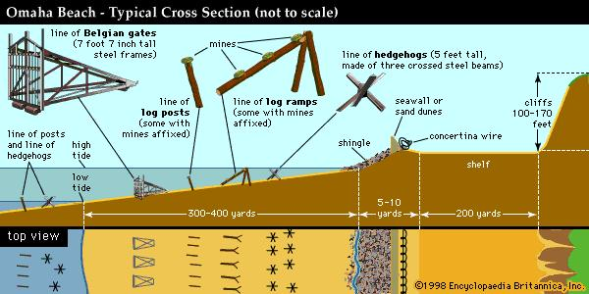
In the soldiers’ boots… (Nazi Defense)---ADVANTAGE
Bunkers stationed on high ground above the beaches in sniper positions
Behind thick concrete and armed with heavy artillery
Germans made defenses along the beaches to hinder the advancements of Allied forces
Consisted of barbed wire and wood fences, along with other jerry-rigged obstacles

Slide 14
Video
Band of Brothers (4:30-6:30)
https://www.youtube.com/watch?v=Qj3X7HfezzE

Slide 15
With such fierce German defenses, how did the Allies manage to succeed?
Quick reminder of our thesis:
Operation Overlord’s element of surprise allowed the Allies to establish a foothold in Europe, proving that D-Day was the greatest turning point in the liberation of Europe.

Slide 16
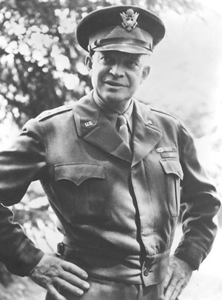
U.S. Involvement
The U.S.’s support was crucial in the success of Operation Overlord
General Dwight D. Eisenhower was the commander of Operation Overlord and formulated the plan

Slide 17
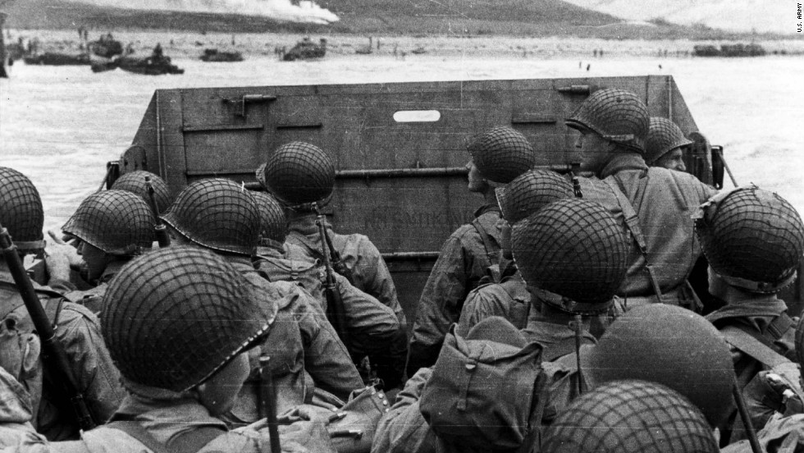
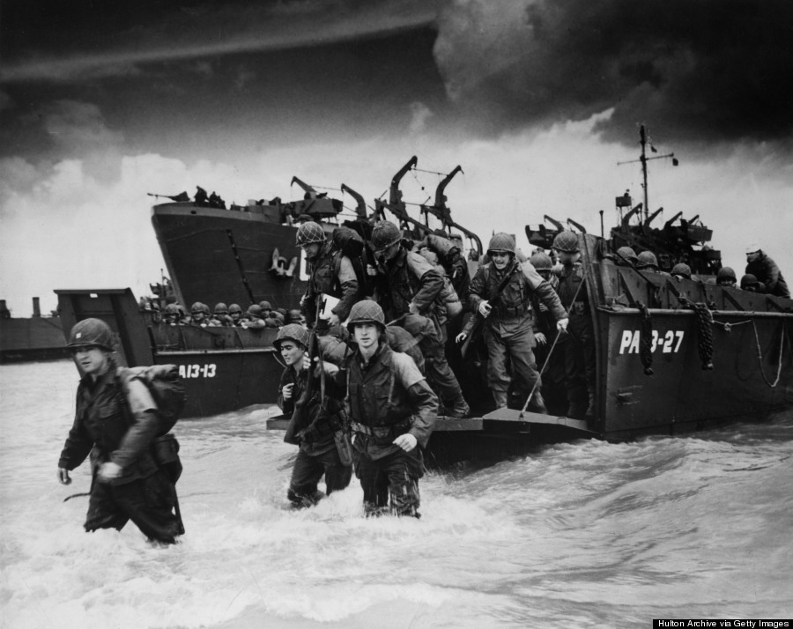
U.S. Involvement (continued)
73,000 U.S. troops fought on D-Day, including efforts by soldiers, sailors, airmen, and paratrooper divisions
With the aid of the many U.S. troops, Operation Overlord had plenty of soldiers to be used to puncture a hole in German-occupied France

Slide 18
U.S. Involvement (continued)
The United States attacked alone at two major beachheads: Utah and Omaha
The only other Allied power with as much land assigned to gain as the U.S. was Britain, but Britain was just across the English Channel, showing the importance of the massive presence of U.S. troops
58,000 U.S. troops landed on the beaches, with an additional 15,000 airborne troops landing scattered throughout Normandy

Slide 19
Allied Air Forces
Prior to D-Day, the Allies intensified air raids against German airfields and communication networks to cripple the German air force
American and British bombers softened German defenses to help the landing troops
Allies won complete air superiority by D-Day
Allied planes dropped paratroopers over Normandy to assist the French Resistance with the disruption of German troop transportation, and to isolate pockets of Germans
Their sabotage delayed German reinforcements from coming to Normandy
Many of these paratroopers, as portrayed in Band of Brothers, missed their intended drop zones on D-Day due to heavy German flak and had to find other Allied paratroopers in the dark, and with Germans all around
They were given twice the pay of an average U.S. soldier for their dangerous work

Slide 20
Geography: Why Normandy
Eisenhower chose the Normandy coast because it was close to British ports and facilities, but away from London and the British population
“Normandy was relatively remote from main German forces” (Berman 171)
The Allies attacked where the Germans had less of a military presence
Major French ports were also far away from Normandy, making it an ideal location for an ambush

Slide 21
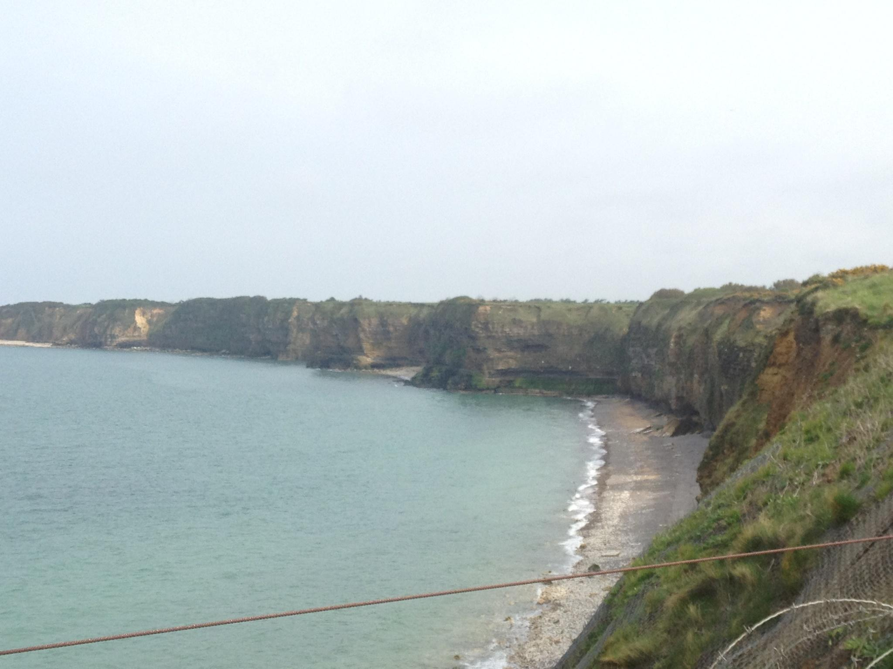
Picture taken by John from Pointe du Hoc, overlooking Omaha Beach in Normandy, France

Slide 22
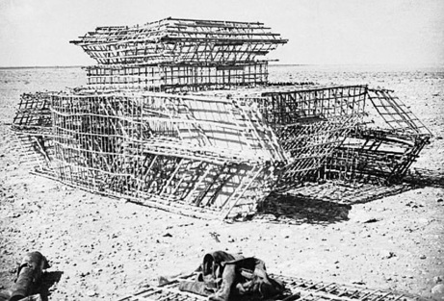
Decoy Strategy (continued)
“Using sophisticated techniques and equipment borrowed from Hollywood and British film studios, Eisenhower staged Operation Fortitude. The deception, under the ‘command’ of U.S. general George S. Patton, was extremely successful…” (“D-Day.”)

Slide 23
Decoy Strategy
German vulnerability in Normandy
The Allies created stationed fake troops and created fake tanks using film techniques at Pas-de-Calais
Tricked into expecting an attack at Pas-de-Calais, nine German military divisions were dug in at Pas-de-Calais, resulting in fewer German troops responding to the Normandy invasion
Divided forces led to less resistance for the Allies during the push into France

Slide 24
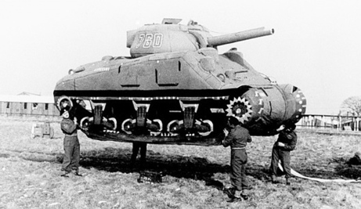
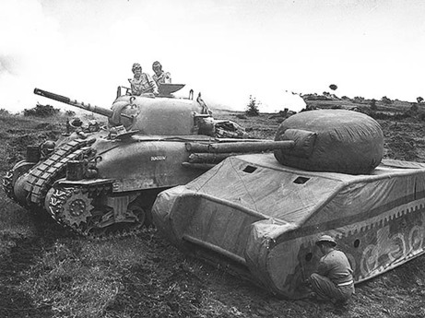
The Allies constructed decoy tanks and placed fake troops and Pas-de-Calais

Slide 25
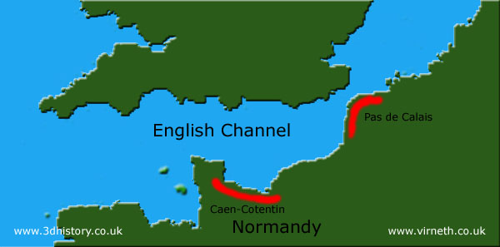
The Germans got goofed pretty hard

Slide 26
German Unpreparedness
“Rommel also believed that Normandy was the most likely site, but his commander in France, von Rundstedt, thought it would be the Pas-de-Calais. As a result, German defenders were spread between the two areas instead of concentrated in one” (Axelrod)
Germans’ lack of command unity was a fatal weakness
Hitler also believed that the attack would be in Normandy, but other Nazi officials didn’t, and so no significant action was taken

Slide 27
German Unpreparedness (continued)
German defenses had to cover over 3,000 miles of coastline, which complicated their distribution of troops
However, these defenses were not necessarily spread thin: the taking of the beaches on D-Day was still a very difficult task for the Allies, even considering that the Germans weren’t at full strength
The Germans’ had the high ground, and the Allied troops had little to no cover on the beaches to find shelter from the fire of German machine gun nests

Slide 28
Lack of German Defenses
success of the allied attack facilitated by the absence of two major forces of Hitler’s polished war machine
1. Luftwaffe
2. Armored Divisions

Slide 29
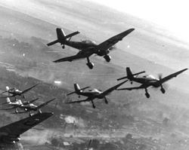
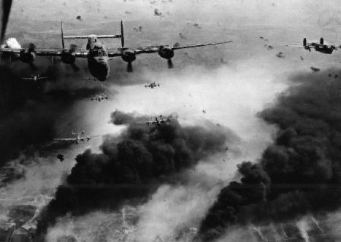
Lack of German Defenses (continued)
1. Luftwaffe
“The Luftwaffe had been driven from the skies for the lack of gasoline by the U.S. Army Air Corps’ precision bombing of Germany’s oil supply in the spring of 1944” (Keylor).
German air force would have greatly contributed to their defenses along the beaches of Normandy
Long range communication
Engage Allied forces farther offshore, combat naval artillery
Wrecked vessels would have clogged busy waterways, decreasing assault efficiency

Slide 30
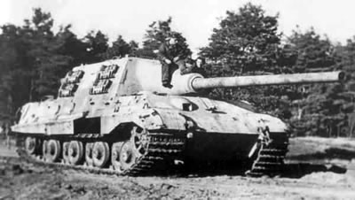
Lack of German Defenses (continued)
2. Armored Divisions
“The German tank units in Northern France had been held in reserve until it was too late on the mistaken assumption that the Normandy Invasion was an elaborate feint to lure the panzers into a trap”(Keylor).
Tanks would have provided heavy artillery and support once allies broke past initial lines of Nazi defenses
Help combat naval vessels with long range rounds
Evened playing field for the Allied forces

Slide 31
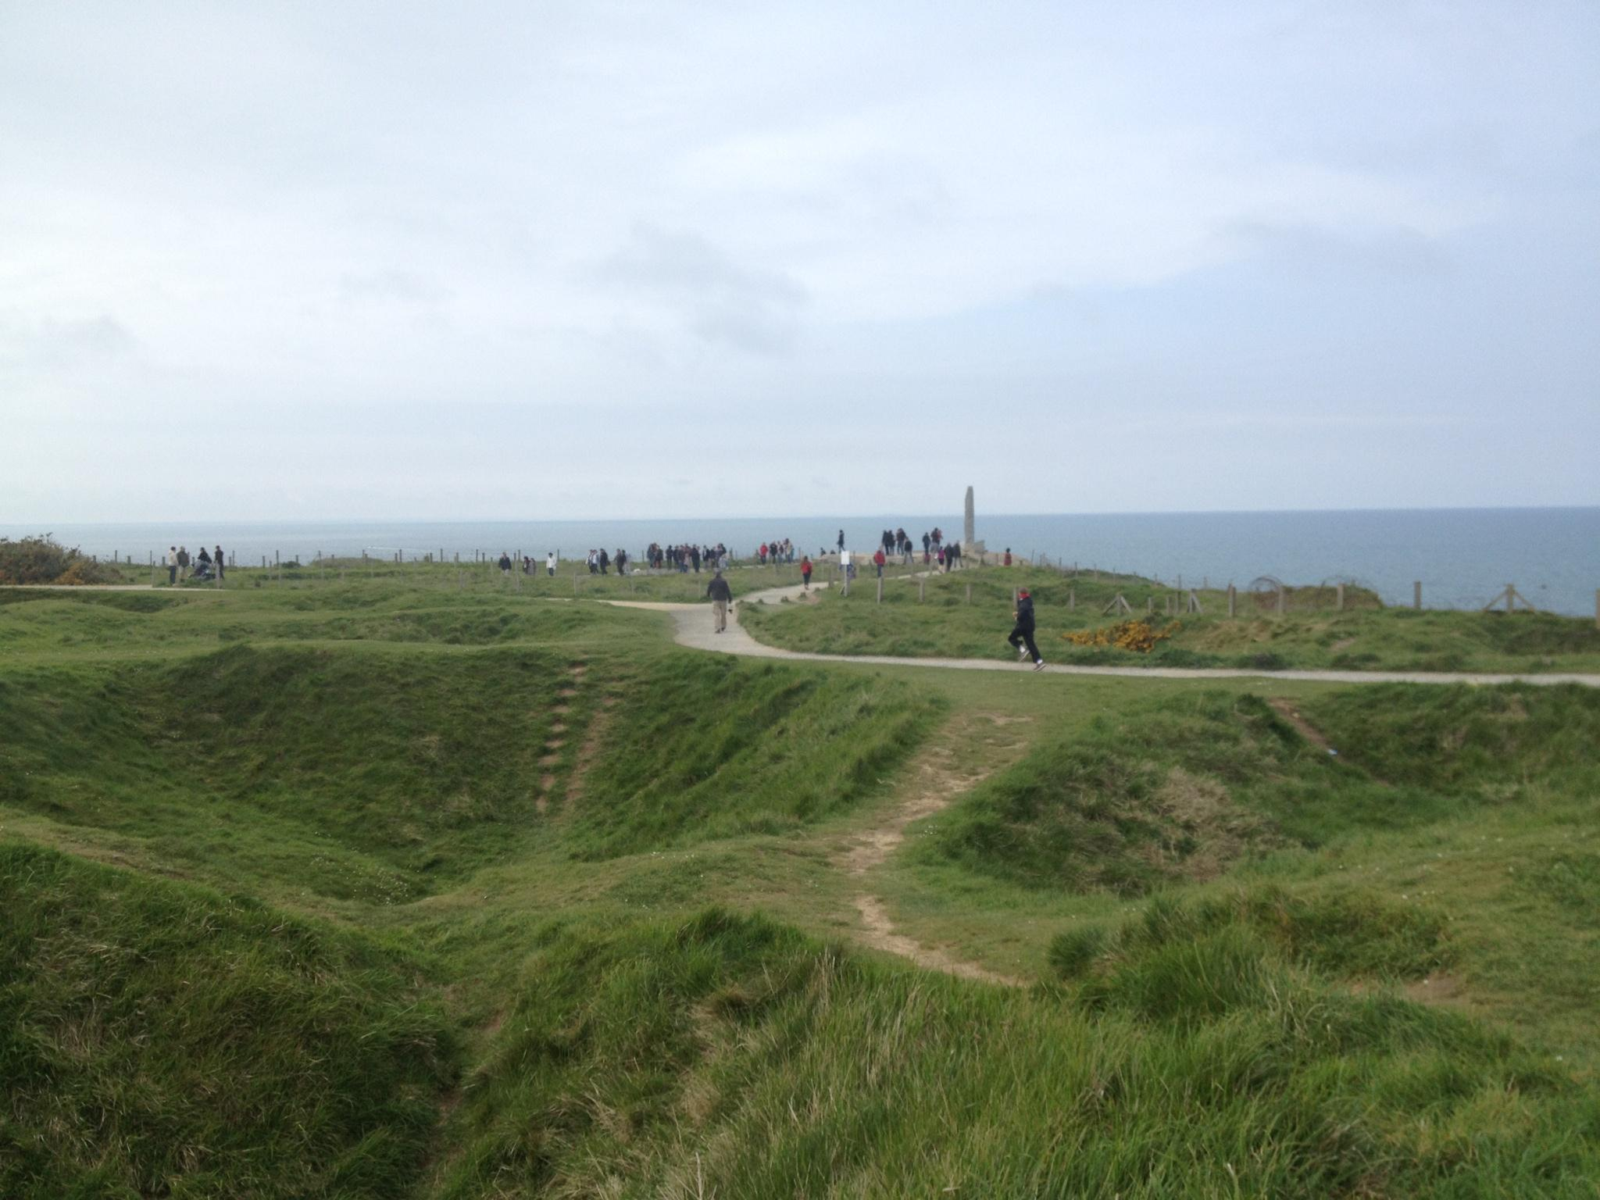
Picture of Pointe du Hoc in Normandy that displays bomb craters caused by Allied naval artillery

Slide 32
Simple Impacts
D-Day allowed the Allies to penetrate Normandy
Eisenhower was unable to attack France directly
“ German forces outnumbered the troops Eisenhower could send to France five to one, surprise was essential to the invasion's success” (“D-Day.”).
Eisenhower’s decoy plan tricked the Germans and misdirected their defensive efforts, allowing Allies a fighting chance at victory

Slide 33
Impacts of Operation Overlord on World War II (WWII)
The combination of the other minor Allied powers’ troops without the U.S.’s wouldn’t have been enough
The naval strength of the U.S. on D-Day was similar to that of Britain’s, and by combining these two forces, the Allies were victorious
Without U.S. troops, Operation Overlord may not have been successful, and France may not have been liberated

Slide 34
WWII Impacts (continued)
A key aspect of Overlord was the importation of military equipment into mainland Europe, since Britain is an island, and was the temporary Allied base of operations in Europe
This meant the Allies needed to make a big push inland to be able to bring in more tanks, jeeps, artillery, and other military supplies
These supplies needed to be brought into mainland Europe for the Allies’ use in liberating Europe

Slide 35
WWII Impacts (continued)
Operation Overlord was a turning point in the European theater of World War II
Established an Allied foothold in France for the importation of supplies and troops
The liberation of France in 1944 paved the way for the liberation of the rest of Europe
Allied forces began their campaign to reclaim Europe from the Nazis
Germany surrendered nearly a year later on May 8, 1945

Slide 36
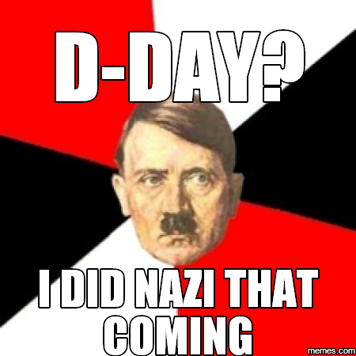
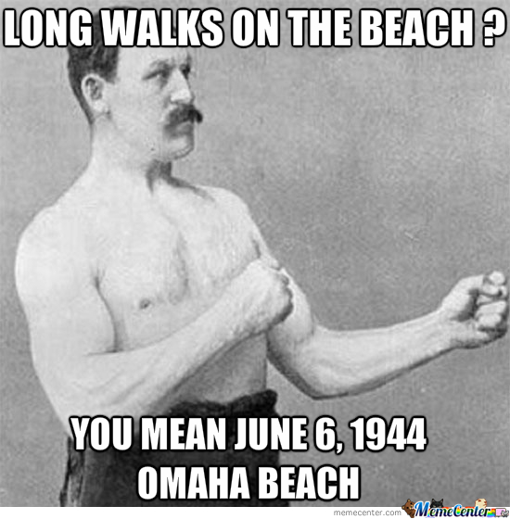
D(ank)-Day Memes

Slide 37
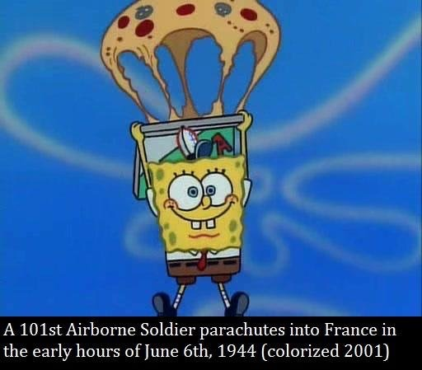
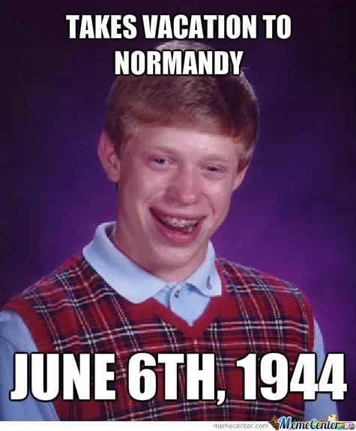

Slide 38
Works Cited
3D History. “D-Day Route Options.” 3d History Illustrated World History. Accessed 24 Apr. 2017.
Ambrose, Stephen, and John Orloff. Band of Brothers - Day of Days (Landing on Normandy). Google, 1 Sept. 2001, Accessed 24 Apr. 2017.
Axelrod, Alan. “Operation Overlord.” Encyclopedia of World War II, Vol. 2, Facts On File, 2013. History Research Center, Accessed 2017.
Bedin, Davide. “ The Extension of the Third Reich before the D-Day.” History Online. Accessed 21 Apr. 2017.
Berman, Mildred. “D-Day and Geography.” Geographical Review, vol. 84, no. 4, 1994, pp. 469–475.
Brooke, Richard S. “OPERATIONS NEPTUNE & OVERLORD .” OPERATION OVERLORD - THE D-DAY LANDINGS. Accessed 25 Apr. 2017.
Churchill, Winston. “The D-Day.” WW2 Live, 6 June 2016. Accessed 21 Apr. 2017.
CNN. “The Allied Invasion of Germany.” CNN, Cable News Network, 2 June 2016. Accessed 24 Apr. 2017.
Coyle, Gene, and William Mahoney. “Before the Beaches: The Logistics of Operation Overlord and D-Day.” Indiana, 2 Feb. 2014.
"D-Day." World History: The Modern Era, ABC-CLIO, 2017, 7. Accessed 19 Apr. 2017.
Florence, Elinor. “D-Day: Dummies and Decoys.” Elinor Florence, 28 May 2014. Accessed 24 Apr. 2017.
Hautetfort. “Les Plages Du Débarquement.” Passion Genealogie Et Histoires Normandes, 6 June 2012. Accessed 24 Apr. 2017.
Huffington. “Reinforcements Disembarking from a Landing Barge at Normandy during the Allied Invasion of France on D-Day. .” Huffington Post, Huffington Post, 6 June 2014. Accessed 24 Apr. 2017.
Isserman, Maurice. “Operation Overlord: The Invasion of Normandy.” World War II, Fourth Edition, Chelsea House, 2016. History Research Center, Accessed 2017.
Keylor, William R. “Chapter 5: Germany’s Second Bid for European Dominace.” The Twentieth-century World and Beyond: An International History since 1900. Oxford: Oxford UP, 2100. 182-183 Print.
Memecenter. “D-Day.” Memecenter, 2014. Accessed 24 Apr. 2017.
Memes.com. “Hitler Nazi D-Day Meme.” Memes, 12 May 2016. Accessed 21 Apr. 2017.
Mikhail. “Rendezvous with Destiny.” Reddit, Aug. 2016. Accessed 24 Apr. 2017.
National Park Service. “General Dwight D. Eisenhower.” National Park Service. Accessed 24 Apr. 2017.
Rodat, Robert. Saving Private Ryan. Google, 24 July 1998, Accessed 24 Apr. 2017.
Schubert, Kyle. “D-Day Brian.” Memecenter, Memecenter, 2013. Accessed 24 Apr. 2017.
Simpson, Jamie. “Blog Post #06: ‘Operation Overlord.’” Wordpress, 23 June 2013. Accessed 21 Apr. 2017.
Tucker, Spencer C. "Casablanca Conference." World History: The Modern Era, ABC-CLIO, 2017, Accessed 30 Apr. 2017.

Slide 39
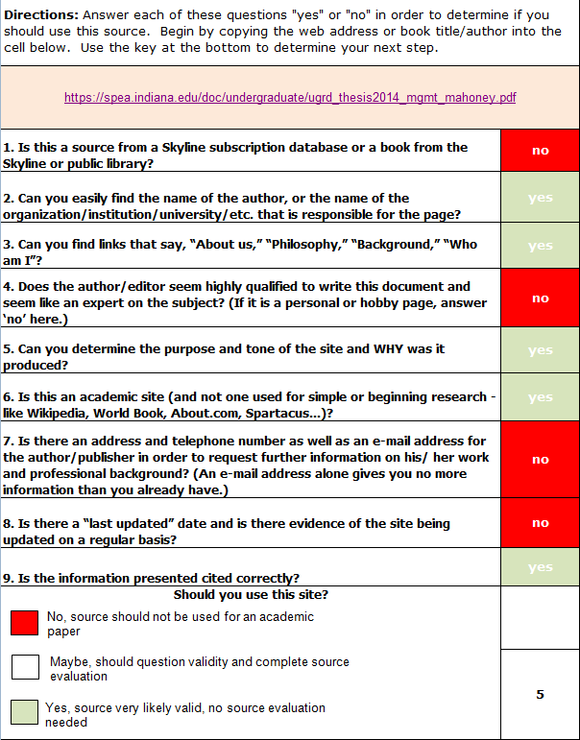
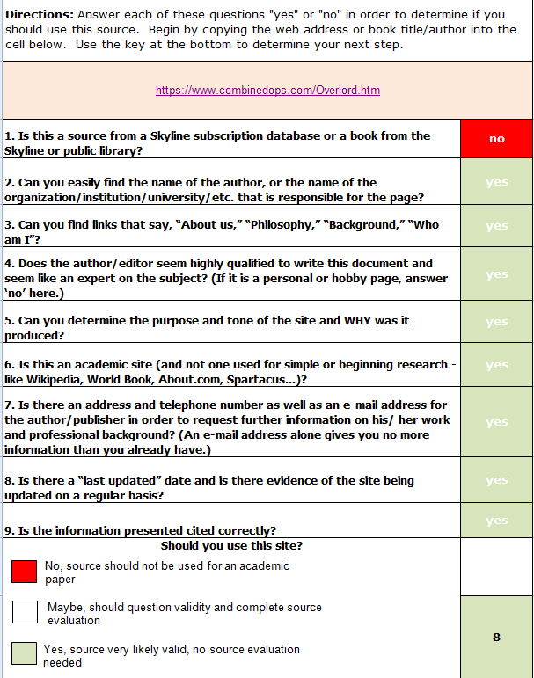
Works Cited (continued)

