Slide 1
Operation Barbarossa Siege of Leningrad BattIe of StaIingrad
BEN YU, KOBE, SHIDE ZHANG, ROBERT “SL” YAN
CURD/MYERS ¾
BATTLES PROJECT
4/26

Slide 2
OveraII Impact of Operation Barbarossa
Thesis: The failure of Operation Barbarossa opened the Eastern Front of World War Two, overtaxing Nazi military resources, allowing the Allies to capitalize on Germany’s vulnerable position from two fronts.

Slide 3
Background Information
Operation Barbarossa was the codename for the German invasion of Soviet Russia during World War II.
Goals:
Take control of valuable Soviet oil supplies to support German army
Russia has vast oilfields near Ural and Siberia as well as Ukraine and provided two million tons of oil to the Reich (Beevor)
Rid the European continent of Jews and Bolsheviks to achieve Aryan Supremacy
Lebensraum (“living space”): take land for the Aryan race to expand into
Capture the Baltic states, the Crimea, and portions of Poland.
Destroy Russian army to prevent a two front war

Slide 4
Background
1939- Hitler and Stalin signed Nazi-Soviet Nonaggression Pact
clarified borders between Germany and Soviet Union, gave Baltics to Stalin-Hitler does not like this
The Western Front had stalled after the Battle of Britain making an invasion of Britain impossible.
Hitler was confident that the operation would go smoothly in Germany’s favor
predicted the assault to last no more than 3 months (“We have only to kick in the front door and the whole rotten Russian edifice will come tumbling down.”) (Hitler)
no effort to coordinate the invasion with Japanese ally
The plan consisted of three phases
1. Go deep into Soviet territory, destroy their forces, disrupt supply lines, cause CHAOS
2. Seize Leningrad and Moscow to prevent military direction and economic support to the Red Army
3. Advance to and hold the Volga-Archangel Line

Slide 5
Timeline
June 28, 1941: German troops capture Minsk, Byelorussia, encircling 27 Soviet Army divisions in the process.
September 16, 1941: German Generals Guderian and Kleist's Panzergruppe linked up east of Kiev, Ukraine, encircling 5 Soviet Armies.
September 29, 1941: The German Einsatzgruppen massacre between 50,000 and 96,000 Ukrainians, 33,771 of whom Jews, at the Babi Yar ravine outside Kiev.
December 5, 1941: Soviets launch massive counter-attack; push Germans back 200 miles
July 25, 1941: 1st Panzer Group clashes with at least six Soviet mechanised corps in the largest tank battle of the war up to that point; lasts four days
June 22, 1941: Nazi forces enter Soviet territory; overwhelm Red Army
August 3, 1941: The first German strategic reports claim that Germany had taken nearly 900,000 prisoners and destroyed or captured 13,100 tanks, 9,100 aircraft and more than 10,000 heavy guns.
September 19, 1941: German troops capture Kiev, Ukraine, along with 600,000 prisoners, 2,500 tanks, and 1,000 artillery pieces.
June 26,1941: German aircraft begin to bomb Leningrad
July 3, 1941: Bialystok pocket in Poland eliminated by German troops, taking 300,000 prisoners.
December 2, 1941: Germans reach within 24km (15 miles) of Moscow, but are shortly halted by blizzards.

Slide 6
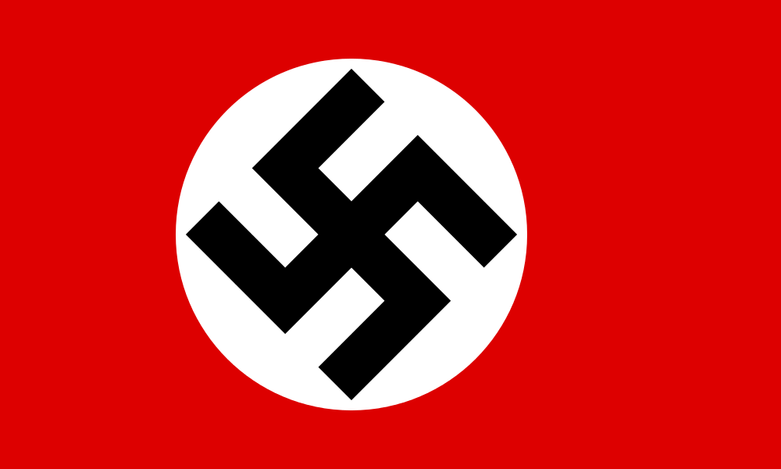
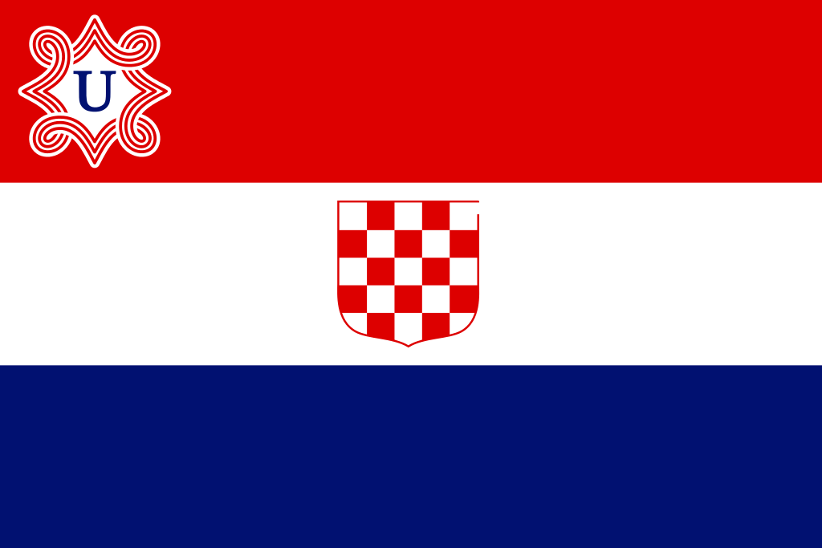
What countries were involved?
Axis | Allies

Slide 7
Operation Barbarossa
Operation Barbarossa began on June 22, 1941.
Russia was poorly prepared for an German invasion.
Stalin had ignored signs of a German attack and intelligence that suggested a invasion.
The Russians had move up their line of defense to the Molotov-Ribbentrop border recently.
The Luftwaffe destroyed 1800 aircraft and 66 airfields on the first day.
The Great Purge by Stalin had left the Red Army devoid of experienced officers and generals. The NKVD had left little power in the officer's' hands and often officers deserted leaving division without leadership.
Stalin had left the Kremlin and holed himself up in his dacha at Kuntsevo, leaving the other members bewildered and fearful (Beevor)

Slide 8
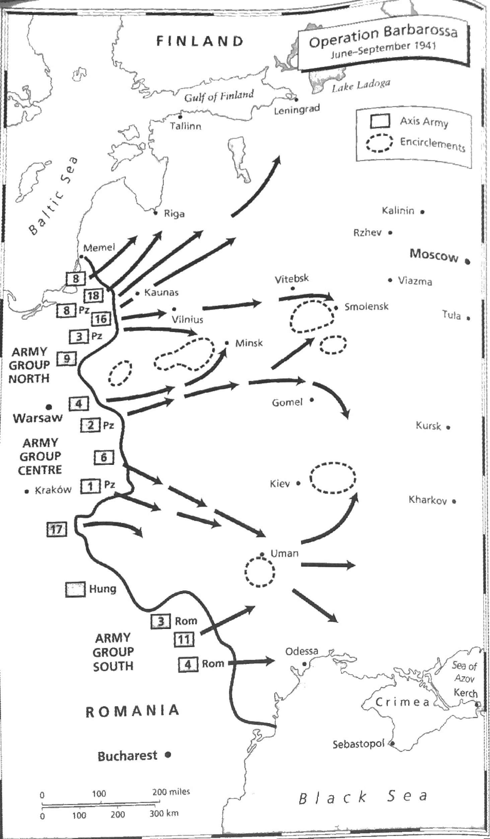

Slide 9
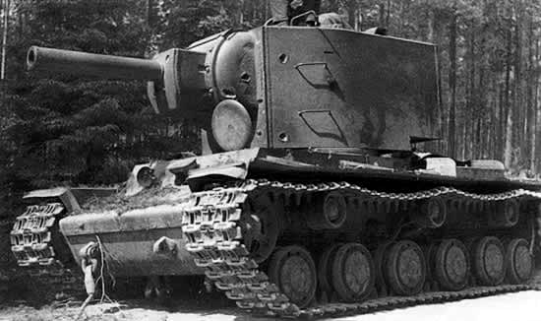
Tactics
German:
Quickly end the Russian war with the Panzer divisions leading the way.
Use superior air force to destroy Russian infantry and control the air.
Have well-armed and supported veteran soldiers.
Use superior training, tactics, and communication
Russian:
Scorched-earth warfare
Use superior armored force(KV, T-34) and mass produce these tanks
Appeal to Russian patriotism and nationalism to inspire troops
Slow down German advance (last until winter) using militia-battalions
Wear out the German Infantry

Slide 10
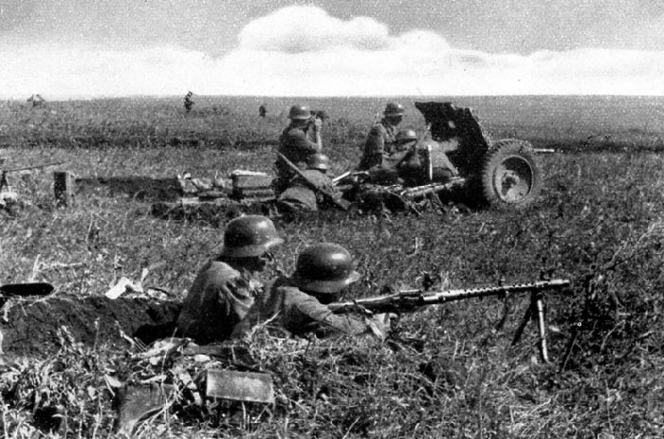
Early Victories
Battle of Białystok–Minsk (July 1941)
Battle of Smolensk (August 1941)
Battle of Uman (August 1941)
Battle of Kiev (1941)
large encirclement of Soviet troops in the near of Kiev
Huge defeat for the Russias
German Casualties: 128,000 Russia Casualties: 700,000
Five Soviet field armies (5th, 37th, 26th, 21st, and the 38th) are wiped out
A major boost in German morale

Slide 11
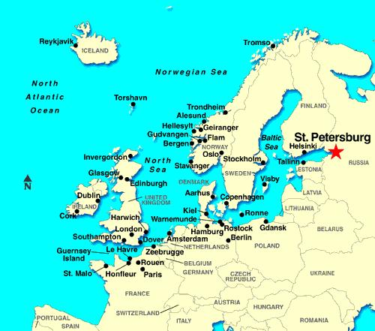
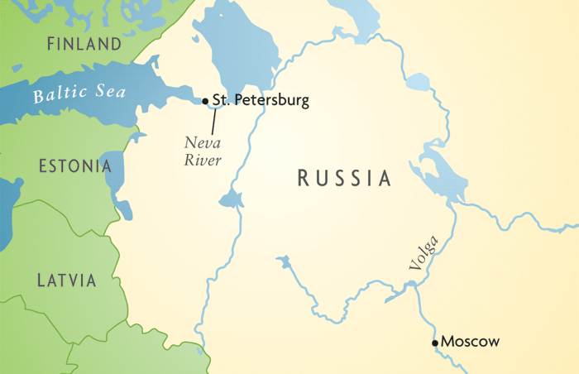
Leningrad (AKA St. Petersburg)
Port city to the Gulf of Finland and Baltic in Northern Russia, on an isthmus that connects to Finland’s southern border
Isthmus: strip of land with water on either side

Slide 12
Early Stages of the Siege of Leningrad
The seizure of Leningrad was a key goal of Operation Barbarossa
Army Group North of Operation Barbarossa (commanded by Field Marshal Wilhelm von Leeb) marched towards the city from the southwest
His forces were to work in conjunction with the Finnish army advancing south, down the isthmus, from north of Leningrad
By July 8, the German Fourth Panzer Army had captured Fort Schlisselburg, which guarded the Neva River’s origin from Lake Ladoga, cutting off Leningrad completely (Stolberg, Tucker).

Slide 13
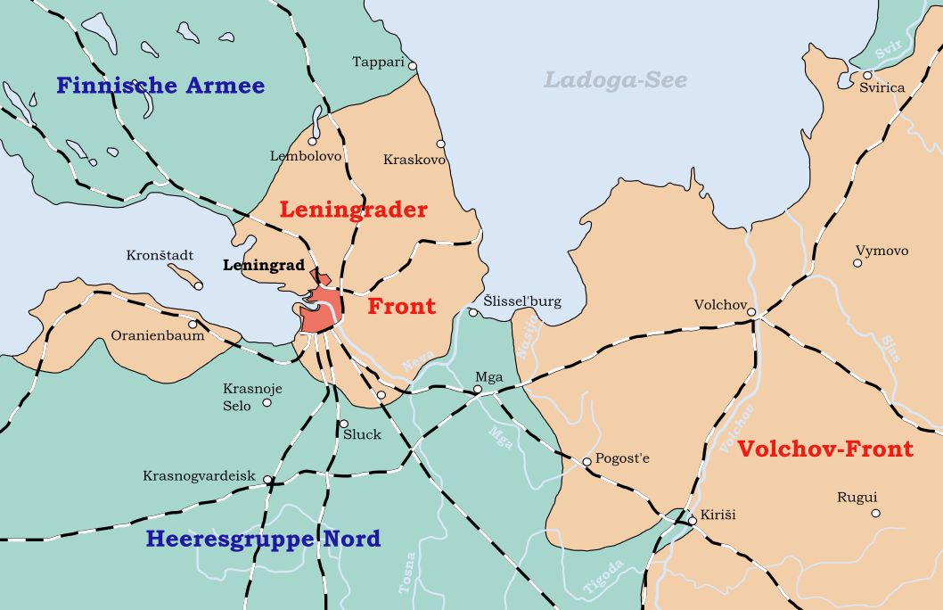
Map of Leningrad Front circa September 1941 (Minasjan, Altgowsen)

Slide 14
Post-Summer 1941
The Finnish Army stopped advancing from the north, simply reclaiming the lost territory from the Finnish-Soviet War of 1939-1940 (Stolberg, Tucker).
This understandably threw a wrench into German Field Marshal Leeb’s order to capture Leningrad, as the Finns refused to get within 26 miles of the city limits.
To make matters worse, Field Marshal von Leeb lost much of his 4th Panzer Army, the armor being redirected to the Moscow offensive (Stolberg, Tucker).

Slide 15
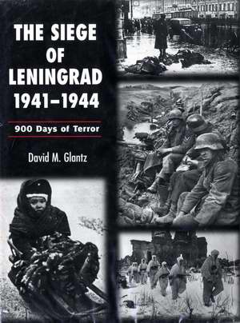
The Siege of Leningrad Begins
Hitler decides to level the city, then give it to Finland
Field Marshal von Leeb sieges Leningrad
Leningrad was completely landlocked by Axis Powers
Only supply line open was from Lake Ladoga
During winter, the lake froze for truck transports
Around half a million civilians were able to leave via water
The rest were starved, firebombed, and shelled (Borrero).

Slide 16
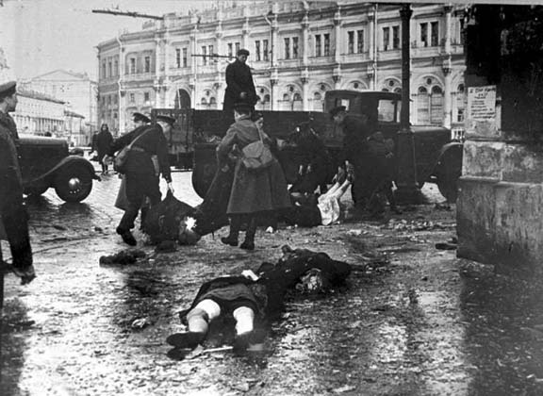
Siege Life in Leningrad
It’s bad.
The entire city was within German artillery range
Large loss of architectural history and culture through mass shelling
Leningrad was a city that imports all of its raw materials
Starvation was the primary cause of death throughout the siege
Western historians state figures of 1 million total dead (Axlerod).
“Later they often carried the dead in single sleds...They wrapped the corpses themselves in sheets, in blankets...Day after day the number of these sleds increased, creating at one period...an endless procession along the main streets” (Krypton 256).

Slide 17
Breaking the Siege
January 1943 Operation SPARK (AKA Operation Iskra) had a successful offensive by the Russians that recaptures Fort Schlisselburg, and created a 10-mile corridor for supplying the city
January 1944 Soviet General Kirill A. Meretskov's Volkhov Front makes a massive attack that outnumbers German Field Marshal von Leeb’s Army Group North by 2 to 1 in manpower, breaking the siege completely (Stolberg, Tucker).
This is also the start of the Leningrad-Novgorod Offensive that begins the Soviet domination of the Eastern Front

Slide 19
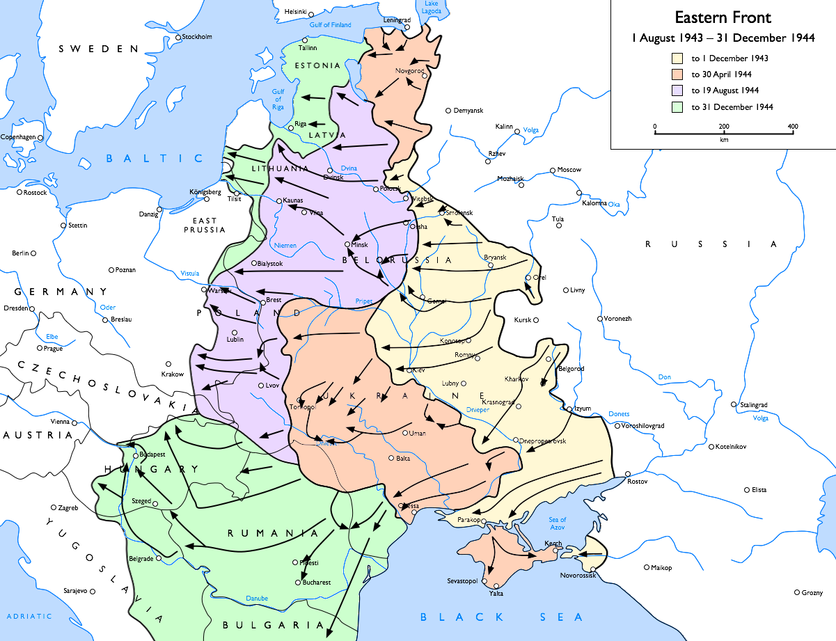
Leningrad-Novgorod Offensive (Dyer)

Slide 20
Endgame of the Leningrad Siege
>1 million Russians died in Leningrad, a large amount of civilians
A significant amount of German Army Group North is tied up sieging the city, rather than continuing onto the offensive
Finnish forces show their lack of participation in the war
The city never falls - the massive loss of human life did not deter the Russians from fighting, nor did it reduce their fighting force significantly

Slide 21
Operation Typhoon
Major objective capture Moscow
Moscow is the political capital of Russia but Hitler thought that weakening Russia economically was more important
The Battles of Vyazma and Bryansk: draw German forces away from Moscow
In the end German forces fail their attack on Moscow and retreat
During the retreat they are attacked by Russian counter-attacks
Overall a failure for Germany
German Casualties: 174,000–400,000 Russia Casualties: 650,000–1,280,000
First time German line is pushed back
Turning point in Operation Barbarossa

Slide 22
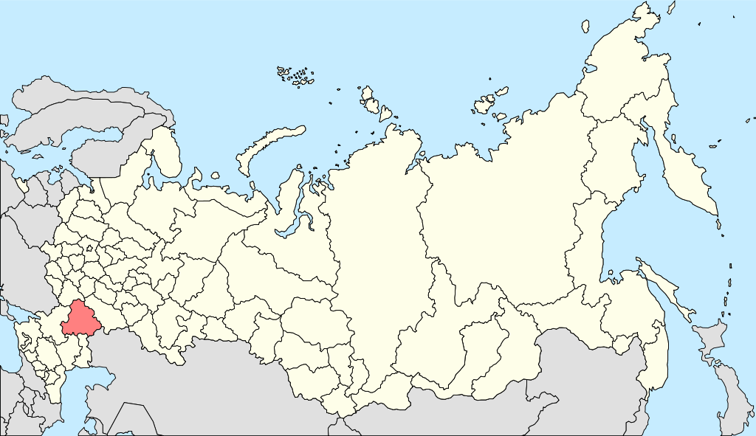
BattIe of StaIingrad (AKA VoIgograd)
August 23, 1942 - February 2, 1943
Turning point on the Eastern Front
Why was it wanted?
Stalingrad was a large strategic point
Was the crossroads between the Volga and the Caucasus
A major industrial center
Hitler really wanted this city because of the
benefits it had
Also wanted it because it had “Stalin” in its name
Was overconfident that they would succeed
following Operation Barbarossa

Slide 23
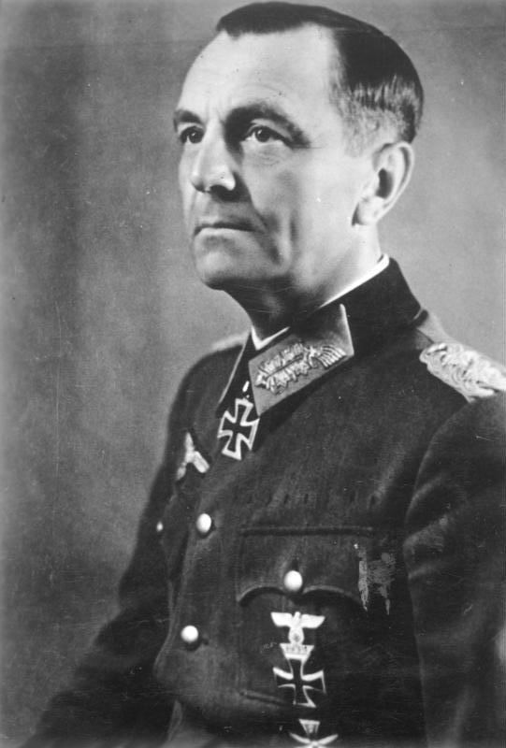
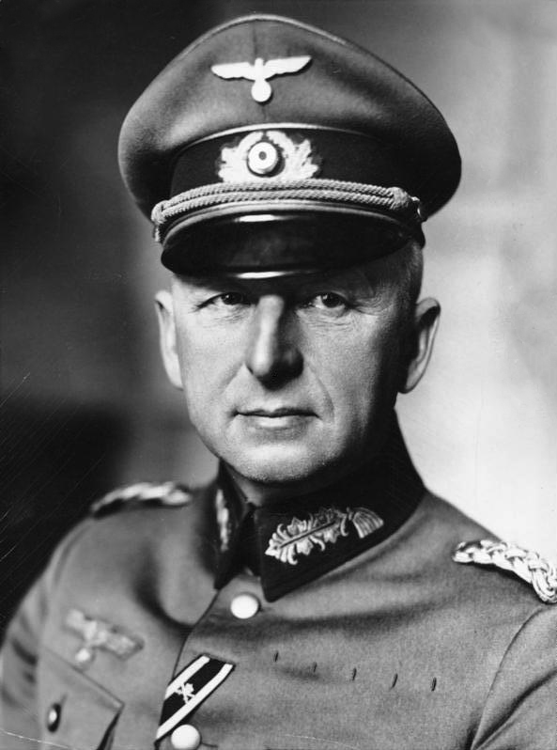
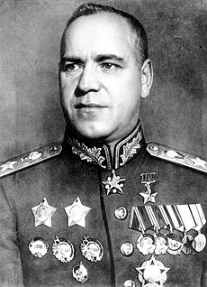
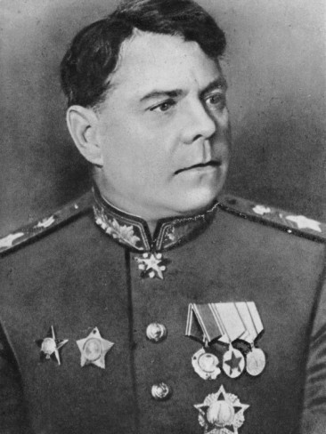
Who led the Battle?
Axis | Allies
Friedrich Paulus Erich von Manstein | Georgy Zhukov Aleksandr Vasilevsky

Slide 24
Preparations
Hitler expects this to be an easy win, but doesn’t expect the Soviets to be well-defended
Stalin forces majority of its citizens to get involved in the defence of the city
Order 227
Issued by Stalin on July 28, 1942
Used to impose discipline on Soviet soldiers
As Axis approached Stalingrad, Stalin rushed supplies and reinforcements to the city
Axis used much of their resources simply arriving to Stalingrad

Slide 25
Trouble Before the Battle Begins
Aware of the dwindling supplies, General Halder, as well as other leading commanders, try to stop Hitler from continuing with the battle.
Hitler has none of it, and demands them to continue approaching, and takes control of Army Group A, as well as sacking Halder
Ironically, if it weren’t for Hitler’s decisions, the Germans might have been able to capture Stalingrad much quicker

Slide 26
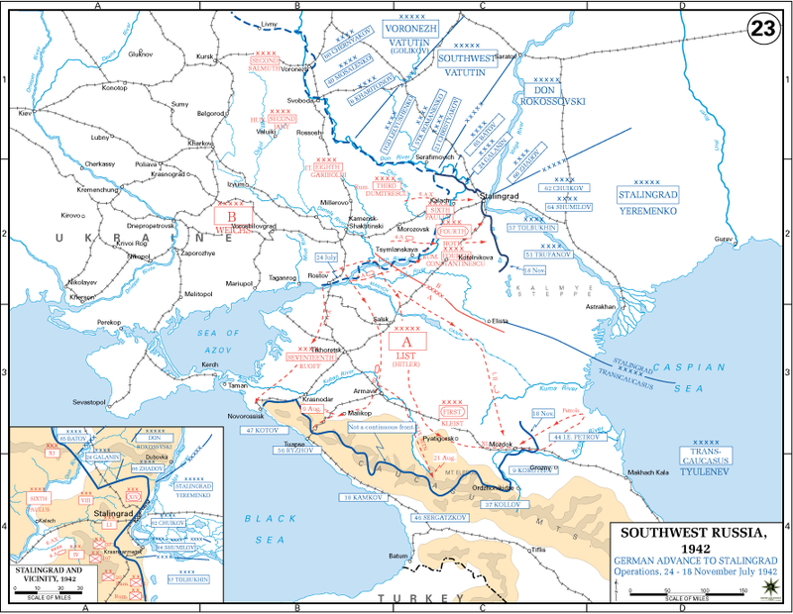

Slide 27
The German Attack
Axis forces initially outnumbered the Soviets by 100,000 men
Began carpet bombing the city at the end of August, killing 40,000 and destroying much of the city
Despite the sheer destruction of the Soviets, Stalin refuses to evacuate civilians, reasoning that it would motivate the forces to defend even more rigorously
The Germans take 90% of the city in 3 months, but Soviets manage to continue to defend the remainder of the city

Slide 28
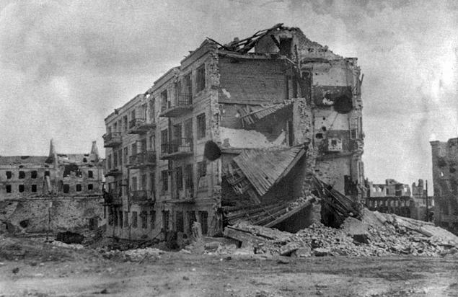
Pavlov’s House
Germans attempted to siege this apartment from September 27, 1942 to November 25, 1942 and failed
Sgt. Yakov Pavlov, the namesake of this landmark, ordered by Stalin to fortify the building and defend it to the last man, in accordance to order no. 227.
Despite the multiple attacks every day, them being heavily outnumbered, and the
lack of resources, Pavlov’s forces managed to defend for
60 days, when counter-attack forces arrived
It is said that more Germans were killed for this building
than in the entire Nazi campaign for France

Slide 29
Operation Uranus
With 90% of Stalingrad captured by the Germans, Zhukov and Vasilevsky plan a counter-attack with over one million soldiers, outnumbering the Germans four-fold.
Created a pincer attack, forcing all but the 6th Army to retreat from Stalingrad
Paulus, who is leading the 6th Army in Stalingrad, requested to surrender to Hitler, who fervently forbade Paulus to do
Demanded Paulus to defend to the last bullet and man
As winter came, German soldiers began to die of frostbite, starvation, and some even committed suicide
By January 31, Paulus personally surrendered, but didn’t allow his forces to do the same.

Slide 30
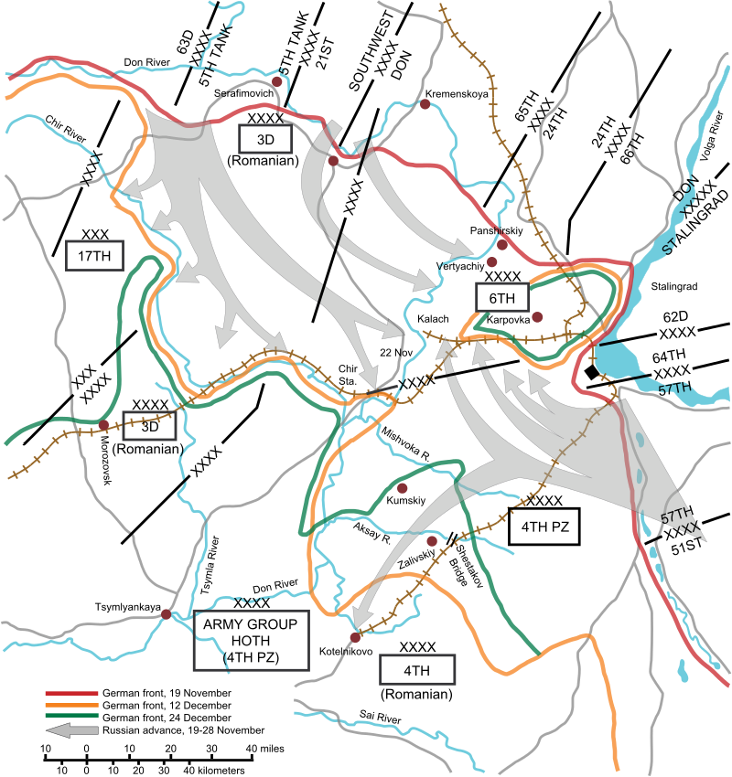

Slide 31
What came out of this?
Ended up being a catastrophic failure for the Germans
After this, they would have no more major victories in the Eastern Front
Destroyed the 6th Army, and expended much of their men and resources, leaving the German Army vulnerable.
The Soviet victory created a huge boost in morale, rejuvenating the Soviets to push on west, ultimately ending with them taking Berlin two years later.
The final nail in the coffin is the Battle of Kursk when the German Offensive was halted complete giving the Soviets the initiative

Slide 32
OveraII Affect of Operation Barbarossa
The failure of Operation Barbarossa opened the Eastern Front of World War Two, overtaxing Nazi military resources, allowing the Allies to capitalize on Germany’s vulnerable position from two fronts.

Slide 33
Works Cited
Axelrod, Alan. "Siege of Leningrad." Encyclopedia of World War II, Vol. 2. Facts On File, 2013. Modern World History Online. Web. 24 Apr. 2016.
Beevor, Antony. The Second World War. New York: Little, Brown, 2012. Print.
Biesinger, Joseph A. "Operation Barbarossa." Germany. Facts On File, 2006. History Research Center. Web. 24 Apr. 2016.
Borrero, Mauricio. "Siege of Leningrad." Russia. Facts On File, 2004. Modern World History Online. Web. 23 Apr. 2016.
CGSC. "Battle of Stalingrad." CGSC. N.p., n.d. Web. 25 Apr. 2016.
Dyer, J. E. "Facts and Implications: Notes on Diana West's American Betrayal - Liberty Unyielding." Liberty Unyielding. N.p., 30 July 2013. Web. 25 Apr. 2016.

Slide 34
Works Cited
Hartmann, Christian. Operation Barbarossa: Nazi Germany's War in the East, 1941-1945. Oxford: Oxford UP, 2013. Print.
The History Department of the United States Military Academy. "German Summer Offensive." USMA. N.p., n.d. Web. 25 Apr. 2016
Krypton, Constantine. “The Siege of Leningrad”. The Russian Review 13.4 (1954): 255–265. Web…
M. M. Minasjan/ M. L. Altgowsen (u.a.): Die Geschichte des Großen Vaterländischen Krieges der Sowjetunion, Bd.2, Deutscher Militärverlag,
Berlin (Ost) 1965. (Kartenband)
Stolberg, Eva-Maria, and Tucker, Spencer C. "Siege of Leningrad: World War II." World at War: Understanding Conflict and Society. ABC-CLIO,
2016. Web. 23 Apr. 2016.

