Slide 1
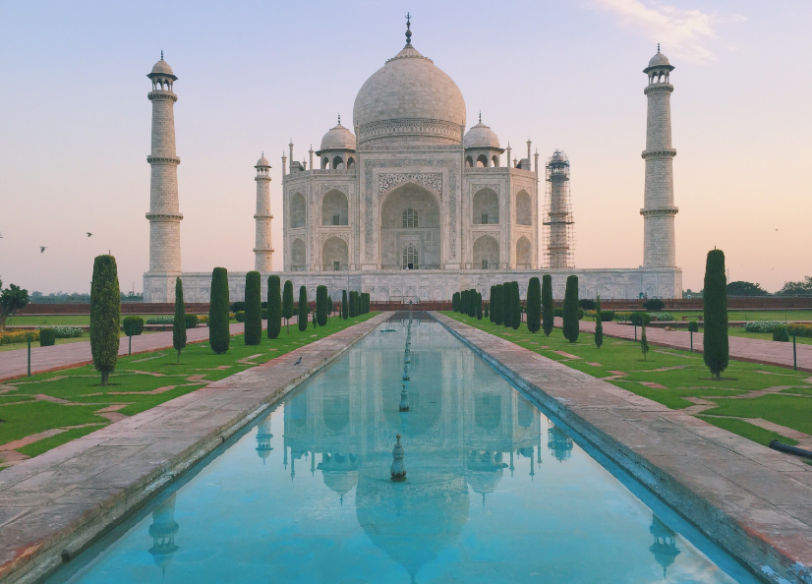
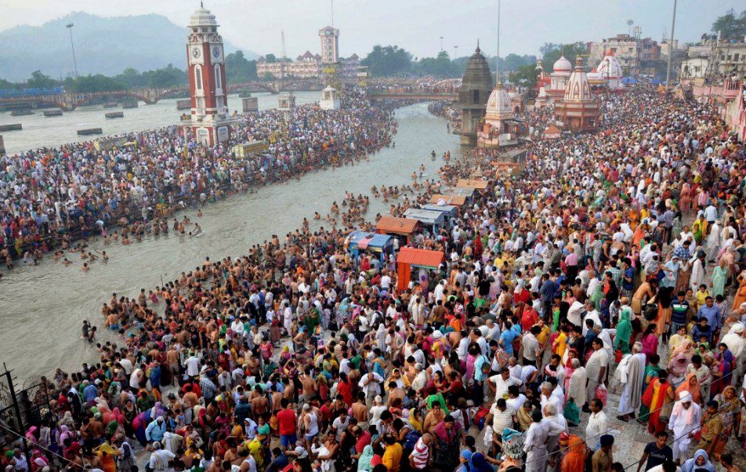
South Asia - India

Slide 2
FACT OR FICTION?
India has the largest population of any country in the world.

Slide 3
Fiction
But, with a population of 1,270,938,000 India is the world’s largest democracy.
United States
Ranks 4th with 308,042,410

Slide 4
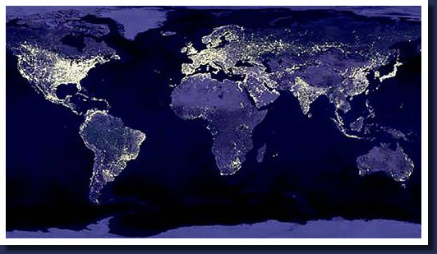

Slide 5
FACT OR FICTION?
India has BOTH a president and a Prime Minister

Slide 6
FACT
Prime Minister
Most powerful gov’t position
Appointed by President
Usually the leader of the majority party
President
Ceremonial Head of State
1st Citizen of India
Supreme Commander of the Indian Armed Forces

Slide 7
FACT OR FICTION?
The majority of Indians practice Buddhism

Slide 8
FICTION
Hinduism 80.6%
Muslim 12.4%
Christian 3.4%
Sikh 2%
Buddhism .7%
Jain .5%
Other .4%
Shiva, the Hindu god of destruction

Slide 9
FACT OR FICTION?
Mahatma Gandhi used and promoted civil disobedience and non-violence when leading India’s struggle for independence from the British Empire.

Slide 10
FACT
Gandhi was the pioneer and perfector of Satyagraha - the resistance of tyranny through mass civil disobedience strongly founded upon ahimsa (total non-violence) - which led India to independence, and has inspired movements for civil rights and freedom across the world

Slide 11
Fact or Fiction?
India won its independence from Great Britain in the late 19th century.

Slide 12
FICTION
India achieved its independence from Great Britain in 1947.

Slide 13
FACT OR FICTION?
In India, males are twice as likely to be literate than females.

Slide 14
FICTION
India's literacy rate is 64.8%
53.7% for females
75.3% of males
These women recently completed a literacy course. With the ability to read, they can be better consumers as well as workers who aren't cheated on their wages.

Slide 15
FACT OR FICTION?
India has about 800 dialects and 15 major Languages

Slide 16
FACT-ISH
The Indian constitution recognizes 23 official languages. Hindi and English are used by the Central Government for official purposes. Two classical languages native to the land are Sanskrit and Tamil. The number of mother tongues in India is as high as 1,652.

Slide 17
FACT OR FICTION?
India’s national sport is cricket.

Slide 18
FICTION
Although cricket has been incredibly popular in recent times, field hockey is still considered the “national sport.”

Slide 19
FACT OR FICTION?
India produces more movies than any other country in the world, and Bollywood is the largest film industry in the world.

Slide 20
FACT
Bollywood is a strong part of popular culture of not only India and the rest of the Indian subcontinent, but also of the Middle East, parts of Africa, parts of Southeast Asia, and among the South Asian diaspora worldwide.

Slide 21
FACT OR FICTION?
The Taj Mahal was a gift of love.

Slide 22
FACT
TO:
Mumtaz Mahal
FROM:
Mughal Emperor Shahjahan
Sheer poetry in marble. Majesty and magnificence, unrivalled. Love redefined. The Taj Mahal, the one and only one of its kind across the world. The monumental labor of love of a great ruler for his beloved queen. One of the wonders of the world. From 1631 A.D., it took 22 years in the making. An estimated 20,000 people worked to complete the enchanting mausoleum.

Slide 23
FACT OR FICTION?
The Caste system was around in ancient times, but since independence, is no longer a reality for most Indians.

Slide 24
FICTION
Their lives continue to be dominated by the ancient Hindu caste system, which assigns each person a fixed place in the social hierarchy.

Slide 25
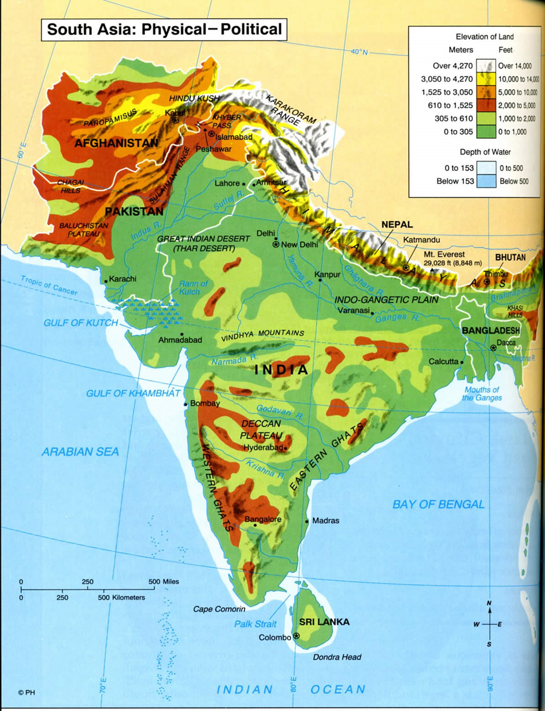
Journal Entry 5/24/18
Use the map on the right to answer the following questions from geographic perspective…
What advantages does India have?
What challenges will India face?
Where would you build a city?
Where will invasions come from?

Slide 26
Indus River Valley Civilizations
Where/when did the oldest South Asian civilization's emerge, what do we know about them?
What are the two “capitals” of the Indus River Valley Civilizations?
What technology did the Harappa (and other Indus Civilizations) have?
Where do scholars believe the peoples of the Indus River Valley obtained the ability to write, why were they able to obtain this ability?
What type of religion did the Indus Valley people follow?
What do we know about the decline of the Indus Civilization?

Slide 27
Ancient India Project
Today we are going to start a project (our final project)
Goal: Research a specific era/empire in India
Outcome: Some form of presentation…

Slide 28
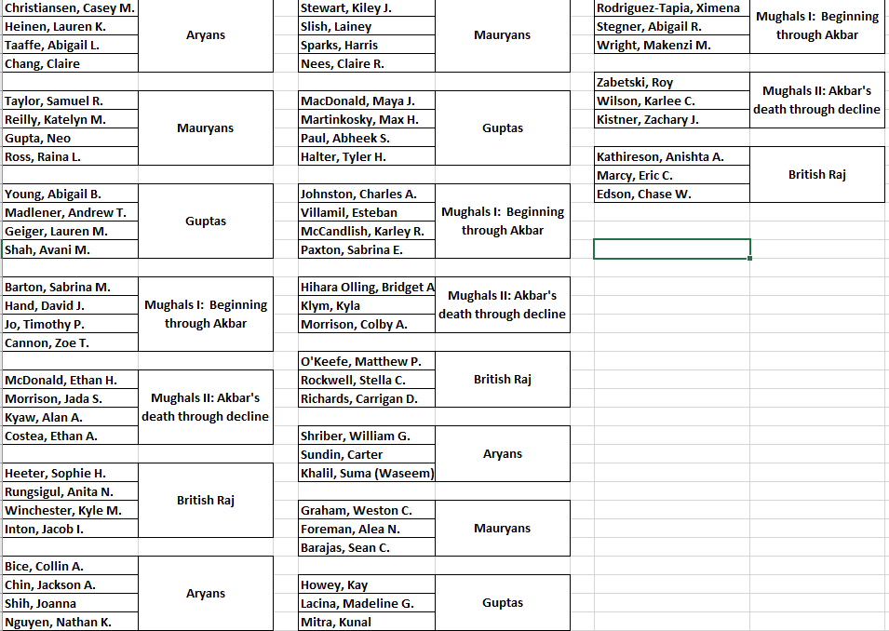
Ancient India Project Groups

Slide 29
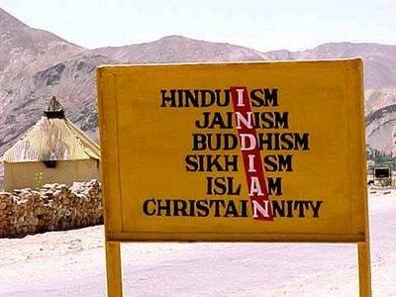
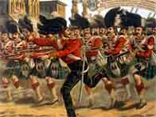
Journal Entry 6/5/18
This is probably our last journal entry for the year.
With in mind – what is one question you would like to ask me that you want to know about
This can be personal, but it must be school appropriate.

Slide 30
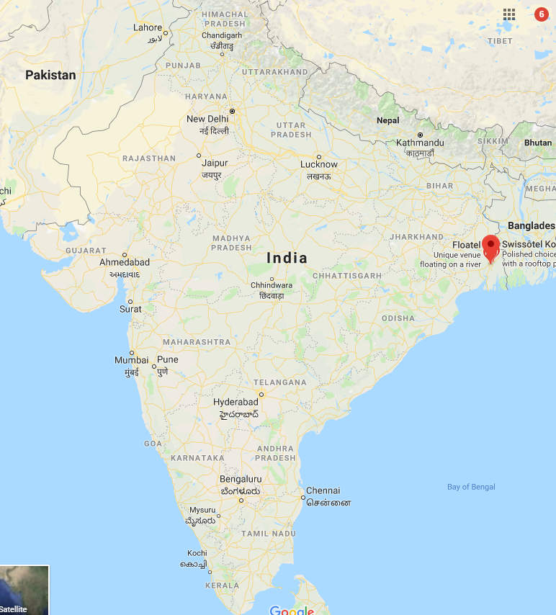
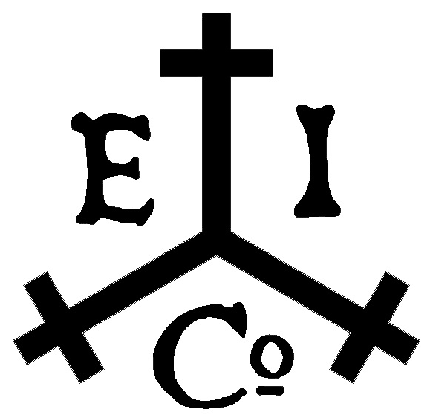
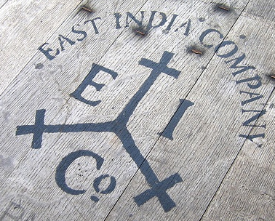
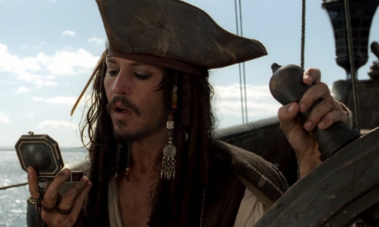
British in India Background
British first start to show up in India around 1600
Led by the British East India Company in Bombay, Madras, and Calcutta
BEIC was met with opposition by the decaying Mughal Empire, and by 1757 the EIC was able to take over the majority of the continent after winning the Battle of Plassey
Until 1800s, EIC dominated territories in India
Notes:
Battle of Plassey – one of several battles between the BEIC & Indians near Calcutta

Slide 31
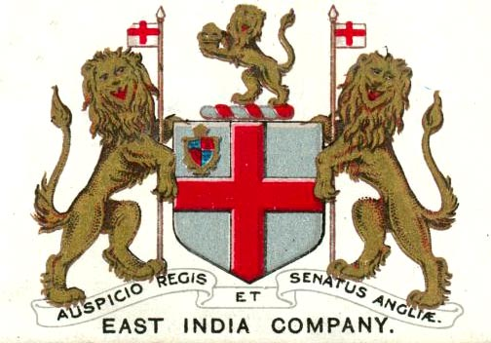

Slide 32
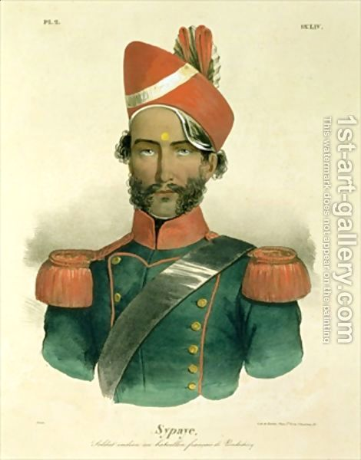
British East India Company
Ruled using a private army
Sepoys: Indian soldiers in EIC army, led by British officers
Governor of Bombay (Mountstuart Elphinstone)
“a delicate and dangerous machine, which a little mismanagement may easily turn against us”

Slide 33
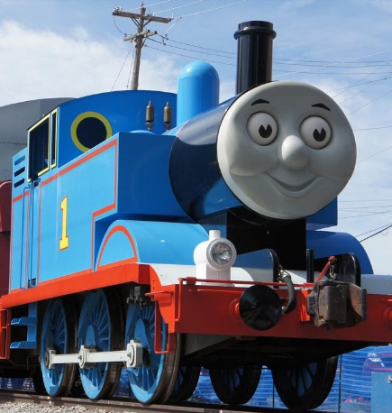
British East India Company
Similarly to Africa Britain is able to dominate India because of advantages gained through the Industrial Revolution
What were those advantages?

Slide 34
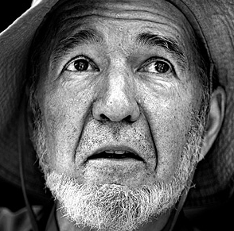
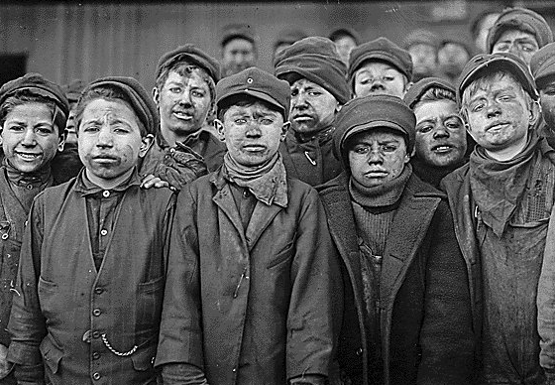
British East India Company
Similarly to Africa Britain is able to dominate India because of advantages gained through the Industrial Revolution
What were those advantages?

Slide 35
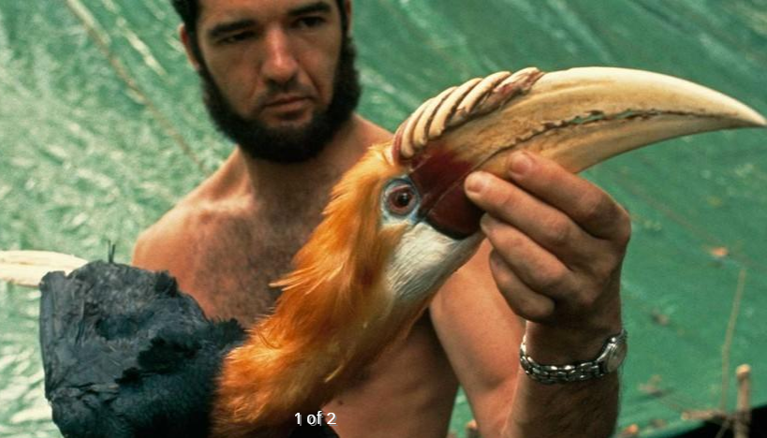

Slide 36
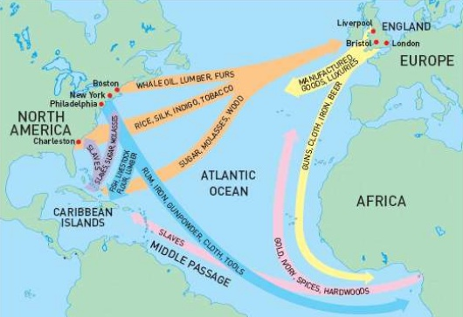
Britain’s “Jewel in the Crown”
Britain restructures India’s economy
Sent all of their raw goods Europe
Europeans (British) refined the goods
India Not allowed to make their own refined goods
Had to buy the refined goods from the British
What does this sound like to you?

Slide 37
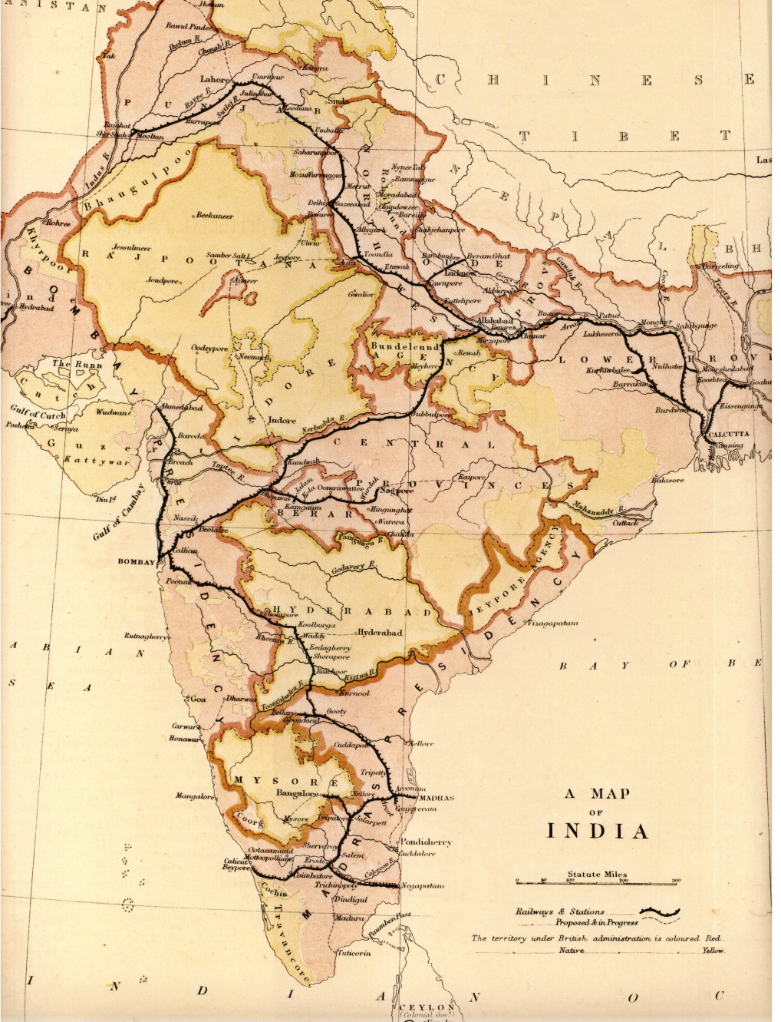
India’s The Railroad
Britain builds an extensive network of railroads in India
This allows raw materials to be shipped from the interior to the exterior
This moved production away from food to cash crops
Such as:
Tea, indigo, coffee, cotton, and jute
Cotton production in India took off during the American Civil War

Slide 38
British Colonial Rule in India - Impacts
The long term impact of Britain's colonial rule in India was negative spurring the rise of British resentment by the peoples of India, ultimately ending British rule in India.
Using the information you learned last week from the Ancient India presentation/posters defend or refute this statement.
Make sure you include how Nationalism played a role in GB’s loss of control in India

Slide 39
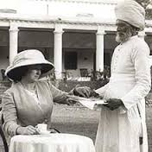
British Colonial Rule in India – Social Control
Positives:
Modernization through railroads, roads, telephones, telegraphs, dams, bridges, and irrigation canals
Sanitation and public health improved
Literacy rates rose
“Bandits” and local warfare ended
Negatives:
British put themselves atop the power structure
Restricted Indian textile industry
Indian villages lost self-sufficiency
Producing cash crops reduced food production, leading to famines in 1800s
British Missionaries and racism threatened Indian life
Do the Negatives out weigh the positives?

Slide 40
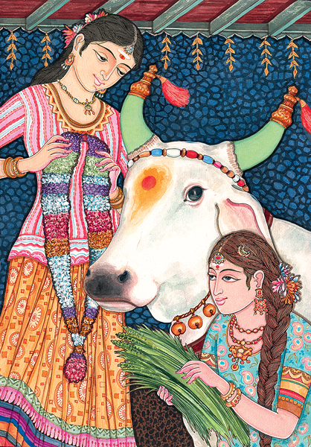
Taboo
Taboos are religious and cultural, but they often have their roots in practical considerations.
For Hindus, beef is taboo.
For Muslims, pork is taboo.
Religious: The cow is a symbol of wealth and plenty.
Practical: the cow provides muscle power, protein (milk, yogurt), fertilizer and fuel (poo).
What is an example in the USA?

Slide 41
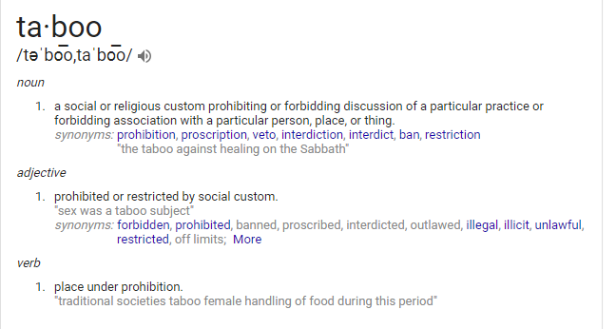
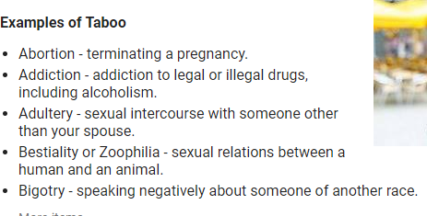

Slide 42
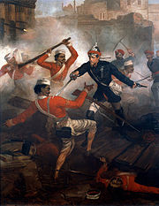
British Colonial Rule in India – Sepoy Rebellion
1857:
Economic problems are severe: Indians are forced to grow and export cash crops (whose price is volatile) and there are few jobs.
Growing sense of resentment and Nationalism.
Technology: The British East India Company introduces a new rifle, with new cartridges.
To load the new rifles, troops must bite off a small piece of the cartridge.
New cartridges issued, supposedly greased with pork and beef.

Slide 43
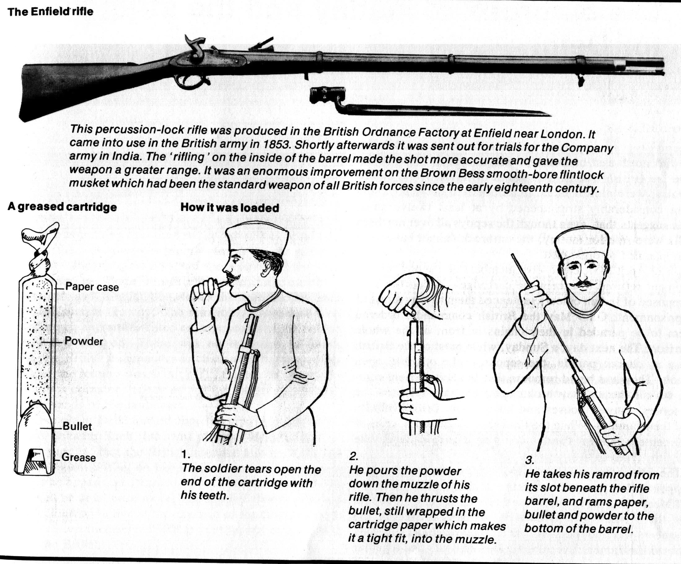

Slide 44
British Colonial Rule in India – Sepoy Rebellion
Captured Delhi
Spread into Northern and Central India
Lasted over a year, but were unable to defeat British due to lack of unity between Muslims and Hindus
Eventually crushed by British Army supporting the EIC
Effects:
British establish direct control over India, launching a period known as the British Raj
Britain gained greater control over interior states
Fueled the racist attitudes of the British further
Increased distrust between Indians and British

Slide 45
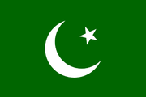
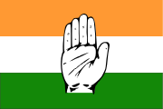
British Colonial Rule in India – Nationalism
Nationalism starts to emerge in India as a response to Westernization, Modernization, and being made second-class citizens in their own country
Nationalism: Strong feelings of pride in one’s nation/language/culture. Usually leads to the desire of the nation to form a state.
Nationalism leads to two main groups in India:
Indian National Congress: Mainly Hindu
Muslim League: Mainly Muslim

