Slide 1
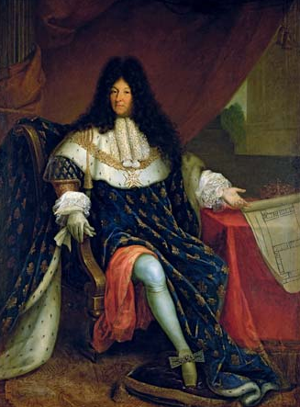
French Absolutism

Slide 2
Absolutism – What is it?
Read the article on my website, define it in your notes

Slide 3
Background to Absolutism in France
France like most of W. Europe was heavily involved in the 30YW
France was heavily influenced by royal minsters prior to Louis XIV
This is because Louis XIII & XIV were only boys when they took power
Two important ministers helped keep France together during the period before Louis XIV took power
Cardinal Richelieu & Cardinal Mazarin

Slide 4
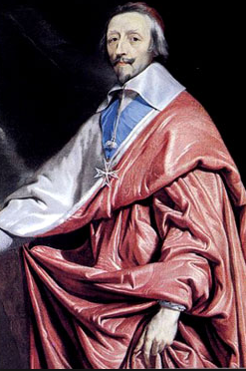
Cardinal Richelieu
Louis XIII chief minister from 1624-1642
Eliminated the political and military power of
The Huguenots
He essentially killed off (during 30YW) any one
Of them that might cause the monarch a problem
Allows them to keep religious privilege
Used intendants to execute orders of the central government in the provinces
This was diplomatic, and the intendants were usually successful
Struggled in the area of finances
Imposed heavy taxes on land/property
During his reign as cardinal it increased over 2.5 times
System was very corrupt
Because of 30YW they could not keep up with debt

Slide 5
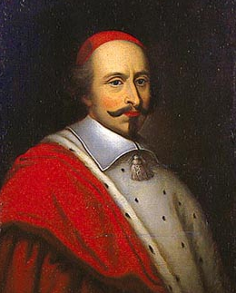
Cardinal Mazarin
Took over after Richelieu died in 1642
Louis XIII died shortly after as well (within a few months of Richelieu)
Dominated government while Louis XIV was coming of age
Was greatly disliked by the French
This was because he was Italian
Quelled the Frondes
Group of nobles that hated Mazarin, and revolted against him
First (1648-1649) was ended by compromise
Mostly protested taxes by a group of nobles called The Robe
Second (1650-1652)
Group called The Sword wanted to overthrow him for their own political gains
Failed when they started fighting each other
Died in 1661, at this point Louis XIV was poised to take over

Slide 6
French Absolutism - Louis XIV

Slide 7
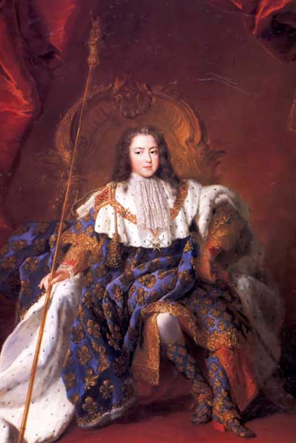
Louis XIV - Background
Raised primarily by his mother
He was 4 when his father died in 1642
23 when Mazarin died
Was extremely serious about taking control of the government…
Upon hearing this Louis XIV’s mother thought it was a joke
This is because he was more known for playing jokes on people and sleeping with the royal maids

Slide 8
“Up to this moment I have been pleased to entrust the government of my affairs to the late Cardinal. It is now time that I govern them myself. You (secretaries and ministers of state) will assist me with your counsels when I ask for them. I request and order you to seal no orders except by my command…I order you to not sign anything, not even a passport… without my command; to render account to me personally each day and to favor no one.”
Louis XIV via Spielvogel 445

Slide 9
Louis XIV – Establishing Power
Louis bitter about the nobles who rebelled in Frondes and swore he would weaken them
Government was violent in its response to Frondes
Willing to murder any noble (or anyone else) that worked against French Monarch
Peasants and townspeople tired, were willing to live under an absolute monarch
Louis XIV made nobles dependent on him for any decision
100 nobles awaited him when he awoke every morning – to wait on him
Kept them away from their homes, which mad the intendants more powerful

Slide 10
Louis XIV – The Sun King
Known as the “Sun King”
Fostered the myth he was the source of light for all of his people
His reign lasted for 72 years

Slide 11
Louis XIV - Versailles
One of the most magnificent royal palaces in the world
Many palaces around the world are copies of Versailles
$2.5 billion in today’s dollars to build this
36,000 laborers and 6,000 horses used to build it
5,000 acres of gardens
Sets the standard for the rest of absolute monarchs

Slide 12
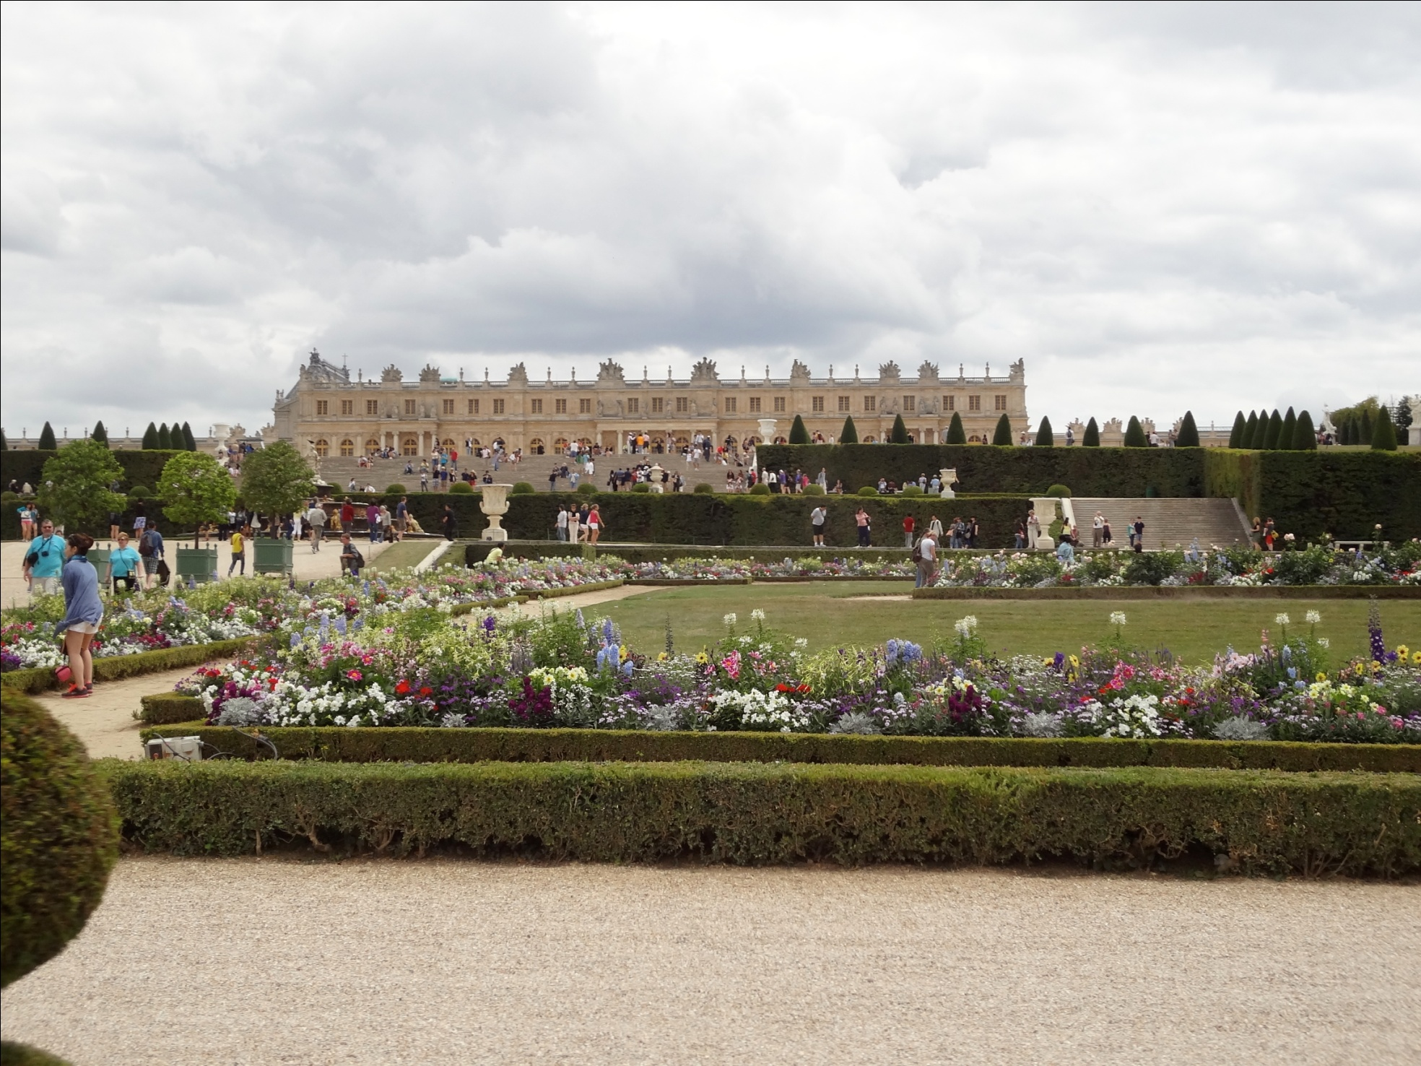
Versailles

Slide 13
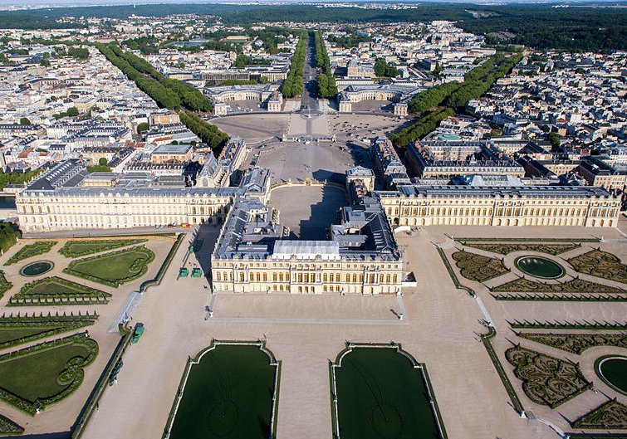

Slide 14
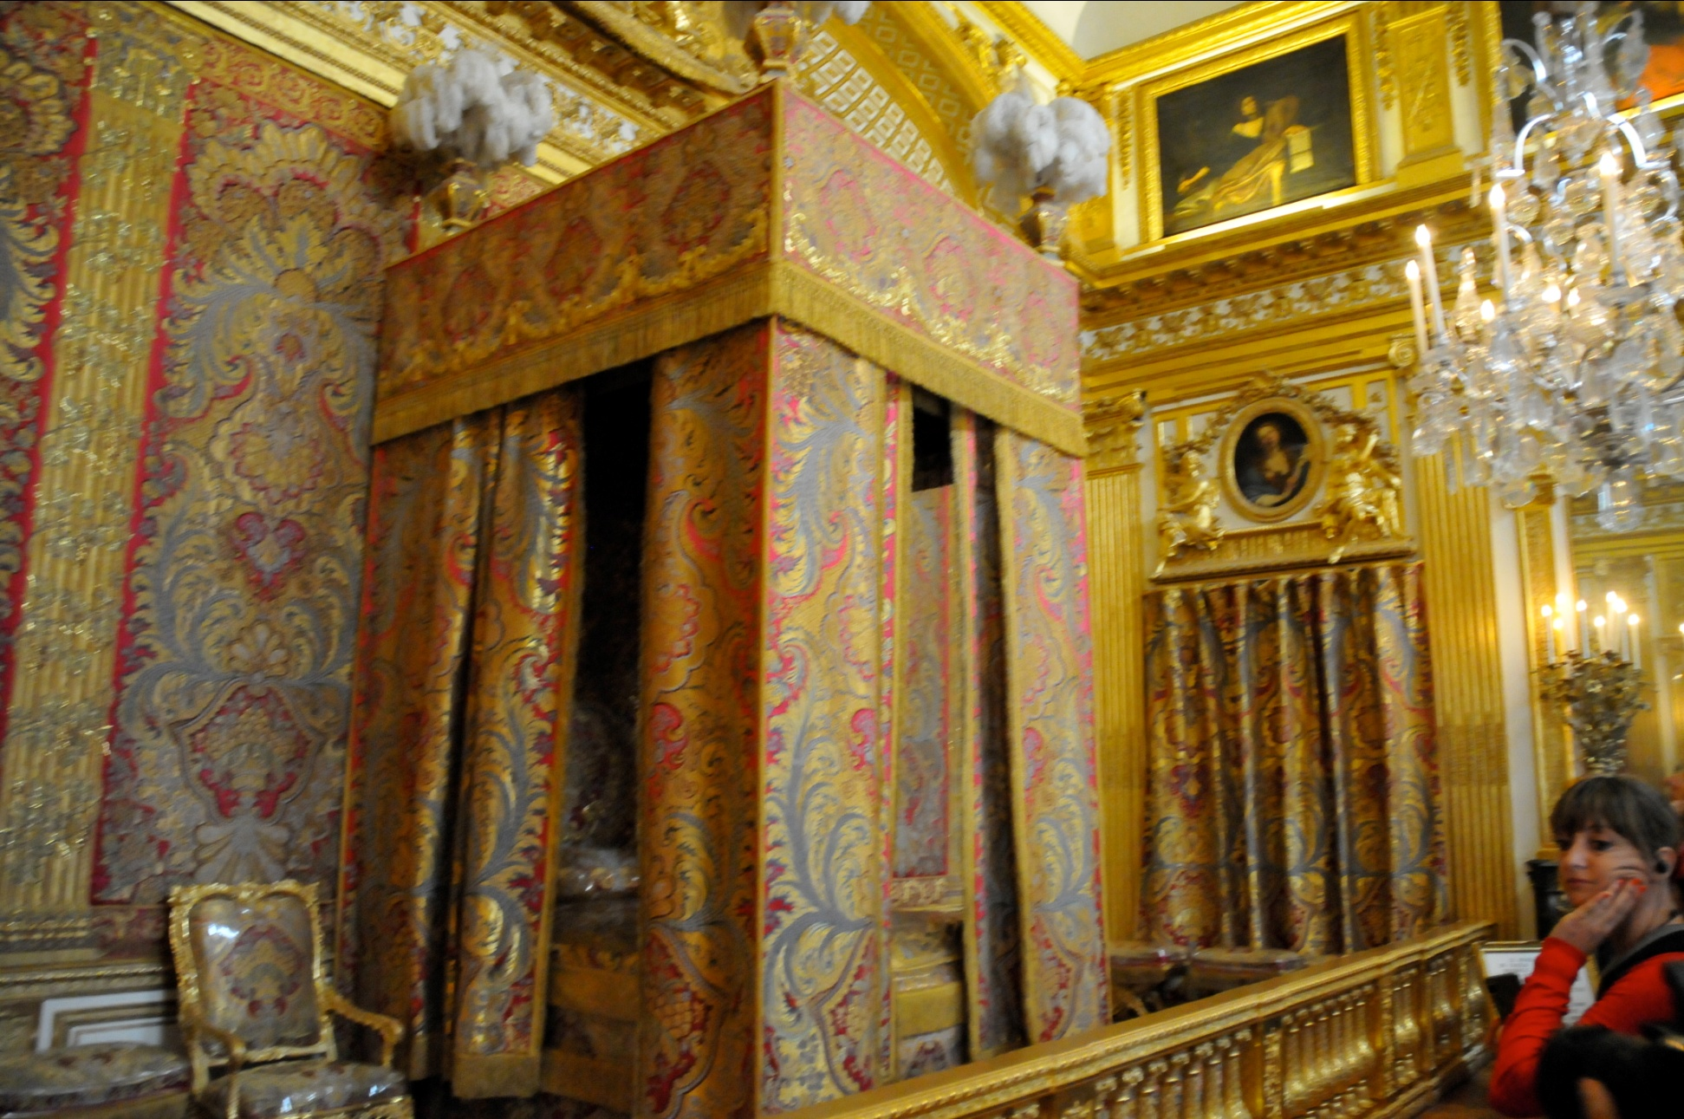
Versailles – King’s bedchamber

Slide 15
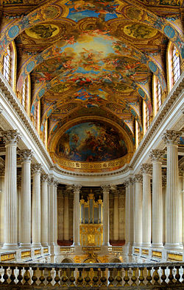
Chapel at Versailles

Slide 16
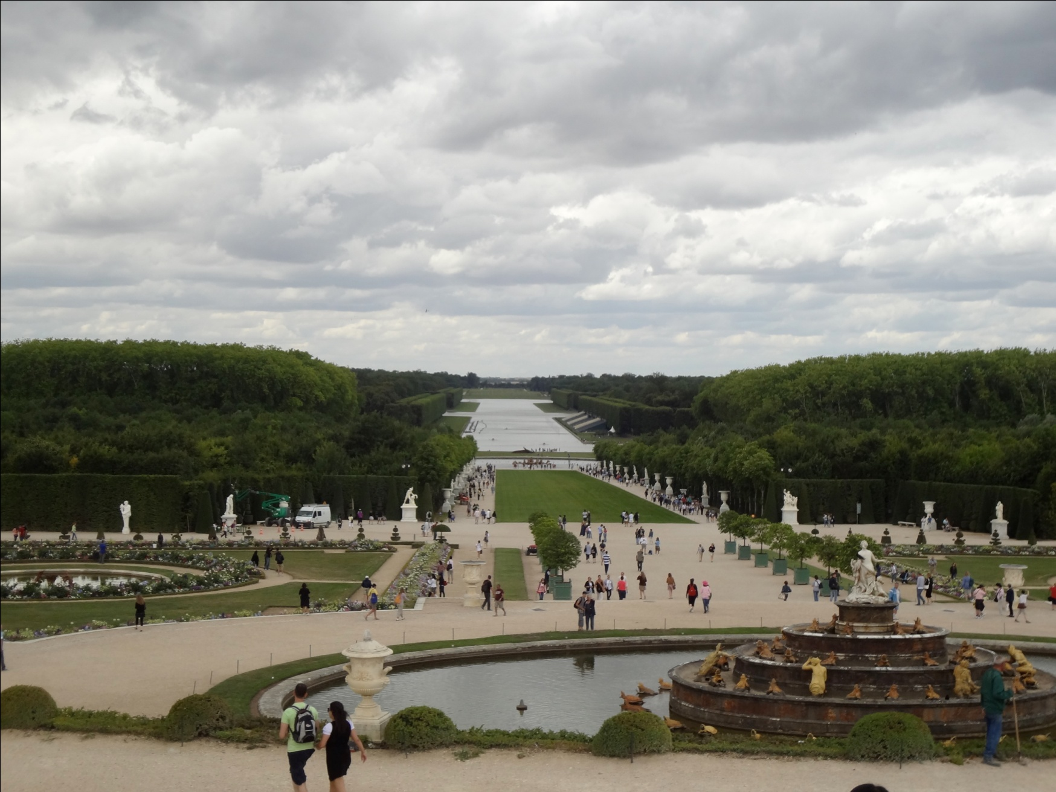
Gardens at Versailles

Slide 17
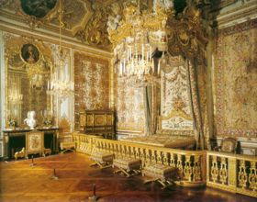
Versailles – Queen’s bedchamber

Slide 18
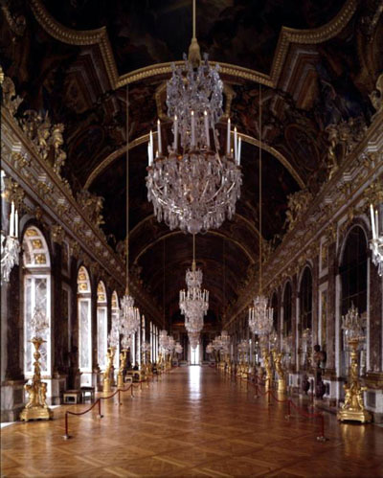
Versailles – Hall of Mirrors

Slide 19
Louis XIV – Government Structure
Prior to his reign the government was still a corrupt system that relied heavily on smaller towns and cities own government to rule them, Louis XIV would change this
They weren’t technically city states, but were kind of a corrupt version of them
Moved the royal court to Versailles (about 30 miles outside of Paris)
Biggest threat to his power was the royal family
They were always attempting to change policy in their favor instead of monarch
Dealt with this by taking them off of any policy making councils
Used other more subservient nobles on his court
“I had no intention of sharing my authority with them.”
By using other nobles he had zero competition when it came to policy making and he created all policy
Foreign, war, secular, religious, taxes, etc.…
Anyone he couldn’t control he bribed

Slide 20
Louis XIV – Religious Control
Louis XIV hated the idea of allowing any person in France to practice Protestantism
“One king, one law, one faith”
Felt that it undermined his political authority
Issued the Edict of Fontainebleau
Revoked the Edict of Nantes -
Called for the destruction of Protestant Churches
Caused over 200,000 Protestants to leave France
Had huge implications on the French economy
Notes:
Edict of Nantes – peace treaties regarding religious wars between the Protestants and Catholics in France, gave rights to protestants, did not protect any other religions outside of protestants
Signed April 1598

Slide 21
Louis XIV – Absolute Economics
Jean-Baptiste Colbert – becomes Louis’ finance minister
Goal: make France super-rich and self-sufficient
Gave government money and tax benefits to French companies
High taxes on products imported from other countries
Big focus on French colony in Canada
Raw materials and trade

Slide 22
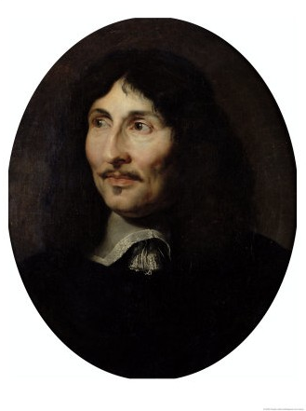
Louis XIV – Absolute Economics
Colbert dies (1683), Louis is left without a good finance minister
Big mistake – cancels the Edict of Nantes in 1685 (Fontainebleau)
Thousands craftspeople and merchants left France (most were Protestant)
Huge negative impact on French economy

Slide 23
Louis XIV – Absolute Economics
Louis XIV makes more financial mistakes
Attempts to use Mercantilism as a form of profit for nation, but they get into the game too late and British/Dutch have that market cornered
Real problem is that all of his major economic policies are geared toward the king
Taxed the peasants heavily
Reaches goal of being one of the richest nations in the world, but because of his extravagant lifestyle and wars France remains on the brink of financial ruin throughout most of Louis XIV reign

Slide 24
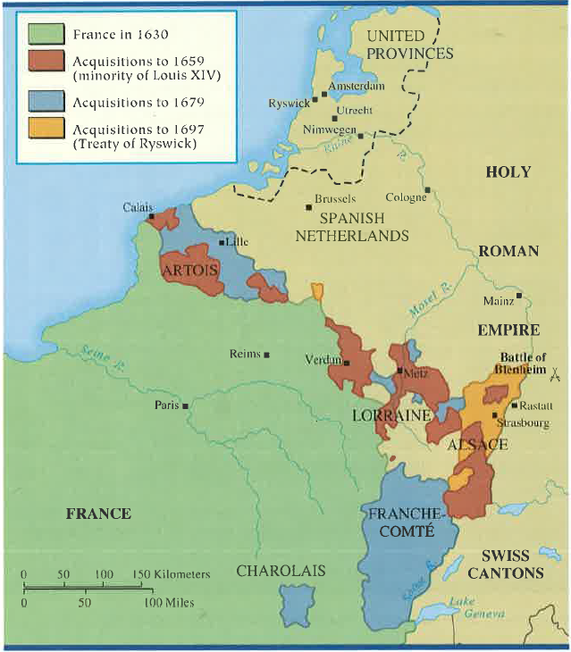
Discussion
Analyze The Wars of Louis XIV (Should be in your notes from last night Sp. Pages 444-450) and answer the following prompt –
Argue the impact Louis XIV decision to go to war(s) on the people of France

