Slide 1
Forms of Government Research
Using the notes you have taken thus far in the unit you will research governments with one other person
When you research you will be asked to learn and understand…
The ruling style of the government – who’s in charge, how is the government typically ruled
What type of power is typically used in the government?
Hard/soft, which of the 5 sources of power are usually exerted, power distribution?
What type of economic system is typically used in the government?
3 Examples of a nation or group of people that have used or are currently using the form government researched
Be prepared to discuss each of these governments in class
You will need to create works cited for all of the information used on this sheet on a separate Word document

Slide 2
Forms of Government Research
Take your notes on the BIG sheet provided
There are multiple articles on the class website that will help you complete your work, you should not have to find other information in order to complete your research
You are expected to use these sources to complete your research
You are not allowed to use random websites in order to complete your work: Wikipedia, History.com, ask.com, etc…
You will have Wednesday and Thursday to work on this assignment in class, it will also be your homework if you do not finish in class
The completed handout is due at the end of 4th period on Friday, September 29
Graded for content, 25 points in process
The works cited is due to turnitin.com under “Forms of Government Works Cited” by 10:00 pm on Friday, September 29
will be graded for format out of 10 points in writing
Use the information you learned from Ms. Bacon to create the works cited

Slide 3
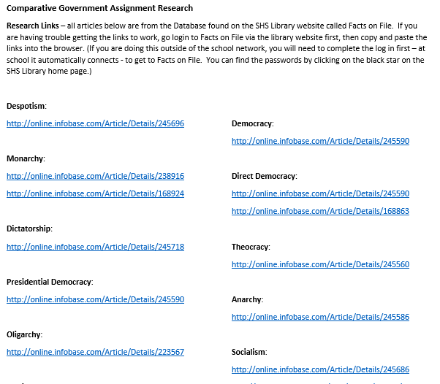

Slide 4
Database Primer
It’s going to improve your writing and save you lots of time. Believe it.

Slide 5
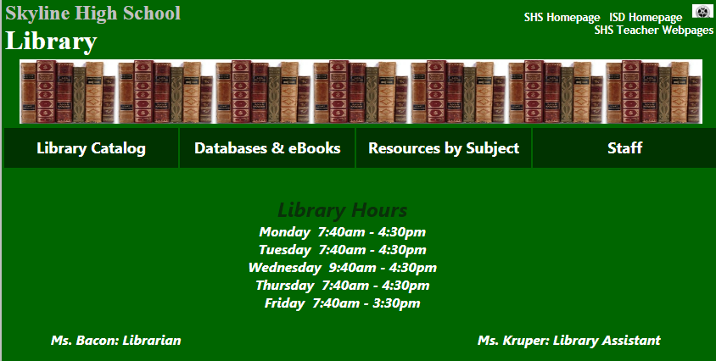
www.msbacon.com

Slide 6
Databases. My favorite
Proquest
History Study Center
Facts on File
Use this one for this particular assignment
ABC-CLIO

Slide 7
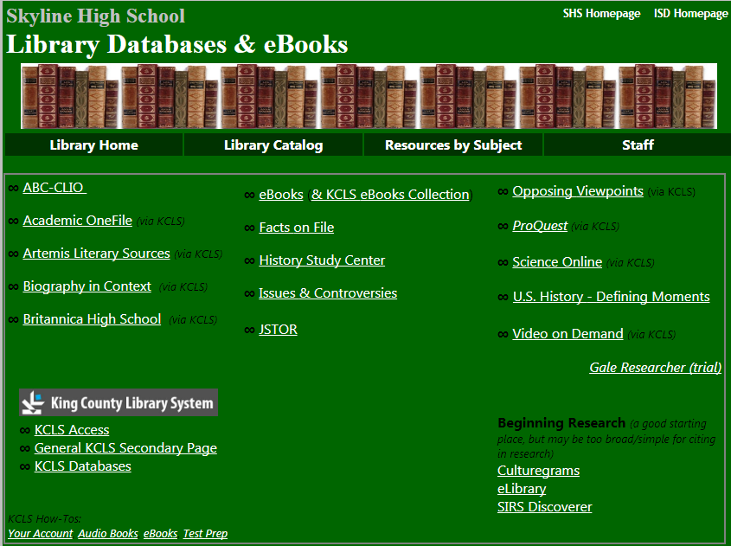
Databases

Slide 8
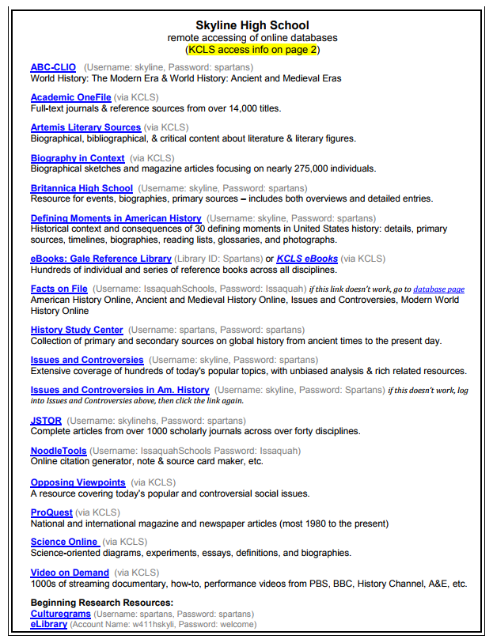
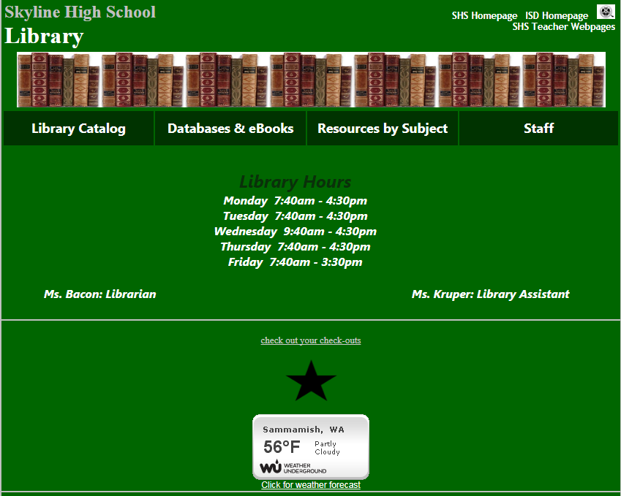
Passwords
When at home you may need to use passwords
You can find them all on the library homepage when you click on the star in the middle of the page
Click on star to open password document!

