Slide 1
Discussion
Talk to your table group about what questions you have for the final exam
Only for the MC & T/F portion, we will talk about the written portion in a minute
What does the term argue mean?
What goes in to a strong argument?

Slide 2
Written Final
You will write two paragraphs, one will be LA focused, one will be SS focused.
Each paragraph will need to be based around one of the eight cultural universals (needs to be incorporated into your thesis)
These two paragraphs are completely separate, they do not need to have connection between the two paragraphs.
There must be connection between the terms and the thesis in each paragraph

Slide 3
Written Final
Each paragraph should include –
SS –
Thesis based around one of the 8 cultural universals
Minimum of 5 terms from SS in second semester
Evidence (potentially your terms)
Analysis (potentially your terms)
You do not need an introduction or a conclusion
It must be one page or less (one side of a page)
LA –
Thesis based around one of the 8 cultural universals
Minimum of 5 terms from SS in second semester
Evidence (potentially your terms)
Analysis (potentially your terms)
You do not need an introduction or a conclusion
It must be one page or less (one side of a page)
I recommend coming up with your cultural universal and terms for each LA/SS side ahead of time

Slide 4
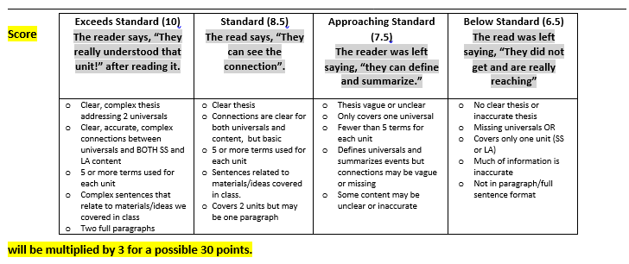
Scoring

Slide 5
Cultural Universals
Arts & Literature: The conscious use of skill and creative imagination. What forms of art do people value? What role do the arts play in people’s lives? Aesthetics: An appreciation of the beautiful.
Economic Systems & Commerce: Methods dealing with the production, distribution, and consumption of goods and services. How the culture deals with the problem of scarcity. Who gets what and why? What is used as currency? What is owned by individuals? What is owned by the community? How do individuals contribute to society? What types of jobs do people do? Large corporations or small businesses owned by individuals?
Communication & Language: The process by which information is exchanged between individuals through a common system of spoken expression, symbols, signs, or behavior. What language do people speak? How do people communicate? How do you display your status?
Customs & Traditions: Accepted communal practices of a group. Rituals, games, holidays, greetings, important values, etc. What are the important holidays? What values and traditions do these holidays celebrate? What rituals mark changing status (adolescent→adult, or student→graduate)

Slide 6
Cultural Universals
Forms of Government: The organization through which a group exercises authority. Who makes the laws? Who enforces the laws? How is power distributed? How do we decide who gets power? What are the most important rules and laws? Politics: The art or science concerned with gaining power and influencing or controlling government.
Religion: The service and worship of a god or the supernatural. How did the universe begin? Why do humans exist? What is the meaning of life? How should we live? Why do bad things happen? What is right/wrong? What happens to us when we die?
Social Organization: An established system of hierarchical relationships or status. Informal groups, families, types of relationships, etc. How is status assigned? What economic and political groups can people belong to? What is the status of women/men? What kind of relationships exist?
Science and Technology: Established systems of investigation, knowledge about, and manipulation and control of the natural world. This includes types of tools, weapons, shelter, agriculture, transportation, irrigation, and other methods of controlling and changing our environment. How do people change their environment? What type of structures do people live in? What do people use technology for? What types of problems do people use technology to solve? What types of technology are considered important? How do people explain the workings of the natural world?

Slide 7
Spring Semester Lit
Bless Me Ultima
Analects of Confucius
Dao De Jing
Romeo and Juliet

