Slide 1
Analyzing Film as Text: A Beginner’s Guide

Slide 2
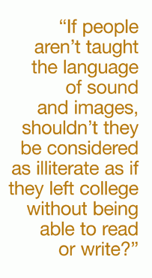
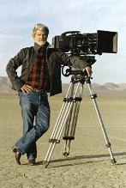
“Reading” Films
Just like reading a book, you can actually ‘read’ a movie.
This requires you to distill information from the moving images and make meaning from what you see.
There are a lot of folks that contribute to the making of movies (directors, producers, editors, sound techs, actors, etc.) and for the purposes of this project we will think about the director much like the author of a novel.
Movies DO NOT exist in a vacuum – film molds the way we think about issues, and they are in turn influenced by the historical context of the time in which they are produced. (Historical context is important here! You need to know when your film was made, and why.)
George Lucas

Slide 3
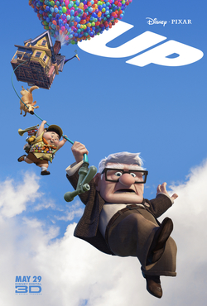
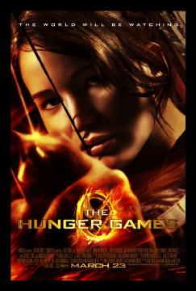
Developing Characterization
https://www.youtube.com/watch?v=F2bk_9T482g&feature=youtu.be
https://www.youtube.com/watch?v=P5lJ-6tWsUY
Fire Motif:
-Used to represent Katniss & her fight against the Capitol

Slide 4
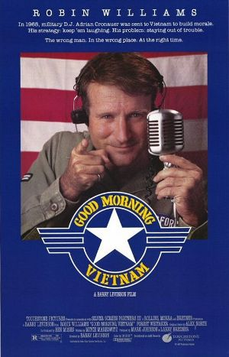
Irony
https://www.youtube.com/watch?v=FzFIDTs3WtI
In film music is often used in juxtaposition to images in an ironic way for a couple of purposes:
To draw laughs
To create an outcome that is contrary to what the viewer expected, thereby challenging what they thought they knew and forcing them to think about the purpose/message of the film

Slide 5
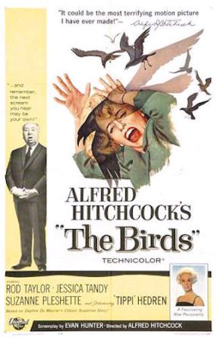
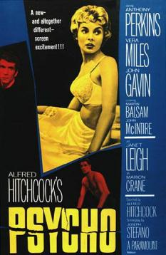
Building Suspense
https://www.youtube.com/watch?v=ydLJtKlVVZw
https://www.youtube.com/watch?v=8VP5jEAP3K4
Suspense is enhanced in film through the use of music as well as pacing.
“It’s because I liked Edgar Allan Poe’s stories so much that I began to make suspense films.” ~Alfred Hitchcock

Slide 6
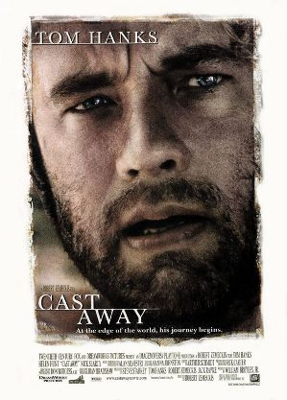
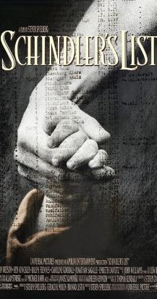
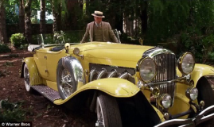
Symbolism
http://klipd.com/watch/cast-away/im-sorry-wilson-scene
https://www.youtube.com/watch?v=j1VL-y9JHuI
This is often presented through color.
Think Gatsby

Slide 7
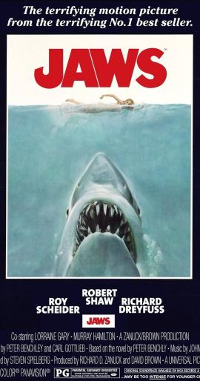
Point of View (Use of Camera Angles)
https://www.youtube.com/watch?v=rW23RsUTb2Y
The film is literally forcing you to look at things in a certain way. Why do you suppose that is? What is the effect of the camera angles on the audience?

Slide 8
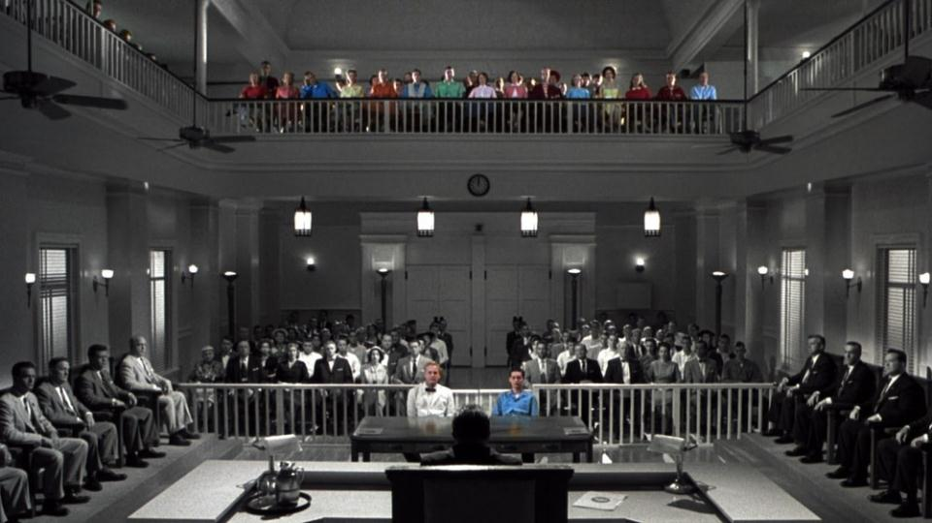
Framing & Staging

Slide 9
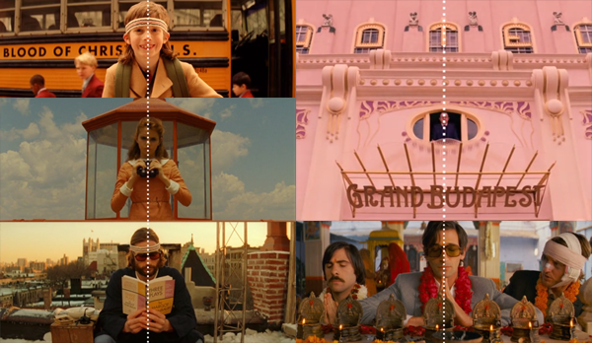
Framing a Shot
https://www.youtube.com/watch?v=7N8wkVA4_8s
Wes Anderson is known for his symmetrical framing, which has multiple effects. It can be humorous, informational, and quite literally appeals to the human brain (we like things to be symmetrical – it feels natural and right). The emphasis on symmetry in his films also works as a strong and clear juxtaposition to the oddball characters his films are filled with.

Slide 10
Theme
All year long we have been exploring the different themes presented in novels.
Take 5 minutes in your groups to brainstorm some theme statements from the novels that we have discussed. (Novels can have more than one theme)
You must figure out what themes are present within your films. These will be enhanced by taking into account historical context as well as the techniques that directors use to create/present these stories.

