Slide 1
Journal Entry 9/17/18
​Read the article Petrine Supremacy (on my website) and answer the following questions -
What is this article saying?
How does this article sum up the reasoning for issues between the church and state?

Slide 2
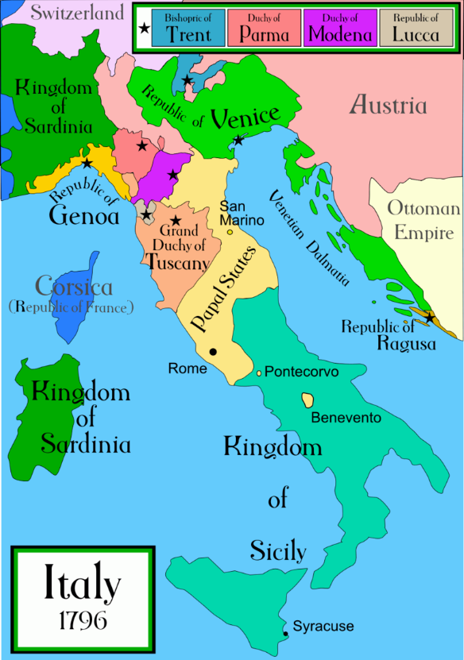
Catholic church’s Early Developments
Saint Augustine (354-430) –
Bishop in Africa for most his life
Important because he developed the concept for relationships between the church and society, played a big role in the development of Petrine supremacy
Advocated that a man/woman should marry because most people would not be able to remain celibate, and that celibacy was best kept for the clergy
Pope Gregory I (AKA Gregory the Great, 590-604) –
Developed the Papal States around Rome
Helped convert the peoples of England to Christianity/Catholic
Helped convert pagan Germans to Christian

Slide 3
Catholic church’s Early Developments
Early Monks
Monk was/is someone who cuts themselves off from the rest of the world in order to pursue an ideal of godliness or total dedication to the will of God
Developed in Egypt around 300
Most early eastern monks resorted to extremes
Saint Simeon lived in a basket on top of a tower for 30 years
Benedictine Monks:
Founded around 525
Rejected the extremism of eastern monks
Developed ideas regarding general moderation of fidelity, obedience, focused on labor and prayer
This is also where the concept of nuns was developed

Slide 4
Early Church Reform - Spielvogel 279-283
Develop a background of information regarding early church reforms. Include the following information…
Why certain people in the church felt the need to reform
Explain what the Clunaic Reform movement was, and what they did
What Pope Gregory the Great (Gregory VII) wanted, and how he aimed to do that.
Include what Lay Investiture is (not the controversy, we will get to this)
Analyze the investiture controversy, argue its cause, justify your reasoning, and predict its long term impacts.

Slide 5
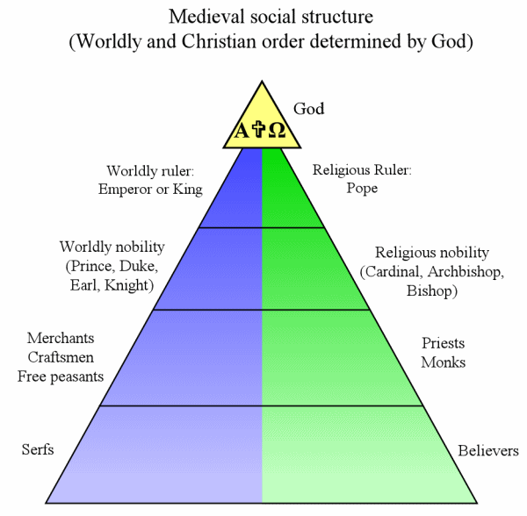
This is what the structure of the church and secular rulers was supposed to look like, what did it actually look like?

Slide 6
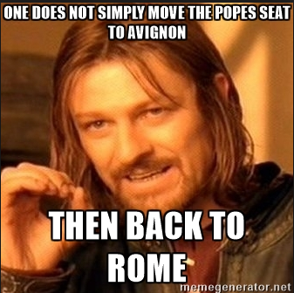
Papal Corruption & The Avignon Schism

Slide 7
Avignon Schism
In your groups do the following…
Create a background of information regarding the Schism
Who, what, when, where
Explain why it matters
Explain the impacts
Specific reactions to the schism
Predict long term impacts
Be specific

Slide 8
Background - Pope Boniface VIII
Pope from 1294-1303
Had major issues with King Philip IV from France
Boniface angry because King Philip was taxing the clergy
Boniface stated that church did not have to pay any taxes unless Pope said otherwise
Real problem was authority of church was in question
This leads to “papal bulls” which were letters or statements about the power of the church – Unam Sanctam

Slide 9
Boniface cont.
Boniface attempts to excommunicate Philip
Philip sends contingent of French forces to capture and put Boniface to trial
Italians rescue him, but it eventually leads to his death
Pope Boniface nearly beaten to death
The outcome of all this is three things….
It shows monarchial power over the pope
The election of Pope Clement V – a Frenchman
The settlement of popes for the next 72 years in Avignon

Slide 10
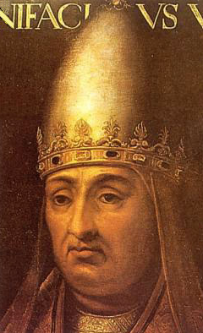
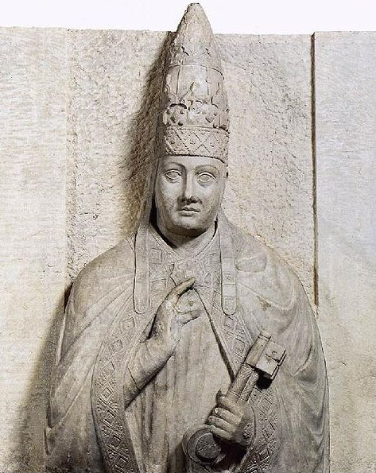
Boniface VIII

Slide 11
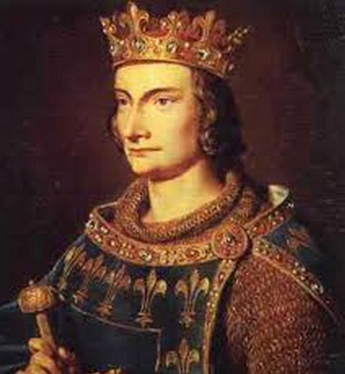
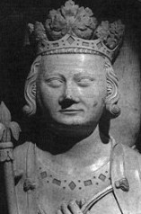
King Philip IV

Slide 12
Journal Entry 9/18/18
Considering the Papacy in Avignon or the Avignon Schism answer the answer the following prompts in your journal
Explain why it matters
Explain the impacts
Specific reactions to the schism
Predict long term impacts
Be specific

Slide 13
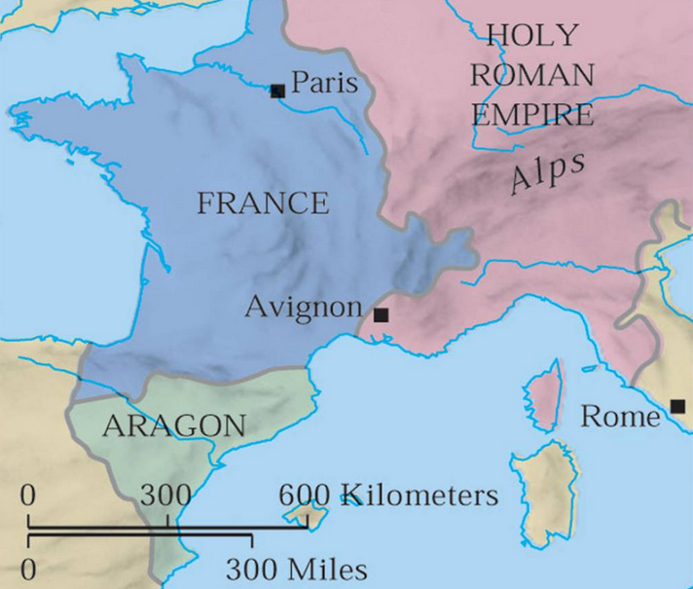

Slide 14
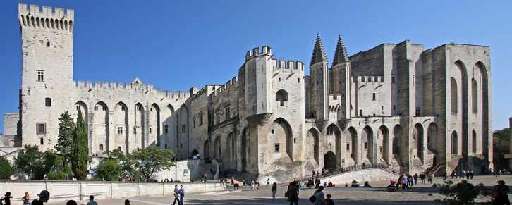
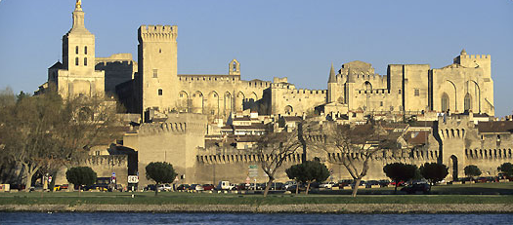

Slide 15
Papacy in Avignon Background
How long was the Papacy in Avignon?
72 Years: 1305 – 1377
During Papacy in Avignon 134 Cardinals are created
About 435 miles from Avignon to Paris
About 560 miles from Avignon to Rome
Don’t need to know the actual distances, need to know that Avignon is closer to Paris than Rome
Avignon sits just on the edge of French controlled land

Slide 16
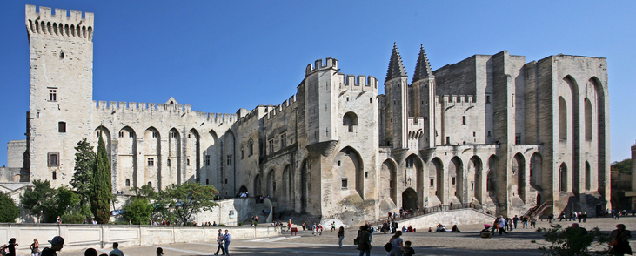

Slide 17
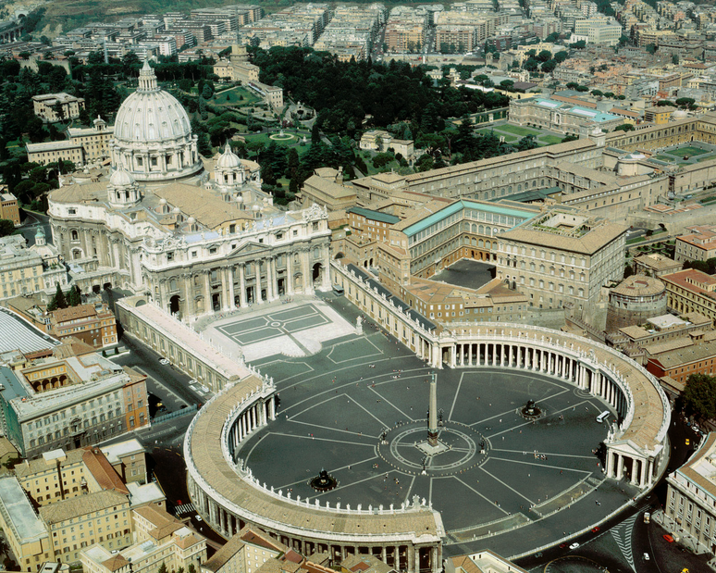

Slide 18
Great Schism Important Facts…
Romans are tired of the papacy’s residence in Avignon
Pope Gregory XI returns to Rome and dies there in 1378
Citizens of Rome scared that a new French pope would be elected
Essentially force an Italian pope to be elected
Pope Urban VI: 1378-1389
French Cardinals finally able to leave Rome
State that they were forced in to electing Urban
Decide to elect their own pope
Pope Clement VII
Lasts for about 40 years
This event called the Great Schism

Slide 19
Great Schism Impacts…
Creates a separation of loyalty in Europe
France, Spain, Scotland, and S. Italy support Avignonese pope (Clement)
England, Germany, Scandinavia, most of Italy support Urban in Rome

Slide 20
Papacy in Avignon vs Great Schism
Technically these are two separate events
Papacy in Avignon…
Lasts 72 Years: 1305 – 1377
Great Schism (Also known as the Avignon Schism or Western Schism)
Lasts 39 years: 1378 – 1417
Even though there is still a pope in Avignon these are two separate events

Slide 21
Impacts of the Pope Problems…
Comment on the impact of the Papal problems during the 14th and early 15th centuries
Consider Conciliarism (Marsiglio Padua)
Loyalty to the Pope versus the King
Skepticism toward Catholicism in general
Predict long term (over the course of the next 100ish years) impacts on the following…
Church
Peasants/common man (include a discussion of pop religion)
Kings
Society as a whole
I am not expecting anything concrete, I realize you haven’t researched this stuff yet

Slide 22
Discuss
Discuss amongst your table mates the following prompt(s):
What event has had the largest impact on Europe thus far (in our discussion in this class)?
This is your opinion as long as you back it up with legit evidence and reasoning there isn’t a wrong answer.
Put yourself in the shoes of a Catholic during the middle ages, how would you have felt about the Great Schism?

