Slide 1
Journal Entry 2
Read your article and answer the following question - What role did the SS play in the Eastern Holocaust?

Slide 2
Article Jigsaw
Take ten minutes and explain each others articles at your table group.
If you are in a table group that doesn’t have five people that’s ok, you will get the idea

Slide 3
WARNING THERE WILL BE PICTURES IN THIS POWERPOINT THAT ARE GRAPHIC

Slide 4
Generalplan Ost – General Plan East
Going back to the theory of lebensraum, Remember the quote from Monday?
“Danzig is not the real issue; the real point is for us to open up our Lebensraum to the east and ensure our supplies of foodstuffs.”
Nazis planned to use the East to “spread out”
conquest and subjugation of Baltics was a necessity
Germans had history ruling Baltics, esp. Lithuania → German was language of nobility
Alfred Rosenberg-Estonian racial theorist-put plan into place for what to do with the German East. Nazism at its core
Involved division into four districts (Next Slide)
Elimination of the Jewish question
Elimination of Bolshevism & Pan Slavism
Establishment of master race; settlement of farmland
Hans Frank began implementation in Poland; next step was USSR
Started as Hitler’s personal lawyer, eventually in charge of E. Holocaust
Started reign of terror and was responsible for murdering Poles (Slavs), and Jews
Eventually tried and executed in Nuremburg Trials

Slide 5
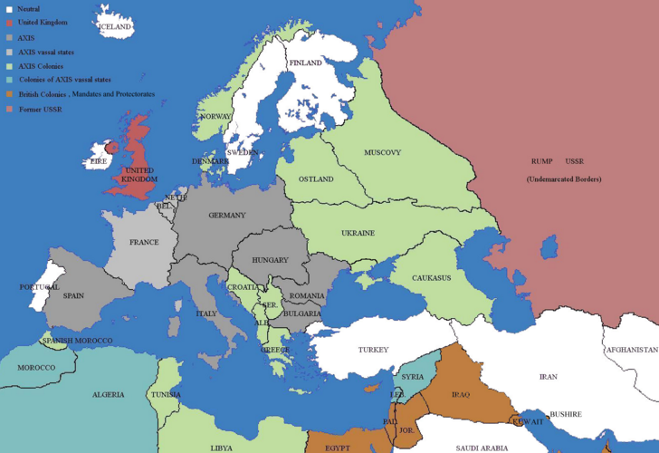

Slide 6
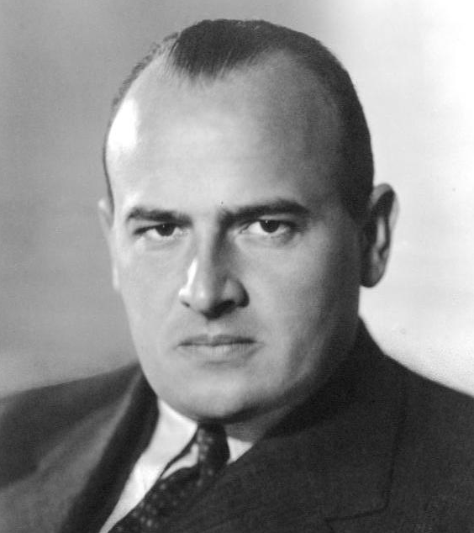

Slide 7
Goals of the Eastern Holocaust
Ethnic group | Percentage subject to elimination
Poles | 80-85%
Russians | 50-60% to be physically eliminated and another 15% to be sent to Western Siberia.
Belarusians | 75%
Ukrainians | 65%
Lithuanians | 85%
Latvians | 50%
Estonians | 50%
Czechs | 50%
Latgalians | 100%

Slide 8
Eastern Holocaust
Einsatzgruppen comes behind Wehrmacht to deal with undesirables – Remember the read from Tuesday?
Massacre of the Jews in the East begins in Lithuania
Vilnius, Jerusalem of the North, sees of population of roughly 500,000 taken down to 1,500
Lithuania goes from between 100,000-1.5 million to 4,000
Most are simply taken out into the woods and shot
Wehrmacht actively cooperates with Einsatzgruppen
One commander issues an order celebrating the “hard but just punishment for the Jewish sub-humans”
Local population generally complacent, but Latvians actively round up and arrest undesirables→still reconciling this today
Comes to the headway at Babi Yar in Ukraine capitol of Kiev, 33,771 Jews killed in two days
Nazis then use East to experiment with mass extermination via gas
Even though Hitler is against using it in warfare because it was so bad in WWI

Slide 9
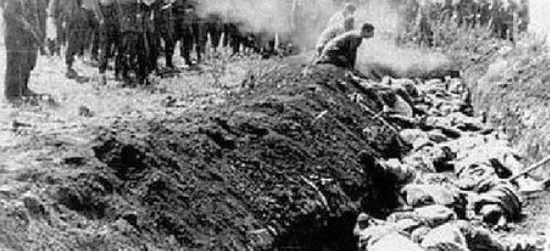

Slide 10
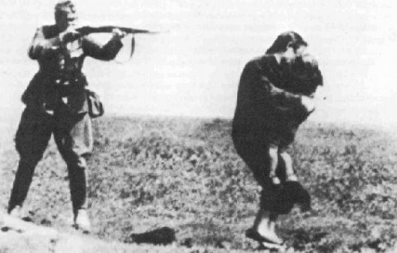

Slide 11
