Slide 1
European Expansion
Write down what motives do you remember about European expansion?
3 motives (important)
Glory
Gold
God

Slide 2
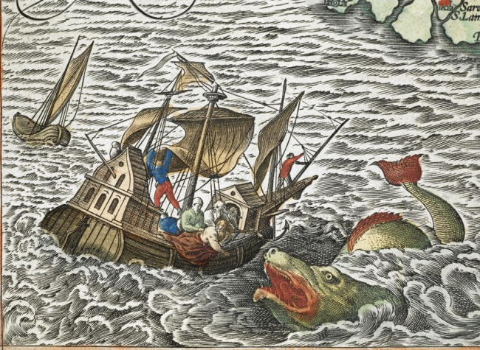
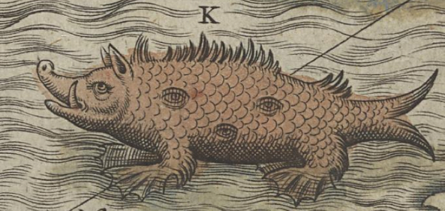
European Expansion - Glory
Europeans expanded for Glory
They were excited by fantastic new lands
Could they be filled with riches?
Could they be terrifying?

Slide 3
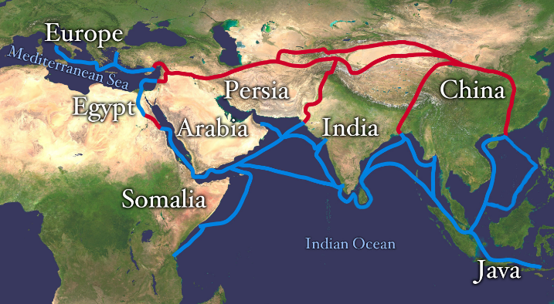
European Expansion - Gold
Europeans expanded for Gold
Merchants were looking for new areas of trade
Spice routes were challenging, and merchants needed a new way to obtain valuable spices from the east

Slide 4
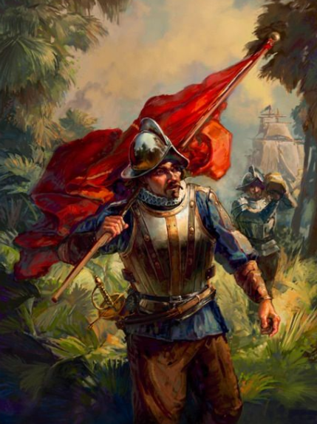
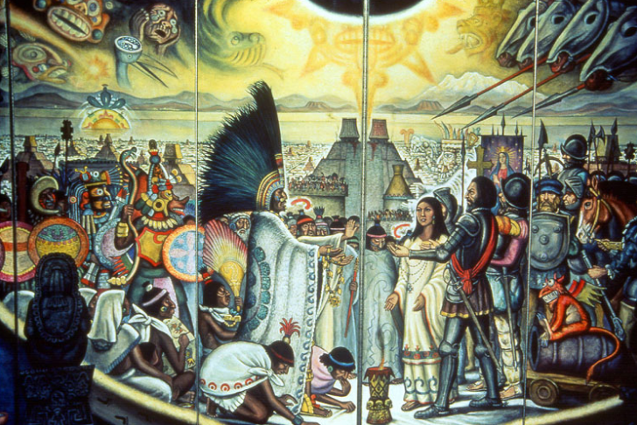
European Expansion - God
Europeans expanded for God
Catholics wanted to expand Christianity,
Both Spain and Portugal had a great impact on LA because of this

Slide 5
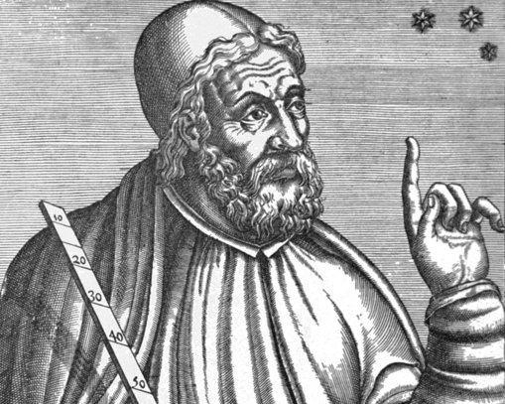
New World Settlement – A Means
Portolani (maps or charts) were made in order to navigate
They were made in the medieval ages, and were designed flat, other than helping around known ports they were nearly useless for long voyages
On of the most
Important people who
Made Portolani was
Ptolemy – 2nd century
C.E Astronomer…

Slide 6
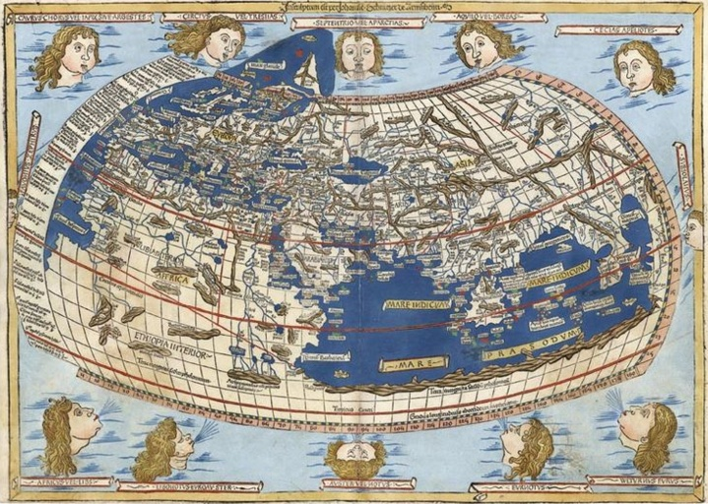
Ptolemy’s world map
Not available to Europeans until the late 15th Century
Considered the most accurate map in the world at its time
Had the 12 wind faces to show currents

Slide 7
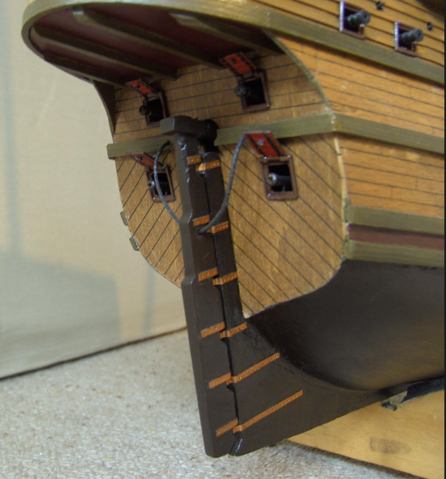
New World Settlement – A Means
Not only did explorers have better charts they also developed better technology
Ships were considered far more seaworthy than in the past
Developed the axial rudder (technology from China)
Learned how to tack into the wind
Had new navigation technology
Compass & astrolabe
Understood how to navigate using the
Stars instead of
Knowledge of the area

Slide 8
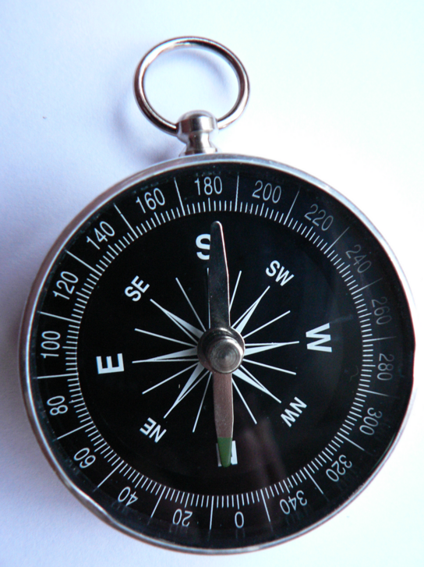
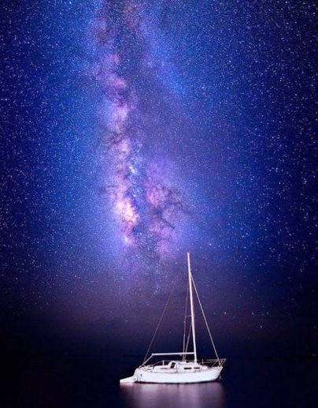

Slide 9
Conquest in the Americas
Start your homework
Read Conquest in the Americas
Pages 472-476
Also on the website for today’s homework
Answer the attached questions
You do not need annotations.

Slide 10
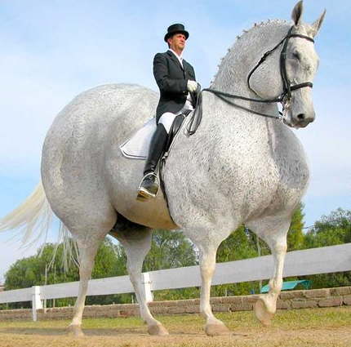
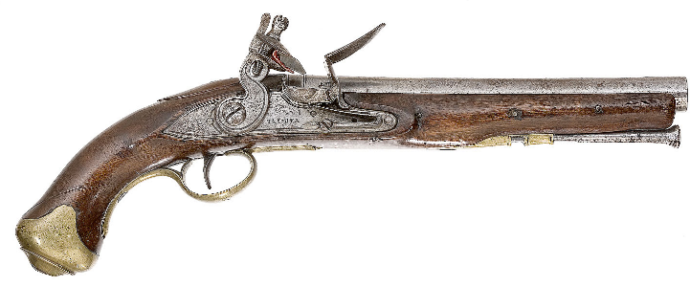
Journal Entry 11/17/16
Explain who the Conquistadors were, and how their guns horses and diseases impacted natives.

Slide 11
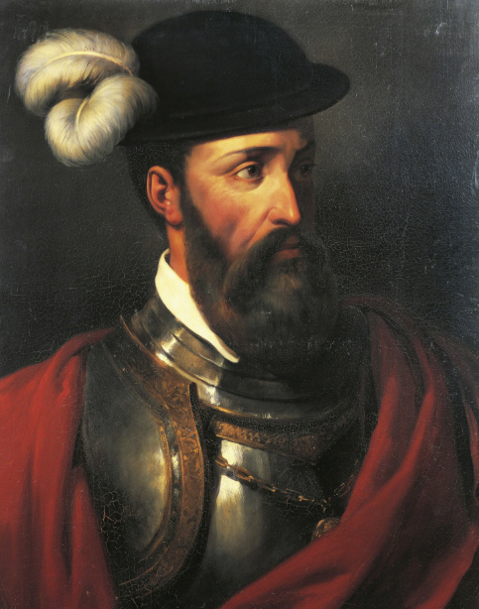

Slide 12
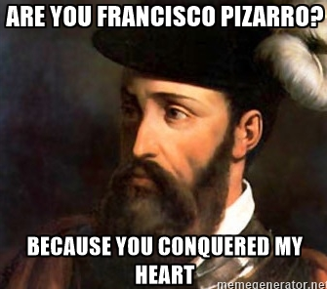

Slide 13
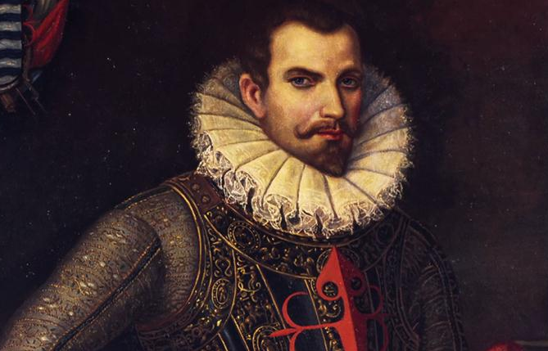

Slide 14
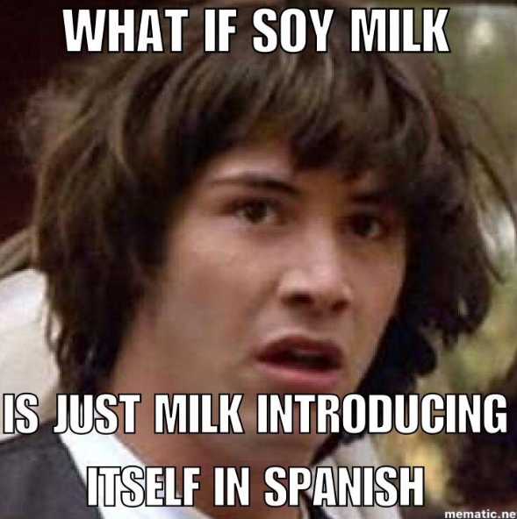
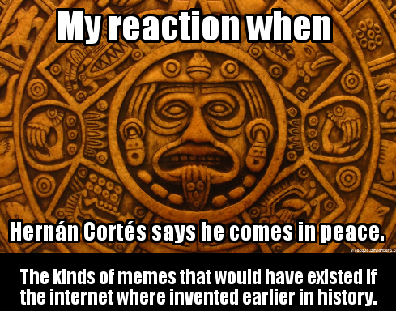

Slide 15
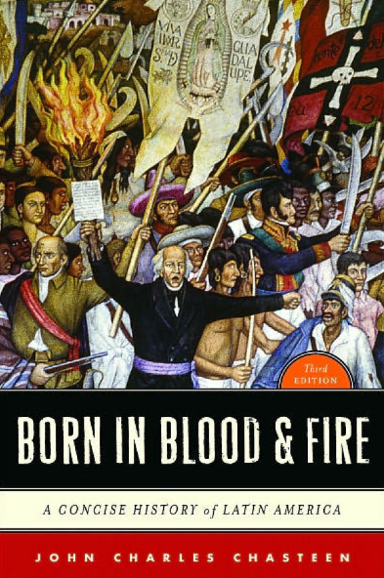
Born in Blood and Fire – John Chasteen
A history of Latin America

Slide 16
BIBF – Fall of the Aztec & Inca
Read section 1:
Title the section, summarize what it was about in your notes.
Read section 2:
Title the section, summarize what it was about in your notes.
Does this section compare to anything you read last night for HW? If so what?
How does the description in BIBF of the fall of the Aztecs compare to the textbook?
What is similar, what is different?
How can you tell which argument is better?
Read section 3:
Title the section, summarize what it was about in your notes.
How does the description in BIBF of the fall of the Inca compare to the textbook?
What is similar, what is different?
How would you describe Pizarro?
Read section 4:
Title the section, summarize what it was about in your notes.
How Cortez and Pizarro have success in the Americas?
How does this argument compare to Jared Diamond’s argument?
Guns Germs and Steel or as your book puts it Guns Horses and Disease?
Notes:
Teach OPVL along with this lesson.

Slide 17
Journal Entry 11/18/16
What is the perspective of the textbook regarding Spanish rule in Latin America?
In other words how does the author explain the situation?
Positive, negative?
Major points?

Slide 18
Spanish and Portuguese Colonies in the Americas
Explain what a Viceroy is?
Define Peninsulares, Creoles, Mestizos/Mulattoes
How does the Encomienda system work?
Predict how much time it will take for the Portuguese to become competitive with the Spanish Colonies?

Slide 19
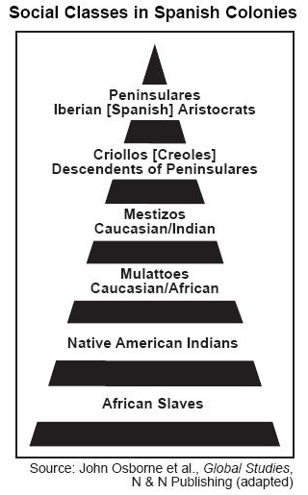
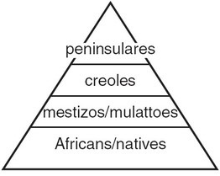

Slide 20
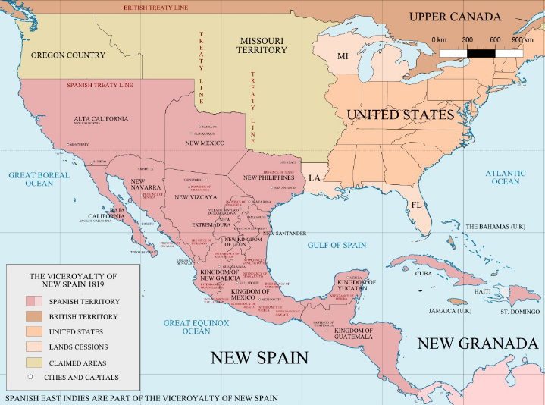

Slide 21
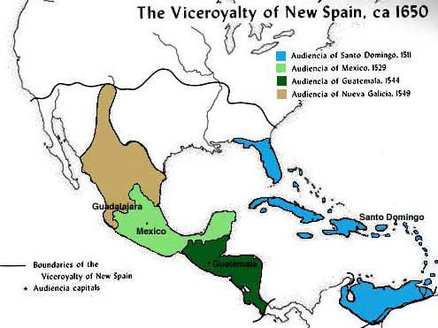

Slide 22
BIBF – The Birth of Spanish America
Read the whole article
Break it into sections and title each section
Justify why you create the sections you created
Compare this reading to your text from last night
What is the same, what is different
How could you use this text if you were preparing for an essay?

Slide 23
Journal Entry 11/22/16
How does Jared Diamond of Guns Germs and Steel compare to Born in Blood and Fire?
What’s similar?
What’s different?
Which do you agree with?

Slide 24
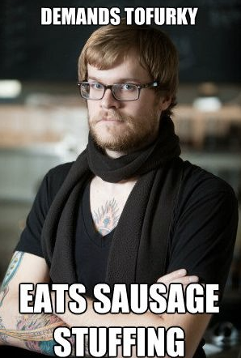
Journal Entry 11/23/16
Argue the best part about Thanksgiving!

Slide 25
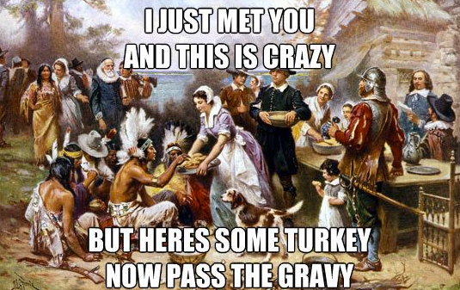

Slide 26
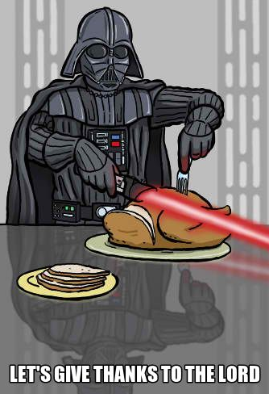

Slide 27
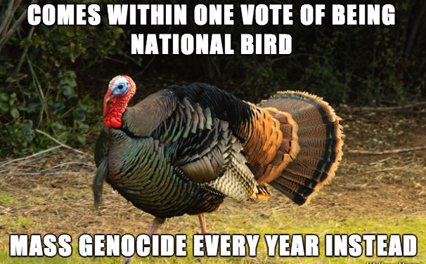

Slide 28
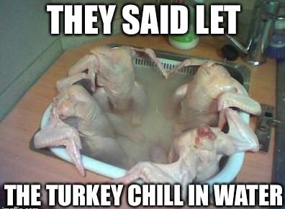

Slide 29
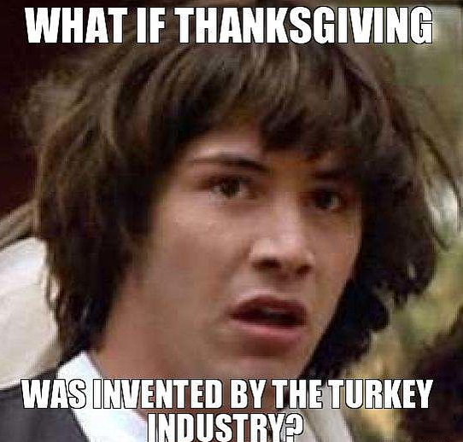

Slide 30
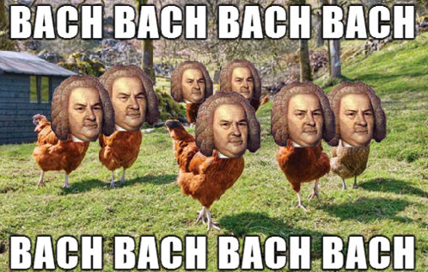

Slide 32
Impacts of Europeans in LA
What do you know about Mercantilism, Triangular Trade, and the Columbian Exchange?
Read pages 487-488 and define in your own words what Triangular Trade is

Slide 33
Slave Trade & Triangular Trade
African Slave Trade – What do you remember?
Originated by Portuguese during their travels south around Africa (still existed in Europe but dwindled significantly)
Realized that they could make money by selling slaves in Europe and the New World
African slaves replaced European slaves
Mostly were domestic (in house) slaves

Slide 34
Slave Trade & Triangular Trade
Slave trade picks up
Portuguese have sugar plantations on east coast of Brazil (along with other needs for slaves in NW)
Need for slaves in new world increases dramatically in both North & South America
The trade becomes what is known as Triangular Trade

Slide 35
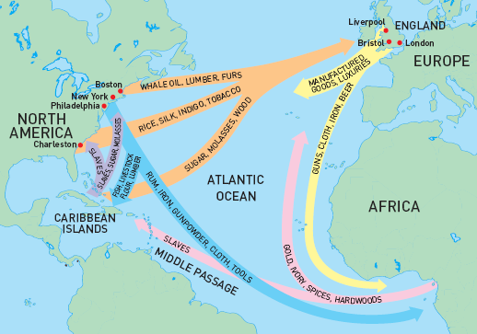
ers

Slide 36
Slave Trade & Triangular Trade
Between the 16th and 17th centuries an estimated 10 million slaves were taken out of Africa and sent throughout the world.
Many to the Americas (you will discuss this more next year)
Many of the slaves take from Africa were captured prisoners of war
African slaves were sold to Europeans by other Africans

Slide 37
Mercantilism
Mercantilism is a system by which a government controls the economic system in another location
This is an extension of Imperialism
This is a system that is used throughout the New World – particularly buy the British in the US

Slide 38
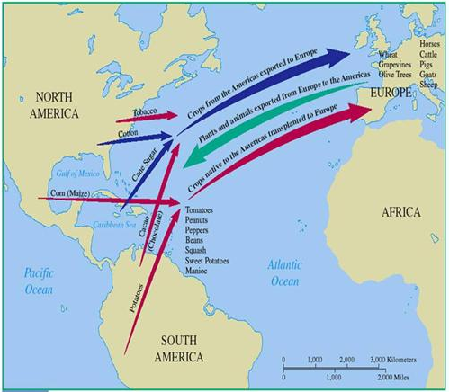
Columbian Exchange
Goods were shipped from the New World to Eurasia and visa versa
Nations competed for goods from the new world – led to various conflicts amongst European nations
Goods were pirated in order to keep proceeds

Slide 39
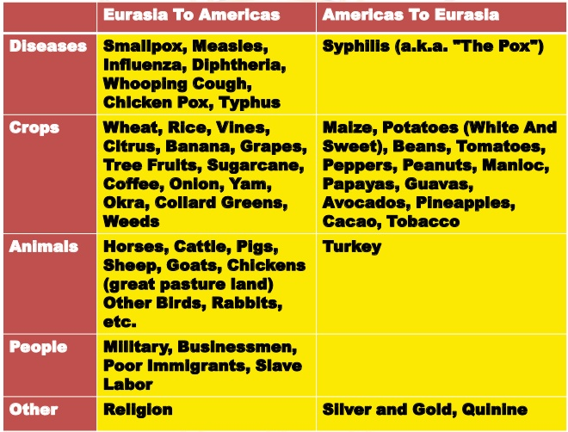

Slide 40
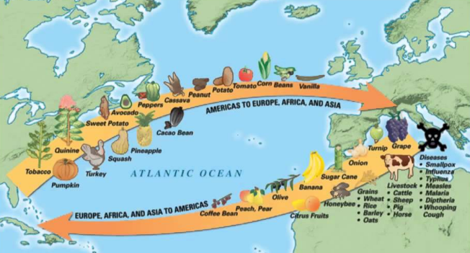
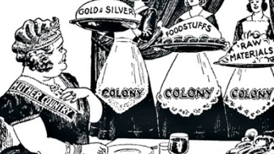
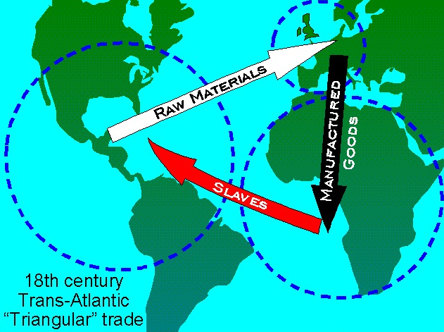
Journal Entry 11/23/16
Argue whether Triangular Trade, the Columbian Exchange, or Mercantilism has a bigger impact on LA.

