Slide 1
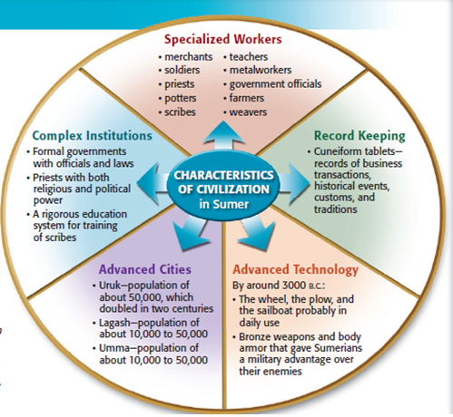
You Need:
A name for you civilization
Factors from Mesopotamia, Egypt, and your imagination in your civilization
Should be a drawing on blank white paper (in front of class)
Should be in color
Label and Represent:
5 Characteristics of Civilization
8 Traits of Culture
Geographic Features and how they impact your civilization
Include ways that people can achieve self actualization on Maslow’s Hierarchy of Needs
8 Traits of Culture
Religion/World View
Arts and literature
Technology
Language
Economics
Government
Social Organizations
Customs and Traditions

Slide 2
Journal Entry
Trade civilizations with someone at your table.
In your journal write down the following items…
Who’s civilization it is, and what it’s called
Does it have all of the pieces necessary to create the Civilization?
Maslow
8 Traits of Culture
Geography
5 themes of Civilization
Explain what makes the civilization a civilization
8 Traits of Culture
Religion/World View
Arts and literature
Technology
Language
Economics
Government
Social Organizations
Customs and Traditions

