Slide 1
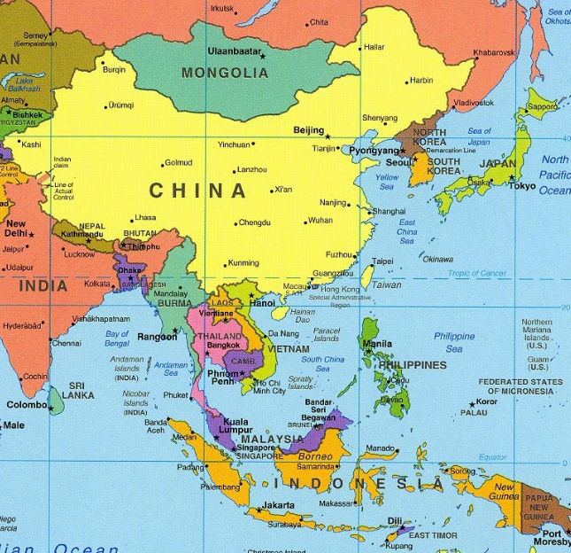
East Asia

Slide 2
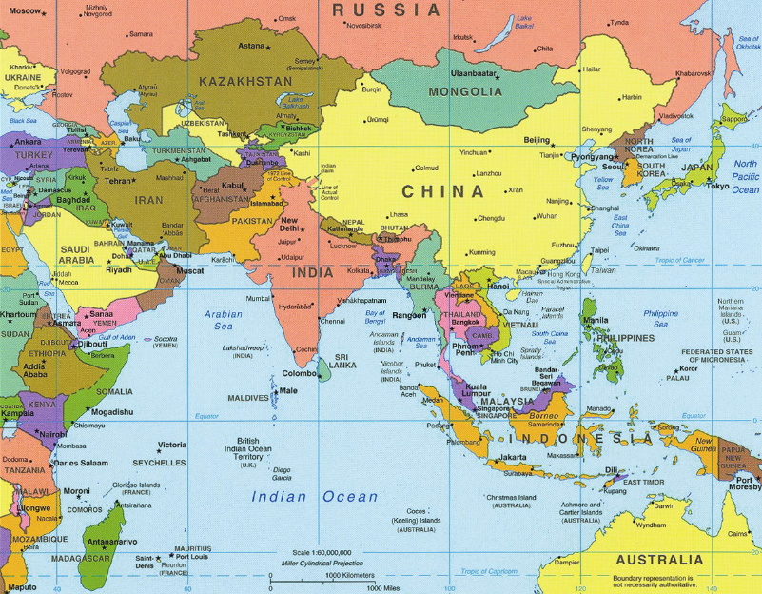

Slide 3
Starting Out…
Read the first section of River Dynasties in China
Setting the stage and The Geography of China
Answer the questions, then we are going to talk about it
Should be questions 1-7

Slide 4
Journal Entry 4/5/18
What is the most interesting thing you learned about regarding East Asia’s geography?
Can be physical, or from the political map (can also be something that you learned about in the reading)

Slide 5
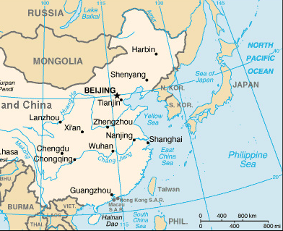
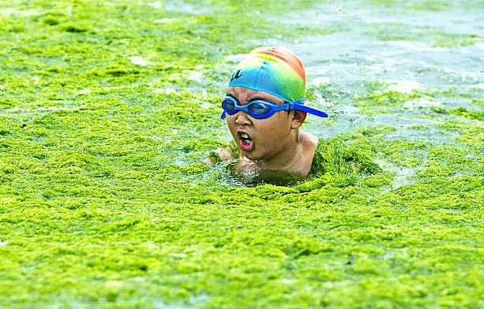
China - Geography
Explain the natural geographic barriers of China.

Slide 6
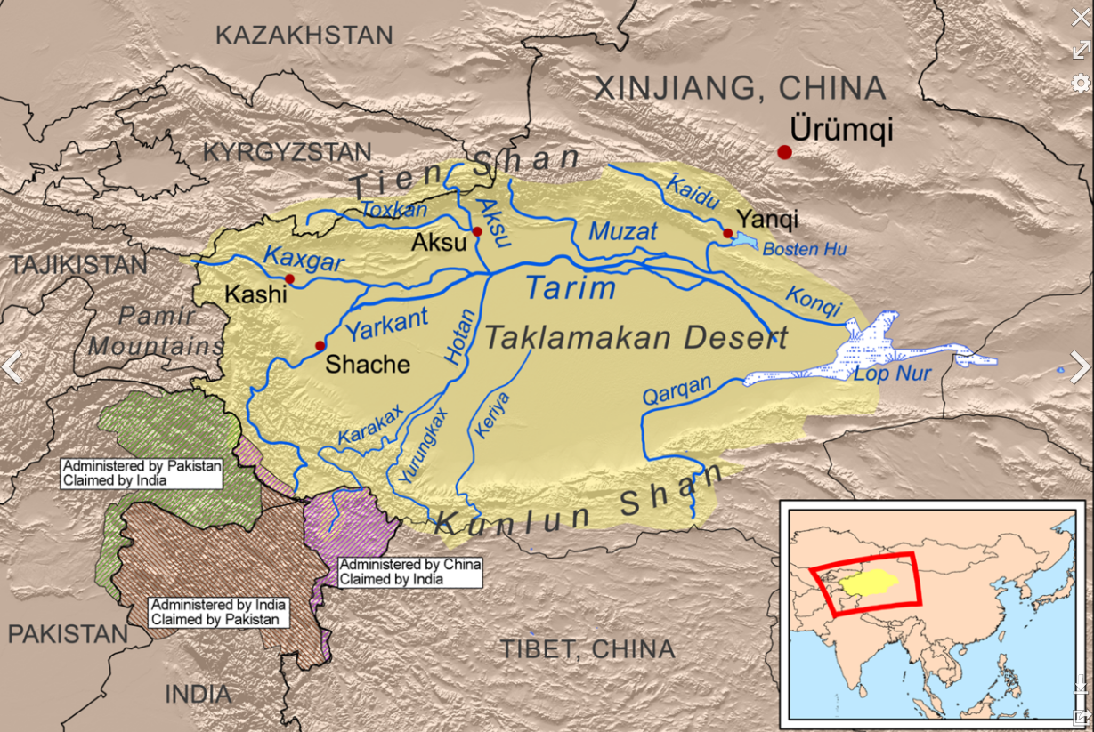
Taklimakan Desert
“Once you get in, you never get out”
About 130,000 sq mi
Independent from the Gobi Desert

Slide 7
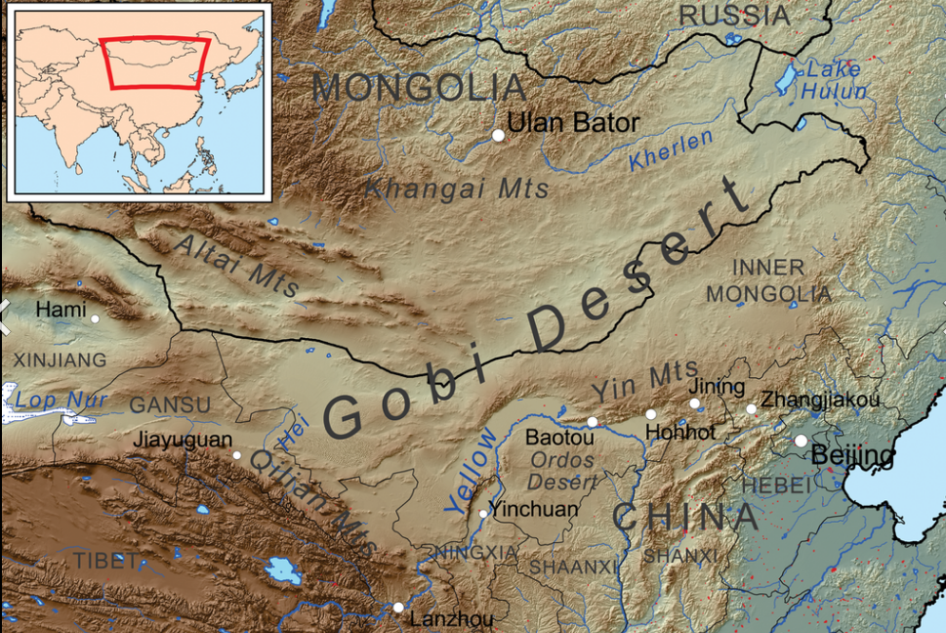
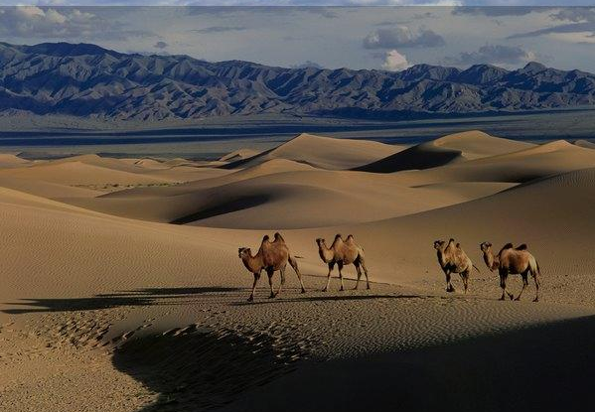
Gobi Desert
Cold desert (high elevation)
Temps span from -40 to 120 degrees
Massive land area, covers about 500,000 sq mi

Slide 8
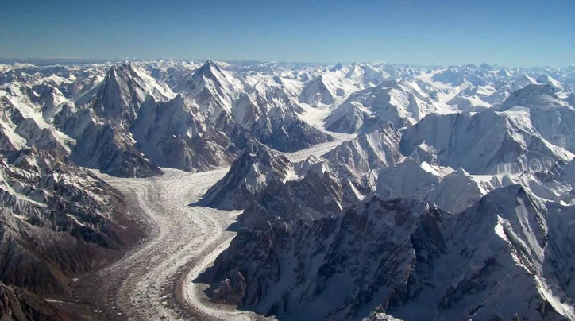
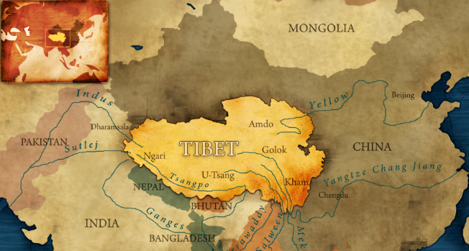
Tibetan Plateau
About 2.5 million sq miles
Holds some of the largest mountains in the world
Everest – 29,029’ tall

Slide 9
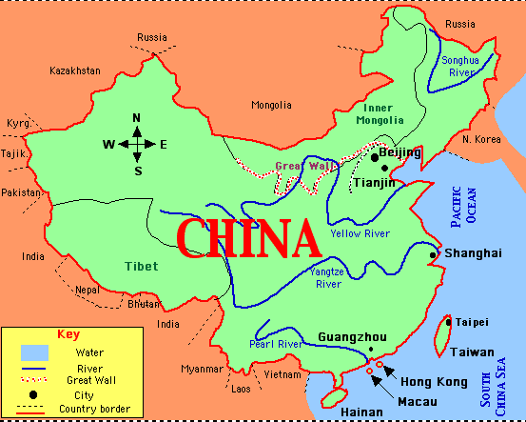
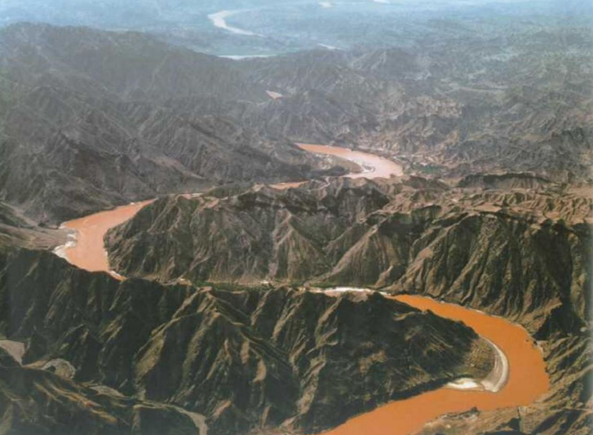
China’s Major Rivers
What are the major rivers in China?

Slide 10
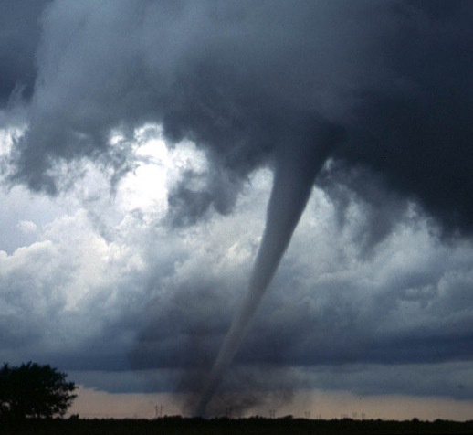
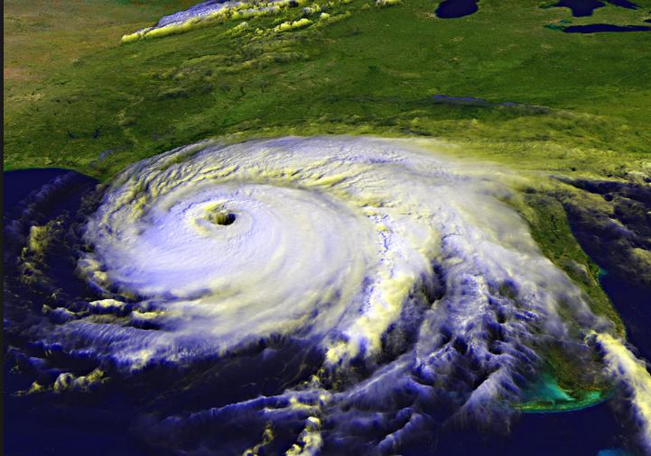
China’s Environmental Challenges
What environmental challenges has China faced?

Slide 11
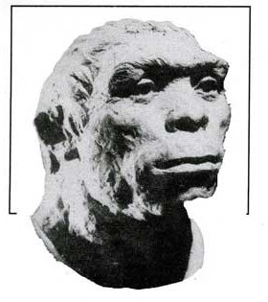
China’s First Dynasties
How long have people been living in China?
What is some background on the earliest people in China?

Slide 12
China’s First Dynasties
Who was Yu? What did he do?
Leader of the first Chinese settlements about 2000bc
Leader of the Xia (Shyah) Dynasty
Led China from a nomadic society to a civilization

Slide 13
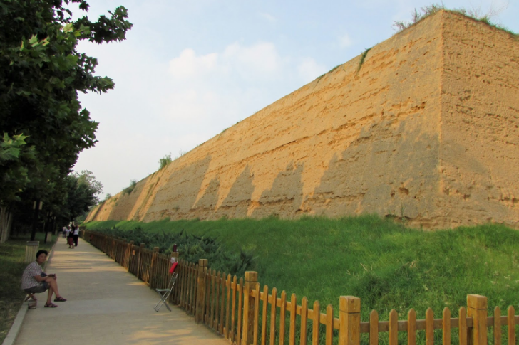
China’s First Dynasties
What is the first major city of China?
How did the Shang protect their cities from enemies?

Slide 14
Journal Entry 4/6/18
Thesis practice –
Argue the impact of Yu on the development of China
Through feats of engineering Yu was able to move the peoples of China from nomadic to a civilization.
Through feats of engineering Yu was the only person who was able to solidify China’s as a civilized group.
Yu was the most impactful early Chinese leader because he was able to develop strong infrastructure which allowed a civilized, stable China.

Slide 15
Chinese Culture Graphic
You are going to create a graphic (picture) representing the development of Chinese Culture, it must include –
Color (colored pencils and markers up front)
Some kind of piece representing family, social class, religious beliefs, and writing
This must be school appropriate, if it is not you get an automatic zero
This image must represent all of the aforementioned pieces
It must also include a one paragraph explanation of how the graphic represents all the pieces of early Chinese Culture
Due at the end of the period

Slide 16
5 Minutes Review
You have five minutes to review your reading from River Dynasties in China
From 4/5/18
Make sure you look at your notes, and be prepared to discuss
I will be calling on people that usually don’t talk, I might even use the iPad

Slide 17
China’s Early Culture
Why did Chinese people believe that other peoples/cultures were barbarians?
Explain early Chinese beliefs on the following…
Family
Social Classes
Religious beliefs

Slide 18
China – Zhou Dynasty
Compare the Zhou Dynasty to the Shang, include the following…
How the Zhou dynasty takes over the Shang
Style of rule/societal structure
Benefits
Detriments
The downfall
How well does the Zhou Dynasty fit in the dynastic cycle?

Slide 19
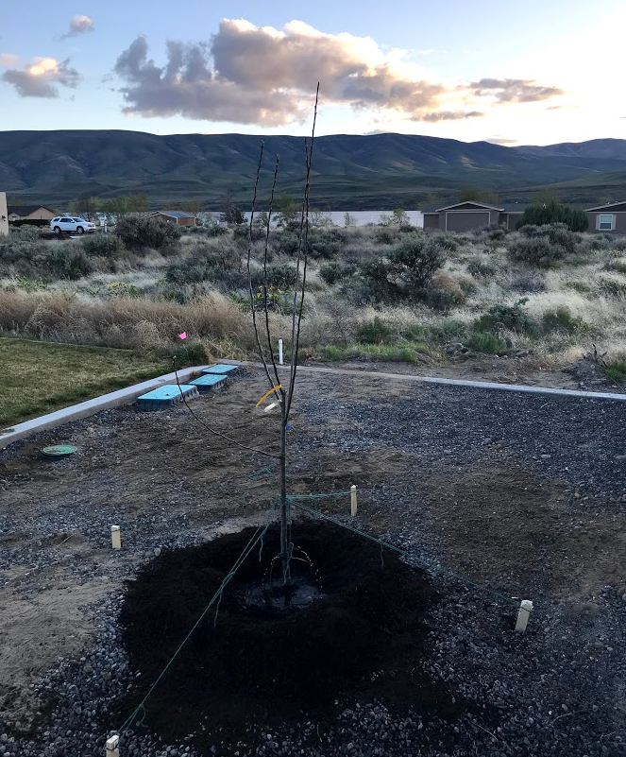
Journal Entry 4/18/18
How was your spring break?
What did you do – minimum of two sentences

Slide 20
China’s Early Culture
What is the Mandate of Heaven?
What is the Dynastic Cycle?
How does the Mandate of Heaven apply to the Dynastic Cycle?

Slide 21
Dynastic Cycle
People believe new dynasty has God’s approval
New dynasty is born
New philosophies are implemented, infrastructure is developed
Dynasty overthrown
MANDATE OF HEAVEN
Some sort of disaster occurs – typically natural, poverty, invasion, famine
Infrastructure declines, peasant rebellion
People believe that the Mandate of Heaven has been lost
Higher taxes are imposed, corruption occurs

Slide 22
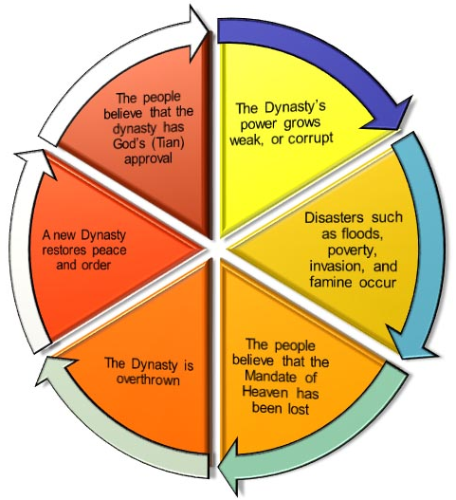
What are the strengths of this system?
What are some problems that might arise?

Slide 23
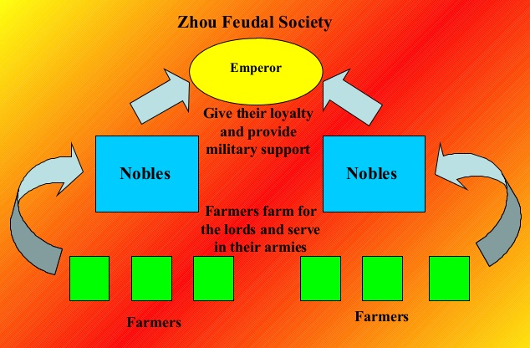
Feudalism
Explain it.

Slide 24
Journal Entry 4/26/18
What is the most interesting thing you learned during your gallery walk over the last couple of days?

Slide 25
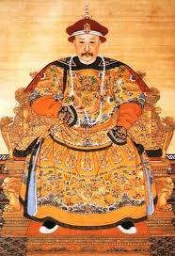
The Qing
1793: The Qing accepts ambassadors from England, despite Chinese distaste of foreigners
English ambassador brings clocks, globes, air-balloons, etc.
China rejected these offers due to their self-sufficiency

Slide 26
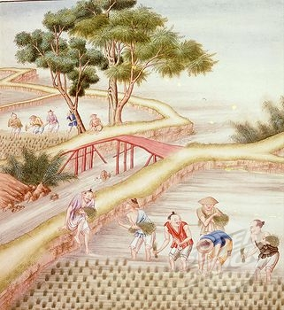
The Qing
Self-Sufficiency:
China’s agriculture flourished due to rice, maize, sweet potatoes, and peanuts
Mining and manufacturing provided work for Chinese laborers
This self-sufficiency meant China had no need to trade with Britain, which made Britain sad.
What should the British do?

Slide 27
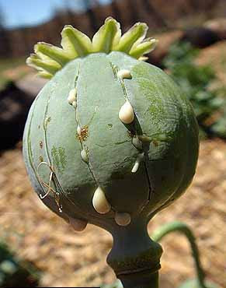
Opium
Habit forming narcotic from the poppy plant
Central narcotic of heroine, hydrocodone, morphine, oxycodone
18th Century: British merchants smuggled opium into China for non-medical use
By 1835: Up to 12 million Chinese became addicted to opium

Slide 28
Journal Entry 3/20/17
Write a thesis statement arguing the following prompt
What impact did opium have on China?
Defend it with 2-3 pieces of evidence from the China resists outside influence reading

Slide 29
China Resists Outside Influence
Read the article on my website titled China Resists Outside Influence.
You don’t need to take notes or anything, we will be doing something with this when you're done.
As a table group work through the article and answer the following questions, we will debrief as a class…

Slide 30
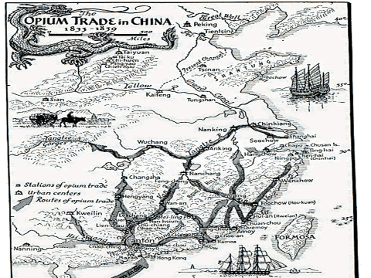

Slide 31
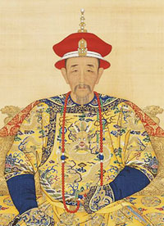
Opium
Opium abuse began to worry Qing Emperors
Lin Zexu (Qing Advisor)
“By what right do they use the poisonous drug to injure the Chinese people? I have heard that the smoking of opium is very strictly forbidden by your country; that is because the harm caused by opium is clearly understood. Since it is not permitted to do harm to your own country, then even less should you let it be passed on to the harm of other countries”

Slide 32
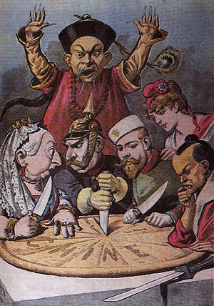
The Opium War
1839: Naval war between outdated Chinese ships and modern British gunboats
China suffers a humiliating defeat, leading to the Treaty of Nanjing
Treaty of Nanjing gave British control over Hong Kong
Also allowed the US (and other foreigners) extraterritorial rights in major Chinese port cities
Century of Humiliation

Slide 33
Problems
1850: Chinese population grew to 430 million
30% growth in 60 years
Food production remained stagnant…
What happens?

Slide 34
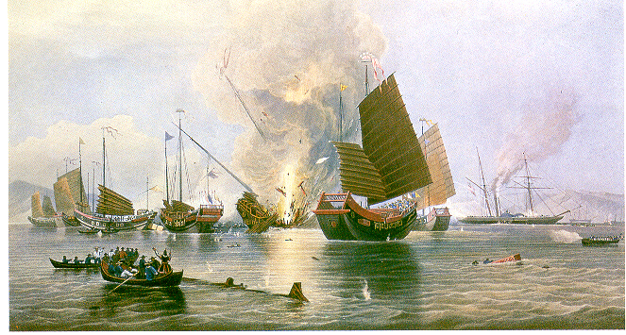
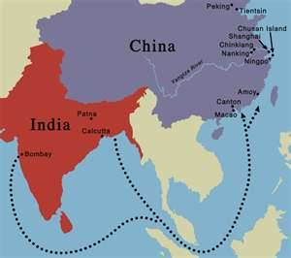
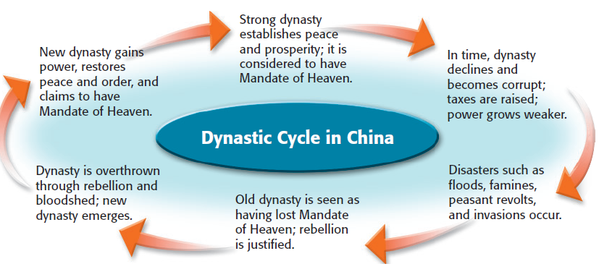
Time to shake things up?
According to the Mandate of Heaven system,
What should have happened after the Qing lost the Opium Wars to the British?

Slide 35
Problems
After the Taiping Rebellion ended, China was launched in chaos
Smaller rebellions followed, instability continued
Foreign nations took advantage of this, and established spheres of influence
Spheres of Influence: An area in which a foreign nation controls trade and investment
America instituted an “Open Door Policy”

Slide 36
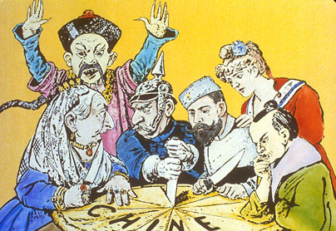

Slide 37
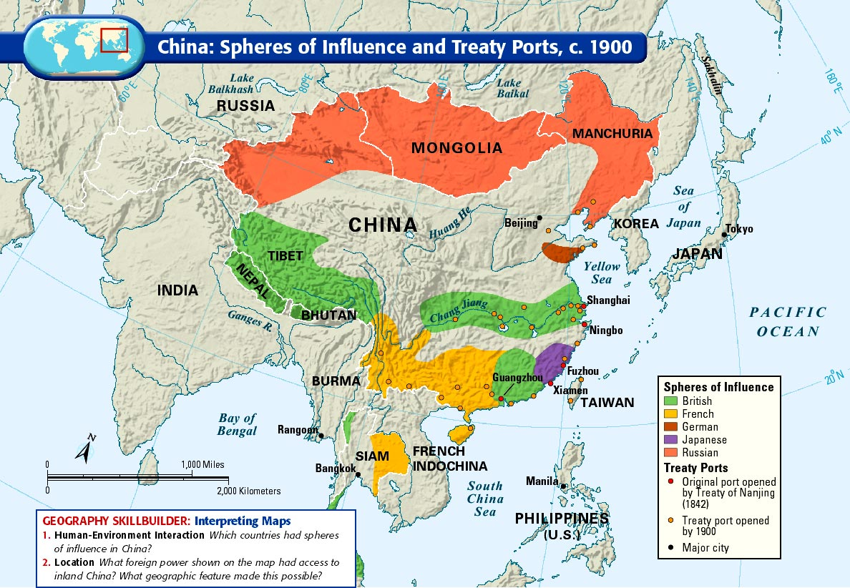

Slide 38
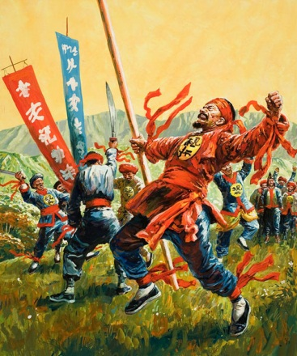
The Society of the Righteous and Harmonious Fists!

Slide 39
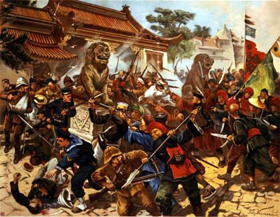
The Boxer Rebellion 1898-1901
Opposed to imperialism
Believed that Chinese weakness came from outside influences
Anti-Christian, anti-foreigner (move back to tradition)
Slogans:
“Support the Qing, Annihilate the foreigners!”
"Take away your missionaries and your opium and you will be welcome.“
“Death to the foreign devils”

Slide 41
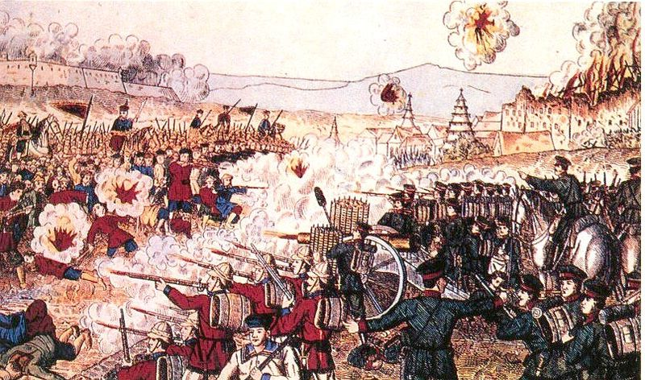

Slide 42
The Boxer Rebellion 1898-1901
Resulted in a growth of Nationalism in China
Nationalism: The belief that the needs/interests of a nation are of primary importance. Incredible pride in your nation.

Slide 43
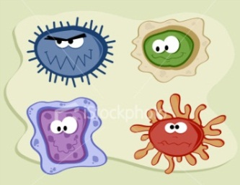
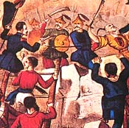
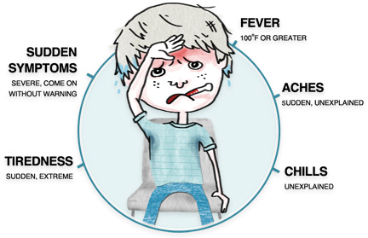
China’s “Century of Humiliation”
You are a doctor.
China is your patient. China used to be great, now it is weak.
Do your job:
Create a visual that illustrates and explains the following:
1. What germs are attacking China? (at least 3)
(Who are China’s enemies? Who is trying to harm China?)
2. What are the symptoms? (at least 3)
(What are the specific problems that China is facing. Be specific.)
3. What is the diagnosis? (at least 2 causes)
(In your opinion, what is the cause of these problems. Are they the result of internal or external changes?)
4.What is the prescription? (at least 2 things China should do to regain power)
(What should China do to regain her lost power?)
Notes:
DIDN’T USE IN 17

Slide 44
Some Figures…
Vladimir Lenin: Leader of Communist Revolution in Russia (1917)
Joseph Stalin: Aided Lenin in Revolution, leader of Communist party after Lenin’s death in 1924
Sun Yat-Sen (Sun Yixian): Leader of Nationalist Revolution in China (1911)
Kuomintang: Nationalist Party
Chiang Kai-Shek (Jiang Jieshi): Nationalist leader following Sun Yat-Sen
Mao Zedong (Chairman Mao): Leader of the Communist Party in China, Civil War: 1946-1949

Slide 45
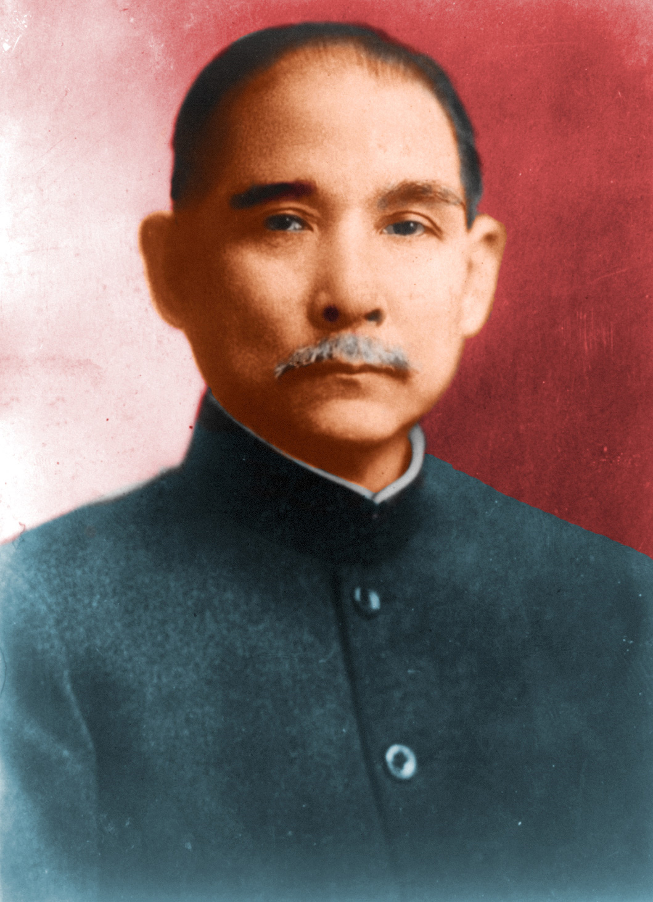
Nationalism
What was China like in the early 1900s?
Who was Sun Yixian (Sun Yat Sen)?
What did the Kuomintang want?

Slide 46
Journal Entry 5/11/18
Create a timeline of events from the last reading
4/25 – China Resists Outside Influence

Slide 47
China looks down on foreigners, little/no foreign influence & self sufficient – late 18th century
GB introduces Opium to China early 19th century, by 1835 12 million Chinese people were addicted
Britain refuses to stop trading Opium to China, first Opium War breaks out 1839
1844 First Opium War ends with Treaty of Nanjing, giving territory (Hong Kong) to the British
As a result of heavy addiction, famine, and foreign influence Chinese nationalism begins to surge during the late 1830s
1853 Taiping Rebellion reaches its peak, led by Hong Xiuquan, they take over Nanjing and make it the new capital, by 1864 the Taiping fall from power from internal dissent, nearly 20 million people died as a result of the rebellion
Led by the Dowager (widow) Empress Cixi from 1862-1908 China went through a series of reforms including industrialization, and education
As a result of poor leadership during the 19th century the foreign spheres played a major role in China’s decision making, this included the Open Door Policy, allowing merchants of all nations the ability to trade with little barrier
A second upsurge in Chinese Nationalism beginning in 1898 the new emporer Guangxu attempted to modernize China (changing all of the previous policies created by his mother) these were taken as a threat…
As a result of frustration from China’s nobility Guangxu was arrested with no change
As a result of continued frustration the secret society of the Righteous and Harmonious Fist was created made of peasants in the 1890s
The peasant uprising led by the Society of Righteous and Harmonious Fist is known as the Boxer Rebellion, which began in 1900
The Boxer Rebellion placed a siege on Beijing and demanded the removal of foreigners
The Boxer Rebellion was quelled by a force if 19,000 multination troops by August 1900

Slide 48
China Falls Apart Debrief
Give me context on what led to the Nationalist overthrow of China – Hint: you might need to look at your China Resists Outside Influence notes
Prove/disprove with evidence from the reading:
WWI and the Nationalist movement in China were the final two issues in China sparking the Civil War and the eventual takeover of Mao’s Communist regime.
Analyze the evidence you have
Explain how/why it connects to your thesis
Explain the significance
Explain the consequence
Explain what changed
Give me context on the rise of Communism in China
Give me context on the Civil War in China
Why was the Civil War suspended in China?

Slide 49
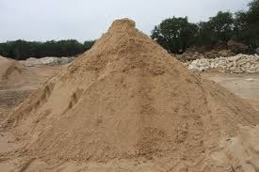
Nationalists
1911: Nationalists overthrown the last Qing Emperor, ending the Mandate of Heaven
Sun Yixian (Yat Sen) attempts to establish a republic
Why did he describe the Chinese as “a heap of loose sand”?

Slide 50
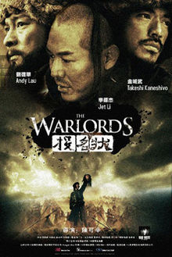
Nationalists
1916: Yuan Shikai given power, betrays democracy of Nationalist Revolution, rebellions start (again)
Provincial warlords and military leaders seize control of China
China launched into chaos

Slide 51
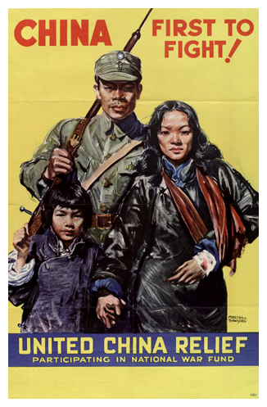
World War 1
China declares war on Germany
Japan invades China
Treaty of Versailles:
Japan given control of territory China used to own…
May 4th, 1919:
Nationalists and Communists launch a protest in Beijing

Slide 52
Journal Entry 5/16/18
What’s your favorite game?
Board/card game that is….
And explain why

Slide 53
Mao’s Journey

Slide 54
Mao’s Journey
Today you are going to create a game about Mao’s Journey to power and China’s conversion to communism
You must create a game in the likeness of Shoots and Ladders, Candyland, or Life (if you can think of another I’m open to negotiation)
Your game must include all of the most important aspects of Mao’s Journey
Causes
Road to power
Changes
Great Leap Forward
Cultural Revolution
You also must create a set of rules
You can draw your game board on a piece of paper
You are welcome to describe your game pieces on the back of the game board
OR create them
You will have today, tonight, and ½ of tomorrow’s class to finish it.
After we finish tomorrow we are going to actually play the games.

Slide 55
Test Review – Graffiti Boards
Title the poster you have based on you table number
Geography
Dynasties
Social Orders
Mongols
Imperialism
Dynastic Cycle
Nationalism & Maoism
General Questions

Slide 56
Test Review – Graffiti Boards
You will be given a question (multiple choice) in just a moment, write and answer the question on your graffiti board
Once you have done that write your own question with 4 options for answers
Do not answer the question on the front
Put the question number and answer on the back
We will then pass the graffiti board to the next group in order so they can answer your question and write a new one for that category
You will only have a couple of minutes to complete this
You will probably want your notes out to help write your questions

Slide 57
Test Review – Graffiti Boards
Geography – Which of the following impacts China’s geography?
Tibetan Plateau b. Atlantic Ocean c. Cascade Mountains d. Death Valley
Dynasties – Who was the first recognized leader of China’s Dynasties?
Yu b. Confucius c. Shi Huangdi d. Mao
Social Orders – Who was responsible for developing the idea of a bureaucracy?
Yu b. Confucius c. Shi Huangdi d. Mao
Mongols – Which of the following people is considered the greatest leader of the Mongols?
Mark the barbarian b. Genghis Khan c. Kubla Kahn d. Mr. Myers
Imperialism – Why did European countries introduce opium to China?
Europeans knew that opium would grow best in China’s climate
Europeans knew that emperor Han loved opium
Europeans couldn’t get China addicted to opium
Europeans wanted to create a dependency on Europe so China would trade with them
Dynastic Cycle – Which of the following is a phase of the dynastic cycle?
The dynasty takes power from Europeans b. The dynasty peacefully takes power from the last dynasty c. The dynasty is overthrown d. The dynasty grows out of the ashes of the phoenix
Nationalism/Maoism – Mao is a huge fan of capitalism.
True b. False
General Questions – What was the name of the naval fleet captain in early 15th century China?
a. Shi Huangdi b. Zheng He c. Vasco da Gama d. Christopher Columbus

Slide 58
Test Review – Graffiti Boards
Geography – Which of the following impacts China’s geography?
Tibetan Plateau b. Atlantic Ocean c. Cascade Mountains d. Death Valley
Dynasties – Who was the first recognized leader of China’s Dynasties?
Yu b. Confucius c. Shi Huangdi d. Mao
Social Orders – Who was responsible for developing the idea of a bureaucracy?
Yu b. Confucius c. Shi Huangdi d. Mao
Mongols – Which of the following people is considered the greatest leader of the Mongols?
Mark the barbarian b. Genghis Khan c. Kubla Kahn d. Mr. Myers
Imperialism – Why did European countries introduce opium to China?
Europeans knew that opium would grow best in China’s climate
Europeans knew that emperor Han loved opium
Europeans couldn’t get China addicted to opium
Europeans wanted to create a dependency on Europe so China would trade with them
Dynastic Cycle – Which of the following is a phase of the dynastic cycle?
The dynasty takes power from Europeans b. The dynasty peacefully takes power from the last dynasty c. The dynasty is overthrown d. The dynasty grows out of the ashes of the phoenix
Nationalism/Maoism – Mao is a huge fan of capitalism.
True b. False
General Questions – What was the name of the naval fleet captain in early 15th century China?
a. Shi Huangdi b. Zheng He c. Vasco da Gama d. Christopher Columbus

Slide 59
Test Review – Graffiti Boards
Now write your own questions with your answer on the back
You don’t have to write the answer out, just give the letter for the correct answer

