Slide 1
Hey Guys,
This matters.

Slide 2
The Battle of France
Nic Chambers, Noah Righi, Makenna Page, Nico Mendez

Slide 3
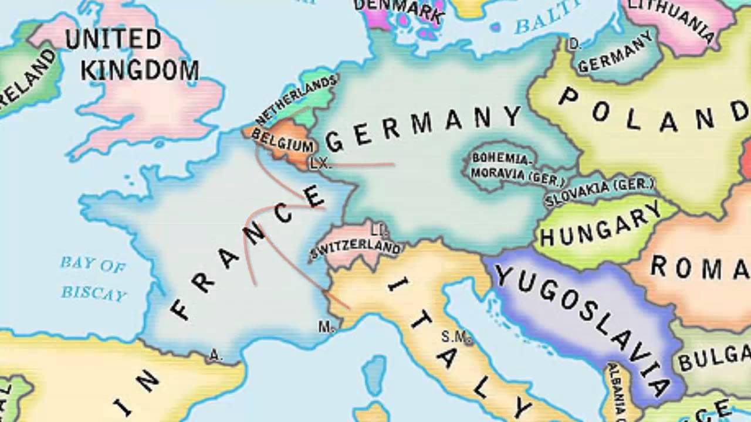
The Fall of France
May 10, 1940
Maginot Line
France learned from WWI
The Battle of France was riddled with daring operations from both sides, but ultimately Germany’s organization led to Axis victory and the fall of France.
Notes:
First off, this is a map of Europe *giggle*. Obviously, this is Germany, and this is Poland, who they took over in 1939. And this is France! The country which led Winston Churchill to say, in response to the rise of the Nazis, “Thank God for the French Army.” This apparently did not get across to the Big Guy, as they were defeated by Hitler in an astonishing SIX WEEKS

Slide 4
Timeline
May 10, 1940 -- Air & ground attacks on Belgium
Complicated Allies
May 13, 1940 -- Panzers arrived on the River Meuse, crossing it in 2 days
May 14, 1940 -- Dutch surrender, German psychological advantage
May 26 - June 4, 1940 -- Operation Dynamo
June 5, 1940 -- Case Red
June 22, 1940 -- French surrender
Notes:
Race to the coast, Germans won on May 20

Slide 5
German Plan
General Erich von Manstein
Go through Belgium and Ardennes
Blitzkrieg
Had 2500 tanks against Allied 3500
Used Panzer formations that concentrated the force
Disorientate, then attack
Notes:
http://www.bbc.co.uk/history/worldwars/wwtwo/fall_france_01.shtml
http://www.jstor.org/stable/1982991?Search=yes&resultItemClick=true&searchText=the&searchText=fall&searchText=of&searchText=france&searchUri=%2Faction%2FdoBasicSearch%3Fso%3Drel%26amp%3Bhp%3D25%26amp%3Bwc%3Don%26amp%3Bprq%3Doperation%2Bdynamo%26amp%3Bfc%3Doff%26amp%3BQuery%3Dthe%2Bfall%2Bof%2Bfrance%26amp%3Bacc%3Doff&seq=1#page_scan_tab_contents

Slide 6
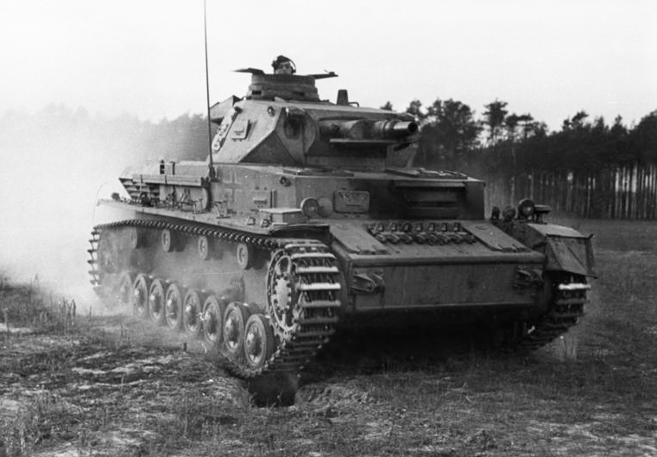
Case Yellow/ Fall Gelb (May 10 -- June 25, 1940)
During the Battle of France there was two sides:
British forces (in France)
German artillery forces
The Germans wanted to use their tanks to push through the French enemy lines guarded by the British Forces
The French did not believe the Germans would be able to break through their defenses
VS

Slide 7
DUN DUN DUN. It’s the German tanks
The Germans pushed through a forested area of France , called the Ardennes, wreaking havoc with their heavy infantry.
The continue to push through past the Somme valley and eventually surrounding the Allied forces pushing them into a corner.
Finally they have to stop to repair and allow supplies to catch up, this gives time for the French and British Forces to plan an escape from this chaos.
Notes:
Somme in Celtic actually means “tranquility” , ironic right?

Slide 8
Operation Dynamo
The evacuation of Dunkirk (codenamed Operation Dynamo) was the evacuation of British and French soldiers upon realizing that the Battle of France was a loss.
The evacuation took place between May 26 and June 4, 1940 and rescued 338,226 soldiers.
Although the operation saved hundreds of thousands of soldiers, a great deal of heavy equipment was left behind.

Slide 9
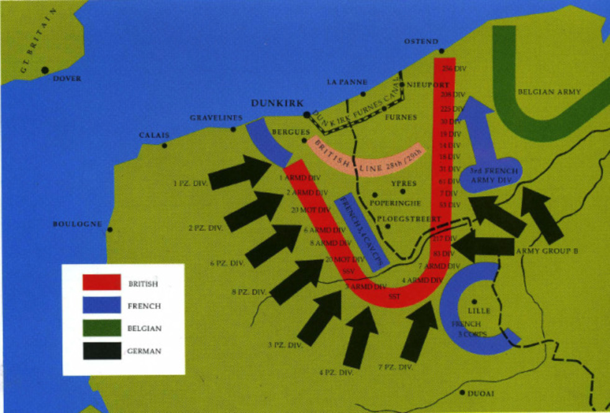
Operation Dynamo (map)

Slide 10
Operation Dynamo (continued)
Due to the enormous number of troops being evacuated, there was tension and a sense of urgency.
Officers would be known to use small arms to control panicking troops, and the oars of the small boats, that were used to get the troops to the larger ships, were often used to beat back the people who were trying to force their way onto the boats

Slide 11
Operation Dynamo (continued)
Luckily for the British Expeditionary force (BEF), the often treacherous waters of the english channel were calm for most of the evacuation
Originally, the ships would evacuate troops at both day and night, but after the Luftwaffe attack on June 1st (in which a passenger liner and three destroyers were sunk causing a severe loss of life) the evacuation only took place during night in the veil of darkness

Slide 12
Case Red
The French had lost a lot of soldiers in Case Yellow/Fall Gelb
Battle of Abbeville takes place to save troops at Dunkirk
The Germans attacked Paris, a long hard struggle but the Germans won, the French declare Paris an open city
Maginot line like Paris but they can not escape
Second BEF evacuation as the British pullout more troops

Slide 13
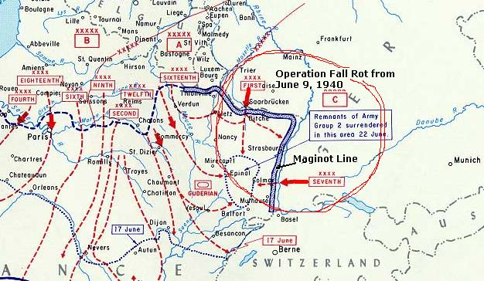
Battle Map

Slide 14
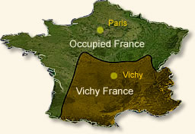
Impacts
Disrupted balance of power in Europe
Britain abandoned the Western Front
Divided France
North and West under German control
Gave Germans confidence in blitzkrieg
Used heavily in Russia, and failed
Notes:
The specific cause of French defeat is complex. It lies in low morale and a divided nation, shaken by rigorous German military tactics.

Slide 15
Work Cited
Axelrod, Alan. “Dunkirk Evacuation.” Encyclopedia of World War II, Vol. 1, Facts On File, 2013. History Research Center,
online.infobase.com/Article/Details/264595?q=operation dynamo. Accessed 2017.
Chen, C. Peter. "Invasion of France and the Low Countries." WW2DB. N.p., n.d. Web. 23 Apr. 2017.
http://ww2db.com/battle_spec.php?battle_id=32
Christian, Kaiser. Fall ROT - WWI World War Tours WWII. N.p., n.d. Web. 23 Apr. 2017.
http://www.worldwartours.be/fall-rot.html
Erich Von Manstein. Digital image. Wikipedia. Wikipedia, n.d. Web.
<https://www.google.com/search?q=Erich+von+Manstein&safe=strict&rlz=1C1CHZL_enUS724US734&source=lnms&tbm=isch&sa=X&ved=0ahUKEwib-8me7b7TAhVR4WMKHXE7Cv4Q_AUICCgB&biw=1707&bih=844&dpr=1.13#imgrc=avw2u1ObkbyfYM:>.
Fall of France. Digital image. Ytimg. Maxres Default, n.d. Web. 24 Apr. 2017. <https://i.ytimg.com/vi/i3UUVBphD_Q/maxresdefault.jpg>.
France Defeat. Digital image. Eyewitness to History. N.p., n.d. Web. 24 Apr. 2017.
<http://www.eyewitnesstohistory.com/images/francedefeat2.jpg>.
"Fall Rot (Case Red)." History Wars Weapons. N.p., n.d. Web. 23 Apr. 2017.
http://historywarsweapons.com/fall-rot-case-red/http://historywarsweapons.com/fall-rot-case-red/
The World at War - German Codenames. N.p., n.d. Web. 23 Apr. 2017.
Sheffield, Gary, Dr. "The Fall of France." BBC News. BBC, 30 Mar. 2011. Web. 24 Apr. 2017.
<http://www.bbc.co.uk/history/worldwars/wwtwo/fall_france_01.shtml>.
Bennett, Peter, and Malcolm Dando. “The Ardennes Revisited: Comments on Laing's Comments on the Fall of France.” The Journal of the Operational Research Society, vol. 30, no. 7, 1979, pp. 670–671., www.jstor.org/stable/3009389.
(and Ethan Hines talking to me about WWII)
"Operation Dynamo." The Story of The Bee and Her Role in the Evacuation of Dunkirk RSS. N.p., n.d. Web. 25 Apr. 2017.

