Slide 1
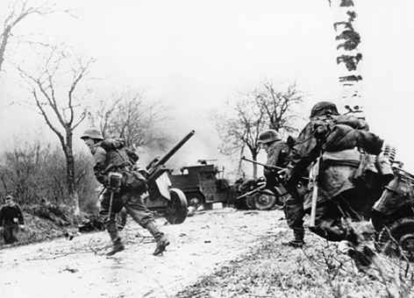
Battle of the Bulge
(Ardennes offensive)
Audrey Ma
Cindy Zhao
Kaci Yoshimura
Kelly Cho

Slide 2
Timeline
December 22- The German army advanced through the center of Ardennes
January 1-
Germany launches their final assault but fails to break through Allied forces
By February 7- All German gains have been undone
December 16, 1944- Germany launched their Ardennes Offensive
December 20-27- The siege of Bastogne
January 3- Germany begins to withdraw
December 23- US launches a counterattack

Slide 3
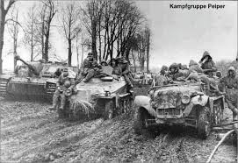
Thesis
Germany launched an ambitious offensive attack in the Ardennes forest as a last attempt for victory, but forming a bulge in the Allied defense caused Germans to lose contact with outside resources, leading to their surrender and proving the Battle of the Bulge to be a significant component of securing an Allied victory during WWII.

Slide 4
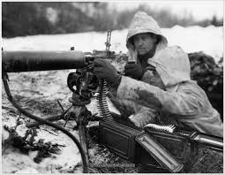
Background
December 1944 - January 1945
Canada, Britain, US vs Germany
Fought in the Ardennes forest of Belgium
American and British forces drove the German army from France and began threatening the German border.
Adolf Hitler attempted to split the Allied armies in northwest Europe by means of a surprise blitzkrieg
Blitzkrieg- troops in vehicles, such as tanks, made quick surprise strikes with support from airplanes

Slide 5
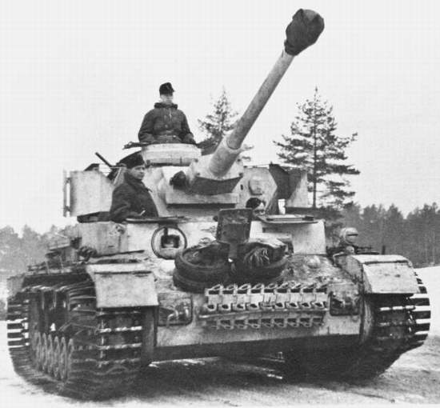
Background
Largest land battle on the Western Front during World War II and the largest engagement ever fought by the U.S. Army
The Battle of the Bulge in the Ardennes Forest of Belgium was Adolf Hitler's last offensive.

Slide 6
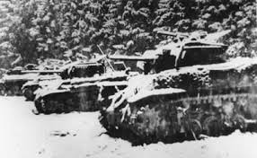
Background
The Germans launched a counteroffensive in the Ardennes Forest in Belgium in a desperate effort to halt the Allied advance and capture the Belgian port of Antwerp.
This was the last German major thrust in WWII. It was intended to drive a wedge between the Allied forces of the US, Britain, and France.

Slide 7
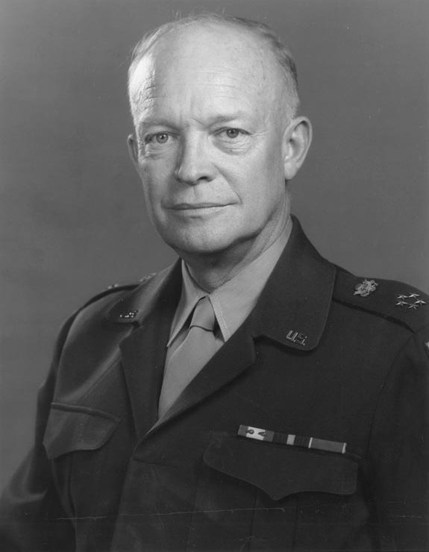
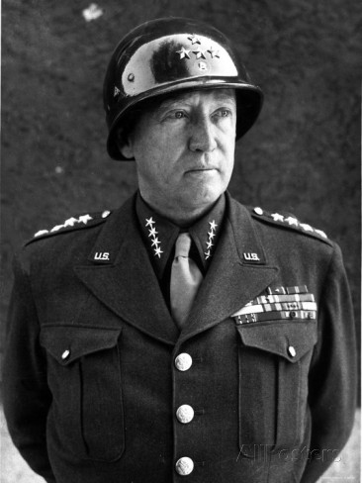
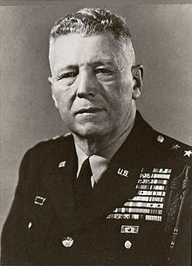
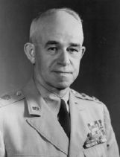
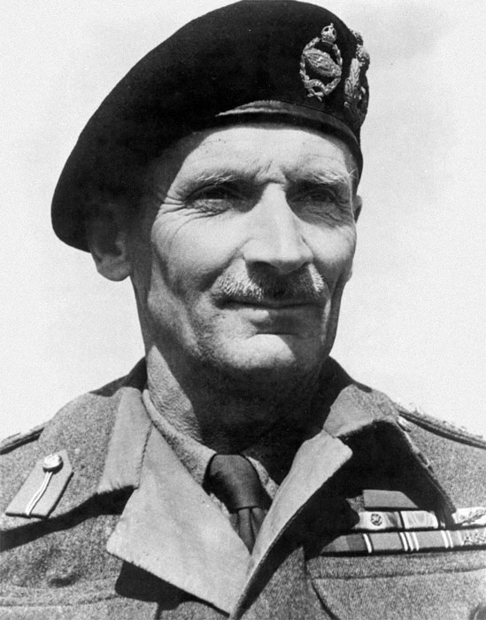
Major Players (Allies)
Dwight D. Eisenhower
(Supreme Allied Commander)
George S. Patton
(Lieutenant General)
Bruce C. Clarke
(Brigadier General)
Omar Bradley
(General)
Bernard Montgomery
(Field Marshal)

Slide 8
Major Players
Allies:
Dwight D. Eisenhower (Supreme Allied Commander)
George S. Patton (Lieutenant General)
3rd army
brought the US troops from a near-defeat to victory
Bruce C. Clarke (Brigadier General)
defended St. Vith, slowing German attack
Omar Bradley (General)
Turned around a sudden and aggressive counter-offensive by the Germans
Bernard Montgomery (Commander of 21st Army Group)

Slide 9
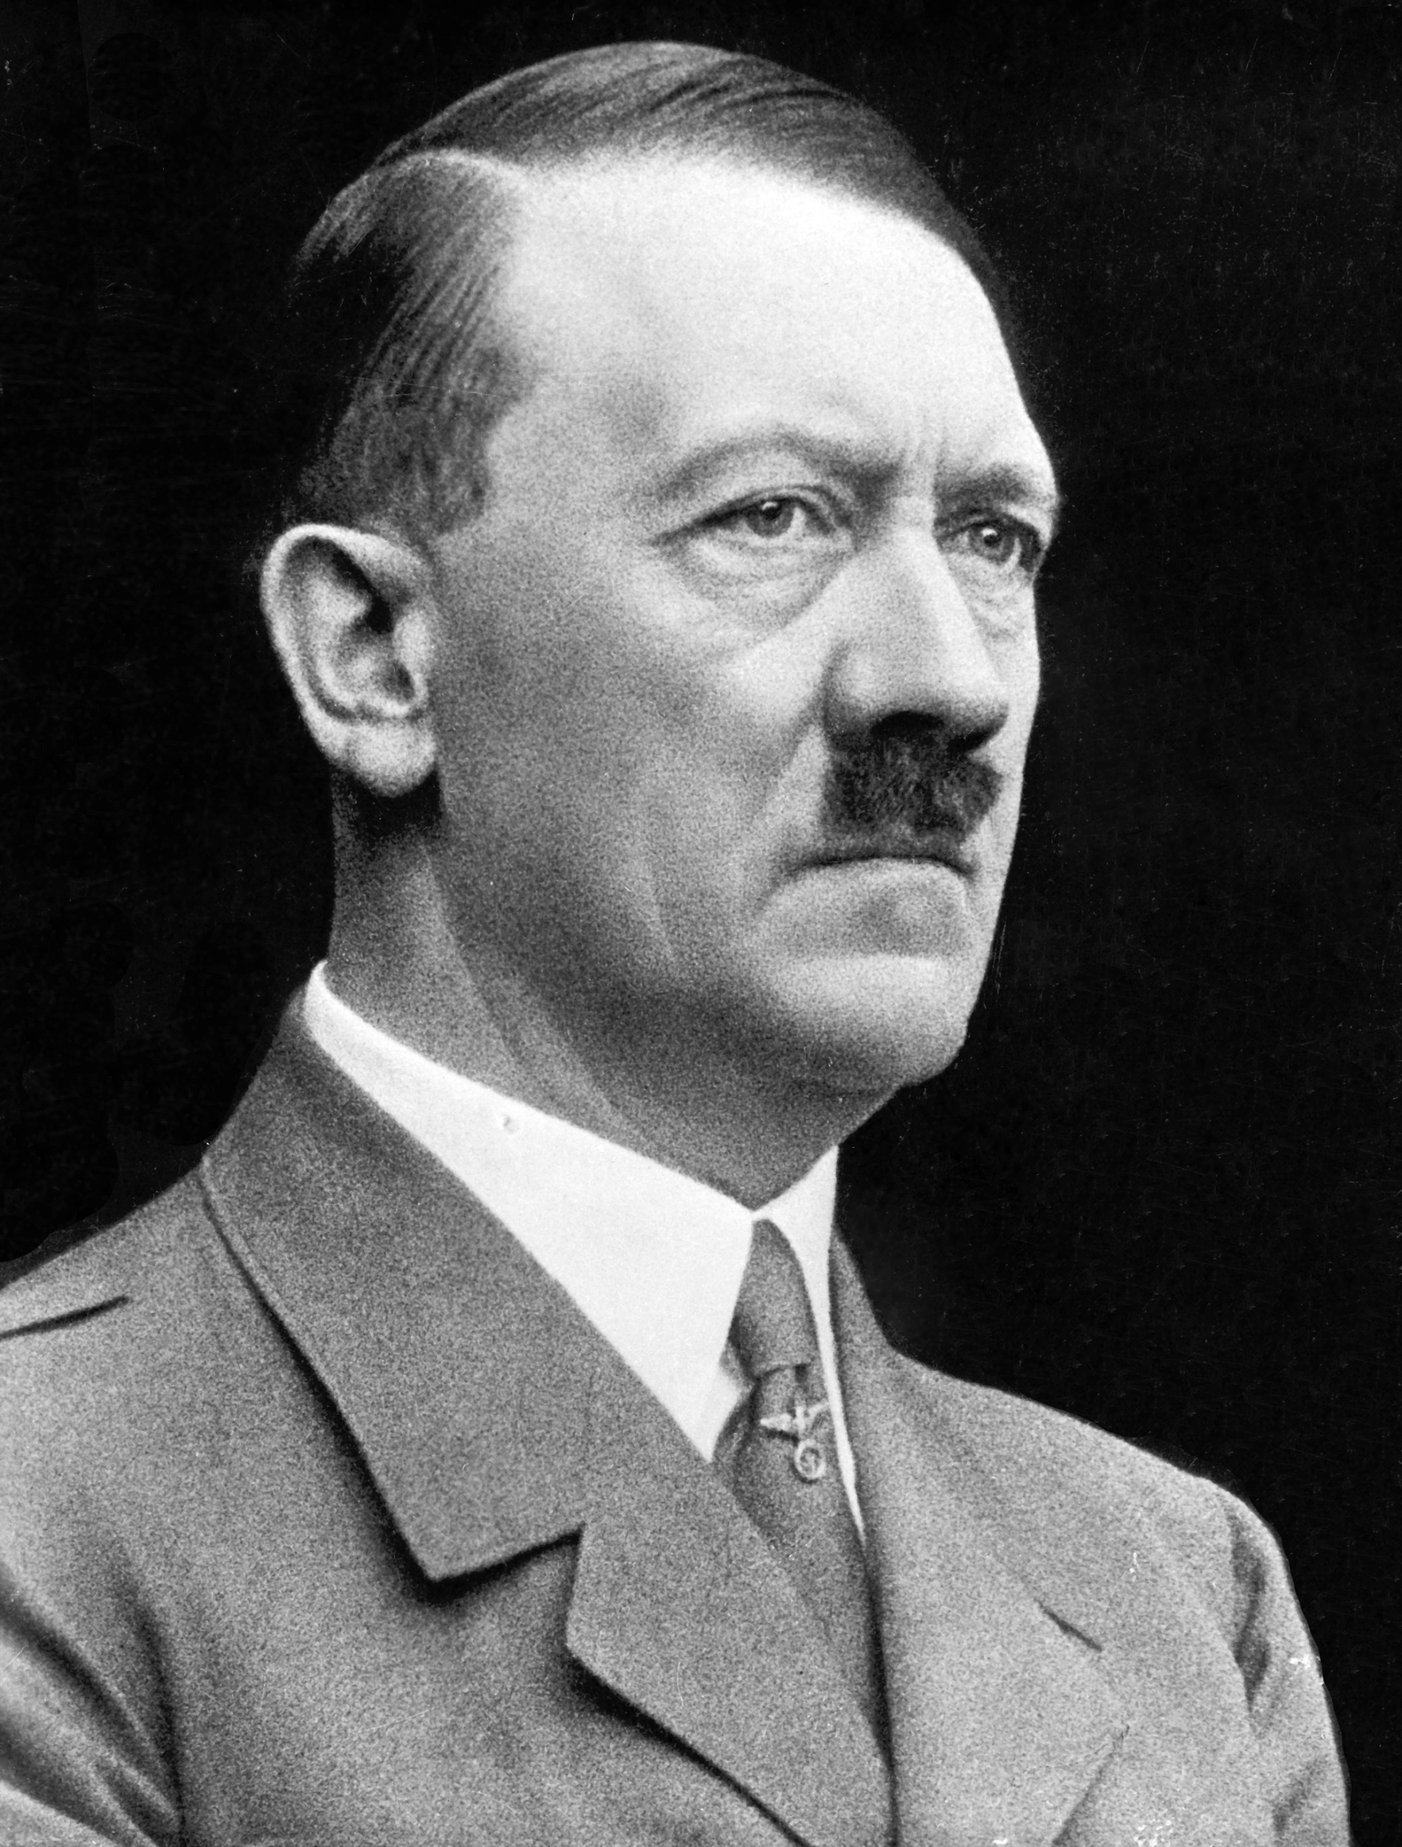
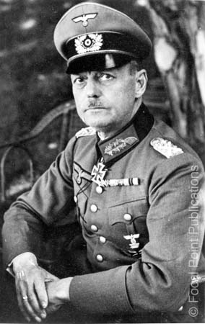
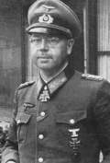
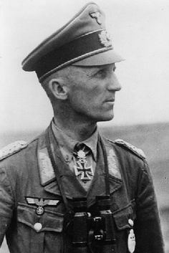
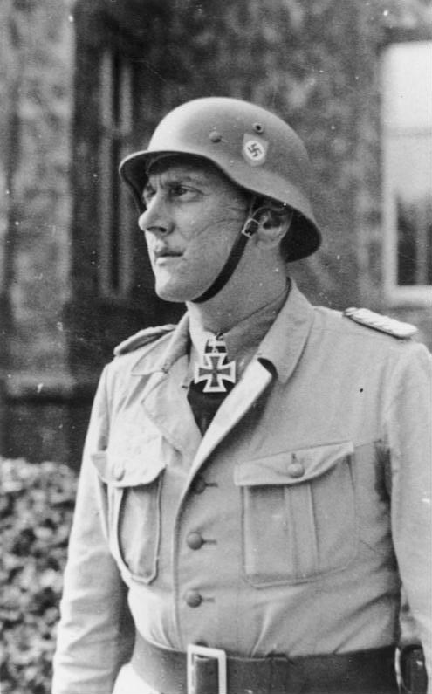
Major Players (Axis)
Hitler
(Leader of Nazi Party, Chancellor of Germany)
Gerd von Rundstedt
(Field Marshal)
Erich Brandenberger
(General)
Hasso von Manteuffel
(General)
Otto Skorzeny
(Lieutenant Colonel)

Slide 10
Major Players
Germany:
Hitler
Gerd von Rundstedt (Field Marshal)
launched a surprise counter-attack against the Allied powers
Erich Brandenberger
Hasso von Manteuffel
Debatably one of the most talented army commanders in the Ardennes Offensive
Otto Skorzeny

Slide 11
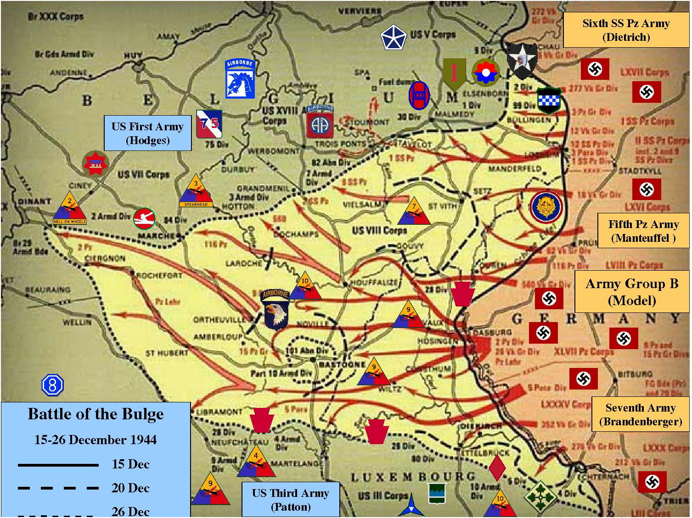

Slide 12
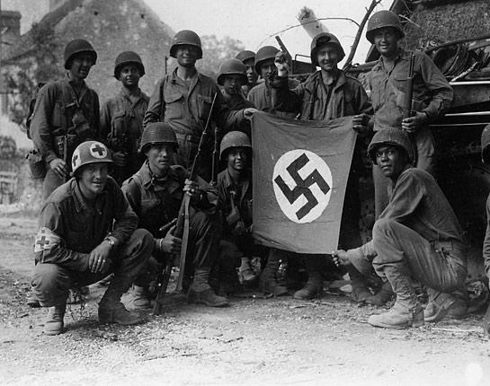
Details
On December 16, 1944, 30 German divisions soared across an 80-mile Allied front, from southern Belgium to the middle of Luxembourg.
Field Marshal Gerd von Rundstedt (German commander) thought Hitler's plan was too ambitious and tried to dissuade him, as did other high-ranking officers, all of whom failed.
Eisenhower had left a 80-mile-wide sector in the Ardennes Forest lightly defended by Major General Troy Middleton's VIII. This made it easy for German forces to advance through Allied forces.

Slide 13
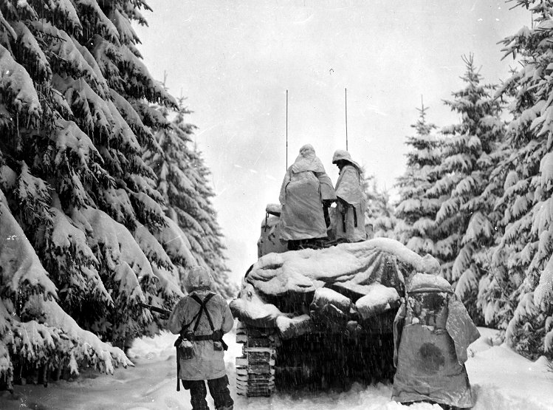
Details
Hitler took advantage of the bad weather conditions. Low clouds and fog prevented the Allies from using their air force.
While Allied aircraft were hampered by bad weather, Gen. Gerd von Rundstedt’s 5th and 6th Panzer Armies launched two parallel attacks with the eventual aim of retaking the great port of Antwerp.

Slide 14
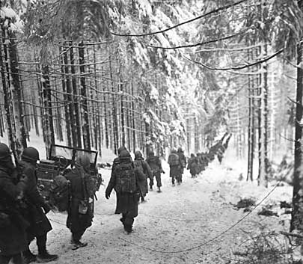
Details
German troops drove deeper into the Ardennes in an attempt to secure vital bridgeheads (area of ground around the end of a bridge which is sought to be defended/taken over during a time of war) west of the River Meuse
The line defining the Allied front took on the appearance of a large bulge, which is how the battle got its name.

Slide 15
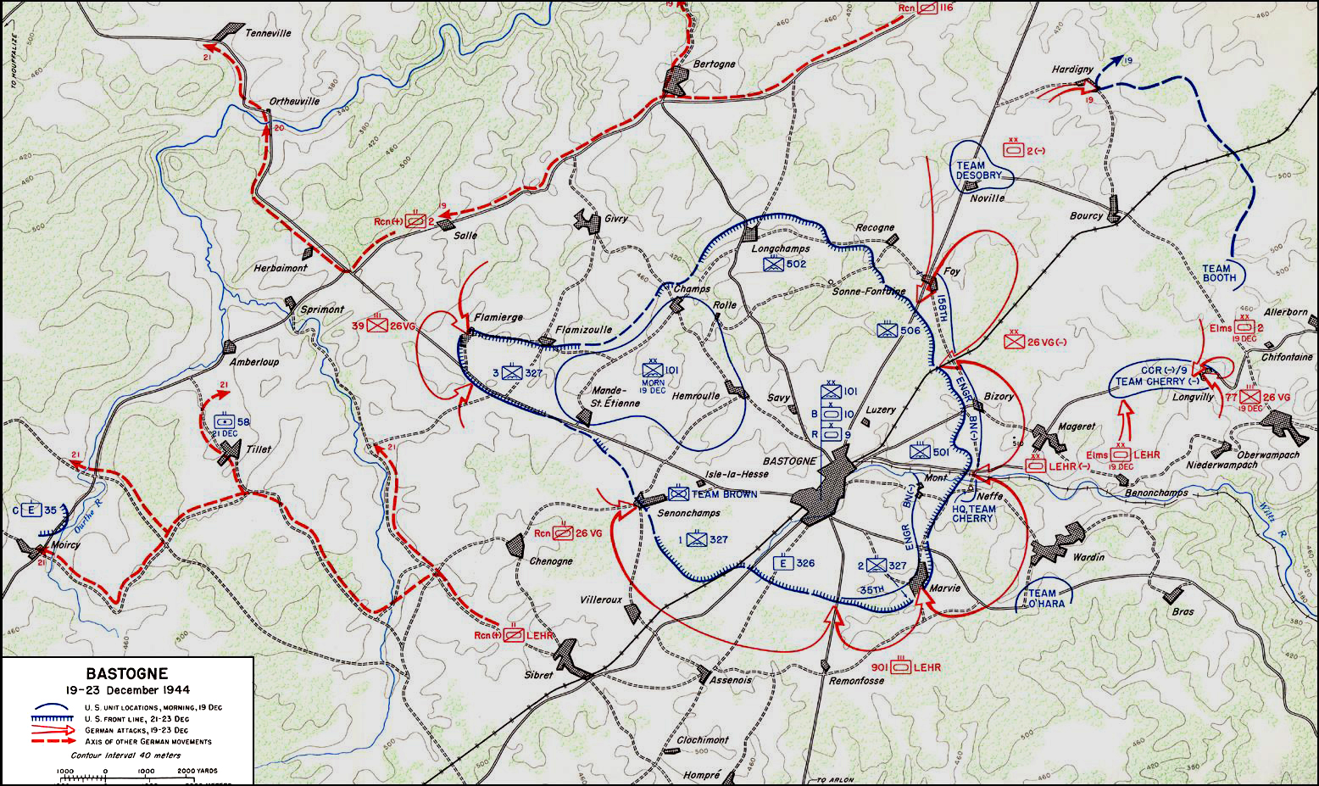
Details
December 20- Both forces met at the town of Bastogne.
Allied forces were able to hold onto Bastogne for a whole week until Patton’s army arrived while being encircled by the German army.
The next day after Patton’s army arrived, Bastogne was firmly in Allied hands and the Allies began their counterattack.

Slide 16
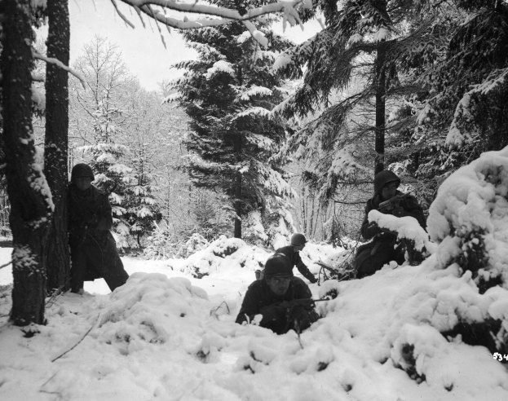
Details
December 22, the weather cleared and General Eisenhower planned major offensives in the northern and southern sectors of the Western Front.
Because German forces were too far deep, it was hard to supply his troops.
German forces suffered from a lack of German personnel, tanks, guns, fuel, and ammunition. They were forced to abandon their vehicles which contributed largely to their loss.

Slide 17
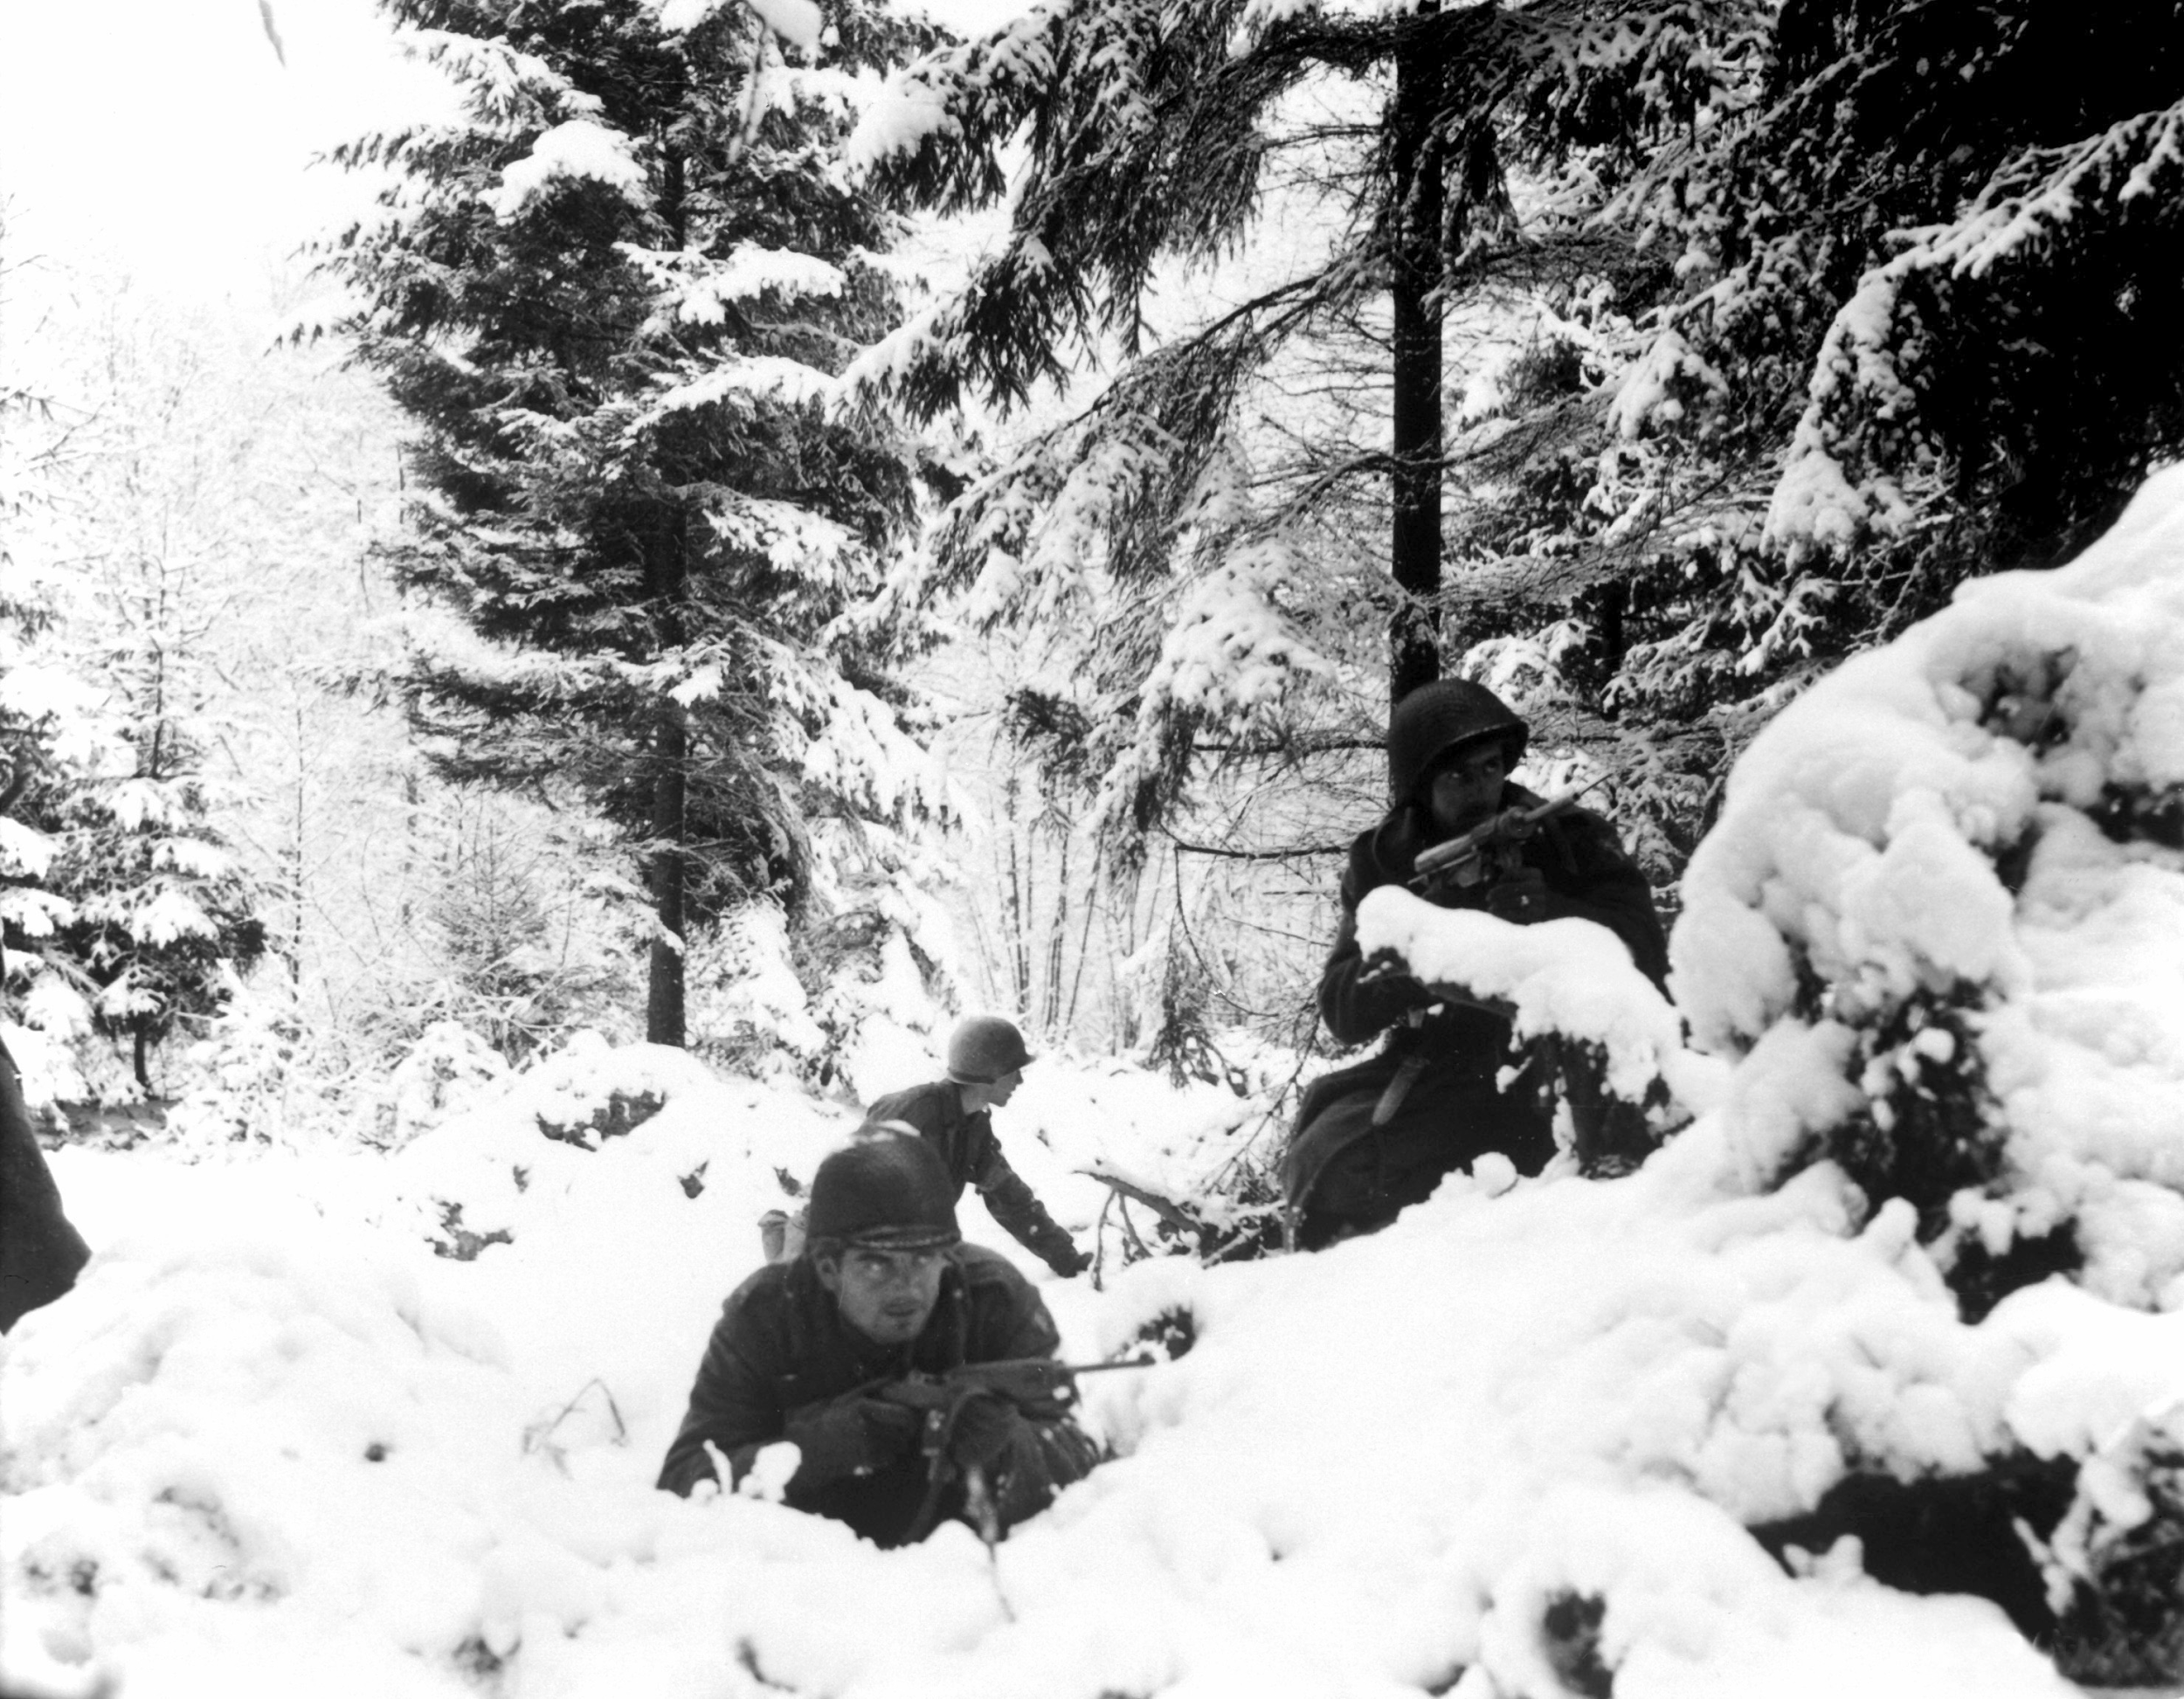
Ending
Ended January 25, 1945
Creating a bulge made German forces very susceptible for a pincer style attack from the Allies.
Montgomery's combined force closed in from the north while Patton's 3rd Army came up from the south, forming a giant noose around the German position

Slide 18
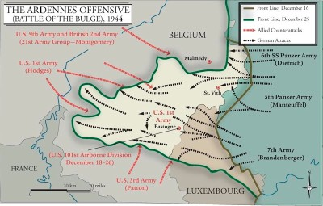

Slide 19
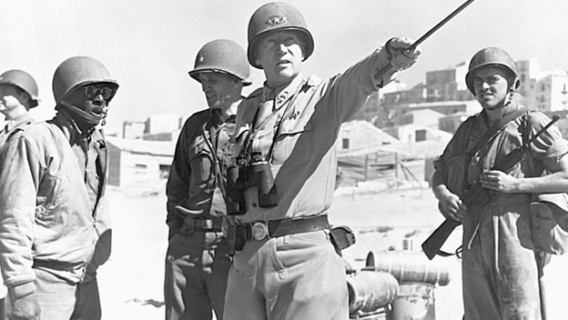
Ending continued
Hitler was left with no alternative but to turn his tanks and soldiers around and send them all back toward Germany
16,000 Americans had lost their lives and 60,000 were wounded or captured
Germany lost roughly 120,000 soldiers and 600 tanks

Slide 20
Outcomes/Significance
Allied Victory
Hitler’s gamble was a disaster
Biggest and bloodiest battle American soldiers ever fought in
Last chance the Germans had to change the war.
Germans lost many experienced troops and equipment that they could not launch another attack.
Marked the end of 8 years of German offensive.

Slide 21
Outcomes/Significance
Horrendous experience for the soldiers who fought in the icy Ardennes. (Many froze to death)
Britain and America began to prepare for a great thrust into Germany.
Russia began to attack with over 300 divisions.
Within weeks they would be a hundred miles near Berlin
Brought the end of the German army and Nazi reign.
Sign out

Slide 22
Interesting Facts
Most of Hitler’s generals advised against the attack
Model even said that Hitler, “has no more than a ten percent chance of success.”
German soldiers tricked the Allies and caused confusion in their camps
Created small acts of sabotage within the camps
Even General Omar Bradley was detained and questioned by his own soldiers
This was the first desegregated battle by the US Army during WWII
US wasn’t officially desegregated until 1948

Slide 23
Thesis
Germany launched an ambitious offensive attack in the Ardennes forest as its last attempt for victory, but forming a bulge in the Allied defense caused Germans to lose contact with outside resources, leading to their surrender and proving the Battle of the Bulge to be a significant component of securing an Allied win during WWII.

Slide 24
Works Cited
Andrews, Evan. "8 Things You May Not Know About the Battle of the Bulge." History.com. A&E Television Networks, 16 Dec. 2014. Web. 03 May 2016.
"ABC-CLIO." World at War: Understanding Conflict and Society. N.p., n.d. Web. 03 May 2016. "Battle of the Bulge." History.com. A&E Television Networks, n.d. Web. 25 Apr. 2016.
"Battle of the Bulge." The Official Home Page of the United States Army. N.p., n.d. Web. 25 Apr. 2016.
The Editors of Encyclopædia Britannica. "Gerd Von Rundstedt." Encyclopedia Britannica Online. Encyclopedia Britannica, n.d. Web. 25 Apr. 2016.
Zaloga, Steve, Peter Dennis, and Howard Gerrard. Battle of the Bulge 1944. Oxford: Osprey, 2004. Print.

