Slide 1
The Battle of El-Alamein
and
Operation Torch

Slide 2
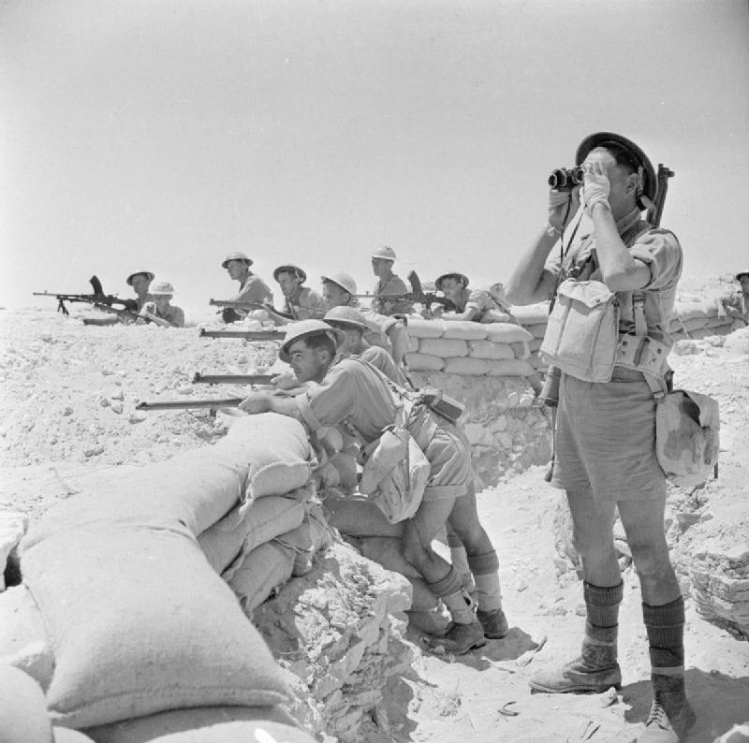
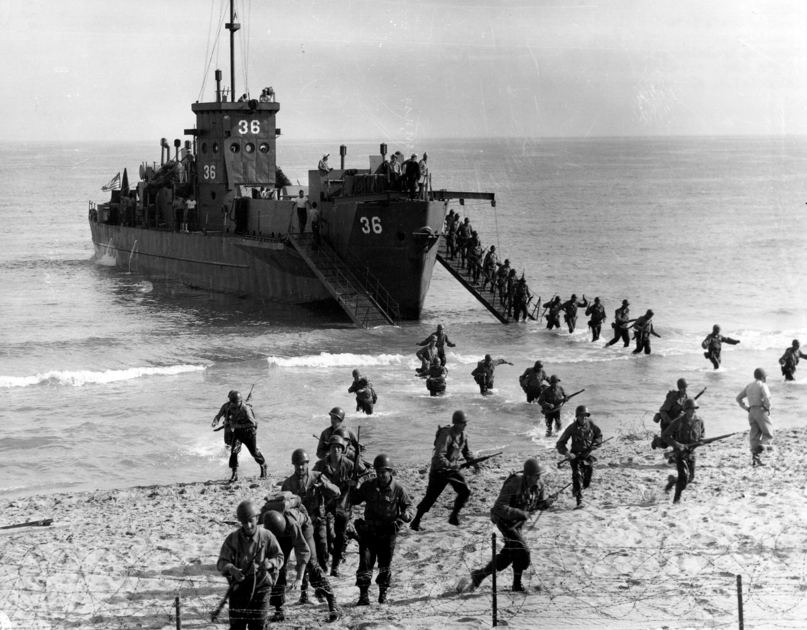
Thesis
The success of the Battle of El-Alamein gave the Allied forces the confidence to organize and successfully execute Operation Torch, setting precedent for joint country cooperation which eventually culminated in D-Day.

Slide 3
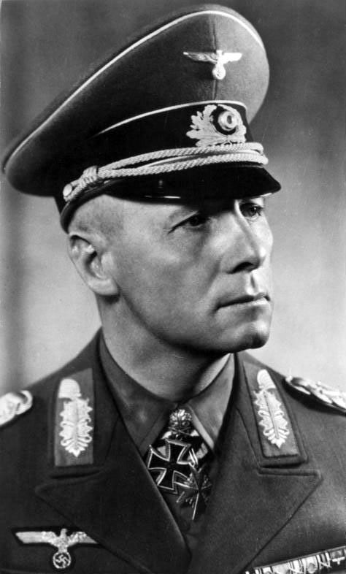
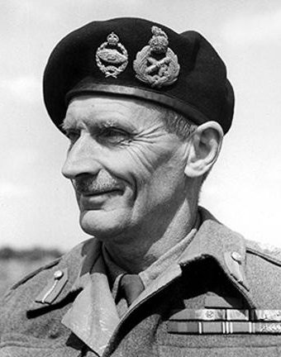
Battle of El-Alamein: Participants
Australia
Italy
New Zealand
VS
Free France
India
South Africa
Germany
Britain
Erwin Rommel
Bernard Montgomery

Slide 4
The Battle
September 1942: Allies take up position between El-Alamein and the Qattara Depression.
Montgomery assembles British, Australian, Indian, New Zealander, South African, and French forces to create a massive army to assault the Germans and Italians.
Germans sets up a barrier of land mines.
“Operation Bertram” is intended to distract the Germans and make them think the British will focus their attacks in the south.
During “Operation Lightfoot,” his troops bombard the Germans with artillery on a huge scale.
Rommel’s defenses cause many casualties, Allies fail to break through the German lines and are surrounded.
Reinforcements arrive for the Allies, and they far outnumber the Germans.
Allies break through German lines, Rommel’s forces retreat. Hitler orders them to fight to the last man, but Rommel refused. A rearguard holds off the Allies as they run.

Slide 5
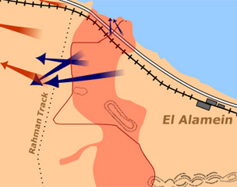
British Forces
German Forces

Slide 6
El-Alamein Outcomes
The victory of the Allies proved a turning point for German power and sent them on the run in North Africa for good.
It weakened the Axis hold there significantly.
The Axis powers never recovered Africa.
Victory at El-Alamein gave Allies confidence to begin Operation: Torch

Slide 7
Operation Torch: Participating Nations
United States
Britain
German Occupied French North Africa

Slide 8
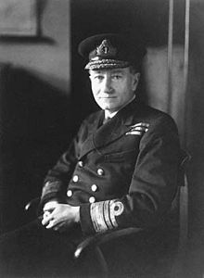
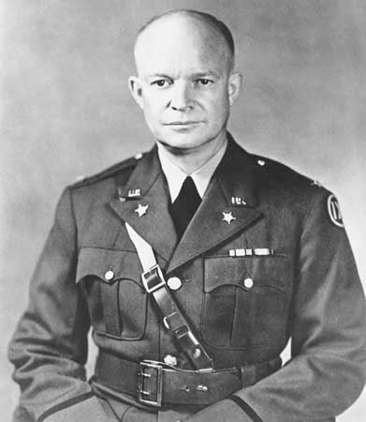
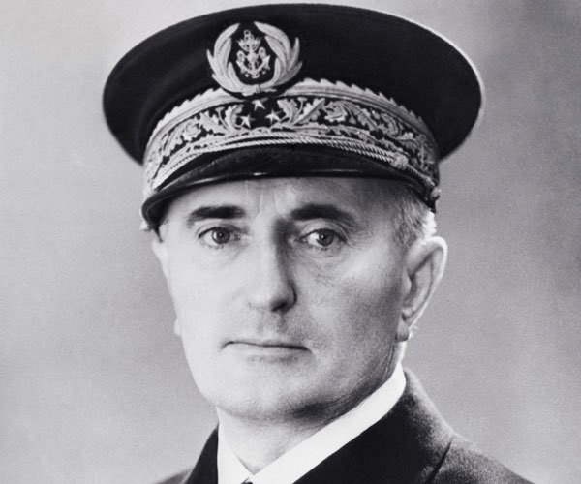
Key Players
Andrew Cunningham (U.K.)
Dwight Eisenhower
(U.S.)
François Darlan
(Vichy France)

Slide 9
Operation Torch: Background
Operation Torch refers to the Allied campaign between U.S. and Britain in North Africa to secure the Mediterranean theatre
Operation Torch was built on cooperation:
Bolero plan ( U.S.) : a buildup of forces in Great Britain in advance of an assault on european continent in 1942 …. Britain disagreed
U.S. agreed to combine the operation (Torch) and agreed that the supreme command must be given to American Major general Dwight D. Eisenhower.

Slide 10
Operation Torch Background
U.S. and British held secret meetings with French leaders and believed that the Vichy French would not fight against them.
The British wanted to land of the Mediterranean Coast so they could quickly get to Tunisia
The U.S wanted to land on the Atlantic Coast of Morocco because of the Vichy French Forces and hostile reaction from Spain and Germany’s counterstroke against Gibraltar
General Dwight D. Eisenhower agreed with British views = compromise
Land inside and outside of the coast of the Mediterranean but far east as Algiers

Slide 11
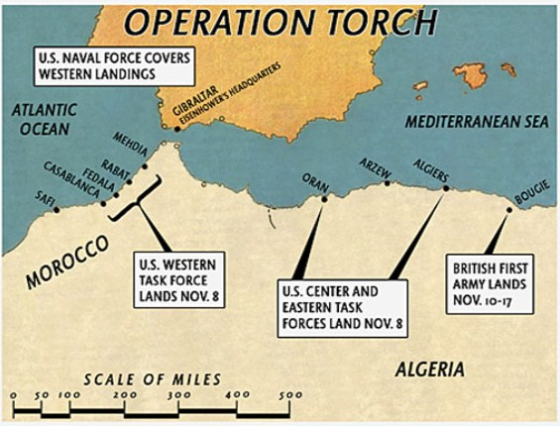

Slide 12
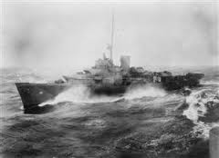
Operation Torch: Moroccan Coast
November 8, 1942- US forces arrive. The Allies thought the French would be less likely to fight Americans
French defenses were not very effective due to a military coup by pro-ally generals. However, the Atlantic Coast proved troublesome for the Allies and many of the US transports sank or were too damaged to be used to move reinforcements
French in Mehdia put up a much stronger resistance, but US troops capture nearby territory. Negotiations begin on November 10.

Slide 13
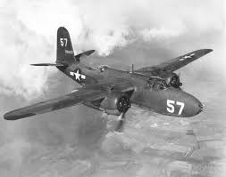
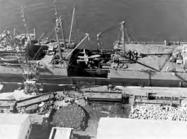
Operation Torch: Oran
November 8, 1942: Initial landings were successful, but Atlantic Coast caused trouble again. The Naval commanders halted further landings. Allies begin a three front attack.
November 9: French prepare a counter attack, but their forces were crushed by air raids and naval fire. The French Surrender.

Slide 14
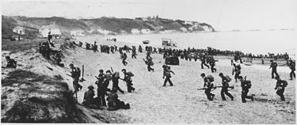
Operation Torch: Algiers
November 8-9: US and Britain launch a combined attack on four fronts: two sites west, one site east, and the port itself. The invasion in the west were delayed due to a French convoy and shallow water, while the invasion in the east went smoothly.
Allies met unexpected French resistance at the port and suffered high casualties. Simultaneous airborne assault and British naval bombardment allowed american troops to enter the port.
French surrender

Slide 15
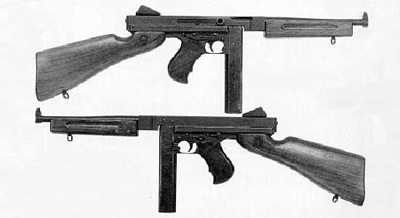
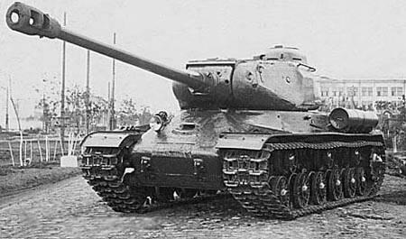
Operation Torch: Why was it successful?
British and American forces cooperated
Pro-ally French resistance
Germany’s trust issues
The Vichy French resisted the Allied forces
Germany did not trust the French and prevented them from modernizing their army and weaponry
The French were not able to keep up sustained warfare with the Allied forces
VS
+

Slide 16
Operation Torch: Outcomes
Darlan is named High Commander of the French forces and orders the North African territories to stop resisting the Allies
Freed up shipping in the Mediterranean.
All North African colonies (except Tunisia) join the Allies in the war
First time US and Britain had a combined invasion
Sets up cooperation for D-Day

Slide 17
Timeline
October 23-24 1942 - El-Alamein: Allies’ artillery bombardment on Axis powers
October 26 - British move north, fail to break through army lines
November 1-2 - Montgomery tries again to break through German lines, Allies suffer heavy losses
November 3 - Italian armor is crushed and withdraws, Germans are far outnumbered. After three failed attempts, the Allies get between the Italian and German forces. They begin to retreat.
November 4 - Allies break through line and try to cut of Rommel’s retreat. Montgomery misses a chance to capture or destroy the entire army, but the battle is won.
November 8 - Operation Torch: US Army lands on the Moroccan coast, Oran and Algiers (French Colonies)
November 9 - French surrender
November 10 - Moroccan Coast secured, armistice between French and US. British forces land on Bougie.
November 16 - 1st Army was over the Tunisian border. Official end of Operation Torch.

Slide 18
Works Cited
"Animated Map: The Battle of El Alamein." BBC - History - World Wars. BBC, 2014. Web. 23 Apr. 2016.
Harney, Will. "World War 2 Facts." World War 2 Facts RSS. World War 2 Facts, 25 Dec. 2012. Web. 24 Apr. 2016.
Murray, Williamson. "Operation Torch: Allied Invasion of North Africa."HistoryNet. World History Group, 12 June 2006. Web. 24
Apr. 2016.
"North Africa campaigns." Britannica School.Encyclopædia Britannica, Inc., 2016. Web. 23 Apr. 2016. "OPERATION TORCH." Combined Operations Command. Www.combinedops.com, n.d. Web. 24 Apr. 2016.
Trueman, C. N. "The Battle of El Alamein." History Learning Site. History Learning Site, 3 Mar. 2016. Web. 24 Apr. 2016.
United States Holocaust Memorial Museum. "Operation Torch (Algeria-Morocco Campaign)." United States Holocaust Memorial
Museum. United States Holocaust Memorial Council, 29 Jan. 2016. Web. 24 Apr. 2016.

