Slide 1
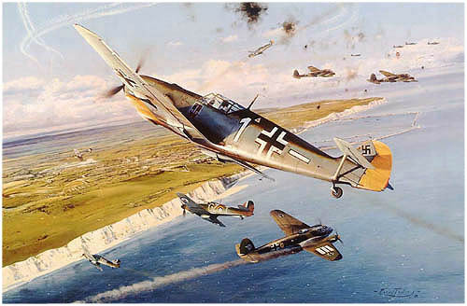
Battle of Britain
1940
Nick B., Sierra H., Liam H., Meghana S.

Slide 2
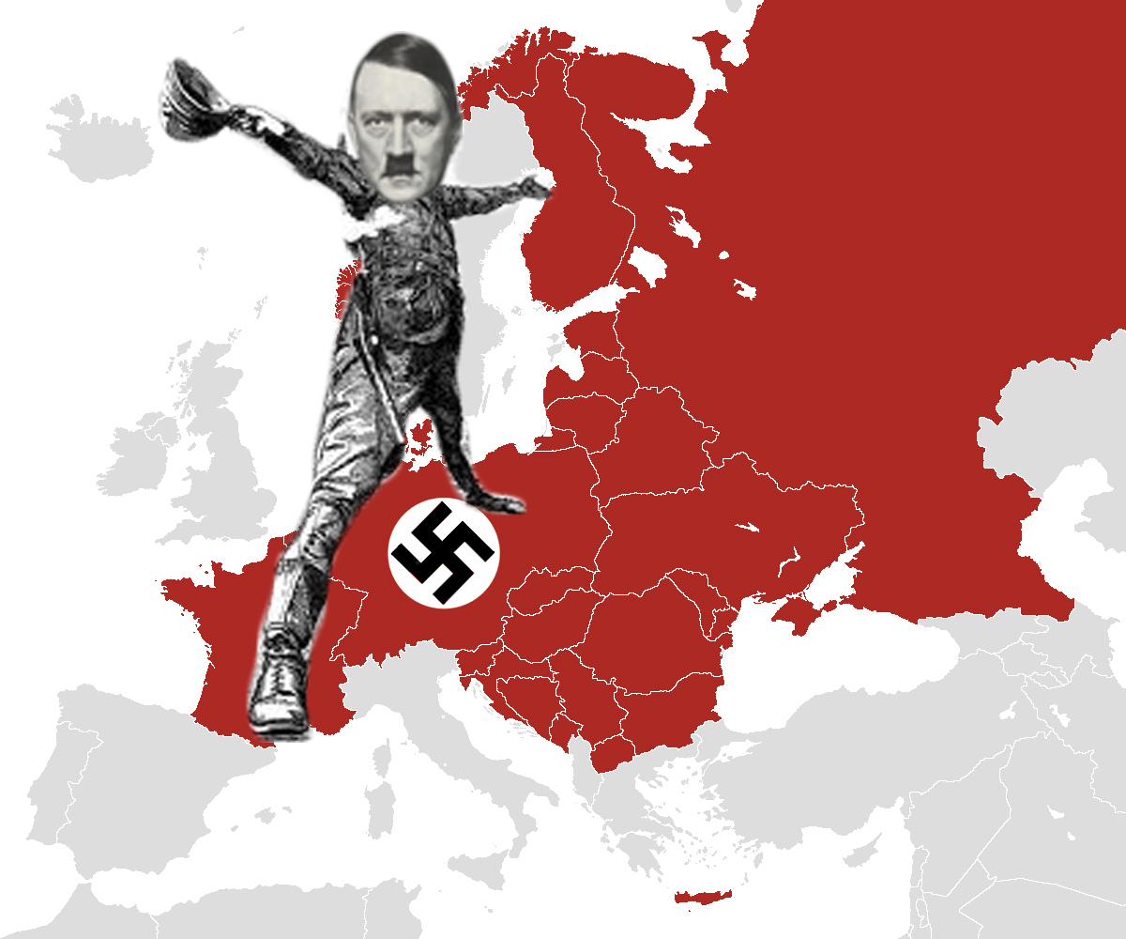
Paris
London
Made by Alex Stejskal

Slide 3
THESIS:
During the Battle of Britain, Hitler’s lack of strategic foresight allowed the Royal Air Force to gain air superiority over the Luftwaffe, averting German invasion and setting the stage for allied landings in France.

Slide 4
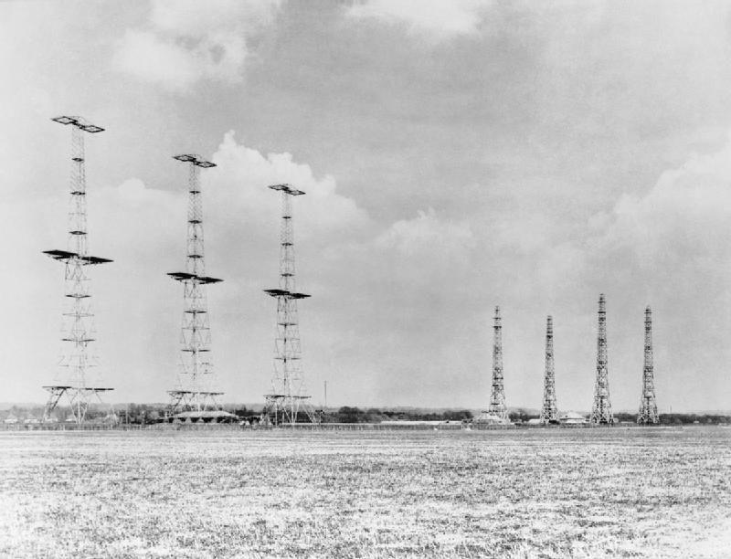
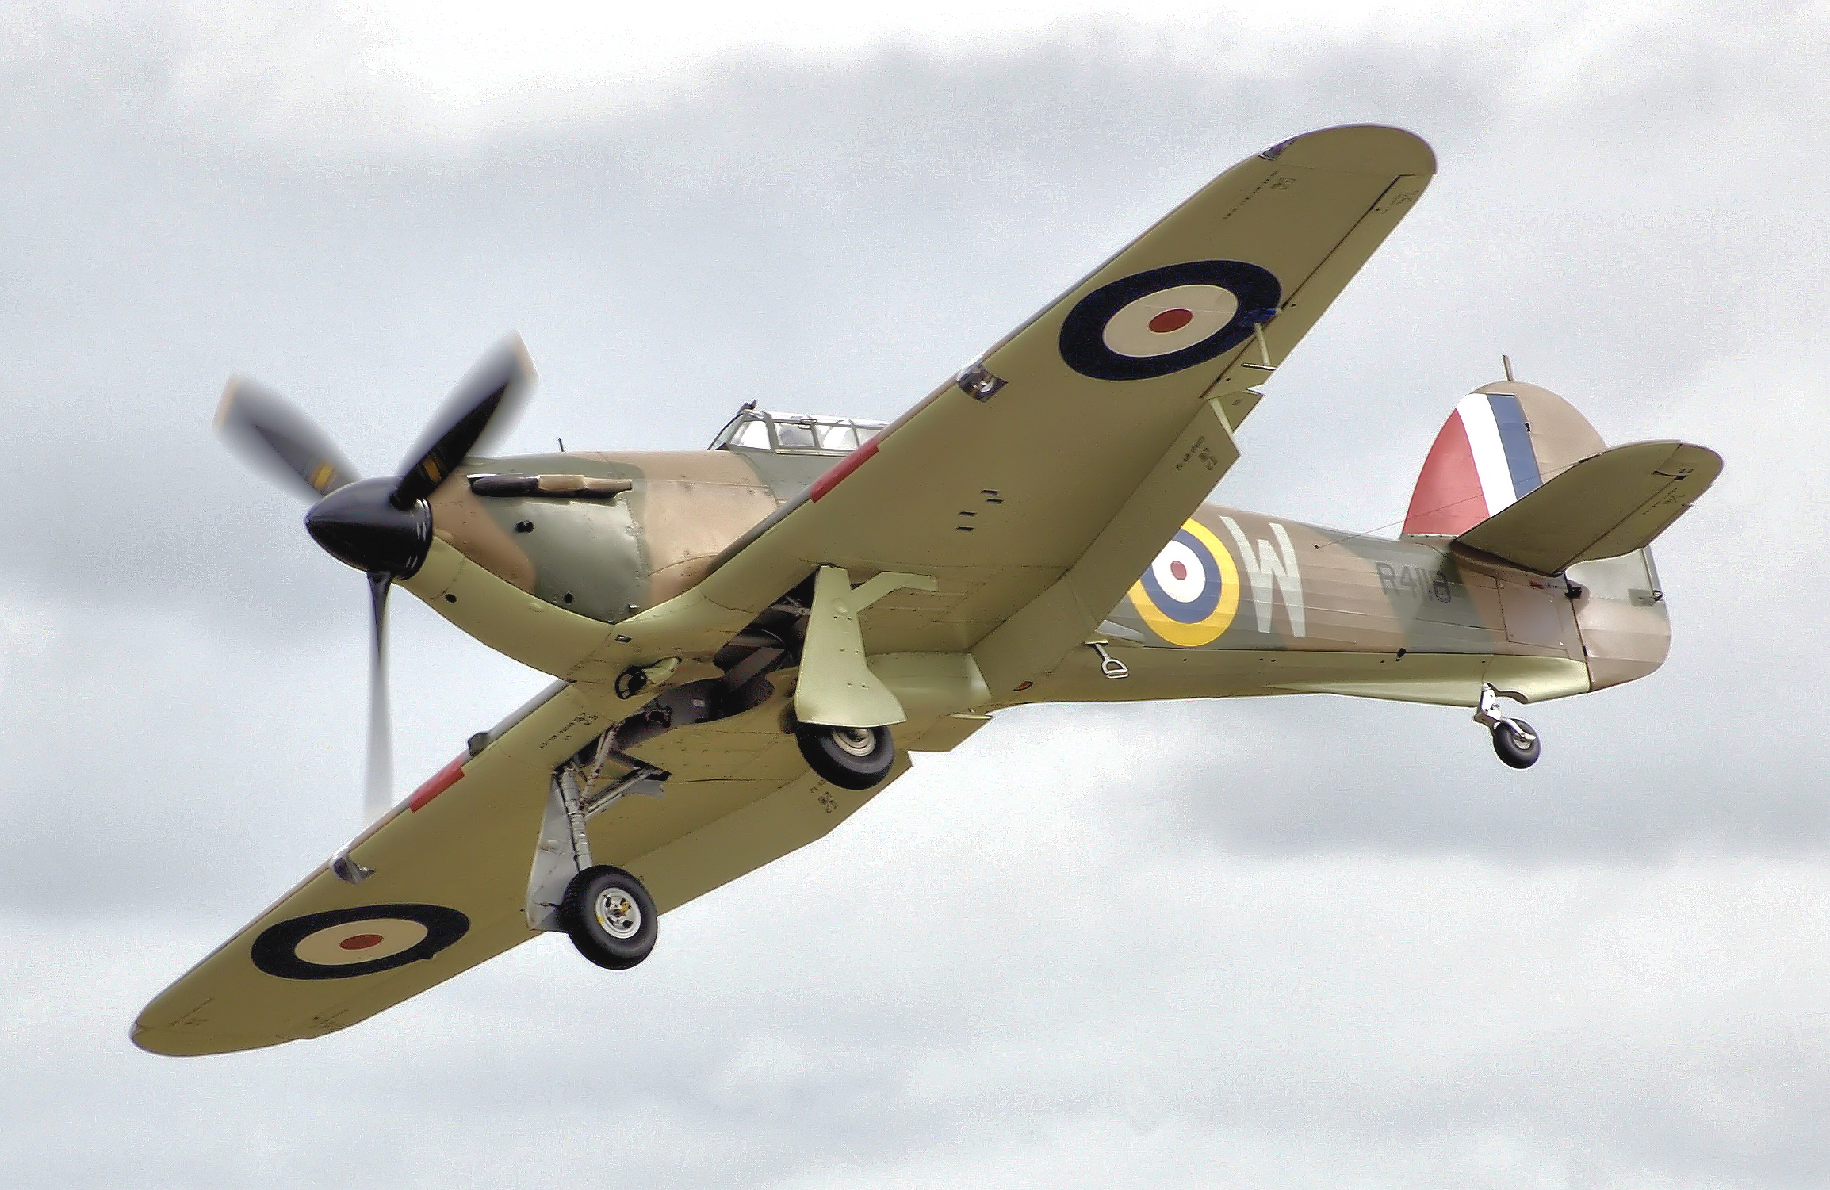
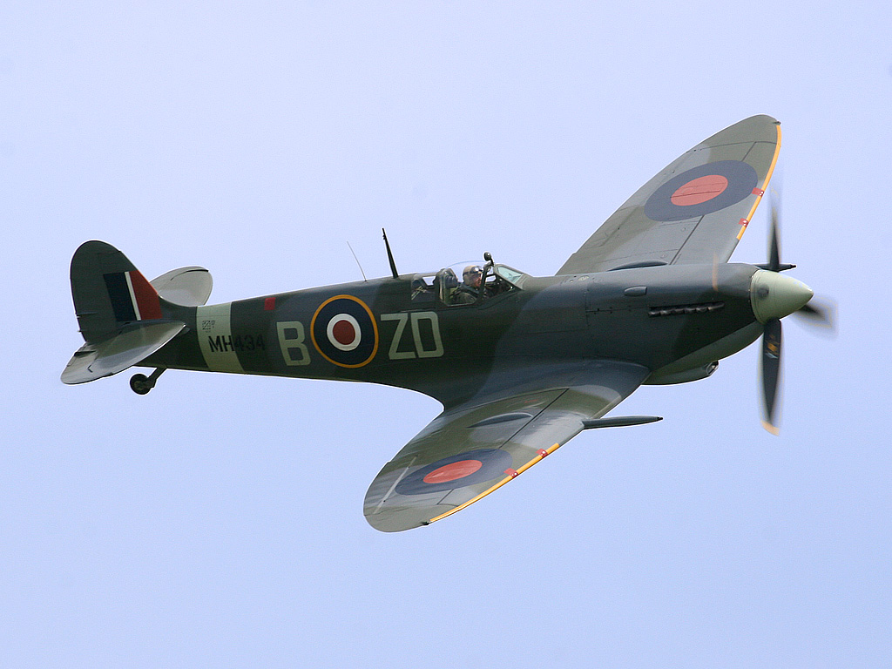
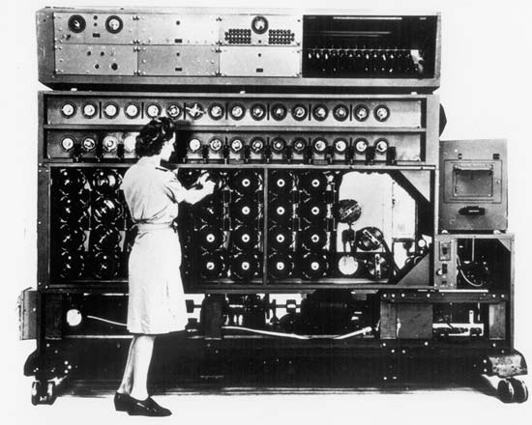
Technologies, Weapons, Planes
British
Radar called Chain Home
Most advanced in world
ULTRA intelligence system
German
Heinkel HE 111 (Bomber)
Messerschmitt Bf-109
Messerschmitt Bf-110
Hawker Hurricanes
Super Spitfire
British Advantage:
German bombers had small payloads and short ranges.
Prevented German surprise attacks as British knew about many of the German plans

Slide 5
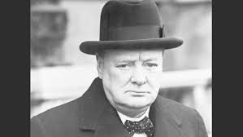
Commanders and Leaders

Slide 6
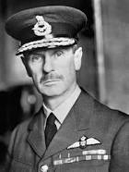
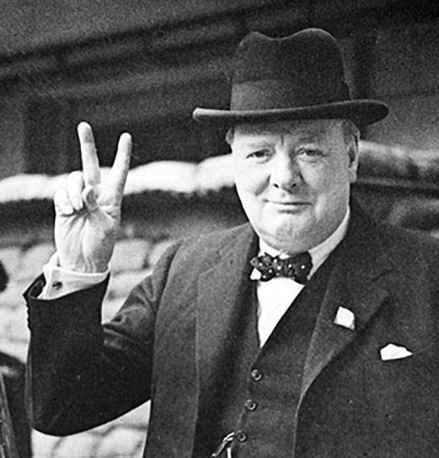
British
Air Marshal Sir Hugh Dowding
Winston Churchill
Commanded the Royal Air Force (RAF)
Prime Minister of United Kingdom (1940-1945, 1951-1955)

Slide 7
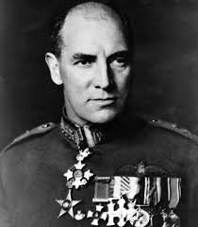
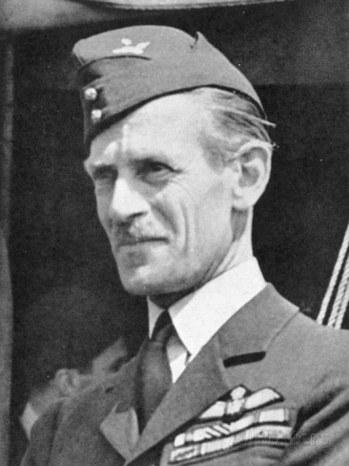
British
Air Vice-Marshal Sir Quintin Brand
Command No. 10 Group
Air Vice-Marshal K R Park
Command No. 11 Group

Slide 8
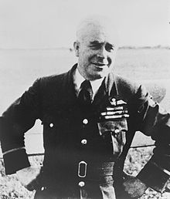
British
Air Vice-Marshal R E Saul
Command No. 12 Group
and No. 13 Group

Slide 9
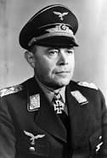
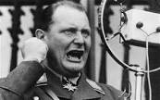
German
Field Marshal Albert Kesselring
Reichsmarschall Hermann Goering
Commander of the Luftwaffe (Air Force)
Commander of the First Fleet

Slide 10
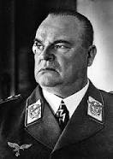
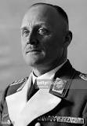
Field Marshal Hugo Sperrle
General Hans-Jurgen Stumpff
Commander of the German 2nd Fleet
Commander of the German 3rd Fleet

Slide 11
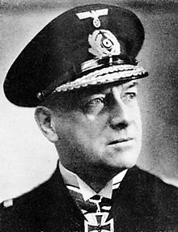
Operation Sea Lion (Unternehmen Seelöwe)
Grand Admiral Erich Raeder

Slide 12
Mental disorders such as hysteria, megalomania, and paranoia schizophrenia have been associated with Hitler. These disorders likely contributed to Hitler’s strategically catastrophic orders including the invasion of Russia, stopping at Dunkirk, and ordering bombings on London instead of other vital targets.

Slide 13
When Hitler invades Russia
y tho

Slide 14
stalin is a scrublord

Slide 15
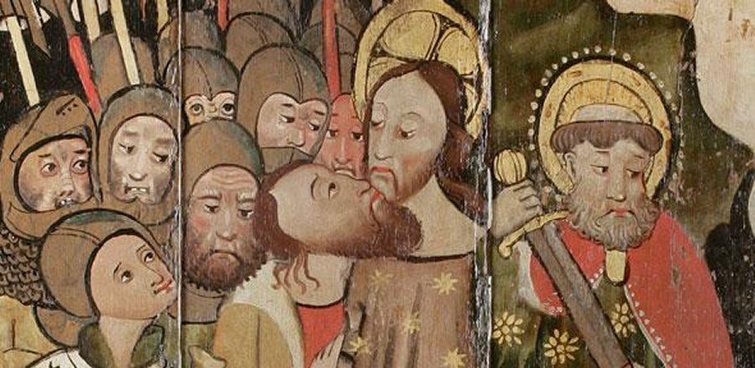
such bad
memes not dank enuf
what a noob
many wow
i cri evry tim
wtf hitler

Slide 16
Operation Sea Lion
Plans for German invasion of the British Isles required air superiority.
Hitler had miscalculated that the British people would lose their resolve and work towards peace.
Hitler had most of his experienced soldiers and fighter squadrons occupied in other areas because of his miscalculation.
On July 2, 1940, Hitler ordered preparations for British invasion.
By July it was obvious that the British would not accept a peace treaty. Operation Sea Lion was prepared for August.
German military unprepared for an amphibious invasion.
German soldiers were unprepared for amphibious landings, and the German navy could not muster enough landing craft or supporting ships for an effective landing.
Air Marshall Hermann Goering believed the Luftwaffe could handle the Royal Navy and Air Force.

Slide 17
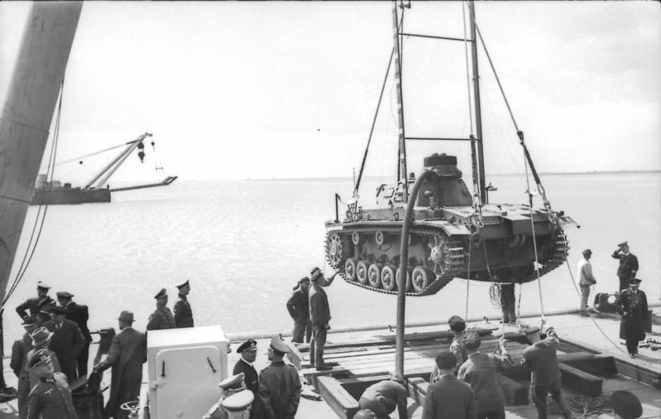
Operation Sea Lion: Planning
Grand Admiral Erich Raeder studied the English Coast in 1939 and concluded that the greatest threat would be the Royal Navy.
No further plans were made until 1940 after France and Norway had already been taken.
Most leaders including Admiral Raeder doubted the invasion would work.
No significant preparations had been made yet and there was a serious lack of landing craft and naval support.
On July 2nd the plan was initiated; the navy began to move to support amphibious operations in the English channel.
Projected for September 15, 1940, the invasion depended completely on German air superiority

Slide 18
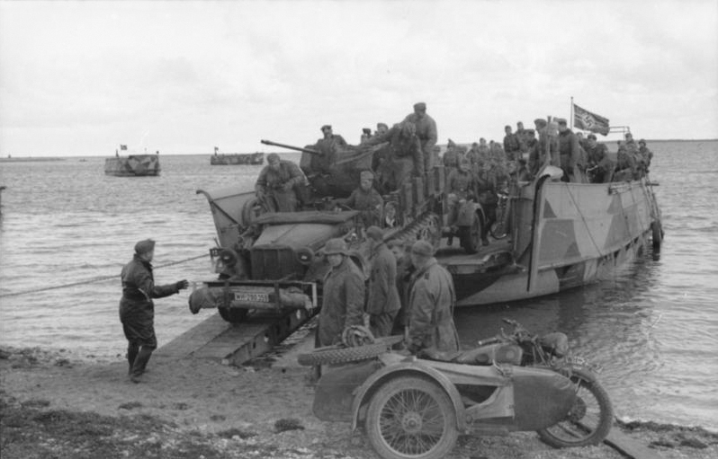
Operation Sea Lion: Planning
Invasion plans called for 13 divisions, with 155 transports and 3,000 smaller craft
Raeder was skeptical of a successful invasion of Britain due to planning difficulties, and considered this operation a last resort
On August 1, 1940, the Luftwaffe was ordered to switch onto the offensive over Southern England.
Bad weather and Hitler’s ill-founded orders prevented German air superiority.
On October 12, the invasion was postponed to the Spring of 1941.
The plan kept being postponed until it eventually never took place

Slide 19
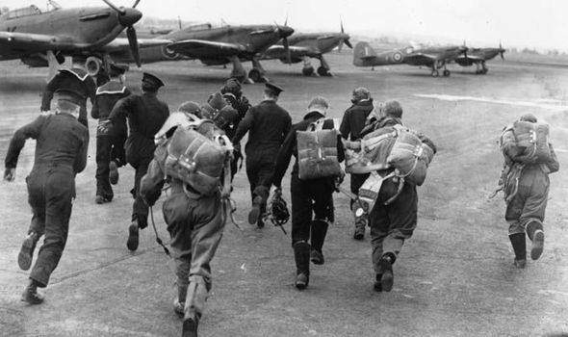
Battle of Britain
July 10: Bombing attacks on shipping lasted until August
German aircraft were targeting convoys and ports (Battle of Britain)
August 13: Main offensive Adlerangriff (Eagle Attack)
Target Air bases, Aircraft factories, radar stations in SE England
1,000 fighter sorties and 485 bombing runs
The British had 600 fighters, and lost13
The German had 1,300 bombers, and lost 45
August 15: Bombing attacks continue
1,266 fighter sorties, 520 bomber runs
Germans lose 75 planes
August 24-September 5: heavy attacks on airbases
Large bomber formations with 100 fighters
Aim for airfields, communications, and control centers
Almost defeat RAF
In total, the Luftwaffe destroy 450 planes killing 103 pilots, wounding 128

Slide 20
Battle: The Blitz (One/Two)
On August 25, German bombers made an error and dropped their payload over central London instead of the strategically more important docks and oil depots.
Churchill ordered a retaliatory strike on Berlin.
In an act of revenge, Hitler ordered the Luftwaffe’s attention to urban areas in London on September 5.
The bombings on strategic locations like military bases, depots, and ports which were much more important and successful were halted.
Military installations across Britain could now regroup, rebuild, and fight for air superiority.

Slide 21
mfw when hitler bombed london

Slide 22
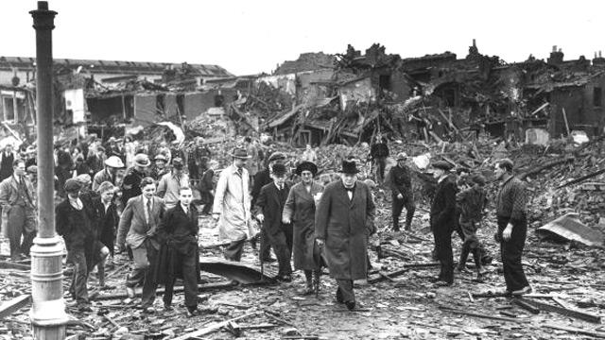
Battle: The Blitz (Two/Two)
Sep. 7, the Luftwaffe conducted a major raid on London’s East End
1000 people killed
Main target through Blitz was London
Up to 538 tons of bombs would fall in one day
London had few bunkers, so residents stayed in Liverpool Street Station
Blitz continued after Battle of Britain ended
Bunks were not built until Blitz was near to ending

Slide 23
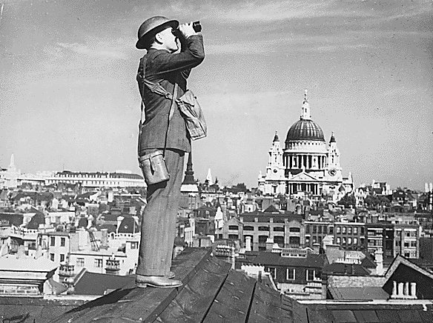
Battle: The End
September 15-20: 56 German planes destroyed
German invasion plans stalled
Resorted to bombing large cities
September 30: last day of attacks
In total, 1,389 German aircraft destroyed and 792 British aircraft destroyed.
Resulted in Winston Churchill’s “Finest Hour” speech honoring Fighter Command

Slide 24
Impact of the Battle of Britain and Operation Sea Lion
Hitler's mistake of bombing London instead of other strategic locations resulted in the British taking air superiority.
After the British success of the Battle of Britain, the allies were able to take the offensive in Russia, Italy, and eventually France.
British success in defending itself later resulted in the placing of troops and equipment for Operation Overlord in Britain
The organisation of Operation Sea Lion resulted in a waste of German resources.
The final result was the Normandy landings on June 6, 1944, and the unconditional surrender of Hitler’s Reich.

Slide 25
Timeline
July 2, 1940: Hitler orders Invasion Plan
October 12: postponed invasion date, then postponed indefinitely
July 10: Begin air attacks on British shipping
August 13: main offensive
September 5: switch to attacks on London (Blitz)
September 15: original projection for Operation Sea Lion
August 1st: Luftwaffe ordered to attack Britain
August 24: attacks on airbases begin
September 30, 1940: last day of battle

Slide 26
Sources Cited
“Battle of Britain.” Britannica School. Encyclopædia Britannica, Inc., 2016. Web.20 Apr. 2016.
Biesinger, Joseph A. “Battle of Britain.” Germany. Facts On File, 2006. History Research Center. Web. 20 Apr. 2016.
Bird, Keith W. “Operation SEA LION: World War II.” World at War: Understanding Conflict and Society. ABC-CLIO, 2016. Web. 20 Apr. 2016
van Hartesveldt, Fred R., and Tucker, Spencer C. “The Blitz: World War II.” World at War: Understanding Conflict and Society. ABC-CLIO, 2016. Web. 20 Apr. 2016.
Baxter, Colin F. "Operation OVERLORD: World War II." World at War: Understanding Conflict and Society. ABC-CLIO, 2016. Web. 26 Apr. 2016.
"20th-century international relations." Britannica School. Encyclopædia Britannica, Inc., 2016. Web. 26 Apr. 2016.

Slide 27
KAHOOT
https://play.kahoot.it/#/?quizId=b2538d0f-88d9-493c-bb20-75bfb747481f

