Slide 1
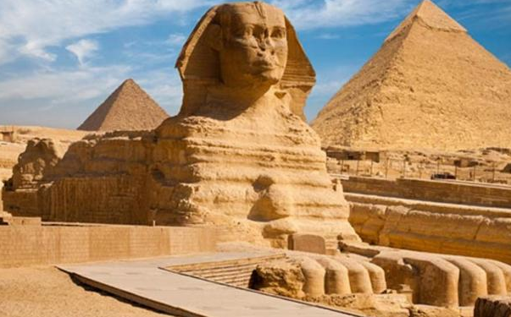
Journal Entry 11/3/17
NOTE – THIS IS A NEW JOURNAL SHEET
Why do we study ancient civilizations?

Slide 2
Daily Agenda Friday 11/3/17
Agenda:
Introduce unit
Emergence of humans & Neolithic Revolution
Establishment of ancient civilizations
Introduce Egypt/Mesopotamia Jigsaw Assignment
Key Terms:
Anthropology
Archeology
Nomad
Animism
Fertile Crescent
Skills:
Large/small group discussion
Analysis of content

Slide 3
Ancient Civilizations & Abrahamic Religions
Course
Introduce ancient civilizations: 2-3 Days
Egypt and Mesopotamia Jigsaw
Abrahamic Religions: About 2 Weeks
Judaism
Christianity
Islam
Purpose
Ancient civilizations
Case study in general structure and life of ancient civilizations
Abrahamic Religions
Understand the basic tenets of Judaism, Christianity, and Islam
Understand how all three of the Abrahamic Religions are interconnected
Understand basic impacts of these religions on the lives of the people who practice these religions
Unit Assessment
Small quiz (20-35 questions) at the end of the unit
Alternative group assessment for Monotheistic religions (more on this later)

Slide 4
Understanding Dates
B.C. or B.C.E
Essentially mean the same things
B.C. – Before Christ
B.C.E. – Before Common Era
This is a recent change over from B.C.
A.D. or C.E.
Also essentially mean the same things
A.D. – Anno Domini (in the year of our lord)
Also known as After Death
C.E. – Common Era
All are based designed around the Julian or Gregorian Calendars (the calendar we follow)

Slide 5
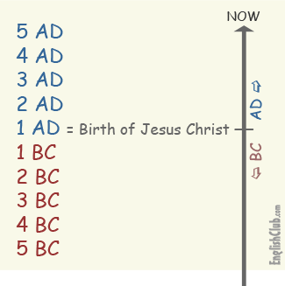

Slide 6
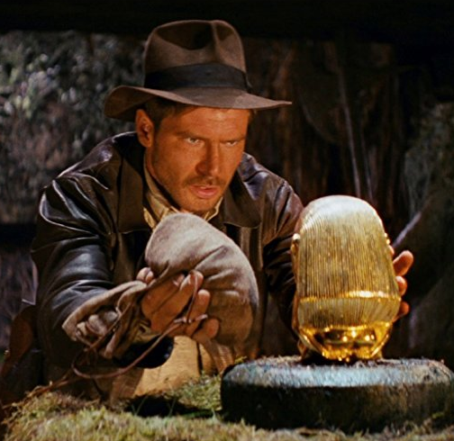
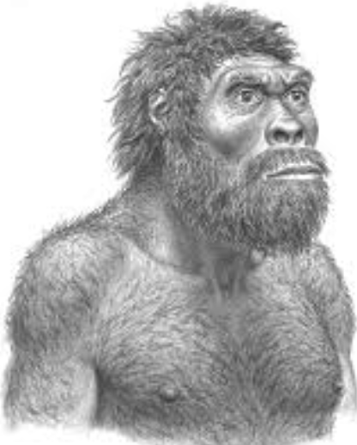
Emergence of Humans
Anthropologists vs Archaeologists
Anthropology: The study of various aspects of human history started about 150 years ago
Archeology: Sub group of anthropologists that focus on the study of past people and cultures through their material remains
Mary and Louis Leakey
Found remnants of early Hominids in the bottom of the Olduvai Gorge in Tanzania in the 1930s
Bottom of the gorge is 1.7-2.1 million years old
Found tools & skulls

Slide 7
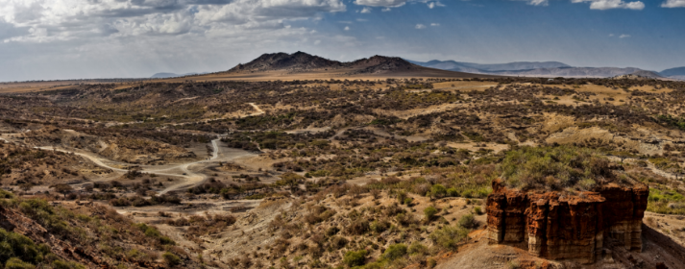
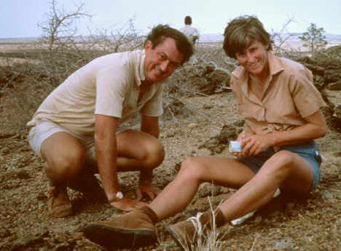
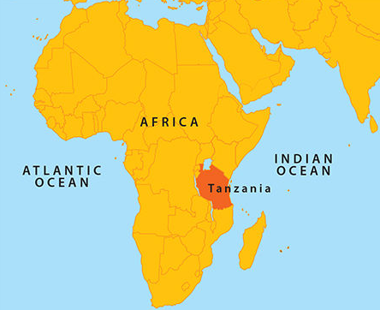
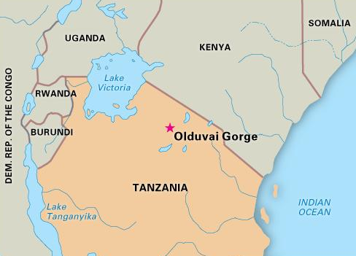

Slide 8
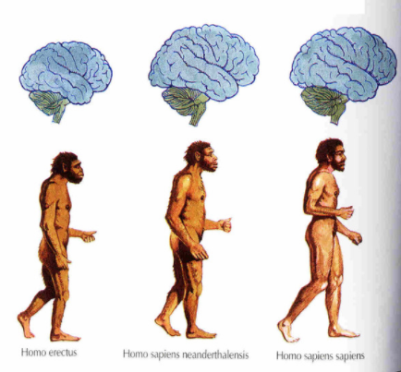
Emergence of Humans
First Homo Sapiens emerged around 100,000-250,000 years ago
According to scientific study Homo Sapiens emerged either in Africa or in various locations around the world (its an argument) from Homo Erectus
Around 50,000-30,000 years ago Neanderthals disappeared and modern humans were the only hominids on earth

Slide 9
Emergence of Humans – Neolithic Rev.
Neolithic Revolution: The transition from a nomadic lifestyle to sedentary lifestyle
Nomad: Group of people (20-30) that moved around who hunted and gathered for survival
Starts around 10,000 B.C. with the end of the Paleolithic Period
Neo. Rev. stated with the domestication of plants and animals
Domesticate - Raise them in a controlled way that makes them best suited for human use
Dog was first about 15K years ago
8,000 B.C.-6,000 B.C. goats, sheep, pigs, cattle, llamas, & alpacas
10,000 B.C.-6,000 B.C. yams, rice, squash, barley, chickpeas, peas, lentils, & wheat

Slide 10
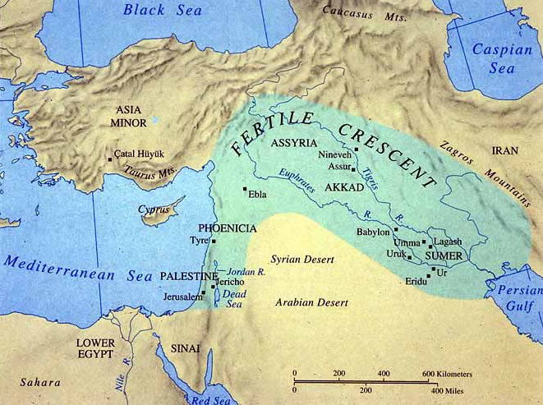
Emergence of Humans – Neolithic Rev.
After domestication of plants/animals villages were established
Occurs in an area called the Fertile Crescent
Catalhuyuk (Turkey) about 7,000 B.C.
Jericho (Israel) about 10,000 B.C.
Both had a few thousand people living in them
Early villages developed technology in order to increase crop yields when farming
Early man develops the first religions, probably animism
Spirits and forces that might reside in animals, objects, or dreams

Slide 11
Rise of Civilizations
Use your homework to answer the following questions –
Why is water significant for the first civilizations?
What is a civilization?
What are the eight basic features of a civilization?
Are all of the basic features of a civilization relevant in 2017?
What impact did the environment have on ancient civilizations?
What is cultural diffusion, how did it affect civilizations?
What is a city-state, is it the same as feudalism?

Slide 12
Mesopotamia & Egypt Jigsaw
Find a partner
You will research all of the basic elements of a civilization regarding either Mesopotamia or Egypt (you and your partner work out who is researching which civilization)
Who, what, when, where, impacts, culture
You will write a thesis statement answering the following prompt –
Argue the most significant cultural aspect of your civilization.
You will also need 2-3 pieces of evidence to prove your thesis
You will need to explain why your evidence is proving your thesis
Your previous research should make this pretty easy
In order to do this you can use one of the readings I have posted on my website, and you will need to use the library database (or library books) to find one more source.
You will need to create a MLA works cited for this assignment as well
You need a minimum of two sources for this assignment, but you can use more if you choose, all sources used will need to be included in your works cited
You will compile all of your research in notes
You will present your information to your partner on Tuesday, and then we will debrief the two civilizations as a class
The idea is you are teaching your partner about the civilization, so make sure you are thorough

Slide 13
Research Tips & Info
Use reputable/academic sources (always) this excludes most googled websites – Wikipedia, history.com, ask.com, wikihow, online encyclopedias like Britannica (unless it is found on Ms. Bacon’s website), if you have a question ask me or Ms. Gilpin and we will help guide you
Write down the whole quote, not just a portion
Write down the page number and name of the document/book you got your information from
Do your citation when you are researching, this will save you lots of time later on
Organize by what your are researching (all culture together, all kings/leaders together etc.)
Have a goal in mind when you are researching
Look at more sources than you need
If you need more info look at the Do’s and Don’ts of taking research on my website (resource tab)

Slide 14
Egypt Mesopotamia Jigsaw
Grab your notes and find your partner
We will start with Mesopotamia –
Explain your contextual information
Who, what, when, where, impacts, culture
Make sure you explain what life was like in Mesopotamia
Tell your partner your thesis statement
Defend your thesis statement with your evidence
I will give you about 10 minutes to get through your information, if we need more time I will give it to you
DO NOT MOVE ON TO EGYPT UNTIL I GIVE YOU THE GO AHEAD
We will move on to Egypt –
Explain your contextual information
Who, what, when, where, impacts, culture
Make sure you explain what life was like in Egypt
Tell your partner your thesis statement
Defend your thesis statement with your evidence
I will give you about 10 minutes to get through your information

Slide 15
Egypt Mesopotamia Jigsaw
Once you complete your explanation of Egypt I want you to discuss the following questions
What was the most important thing about the society you researched (this doesn’t have to be cultural like your thesis, it can be anything)
Based on the descriptions of the two civilizations you researched which do you (the two of you) believe was the most successful?
Be able to explain your reasoning

Slide 16
Journal Entry Wednesday 11/8/17
What is the most interesting thing that you learned about the civilization you researched?

Slide 17
Jared Diamond
How did you like the film?
What did you like, what didn’t you like (I’m looking for honest answers)
Who is Jared Diamond?
What question does he want to answer?
Why does J.D. believe specialists are so important?
Why doesn’t J.D. believe that Papua New Guineans didn’t develop technology?
What is the East/West Axis, why does it matter?
What is J.D.’s thesis statement, has he proven it?

Slide 18
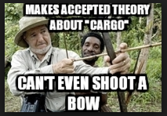
Jared’s Thesis
Do you agree with J.D.’s thesis statement?
Why or why not?

