Slide 1
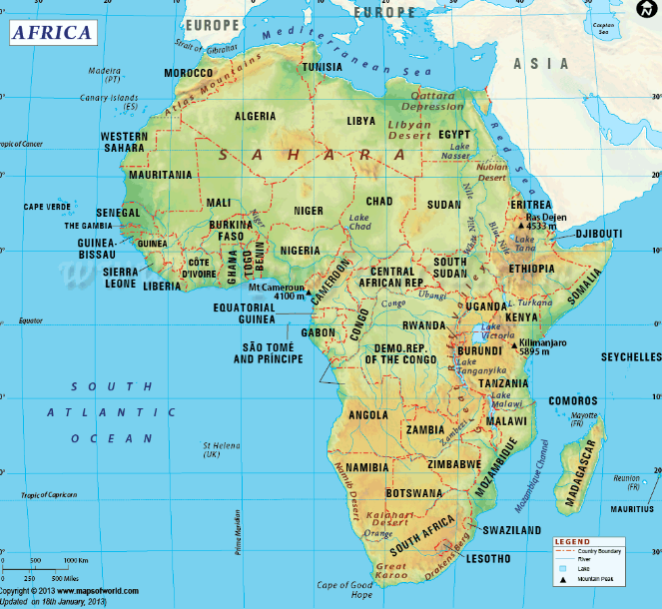
Africa – A Continent, not a country

Slide 2
Africa – Unit Introduction
This unit will consist of the following…
Africa’s geography
Ancient civilizations of West Africa
European expansion into Africa
Modern Africa

Slide 3
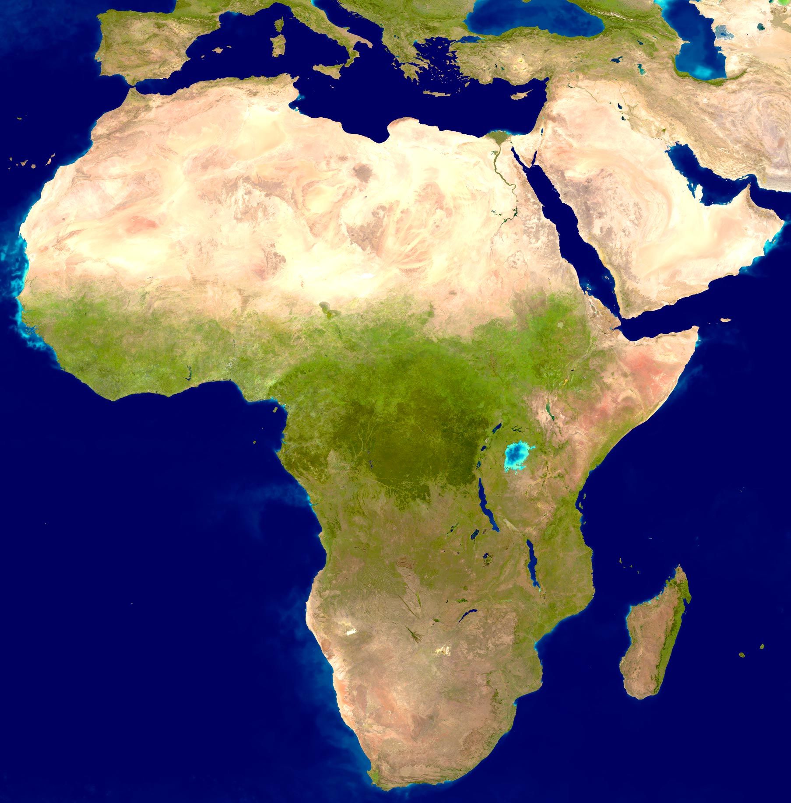
Journal Entry 11/29/17
Why does geography matter?
What can you say about Africa just by looking at it?
How different is Africa’s geography from other places we have studied?

Slide 4
Daily Agenda Thursday 11/29/17
Agenda:
Geography of Africa
Ancient Africa
Key Terms:
Skills:
Large/small group discussion
Analysis of content

Slide 5
Fact or Fiction?
There are 1200 languages spoken in Africa.

Slide 6
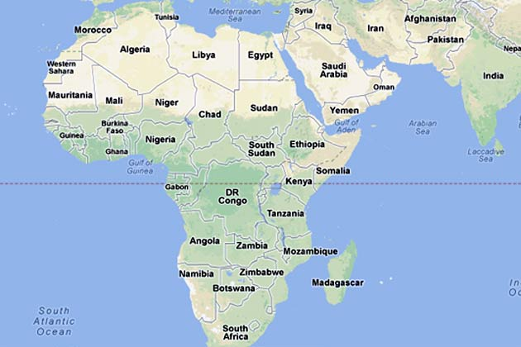
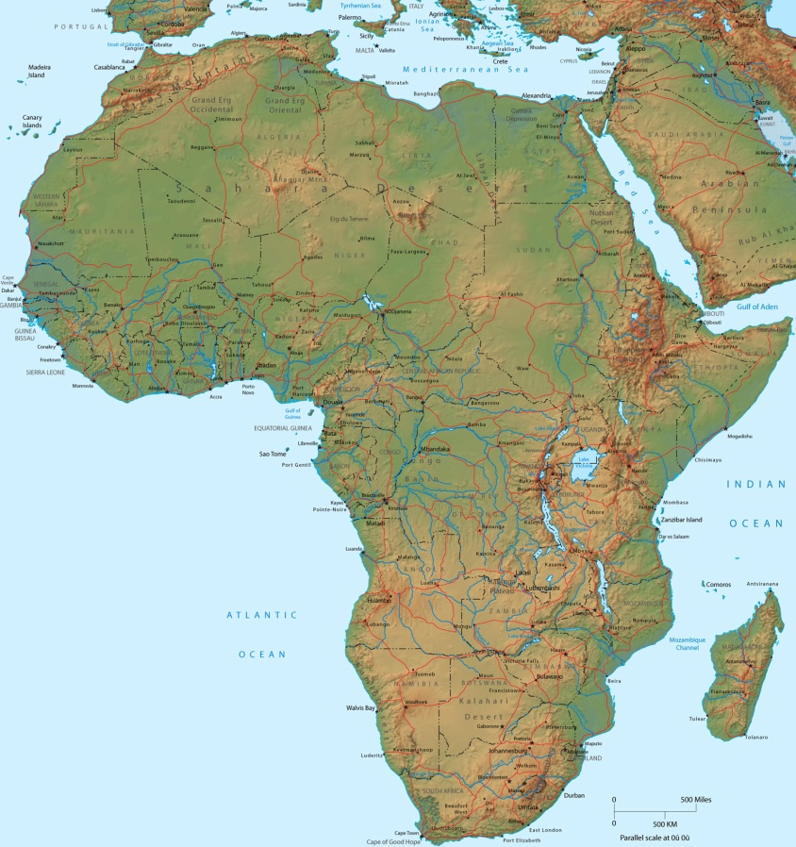
Africa!
Over 1 billion people.
54 countries.
Over 2100 languages!

Slide 7
FACT OR FICTION?
The Continental United States, India, China, Europe, and Japan would ALL fit within the African continent.

Slide 8
FACT
All of those places fit inside of Africa!

Slide 9
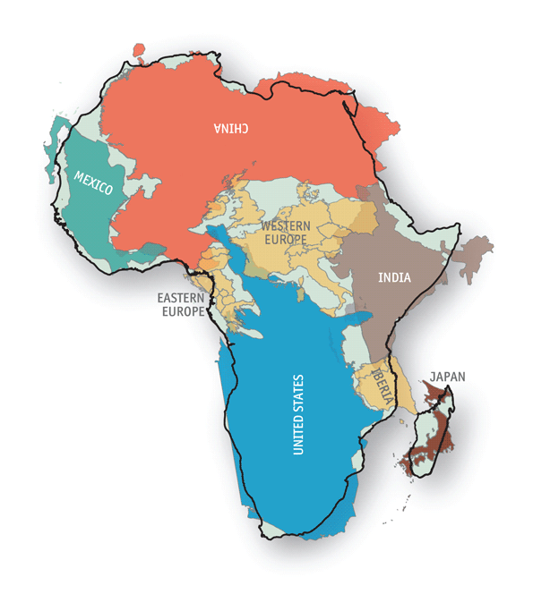

Slide 10
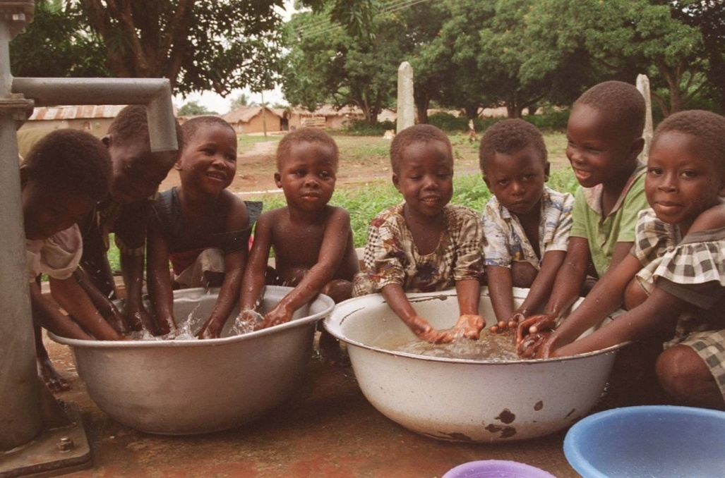
Fact or Fiction
7 out of the world’s 10 poorest countries are in Africa.

Slide 11
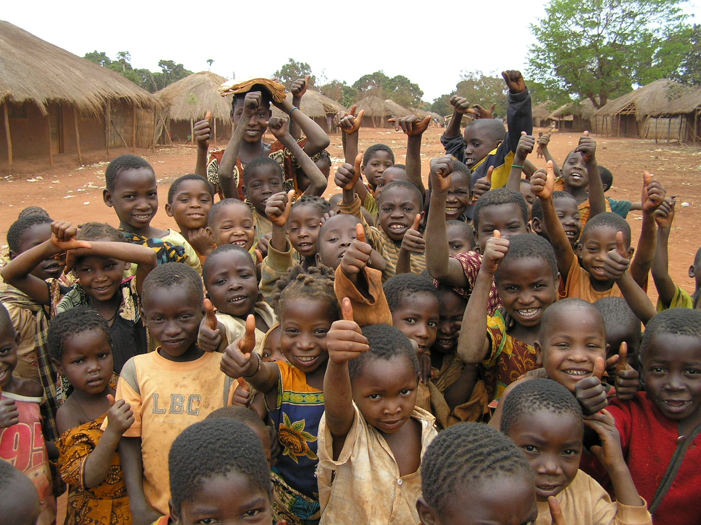
10/10 of the poorest nations in the world are in Africa
Haiti & Kiribati (Oceana) are the only countries on the top 20 that aren’t in Africa
Only 4/25 are non-African countries

Slide 12
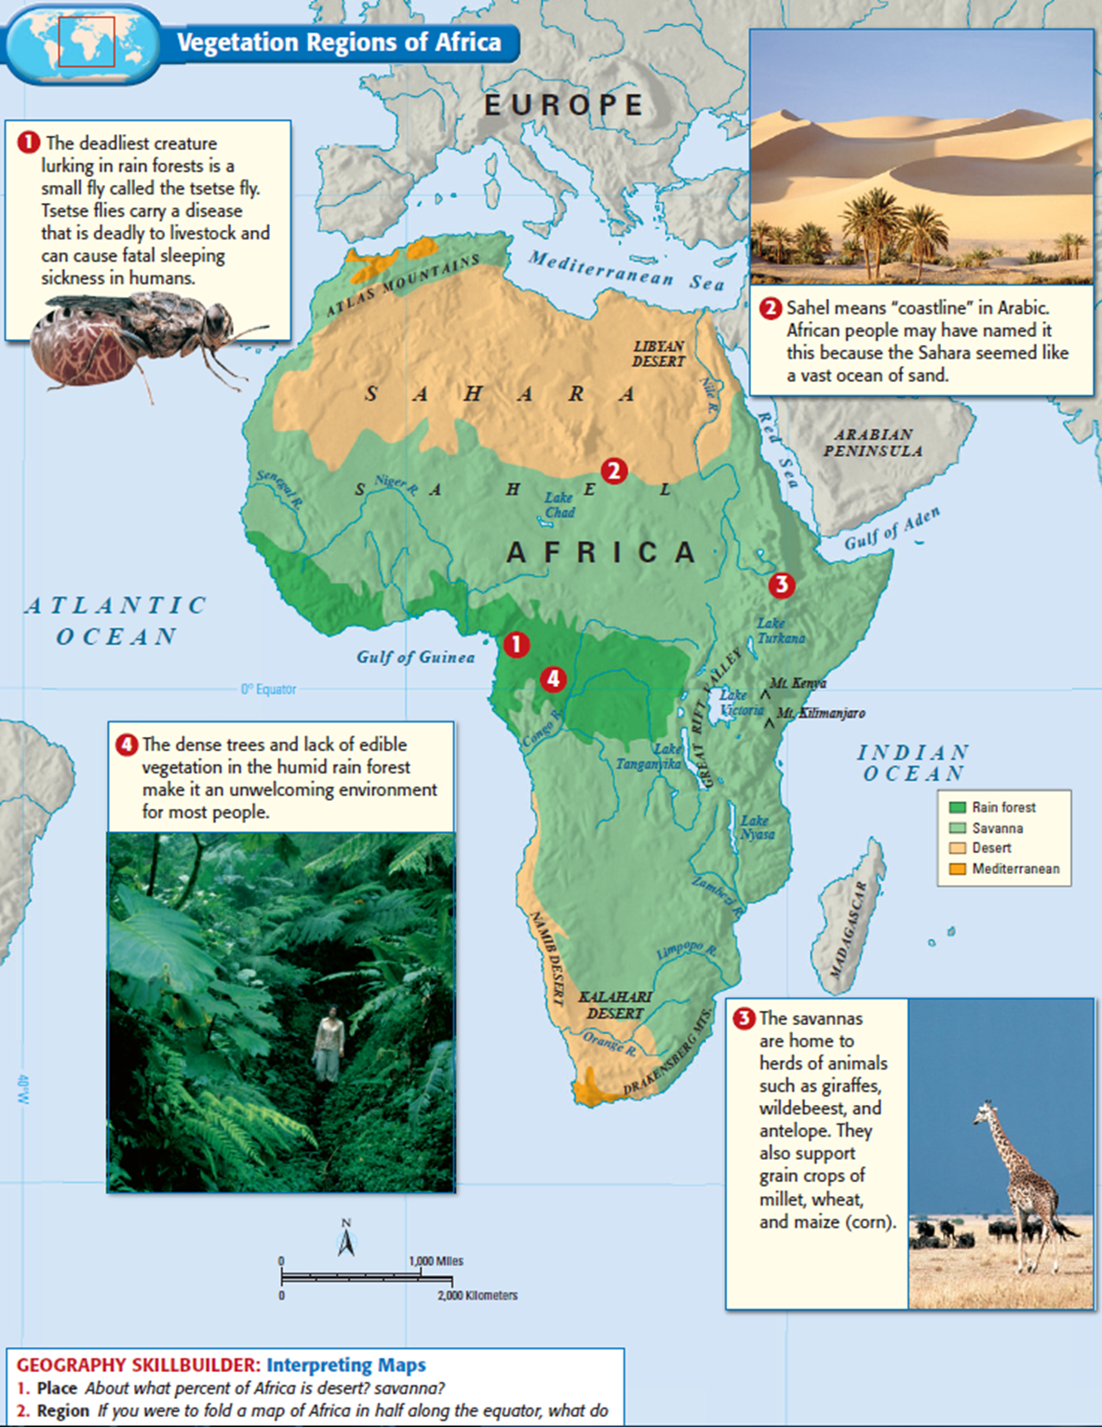
Features of Africa
Sahara Desert
The Sahel
Kalahari Desert
The African Rainforest
Tsetse Flies
Lack of edible vegetation
The Savanna
Mediterranean Climates
Grassy plains
Great agriculture
What problems does this cause?

Slide 13
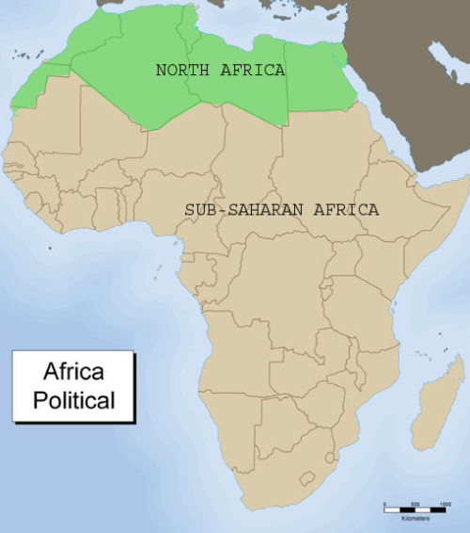
Early African Societies
Sedentary societies first develop South of the Sahara & along the Nile
Religion develops: Generally monotheistic
Animism: A religion in which spirits play an important role in regulating daily life and are presents in plants/animals/nature
Written languages are rare, stories passed orally
Griots: African storytellers
What are the advantages of this? What are the disadvantages?

Slide 14
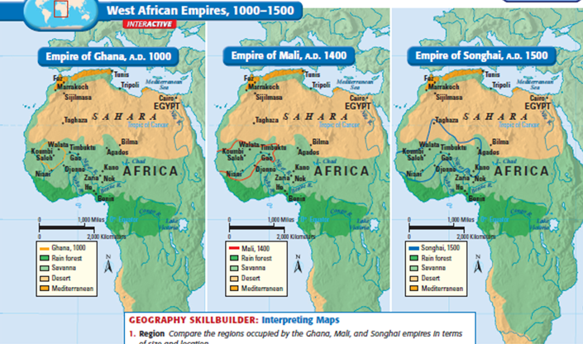
West African Civilizations
3 Empires emerge by dominating trade across the Sahara
- Empire of Ghana
- Empire of Mali
- Empire of Songhai

Slide 15
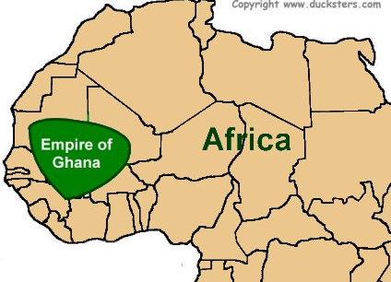
West African Civilizations - Ghana
Why is salt important for survival?
What impact does salt have on the kingdoms of West Africa?
What similarities does Ghana have to Mesopotamia?

Slide 16
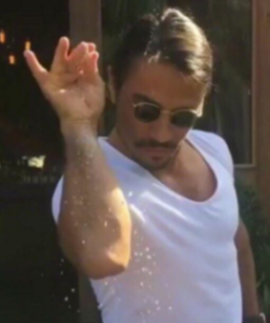
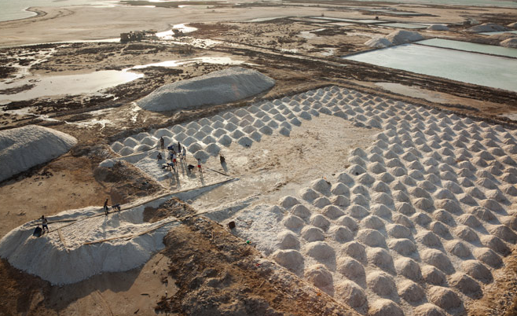
Journal Entry 11/30/17
What impact does salt have on the kingdoms of West Africa?

Slide 17
Daily Agenda Thursday 11/29/17
Agenda:
Ghana, Mali, Songhai
Key Terms:
Skills:
Large/small group discussion
Analysis of content
Argument recognition

Slide 18
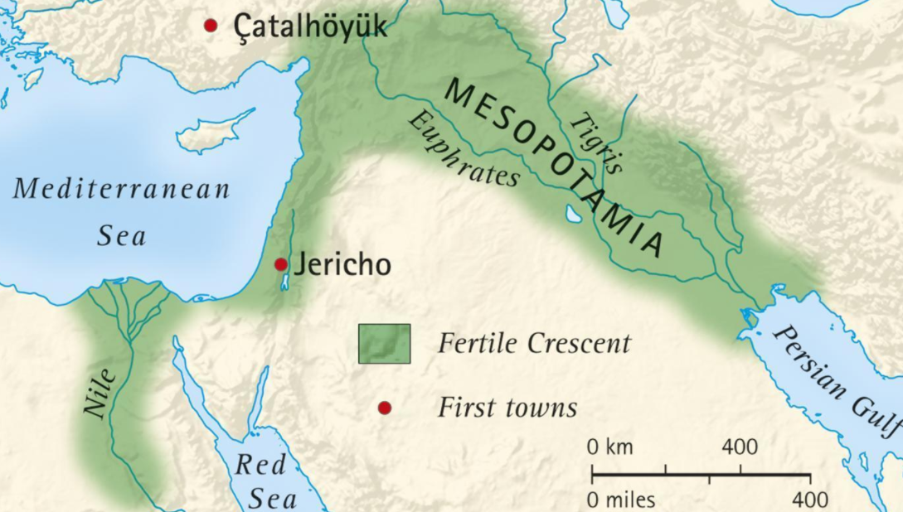
West African Civilizations - Ghana
What similarities does Ghana have to Mesopotamia?

Slide 19
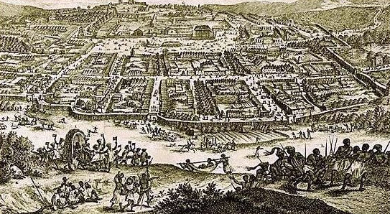
West Africa Civilizations - Ghana
How important was the king to the kingdom of Ghana?
King controlled all of the gold, and levied taxes on the peoples of the kingdom.
Ghana king acted as religious leader, judge, and military commander
What was the capital of Ghana?
Kumbi Saleh
Was a major trading center

Slide 20
West Africa Civilizations - Ghana
Explain the impacts of Islam on the kingdom of Ghana?
Islam was spread to N. Africa through warfare, and to S. of the Sahara through merchants
Kings of Ghana accepted Islam as religion, many peoples living in the kingdom stuck to animism
Overall the kingdom was weakened by the presence of Muslim rulers, as they disrupted the gold-salt trade

Slide 21
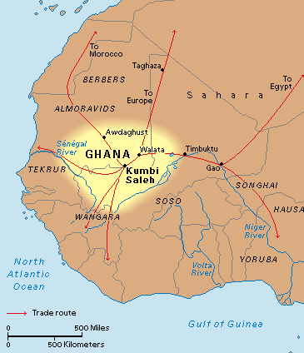

Slide 22
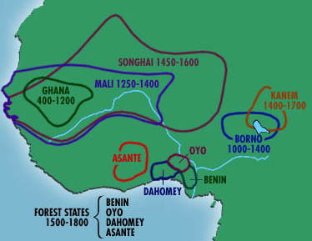
West Africa Civilizations - Mali
How was the Mali kingdom able to gain power and wealth?
Kingdom was able to gain power/wealth because they filled the trading void left from the kingdom of Ghana

Slide 23
West African Civilization - Mali
Who were two powerful leaders in Mali?
Sundiata and Mansa Musa.
Sundiata first major leader of Mali, got rid of poor leaders, expanded the empire, and put a legitimate government in place to rule the empire.

Slide 24
Western Africa - Mansa Musa
Mansa Musa was a Muslim leader from about 1312-1332
Expanded the empire
Had a massive army he used to control and protect the Mali
Successfully divided up the empire and put governors in place to help him rule
Makes Timbuktu an important trading center
Maybe the richest person of all time, it is estimated he would be worth over 400 billion dollars
Why would he have been this rich?

Slide 25
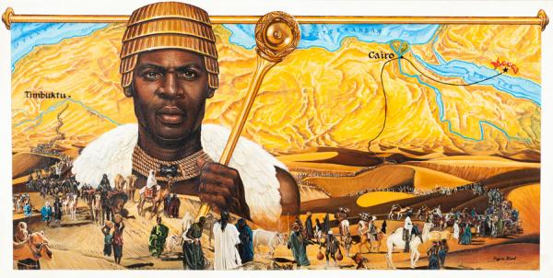

Slide 26
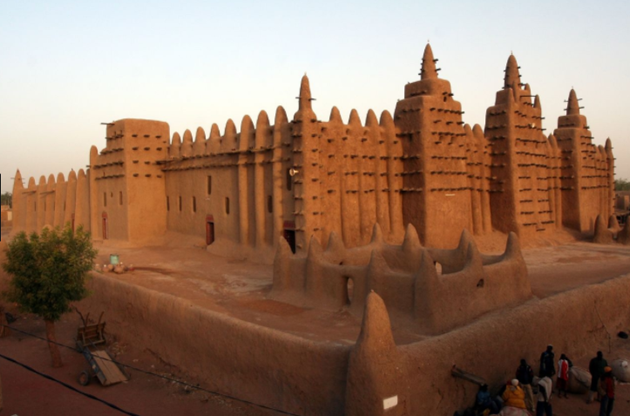
Djinguereber Mosque – Built 1327
Phonetically – Jing-gurb-er
Built during Mansa Musa’s reign

Slide 27
West African Civilization – Mali Downfall
Predict the eventually downfall of the Mali empire?
The death of Mansa Musa led to a series of poor leaders, none of which could govern the empire well.
Left a power gap for other civilizations to fill
Other gold fields were found and the spotlight of power moved to other locations in Africa.

Slide 28
West Africa Civilization - Songhai
How was the Songhai empire able to rise to power, what did they control that allowed them to continue to have power?
They broke away and expanded the territory that the Mali had.
They were able to control all important trade routes through that region of W. Africa

Slide 29
West Africa Civilization - Songhai

Slide 30
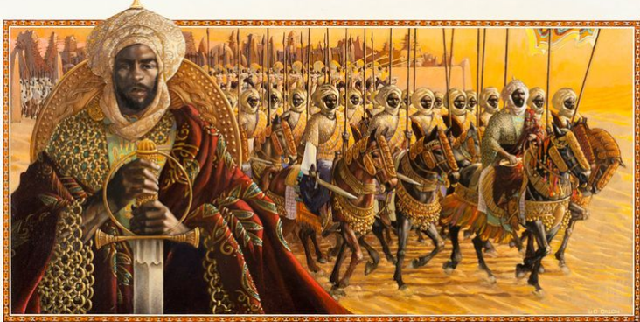
West Africa Civilization - Songhai
How do you think Sonni Ali was able to expand the Songhai empire?
He was able to build a strong army and conquer neighboring cities like Timbuktu and Djenne.
He used technology like war canoes and a fleet of soldiers on horseback

Slide 31
West Africa Civilization - Songhai
What did Askia Muhammad do to expand Songhai?
Set up efficient tax system, created a centralized government, and put officials in place to help him rule
What caused the Songhai empire to fall?
Gunpowder, used by the Moroccans to defeat the empire.

Slide 32
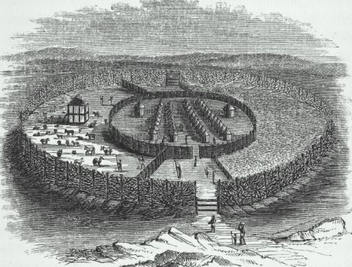
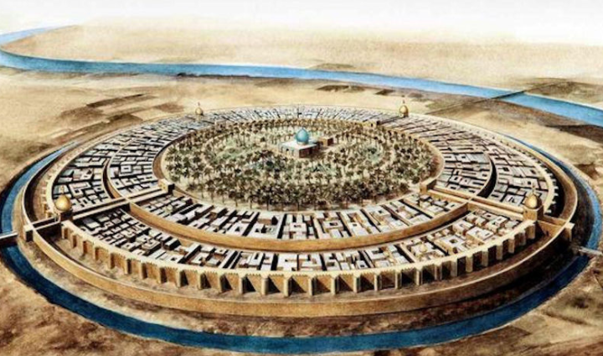
West Africa Civilization – Other Empires
In your groups summarize the kingdoms of the Hausa, and Benin

Slide 33
West Africa Arguments
Prompt: Who was the most successful ruler of early African civilizations?
Mansa Musa, the most successful ruler of early West African civilizations, was able to maintain control through his use of both hard and soft power.
What is the how, what, and so what of this thesis?
What – Mansa Musa
How – was able to maintain control through his use of both hard and soft power
So what – the most successful ruler of early West African Civilizations
Using your notes and the text book create two body thesis statements that will support this thesis

Slide 34
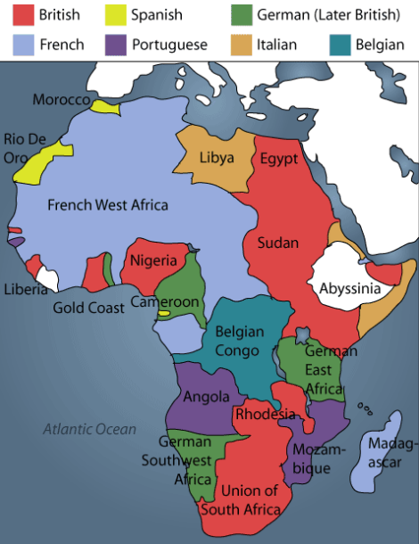
Journal Entry
Answer both questions…
Do you think that the ancient empires and civilizations of Africa were thriving or struggling?
Predict how/why Europeans were able to imperialize Africa

Slide 35
Daily Agenda Thursday 11/29/17
Agenda:
Transition from Ancient Africa to Imperialized Africa
Start Slavery & European influence on Africa
Transatlantic Trade
Mercantilism
Columbian Exchange
Key Terms:
Transatlantic Trade
Mercantilism
Columbian Exchange
Skills:
Large/small group discussion
Analysis of content

Slide 36
West Africa Civilization
What are some common themes amongst these WAC?
Why wouldn’t Europeans be able to just stroll right into Africa and conquer the continent?
Strong empires
Geography
Disease
How did Europeans respond?

Slide 37
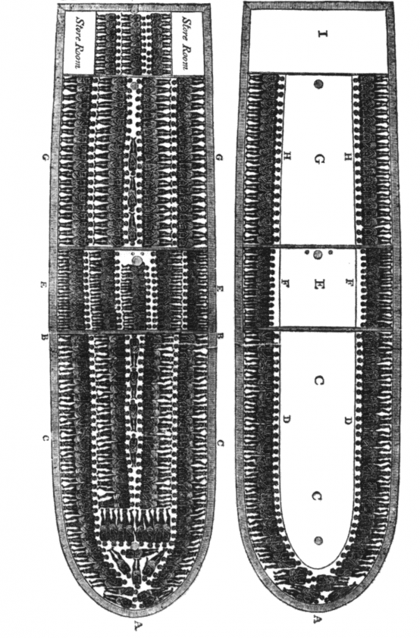
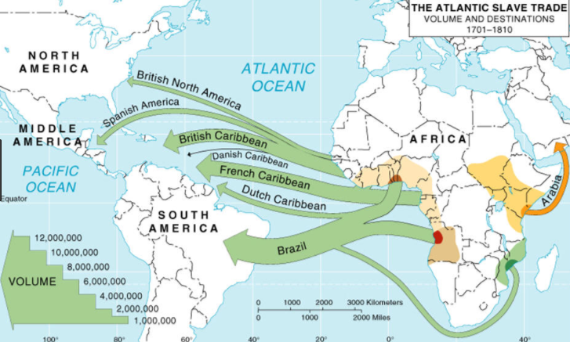
Journal Entry 12/18/17
What do you remember about the African Slave Trade?

Slide 38
Slavery Research Instructions
Read each of the articles found on my website (one of them is from the textbook, so if you want to use the text in class that is OK too)
You should have two answers per question. One from each reading
Your answers should be compete sentences and complete thoughts.
Answer the following questions for each article
What motives did Europeans have for exploration?
What technology did the explorers have, why were they able to explore now and they weren’t before?
What are the origins of the slave trade?
Make sure you include the impact of both Europeans and Africans
How did the slave trade operate?
What is the impact of the slave trade on Africa?
Once you have completed the questions above complete the following questions…
What were the similarities between the two articles?
What were the differences between the two articles?
Which article has better information?

Slide 39
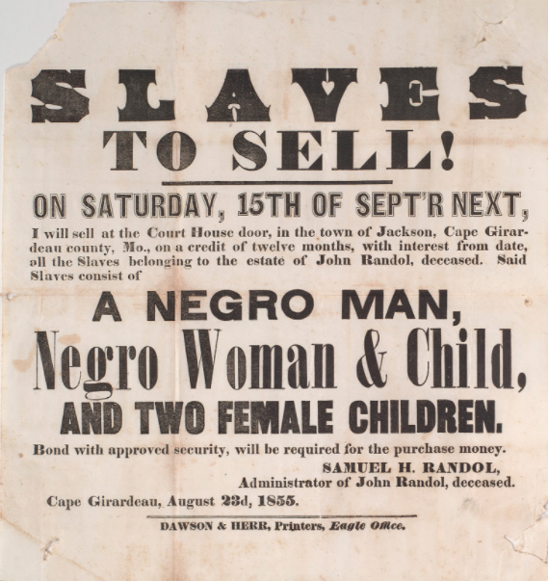
Journal Entry 12/19/17
Argue the greatest impact of slavery on Africa.

Slide 40
Daily Agenda Thursday 12/19/17
Agenda:
Slavery
Key Terms:
None
Skills:
Large/small group discussion
Analysis of content
Argument recognition

Slide 41
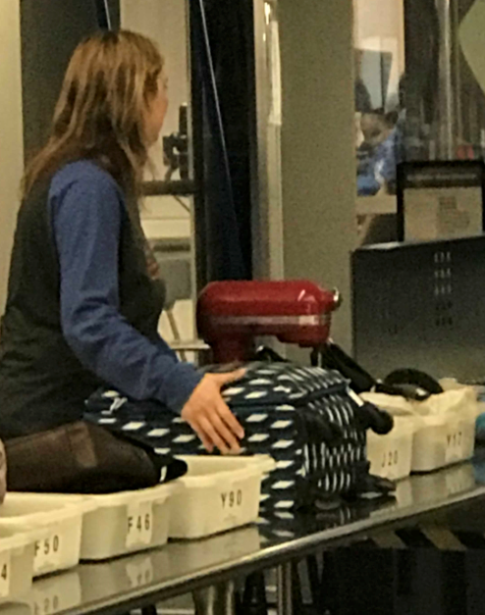
Journal Entry 1/2/18
Answer both questions…
What was the best part about break?
Argue the importance of breaks from school/work.

Slide 42
Daily Agenda Thursday 1/2/18
Agenda:
Review slavery
Scramble for Africa
Key Terms:
None
Skills:
Large/small group discussion
Analysis of content
Argument recognition

Slide 43
Slavery Research Questions
Lets warm ourselves back up with some basic questions from your homework/reading from the week before break.
Use the readings from 12/18/17 to answer the following questions, this should be review since we discussed some of these already
What motives did Europeans have for exploration?
What technology did the explorers have, why were they able to explore now and they weren’t before?
What are the origins of the slave trade?
Make sure you include the impact of both Europeans and Africans
How did the slave trade operate?
What is the impact of the slave trade on Africa?
Once you have completed the questions above complete the following questions…
What were the similarities between the two articles?
What were the differences between the two articles?
Which article has better information?

Slide 44
African’s Lose Power…
Based on what you know from your reading (Tuesday 12/19) define what the term “Scramble for Africa” means
Quickly review the reading the in your table groups…

Slide 45
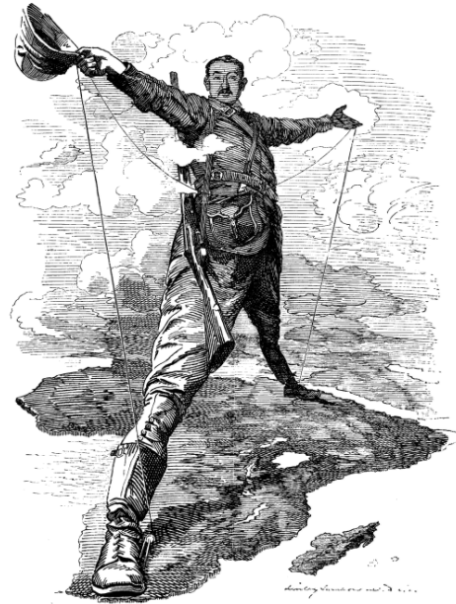
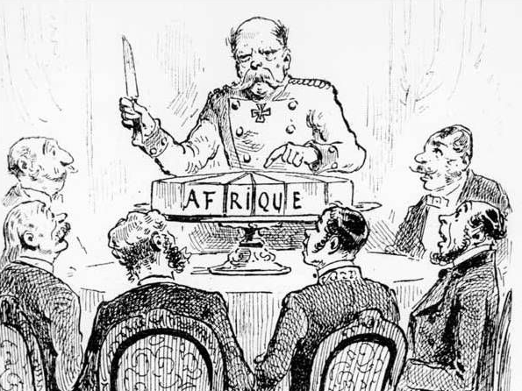
Journal Entry 1/3/18
Define the term imperialism.

Slide 46
Connecting the Dots – Slavery to the Scramble
Africans now have the following things working in their favor to keep Europe from completely colonizing them
Angry people because of slavery
Guns because Europeans traded with them
Diseases that Europeans do not have natural immunities for
Malaria
Challenging terrain to navigate (that they aren’t familiar with)
How might Europeans might be able to colonize Africa?
More importantly why might Europeans want to colonize Africa?

Slide 47
Connecting the Dots – Slavery to the Scramble
First step towards colonizing Africa – Industrial Revolution
The IR – What it does
New type of revolution changes the way people live and work
Mostly refers to how machines helped people do their jobs faster
Huge impact on society→ more so than political revolutions
Historians claim three IRs:
Britain
Rest of Europe, US, Canada, Japan
Rest of the world (still going on today)
Social scientists claim three different phases:
Farming, textiles, early factories & transportation
New inventions in weapons, sanitation, mass production and culture
Technological revolution (still going on today)

Slide 48
Connecting the Dots – Slavery to the Scramble
What do Europeans get out of the IR that allow them to dominate Africa?
Steam, steel, weapons, and medicine
They get better guns
Better tools/technology
Better medicine (for the germs)

Slide 49
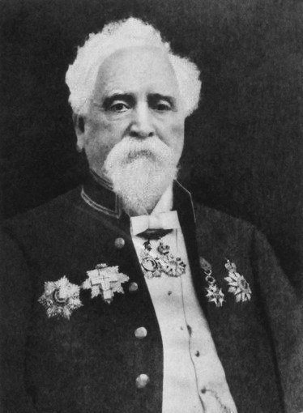
Challenge: Technology
African Nations have guns, and ferocious warriors
Solution - 1881: Hiram Maxim visits Paris Electrical Exhibition
Told "If you wanted to make a lot of money, invent something that will enable these Europeans to cut each other's throats with greater facility."

Slide 50
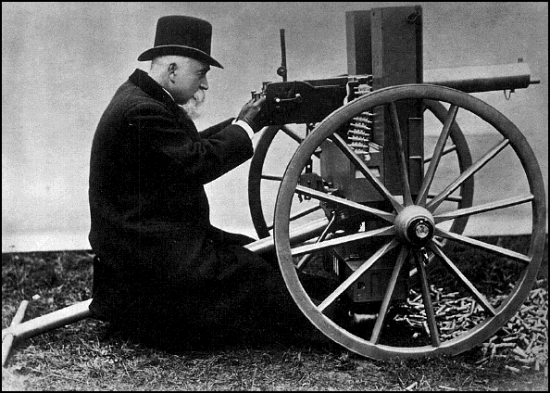
The Maxim Gun Invented in 1884 500 bullets per minute (as many as 100 riflemen)

Slide 51
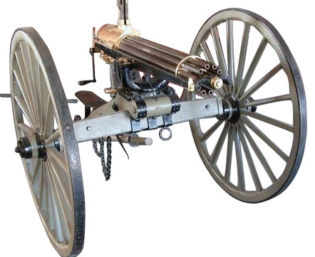
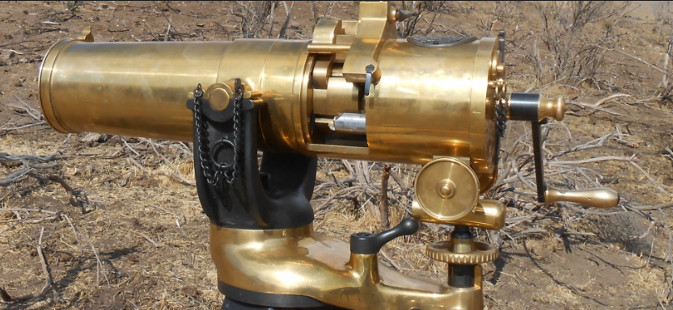

Slide 52
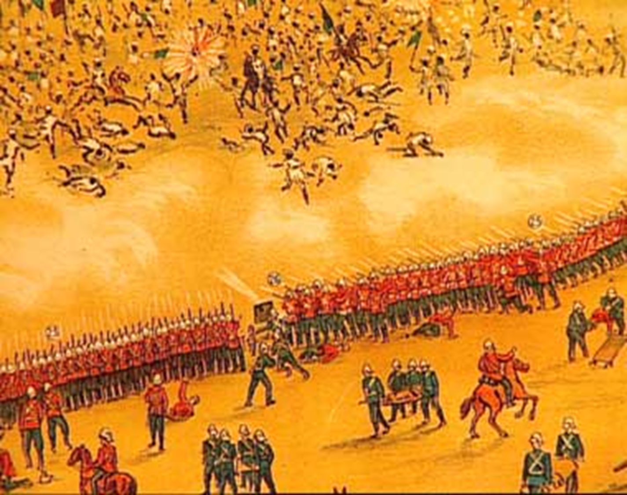

Slide 53
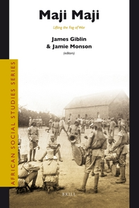
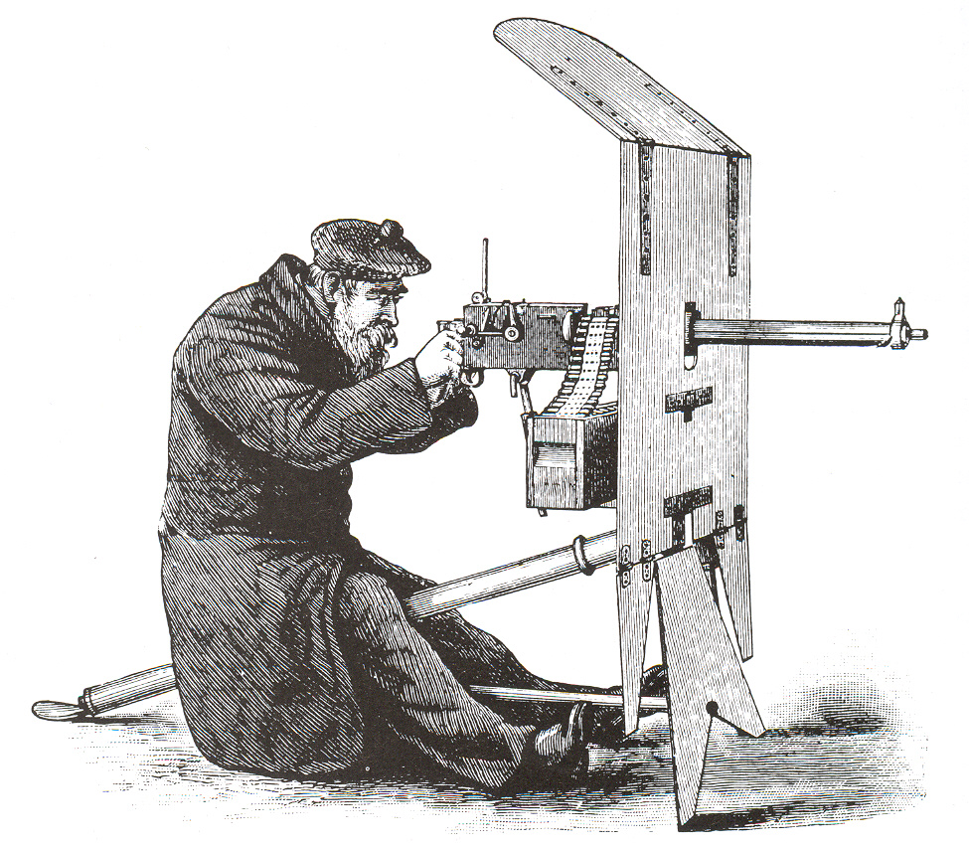
Maji Maji Rebellion
1905: German East Africa
15 Europeans killed
10,000 Africans killed

Slide 54
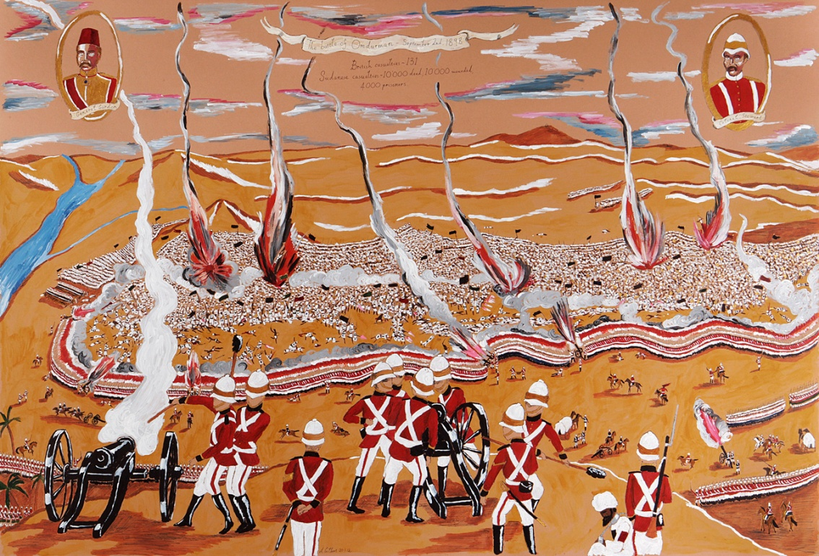
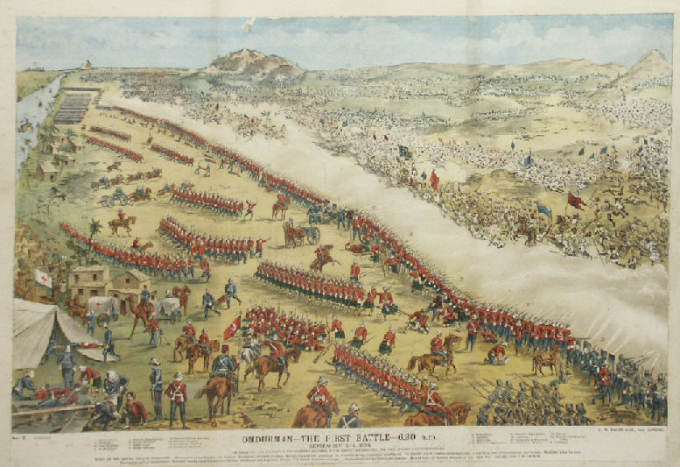
The Battle of Omdurman: 1898, Sudan
8,000 British troops
52,000 Sudanese Troops
47 British soldiers killed
10,000+ Sudanese Killed

Slide 55
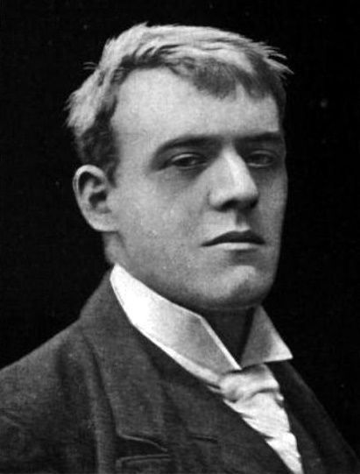
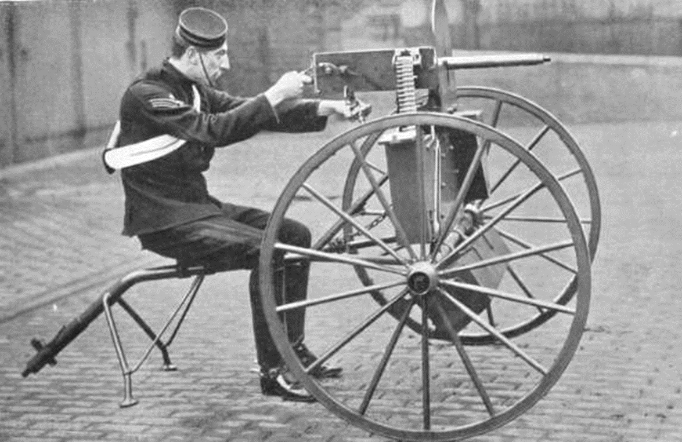
“Whatever happens, we have got
The Maxim Gun, and they have not”
-French Poet Hilaire Beloc

Slide 56
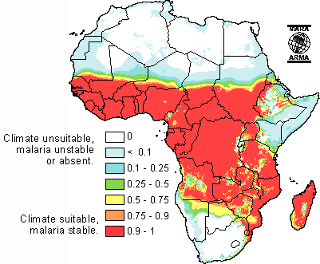
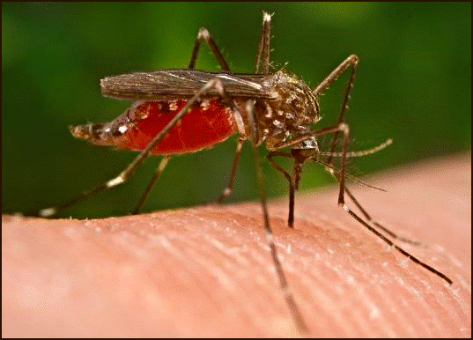
Challenge: Disease
Malaria: Deadly disease spread by mosquitoes in hot/tropical areas
1700s: Death rate for European explorers in Africa is 50%

Slide 57
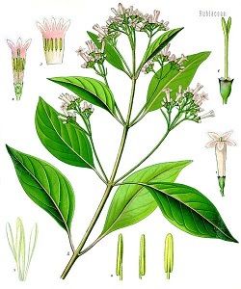
Solution!
Quinine!
Found in the bark of the cinchona tree
Native to Peru and Bolivia
Treats malaria!

Slide 58
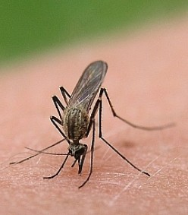
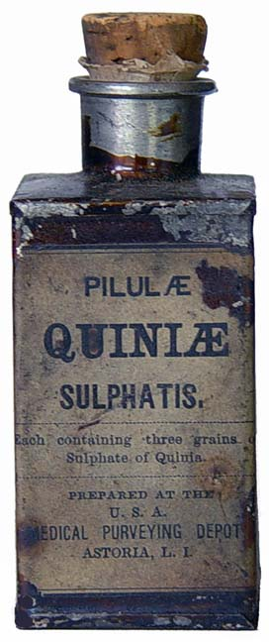
Quinine 1829

Slide 59
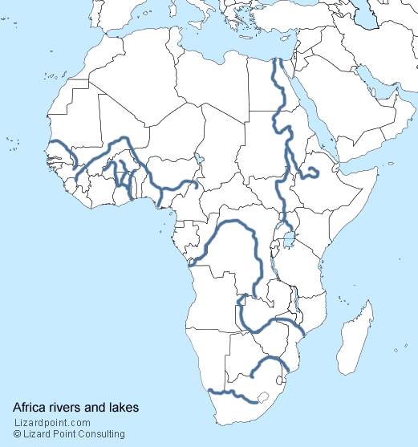
Challenge: Transportation
Africa has rivers
But they flow towards the sea…
This makes Europeans sad.

Slide 60
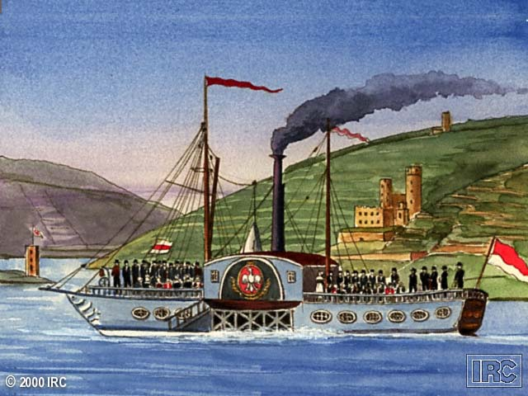
Solution!
Early 1800s: Steam Boats!

Slide 61
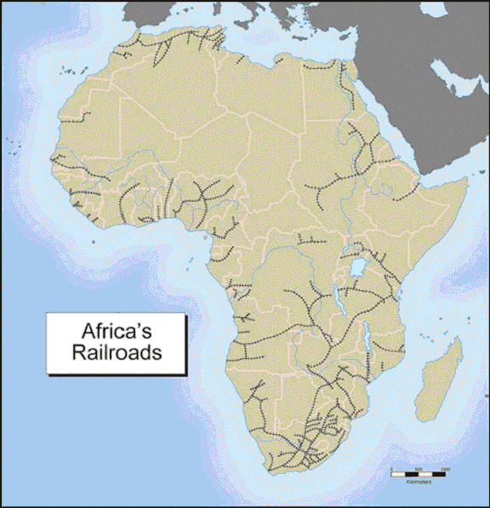
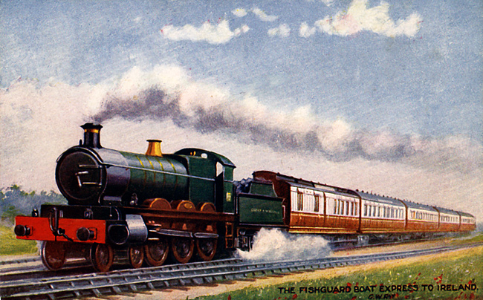
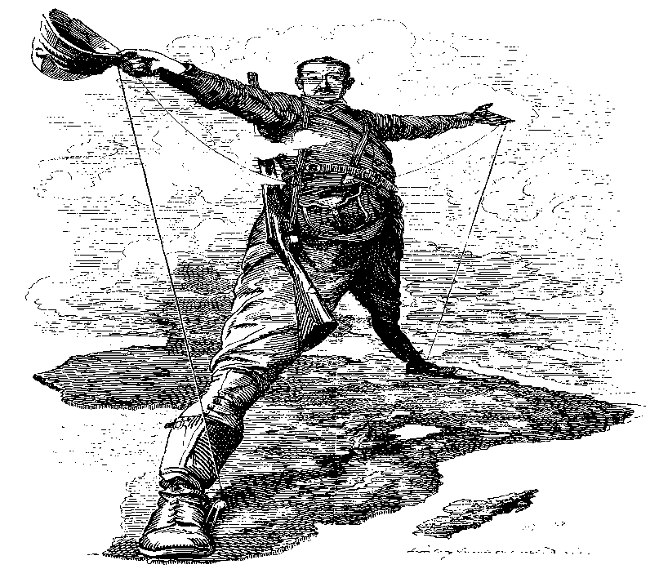
Railroads Early 1800s

Slide 62
Colonization/Imperialism of Africa
All of the factors in the previous slides led Europe to have the strength to imperialize Africa
Using your knowledge what did Europeans want in Africa?

Slide 63
Colonization/imperialism of Africa
What they want…
God, Glory, Gold, or Adventure, Mystery, Excitement?
“Dr. Livingstone, I presume?”
Scottish
Celebrity explorer/missionary
Looking for source of the Nile
Claims that Europeans have a duty to bring “3 Cs” to Africa
Christianity
Commerce
Civilization

Slide 64
Journal Entry 1/4/18
What is economic imperialism?

Slide 65
Colonization/imperialism of Africa
What Europeans want…
Rubber
King Leopold II
The Belgian Congo
The Capital is Leopoldville.
Exploited Congo for Rubber, stated they were there for the 3 C’s
80 times larger than Belgium!

Slide 67
Colonization/imperialism of Africa
What they want…
Minerals
Diamonds & Gold
Discovered in S. Africa 1860s-1880s
Sparked wars (we will get to the Boer War)
Copper and Tin
All mined from Africa from various locations

Slide 69
Cecil Rhodes & Colonization
British business man & African imperialist
Responsible for multiple pieces that contributed in the scramble for Africa
Mined huge amounts of ore in South Africa
Responsible for the South African Colony
Huge proponent of imperialism
Played a major role in the attempted development of the Cape to Cairo railway
Founded the De Beers diamond company
Had (and still has) a complete monopoly over diamonds
He is literally responsible for the price of diamonds (to a certain extent) in 2018

Slide 70
Cecil Rhodes - Cape to Cairo
Major proponent in the development of the Cape to Cairo Railway
Railway would have ran from Cape Town to Cairo, connecting the British Empire across Africa
Proposed in 1874
Started to be build in the 1890s
Never fully completed, there are still pieces that are under construction, or do not exist
If ever completed it will span nearly 5,000 miles, making it one of the longest in the world
China-Europe Block Train 8,077 miles

Slide 71
How do civilized people act?

Slide 72
Civilize: (verb)
to bring (a place or people) to a stage of social, cultural, and moral development considered to be more advanced.
Civilized:(adjective)
Having well-organized laws and rules about how people behave
polite, reasonable, and respectful
pleasant and comfortable

Slide 73
Colonization/imperialism of Africa
What they want – to “civilize” Africa
Theory where Darwin’s “survival of the fittest” applied to social groups and races
Not scientific. Used by some Europeans to justify their “superiority”
Also super racist…

Slide 74
Social Darwinism – Eugenics
The belief and practice of improving the genetic quality of the human population.
Coined by Sir Francis Galton in 1883 (England)
Used by various people/governments to “breed out” certain races (including Hitler and the Nazis)
Applied in Africa as well

Slide 78
Scientific Racism - Phrenology
Pseudoscience where the skull is measured, and depending on the measurements, you will be able to understand where a human is from, and why/how that person is going to behave.
Coined by Franz Joseph Gall (German) in 1796, practiced throughout the 19th century

Slide 86
Rudyard Kipling 1865-1936
British
Nobel Prize winning novelist, reporter, and poet.
Author of the Jungle Book
Proponent of White imperialism.
Born in Bombay, India.

Slide 87
White Man’s Burden

Slide 91
Walk Like You
I wanna be like you I wanna walk like you Talk like you, too
I wanna be a man, mancub And stroll right into town And be just like the other men I'm tired of monkeyin' around!
You'll see it's true An ape like me Can learn to be human too

Slide 92
Colonization/imperialism of Africa
What they want – to “civilize” Africa
More Cecil Rhodes…
BIG SUPPORTER OF British Imperialism
“I contend that we are the first race in the world, and that the more of the world we inhabit the better it is for the human race...”
“If there be a God, I think that what he would like me to do is paint as much of the map of Africa British Red as possible..."

Slide 93
Journal Entry 1/8/18
Answer both questions…
What are the different Cultural Universals?
Describe the two types of power and how they work.

Slide 94
The Scramble for Africa
Around 1880, European Nations began to race for control of the African Conference
Driving Factors:
Desire for Resources and Land
Nationalism
Justification: Social Darwinism and White Man’s Burden
Competition became fierce, leading the Europeans to fear war
1884-1885: The Berlin Conference is called

Slide 95
Colonization/Imperialism of Africa
Using the HW from Wednesday/Thursday answer the following question regarding the imperialization of Africa
How impactful was the Berlin Conference?
Is it fair that Europe divided up a continent?

Slide 96
Colonization/Imperialism of Africa
Berlin Conference…
1884-1885
13 European Nations and the United States meet in Berlin to regulate European colonization in Africa
Nations debated control over already autonomous African areas
Divided up Africa without an African ruler present
What were the rules set forth by the conference?

Slide 97
Control
What’s the best way to control someone?

Slide 98
Indirect Control
Using local leaders in order to handle daily management of colony
Goal: Develop future leaders within the colony
Eventually would allow for independence
What are the advantages of this?
What are the disadvantages?

Slide 99
Direct Control
Based on Paternalism
Inserts European bureaucrats into positions of power
Goal: Assimilation
What are the advantages of this?
What are the disadvantages?

Slide 101
European Colonial Rule in Africa
We are going to look at 3 different case studies of colonial rule in in Africa, and two different studies of independence movements.
Colonial Rule – Kenya & Congo
Independence movements – South Africa & Rwanda
We are going to do this mostly through guided research…
What is the best way to use a document when researching?

Slide 102
Research – 4 Things to Consider…
Causation
Change
Consequence
Significance
Define each of these terms, and discus how each of these terms might guide your research

Slide 103
Research – 4 Things to Consider…
Causation:
Read and research what was, and what event caused a change
Why does this matter, how will this help your writing?
How could this be context and an argument when writing?
Argument – Something changed as a result of a cause
Context – The thing that led to change was this cause. However, the significance of what happened does not matter as much as the event, or the eventual outcome

Slide 104
Research – 4 Things to Consider…
Change:
What was different after the event that caused change
Is this context or argument?

Slide 105
Research – 4 Things to Consider…
Consequence:
Was the consequence of an event good or bad? Why does that consequence matter?
How could this be applied to writing?
Thesis
Analysis

Slide 106
Research – 4 Things to Consider…
Significance:
What was the significance of the change?
How did that change impact society, politics, religion, etc.?
Do consequence and significance potentially go hand in hand? Explain why or why not.

Slide 107
Research – Improving your skills
Considering these four terms as you work will vastly improve your research
Why would I think this?
They give you a blue print for what to look for when answering a question
They potentially will help you writing a question
Practicing our skills –
Over the course of the next week we are going to put these terms work through practice.
We are going to start tomorrow with a Document Based Question (DBQ) regarding colonialism in Kenya
Using each of these terms in your research will help you answer an essential question
You will have plenty of class time to work on these assignments
These skills will help you with your research for future essays in all grades
Your homework for this evening will give you basic context on colonialism in Africa in a broad sense

Slide 108
Journal Entry 1/9/18
Is colonialism good or bad? Explain.

Slide 109
Kenya DBQ
Today we are going to start a DBQ (document based question) regarding colonialism in Kenya
To start, what do you know about Kenya?

Slide 110
Kenya DBQ
We are going to start by reading and answering the questions pertaining to the background essay.
FYI – This is not a group project, it is individual

Slide 111
Research Guide
Four more terms to consider when researching…
Origin
Purpose/Value
Limitations
Categorization
Origin – Where did the document come from?
Purpose/Value – What is the purpose of this document, can I actually use it for my research? Does is it actually have value, or should I trash it?
Limitations – What are the limitations of the document? Is it pure context, or does it help me develop analysis? What is the perspective of the author, how biased is the article?
Categorization – Categorize each article/book etc. into categories based on the questions above

Slide 112
Journal Entry 1/11/18
What is the most important piece of context you learned when researching about Kenya?
After you are done with the journal entry figure out which documents you want to analyze as a class most and put a tick mark on the white board under the document number, we will analyze some of the documents as a class

Slide 113
DBQ Review
We are going to go through the documents, you are going to give me information regarding the research you did
We are going to answer the question – What was the impact of colonialism on Kenya

Slide 114
Document 1
What is this document (summary)?
Where did it come from? Primary/secondary?
What is the purpose and value of this document?
What limitations does it have?
What does Tabula Rasa mean?
Nature vs Nurture, people are born without any names

Slide 115
Document 2
What is this document (summary)?
Where did it come from? Primary/secondary?
What is the purpose and value of this document?
What limitations does it have?
Does this map counter Sir Charles Elliot’s argument?
Is there Tabula Rasa in Africa?

Slide 116
Document 3
What is this document (summary)?
Where did it come from? Primary/secondary?
What is the purpose and value of this document?
What limitations does it have?
Why is this a powerful document?
Why might Chief Kabongo be confused?

Slide 117
Document 4
What is this document (summary)?
Where did it come from? Primary/secondary?
What is the purpose and value of this document?
What limitations does it have?
Is this article pro Kenyan colonization or not? Explain why.

Slide 118
Document 5
What is this document (summary)?
Where did it come from? Primary/secondary?
What is the purpose and value of this document?
What limitations does it have?
Is this photo a credit/discredit/irrelevant to British colonialism in Kenya?

Slide 119
Document 6
What is this document (summary)?
Where did it come from? Primary/secondary?
What is the purpose and value of this document?
What limitations does it have?
What is the authors perspective on Kenyans?
How does this document compare to document 7?

Slide 120
Document 7
What is this document (summary)?
Where did it come from? Primary/secondary?
What is the purpose and value of this document?
What limitations does it have?
How does this document compare to document 6?
How do documents 6 & 7 relate to Things Fall Apart?

Slide 121
Document 8
What is this document (summary)?
Where did it come from? Primary/secondary?
What is the purpose and value of this document?
What limitations does it have?
How successful do you believe missionary work by Christians was, both short and long term?

Slide 122
Document 9
What is this document (summary)?
Where did it come from? Primary/secondary?
What is the purpose and value of this document?
What limitations does it have?
Do you think that fiction can be a source of historical information?
What is the perspective of the article/teacher?
Do you think (if this document is typical) that British education in Kenya was positive or negative?

Slide 123
Document 10
What is this document (summary)?
Where did it come from? Primary/secondary?
What is the purpose and value of this document?
What limitations does it have?
What is compulsory education?
Why do we have compulsory education in the US?
Based on this document what does the fact that Kenya spent twice as much money on educating Africans than they spent educating Europeans tell you? (this is in Kenya only)

Slide 124
Document 11
What is this document (summary)?
Where did it come from? Primary/secondary?
What is the purpose and value of this document?
What limitations does it have?
What important cities does the railroad connect, why, what did the railway carry?
What determined (based on these maps) the location of postal services?
Do you think it was in native Kenya’s best interest to build a railroad?

Slide 125
Document 12
What is this document (summary)?
Where did it come from? Primary/secondary?
What is the purpose and value of this document?
What limitations does it have?
Can you trust the information in this document?
What are some inferences you can make when examining this data?
Is it a fair system for the colonies?

Slide 126
Kenya DBQ Follow Up Questions
What changed as a result Britain colonizing Kenya?
What were the consequences (both positive and negative) of the colonization of Kenya?
Explain the significance the colonization of Kenya.
Explain in detail the impact of colonialism on Kenya.

Slide 127
Congo Colonization DBQ
Tomorrow you will have time to work on a dbq for the colonization of the Congo
It is a little different format as far as the documents go
The assignment is essentially the same, you will be working to answer the following prompt –
Who was responsible for fixing Congo?
Unlike the last dbq I am not going to create a graphic guide for you to take notes on, you are responsible for your own notes
If you happen to use the graphic organizer from the Kenya dbq to develop your notes I am good with that
You have tonight, tomorrow in class, and the weekend to complete this assignment
It is due on Tuesday when you get back, and we will debrief then

Slide 128
Colonization/Imperialism of Africa
Using the HW from your homework on 12/19 & on 1/2/18 to answer the following question regarding the imperialization of Africa
Analyze each of the conflicts in Africa, what impact does this have on the continent?
This is vague on purpose

Slide 129
Case Study on the Congo
Today you are going to do a DBQ (Document Based Question) on the Congo in Africa.
I am going to give you a series of documents, you are going to analyze them and answer a prompt regarding the Congo.
Remember OPVL when you look at these documents
ORIGIN, PURPOSE, VALUE, LIMITATIONS
Prompt:
Who was responsible for fixing Congo?
Use the documents found on my website under today’s daily activities and the iPad cart to figure out the answer to the question.
It is about 20 pages of reading, so split it up at your table group and work on it together.
I am here to guide and help, not give answers. This is on you to figure out.

Slide 130
Journal Entry 1/16/18
Compare Congo to Kenya, and answer the following questions
Which country was more heavily impacted by European nations?
This can be negative and positive
Be able to defend your argument
How do you think Europeans could have handled imperializing these African nations better?
This is an opinion question, there are not right or wrong answers

Slide 131
Congo DBQ Debrief
What is the background on the situation in the Congo?
What did imperialism in the Congo actually look like?
How were the peoples of the Congo impacted?
How good/bad was it?
What were some of the ways that people attempted to fix the Congo, and to what extent were they successful?
Who was responsible for fixing the Congo?

Slide 132
Modern Congo
Who read this article?
Take a few minutes and refresh if you read it, or skim it if you didn’t
How much has “Modern Congo” changed since it was originally imperialized?

Slide 133
South African Independence
We are going to start studying South African Independence
It will be similar to the work you have completed over the last few days (in other words it will be research based)
I am not going to give you the final question you will be answering until you have done some initial research
You will be working in groups of 2
No groups of 3, if you want to work in a group of 1 that is OK
Find a partner and start working on your basic research
What is a basic history of South Africa?
How diverse was SA prior to European influence?
Who imperialized SA?
What was life like in SA during imperialism?
You will be able to use one website for you research, I have the link on my website under today’s date

Slide 134
South Africa Independence
Next steps…
You and your partner will create the following based on your research (you can only use the website I have given you)
A timeline of events spanning from pre-colonial involvement in South Africa through South African independence
An answer to the following prompt:
What caused South African Independence
A description of Apartheid
Include any pieces of Apartheid that would have caused racial tension
A brief biography of Nelson Mandela, and his achievements
This assignment should be digital, and turned in via email (you only need one per group) by tomorrow at the end of the period.

Slide 135
Journal Entry 1/19/18
In a few sentences (2-3) give me the most important context on South Africa prior to European colonialism.

Slide 136
Clarifying South African Colonialism/Independence
Give me context on life in South Africa during Colonialism.
Who colonized South Africa?
What was life like?
How long did it last for?
What is Apartheid?
Give me context on Nelson Mandela.
Where was he from?
Why is he someone I asked you to research (in other words why was he important)?
What caused South African Independence?

Slide 137
Final Information
My multiple choice & true/false is going to be about 100 questions (it is 90 questions right now)
The format will go like this…
You will take the SS MC/TF portion of the final (you can have one 3”X5” hand written notecard)
You will turn that portion of the final in (along with your notecard)
You will take the LA MC/TF portion of the final (Ms. Gilpin is not allowing a notecard)
You will finish with the written portion of the final (no notecard)
Written portion of the final
It is called the “100 Things”
Every freshman class is taking it
I am going to explain it today
We are going to practice it on Monday
It seems more complicated than it actually is

Slide 138
Dehumanization
How do you dehumanize people?

Slide 139
Genocide: Greek genos (γένος), "race, people“ Latin cīdere "to kill"
Genocide is the systematic destruction of all or part of a racial, ethnic, religious or national group.
The term was created in 1944 to describe the Holocaust.

Slide 140
United Nations: Convention on the Prevention and Punishment of the Crime of Genocide (CPPCG).
Defines genocide as:
"any of the following acts committed with intent to destroy, in whole or in part, a national, ethnical, racial or religious group:
killing members of the group;
deliberately inflicting on the group conditions of life, calculated to bring about its physical destruction;
imposing measures intended to prevent births within the group;
[and] forcibly transferring children of the group to another group."

Slide 142
Rwanda
Hutu: 85-90%
Tutsi: 10-14%
Twa: 1-2%
“Tutsi” were originally the Rwandans who had the most wealth (cattle).
Considered to be taller, with longer noses (more European).

Slide 143
Rwanda
Colonized by the Germans after the Berlin Conference.
Taken by the Belgians after WWI (1918)
Hutus-majority (85-90%)
Tutsis-minority (10-15%)
They speak the same language.
There is no genetic difference.

Slide 144
Rwanda
Germans and Belgians used the Tutsi to rule over the Hutu.
Before colonization, these were social labels, not racial labels.
The Belgians labeled people as Tutsi or Hutu:
Height, facial features, eye color, build
If they couldn’t tell: more than 10 cows makes you a Tutsi.
Gave the Tutsi power, education

Slide 145
Hutu and Tutsi

Slide 146
Although the Tutsi constituted only about ten percent of Rwanda's population and the Hutu nearly 90 percent, the Belgians gave the Tutsi all the leadership positions.
This upset the Hutu.

Slide 148
Rwanda
Hutu: 85-90%
Tutsi: 10-14%
Twa: 1-2%
Colonized by Belgium
Indirect Control
Power given to the Tutsi
Tutsi: “a person rich in cattle”
-Becomes term for Upper Class
1935: Belgium issues identification cards
Gains independence in 1962
Becomes Hutu led state
1990: Tutsi rebels launch Civil War against Hutu Majority

Slide 149
Identity cards

Slide 151
Rwanda: Hutu Children

Slide 152
Tutsi children

Slide 153
Hutu or Tutsi?

Slide 154
Neither.

Slide 156
1994
Hutu Majority in power.
Tutsis are kept out of government.
Hutu still angry about colonization.
Tutsi feel left out.
Tutsi form rebel groups
The Hutu president is going to make peace with the Tutsi.
The UN is in Kigali to monitor the peace

Slide 157
Rwanda:
The Interahamwe is a militia, an unofficial Hutu army.
“Those who strike as one fist”
“Those who work together”
Made up mostly of young men.
Blame the Tutsis for all of the problems of Rwanda.
Organized (connections to the official military)

Slide 158
Interhamwe

Slide 160
Radio Rwanda

Slide 161
Radio Rwanda
Language as a weapon.
Dehumanizing speech:
“Kill the cockroaches”
“Cut the tall trees”
“Defend yourself from the Tutsi”
“Beware of Tutsi plots”
“Traitors”

Slide 162
Tutsi Rebels

Slide 163
The Arusha Accords Peace between Hutu and Tutsi
April, 1994
The Hutu President’s plane is shot down.
He is killed.
This sparks an uprising

Slide 164
Who shot the plane down? Still a mystery…

Slide 165
Hotel Rwanda
Great movie.
Tells the story of April-May, 1994 in Rwanda
Tells the true story of Paul Rusesebagina, a hotel manager.
Paul is a Hutu. His wife is a Tutsi.

Slide 167
The United Nations
A small force of UN soldiers was in Rwanda to help implement the Arusha Accords.
Keep peace between Hutu and Tutsi
They had strict rules of engagement:
Only fire in self-defense
Peace-keepers, not peace-makers

Slide 169
The Press

Slide 171
The Red Cross Non-Governmental Organization (NGO)

Slide 172
Characters
George Rutagunda:
Hutu businessman
Interhamwe leader

Slide 173
Characters
General Bizimungu
Hutu
Rwandan Military leader

Slide 174
Dube: Tusti employee

Slide 176
Gregoire: Hutu employee

Slide 177
Regular people, Impossible choices

