Slide 1
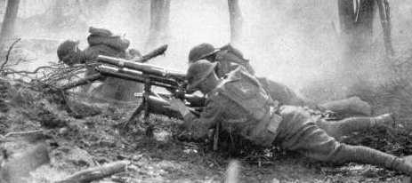
2nd Battle of the Marne
Jennifer Wang, Zoe Chau, Parinita Tyavanagimatt, Emily Wang, Katie Biscocho

Slide 2
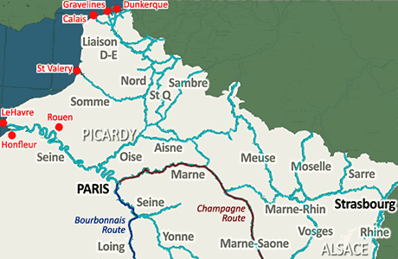
When and Where the Battle Occurred
When:
July 15 - August 6, 1918
Where:
Marne River, France
Caused serious apprehension from France to keep their industries safe.

Slide 3
Who Was Involved
German Empire
vs.
French 3rd Republic
Kingdom of Italy
Great Britain
America

Slide 4
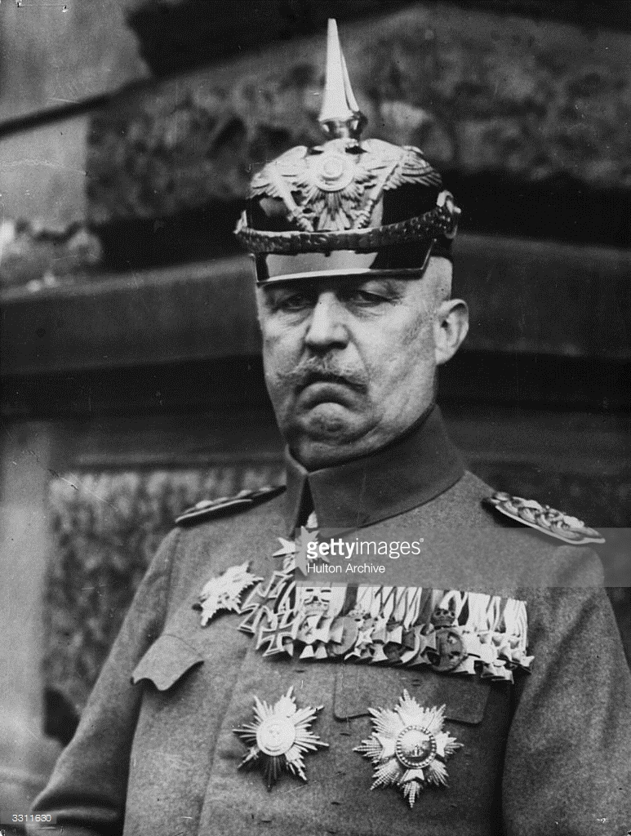
Leaders
General Erich Ludendorff of the German army
Joined the German army in 1882
Head of mobilization of the Schlieffen plan
Egotistical and believed in Darwinian ideals
Did not know the connection between war, economics, politics, and diplomacy
Issued the Treaty of Brest-Litovsk
Stated the consequence of the allies if they lost
Created “stab-in-the-back” phrase
Claimed no responsibility for the German defeat

Slide 5
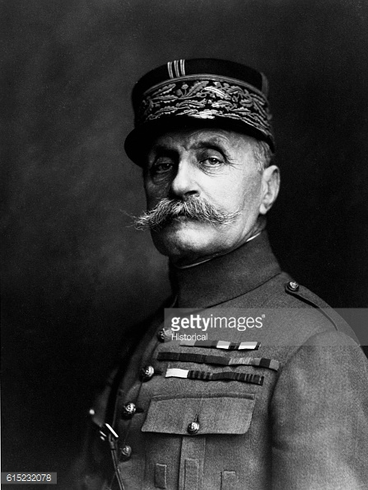
Leaders (cont.)
General Ferdinand Foch of the Allied armies
Fought in Franco-Prussian war
Wrote The Principles of War and The Conduct of War
Named Commander in chief of allied armies
in 1918
Victory against the Germans with a counter offensive
Named marshal of france in 1919

Slide 6
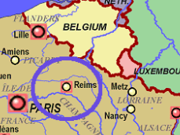
Battle Techniques
German General Erich Ludendorff planned to bring war to Flanders.
Used Marne as a diversion so he could lead most of Allied force to the city.
German First and Third Army began to attack east of Reims.
Remaining soldiers attacked from west to split up French forces.
French dug false trenches.
German troops would waste ammunition on these.
When facing real French army, had no time to get supplies, ended up retreating.

Slide 7
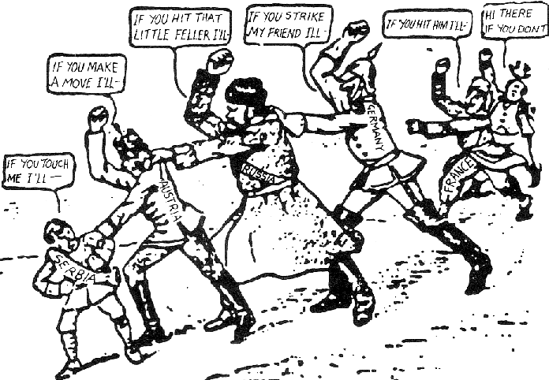
Who Won? Why did they succeed in winning?
The Allies, which consisted of Great Britain,
Italy, America, and France, won.
They won because they overpowered Germany’s offensive strategy and attacked back at the Germans (called counteroffensive). France not only had the support of Great Britain and Italy, but American troops of 140,000 had also joined them. This forced the Germans to return back to their grounds.

Slide 8
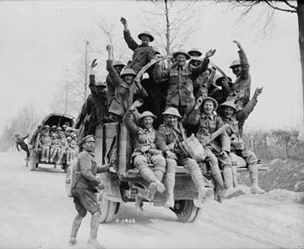
Impacts on the War
Second Battle of Marne marks the point at which the Allies managed to stop the massive offensive German army and become offensive themselves.
Battle was pivotal in the victory of WWI for the Allied forces.
Germans would never become offensive again.
After a series of defenses, Germany surrendered on November 11, 1918, which ended WWI.

Slide 9
Works Cited
"All Flags in Alphabetical Sequence - Flag Image Identifier." All Flags in Alphabetical Sequence - Flag Image Identifier. N.p., n.d.
Web. 08 Feb. 2017.
Archive, Hulton. "General Ludendorff." Getty Images. N.p., 01 Jan. 1924. Web. 09 Feb. 2017.
Barton, Mackenzie. "Causes of World War I - Wikipedia, the Free Encyclopedia." Pinterest. N.p., 04 Nov. 2013. Web. 09 Feb. 2017.
Biesinger, Joseph A. “Ludendorff, Erich.” Germany, Facts On File, 2006, History Research Center
Byrne, Stephen. " Second Battle Of The Marne - World War 1 - History For Kids ." History for Kids, Feb 2017. Web. 08 Feb 2017.
Downham, John. This poor-quality but historically priceless photograph shows the 1st East Lancashire Regiment facing the enemy at
Solesmes on 25 August 1914. Digital image.The Regiments In The Great War 1914-18. N.p., n.d. Web. 9 Feb. 2017.
Grossman, Mark. “Foch, Ferdinand.” World Military Leaders: A Biographical Dictionary, Facts On File, 2007, History Research Center
Historical. "Ferdinand Foch." Getty Images. N.p., 01 Jan. 1900. Web. 09 Feb. 2017.
King, Curtis S. “Second Battle of the Marne.” Encyclopedia of American Military History, Vol. 2, Facts On File, 2003, History
Research Center, online.infobase.com/Article/Details/192480?q=second battle of the marne.

Slide 10
Works Cited (cont.)
"Map of Marne River." French Waterways. N.p., n.d. Web. 8 Feb. 2017.
Neiberg, Michael S. "The Second Battle of the Marne." Preface. The Second Battle of the Marne. Bloomington: Indiana UP, 2008. N.
pag. Twentieth-Century Battles.Indiana University Press. Indiana University. Web. 08 Feb. 2017.
Pride at Vimy Ridge. Digital image. Le Canada. CBC, n.d. Web. 9 Feb. 2017.
Roberts, William J. “Foch, Ferdinand.” France, Facts On File, 2004, History Research Center
"Second Battle of the Marne." Britannica School. N.p., 19 May 2010. Web. 08 Feb. 2017.
"SECOND BATTLE OF THE MARNE." The Second Battle of the Marne. N.p., n.d. Web. 09 Feb. 2017.
"Who Won the Second Battle of Marne?" Articles Master of Arts in Military History. Norwich University, Dec. 2016. Web. 08 Feb.
2017.
Spielvogel, Jackson J. Western civilization. 9th ed. Stamford, CT: Cengage Learning, 2015. Print.

