Slide 1
The Battle of Jutland
By: John Froman, Dyuthi Nair, Kellen Hoke, and Adam Callahan

Slide 2
Who it involved
-The Battle of Jutland was a naval battle between Germany’s High Seas Fleet and Great Britain’s Royal Navy.
-The German goal of the Battle was to break the British Naval blockade so the Central powers could import supplies and weapons

Slide 3
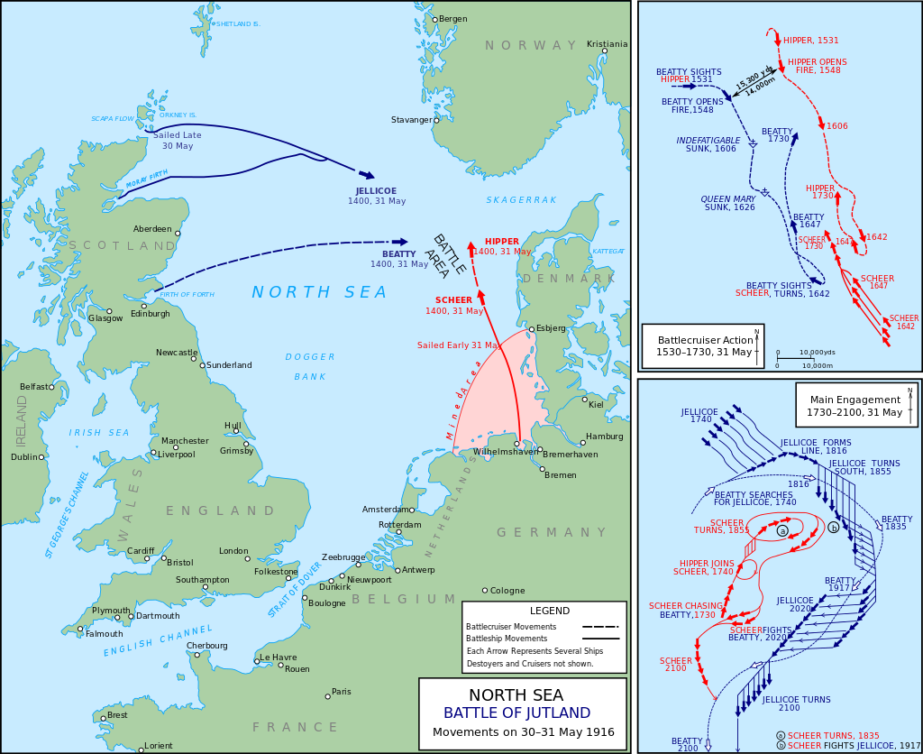
Where was it?
The Battle took place on the North Sea, near Denmark.
British Forces
German Forces

Slide 4
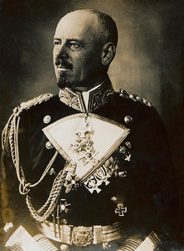
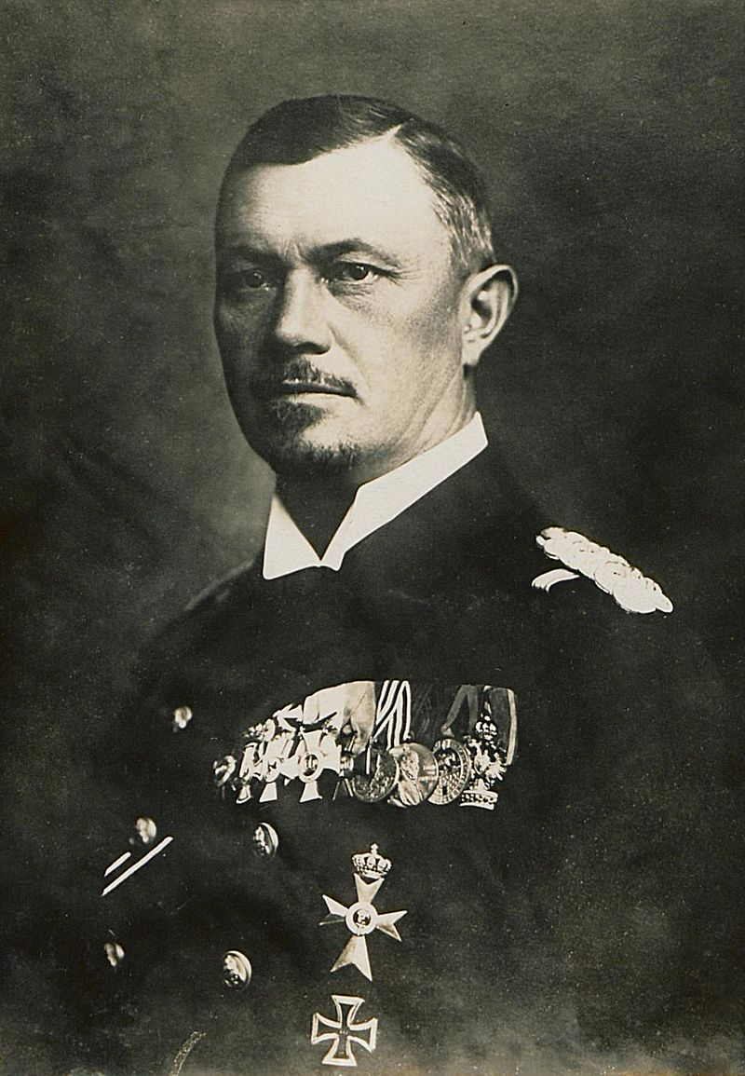
German Admirals Involved
Franz Hipper
Reinhard Scheer
Commander of the German naval scouting forces
Vice admiral of the German High Seas Fleet

Slide 5
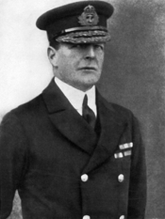
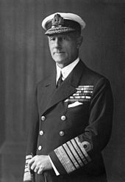
British Admirals Involved
John Jellicoe
David Beatty
Admiral in the Royal Navy
Admiral Sir in the Royal Navy

Slide 6
Planning
The British Royal Navy had 149 ships at their disposal, while the Germans only had 99 ships and stood little chance of winning a head-to-head battle.
The Germans used a divide and conquer strategy: Defeat in Detail
“Defeat in detail is a doctrinal military term that means to defeat an enemy by destroying small portions of its armies instead of engaging its entire strength” -(Edward Erickson, 2003)

Slide 7
Divide and Conquer Tactic: Defeat in Detail
BRITISH
GERMANS

Slide 8
Result and Impacts on Europe
Indecisive overall; both sides claimed victory
Germany failed to break out of the British naval blockade, although the British fleet suffered more losses than the Germans.
It was the largest naval battle during the war. The Battle convinced Admiral Scheer and the Germans to be less aggressive towards England.
It effectively eliminated the German Navy from the rest of WWI, as their navy was not fit to be put to sea for the rest of the war

Slide 9
Works Cited
Beisinger, Joseph A. “Battle of Jutland.” Germany, Facts On File, 2006, History Research Center.
Erickson, Edward J (2003). Defeat in Detail: The Ottoman Army in the Balkans, 1912–1913. Praeger Publishers. ISBN 0-275-97888-5.
Grossman, Mark. “Scheer, Reinhard.” World Military Leaders: A Biographical Dictionary, Facts On File, 2007, History Research Center.
"John Jellicoe." World History: The Modern Era, ABC-CLIO, 2017, worldhistory.abc-clio.com. Accessed 9 Feb. 2017.

