Slide 1
Isonzo
By: Noah Righi, Gene Wang, and Nico Mendez

Slide 2
Lead-In
Italy was bounded to Austria and Germany through a defensive alliance, meaning that it was only supposed to defend it when it had been attacked.
Technically speaking neither Austria or Germany had been attacked yet so Italy had no reason to stick with them.
Italy sided with Britain under the Treaty of London during April 1915.
London promised Italy part of Austria, a small piece of land with some native tribes inhabiting it.
Italy rounded up an army to take control of the land it was promised, but Austria had heard about what happened and sent an army to take care of them, thus the battle of Isonzo.

Slide 3
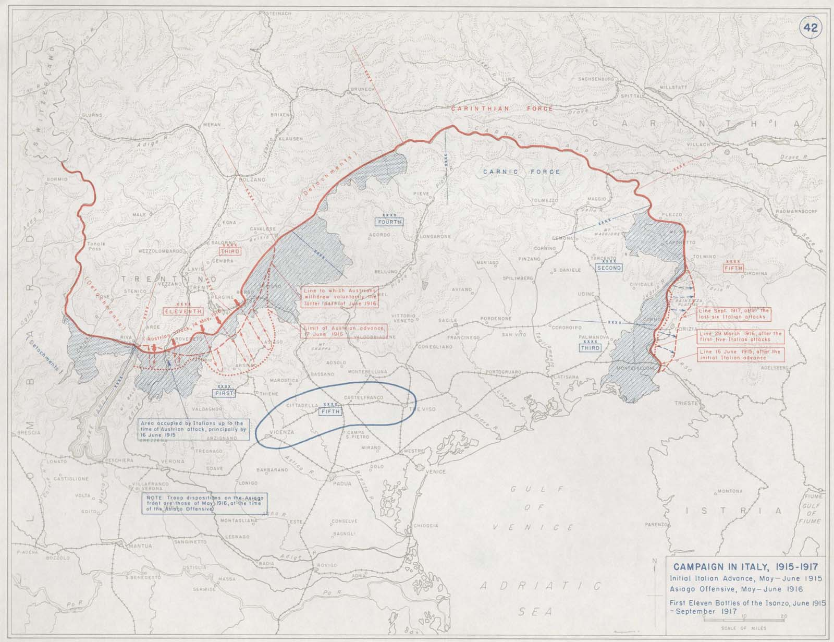

Slide 4
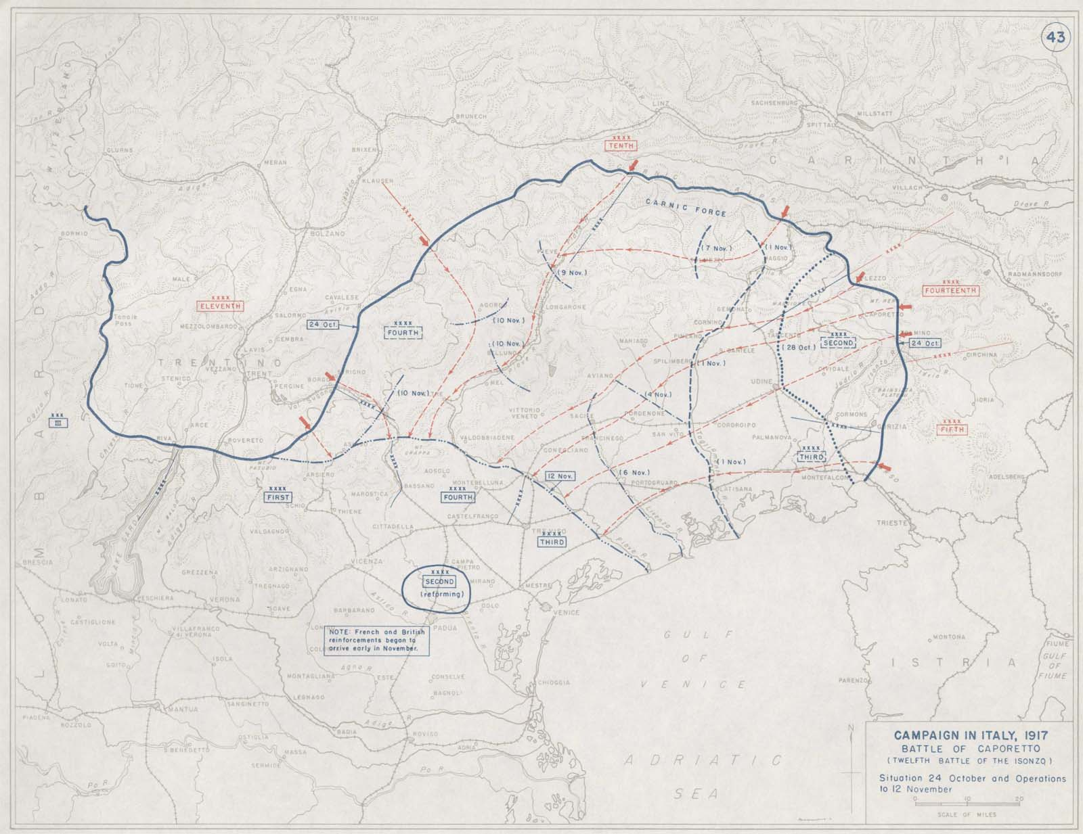

Slide 5
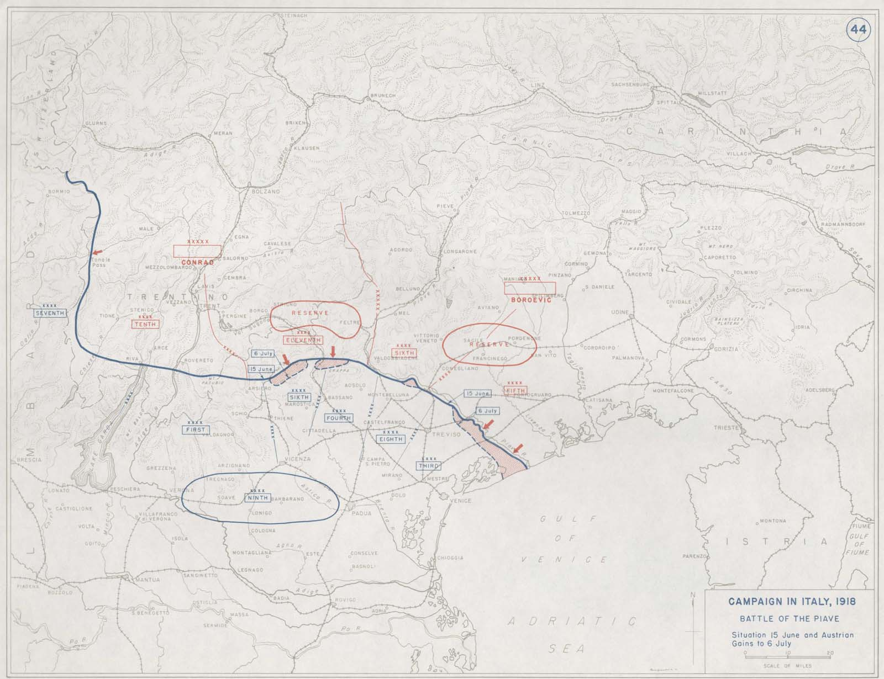

Slide 6
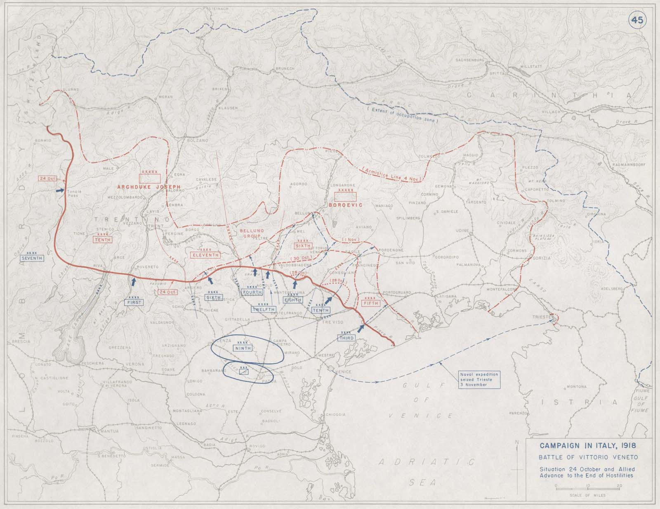

Slide 7
The Battles… a whole lot of them
“10, 11 or 12 Battles?”
“Fought along the Isonzo River”
“Austrians had taken due care to fortify the mountains”
Needed to cross the river
To cross the river they needed to destroy the defences
To destroy the defences they needed to cross the river
300,000 - 600,000 Italians
200,000 Austrians
Around 1.2 million casualties (deaths and injuries)

Slide 8
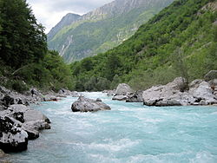
The Significance
Some idiots thought that it would be a brilliant idea to try this for two years
1.2 million casualties later, Italy had gained no land
However, the constant battles here forced Austria (and later Germany) to waste a lot of troops to defend this
This weakened Austrian and German forces since those troops were stuck defending and couldn’t be used to do something actually useful

Slide 9
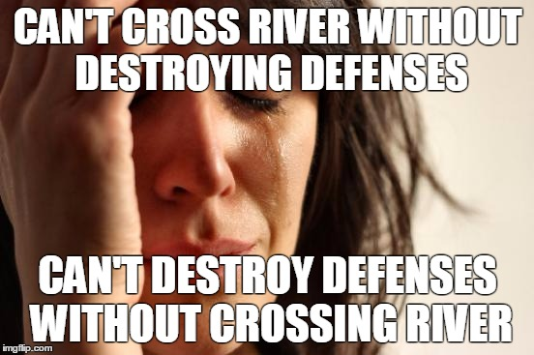
Take Good Notes on These Memes

Slide 10
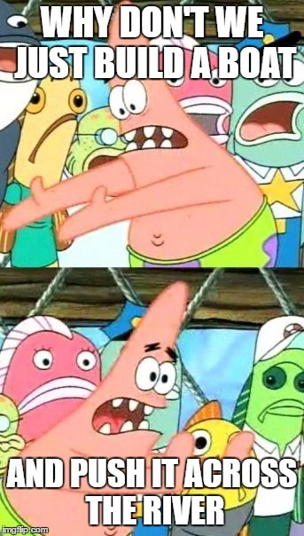
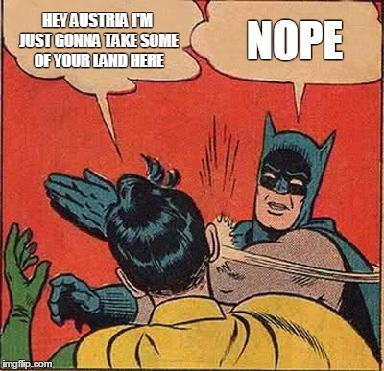
And Another Slide

Slide 11
Works Cited
"Allies Sign Treaty of London." History.com. A&E Television Networks, n.d. Web. 10 Feb. 2017.
"Firstworldwar.com." First World War.com - Battles - The Battles of the Isonzo, 1915-17. N.p., n.d. Web. 10 Feb. 2017.
"Meme Generator." Meme Generator - Imgflip. N.p., n.d. Web. 10 Feb. 2017.
"Soča." Wikipedia. Wikimedia Foundation, n.d. Web. 10 Feb. 2017.
Watts, Tim. "Isonzo Campaign." World History: The Modern Era. ABC-CLIO, 2001. Web. 10 Feb. 2017.

