Slide 1
30YW – Background
Peace of Augsburg – 1555
Peace over religious warfare between Catholics & Lutherans, didn’t last
Left Protestant and Catholic princes very suspicious of each other
Both groups start to organize formally to spread their own influence
Ferdinand is the spark that ignites the flame of war
30 Years War lasts from 1618-1648

Slide 2
30YW - Background
4 Phases of War
Bohemian (Ferdinand)
Danish (Christian IV)
Swedish (Gustavus Adolphus)
Franco-Swedish (Louis XIII and Richelieu)

Slide 3
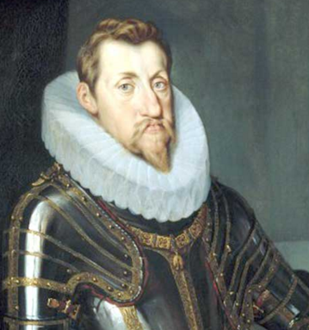
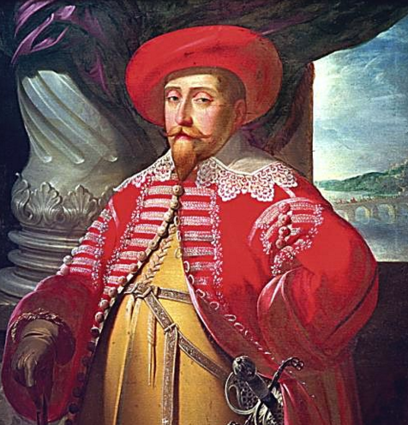
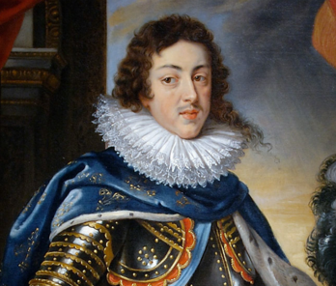
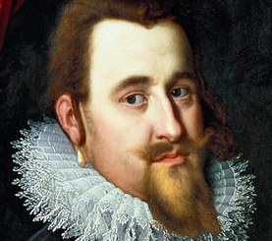
Ferdinand II
Gustavus Adolphus
Christian IV
Louis XIII

Slide 4
30YW – Causes (Start of Bohemian Phase)
Ferdinand II becomes king of the Austrian part of Charles’ empire (Philip was King of Spain)
Son of Charles V HRE (this will matter in a minute)
Austria mainly Catholic, but parts were Protestant (Bohemia)
Bohemia is where Ferdinand II is
Protestants in Prague revolt, Ferdinand’s army crushes them

Slide 6
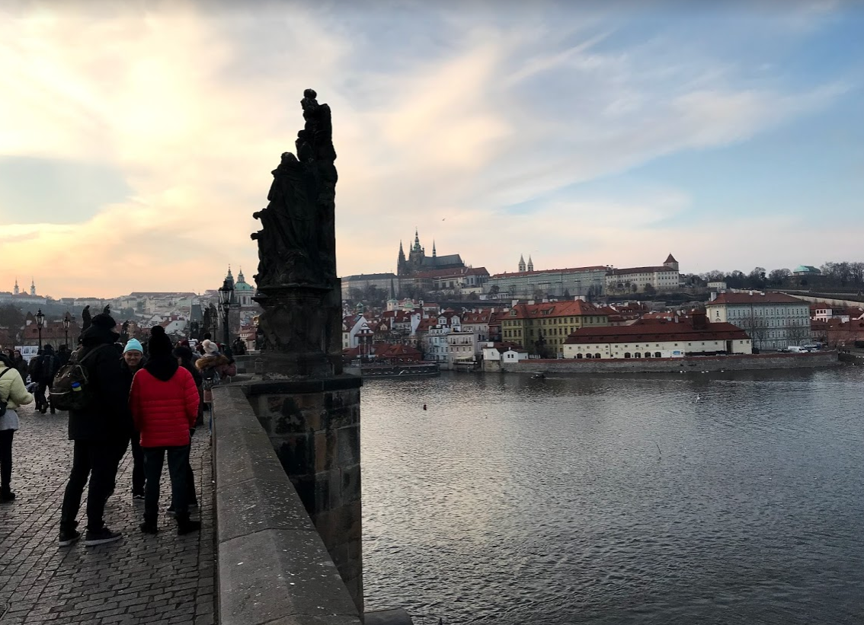
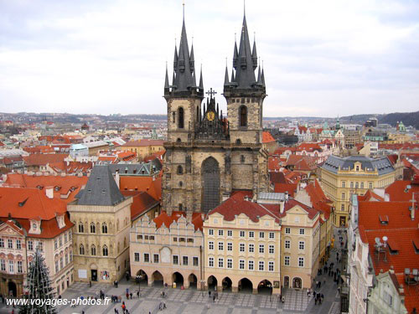
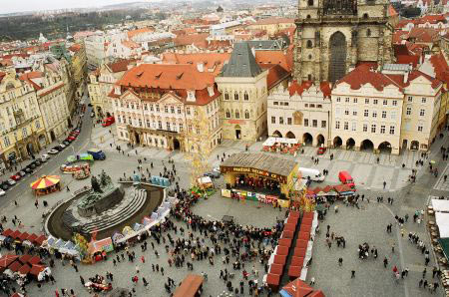
Prague - & the start of the 30YW

Slide 7
30YW – Causes (Start of Bohemian Phase)
DEFENESTRATION (throwing someone/thing out a window) OF PRAGUE
Protestants rebel and throw two Habsburg governors and a secretary out a window
Saved (according to Catholics) by the Virgin Mary
Landed on a pile of manure
German Protestant princes join rebellion
This starts the Thirty Years’ War - Official cause, but remember this is a symptom of a larger issue
War over religion and territory and power among European royal families
(Hapsburg = name of Spain and Austria’s royal families)

Slide 9
30YW – Bohemian Phase (Finishing Up)
Ferdinand II is crowned HRE
Mad about Defenestration of Prague
New King is crowned in Bohemia Frederick V (Protestant)
Ferdinand sends in troops, doesn’t want to lose kingship
Was also afraid of losing the balance of religious power throughout central Europe
Uses both help from Spanish and Bavarians (all Catholics) to defeat Frederick V
They dominate and Frederick has to flee
Ferdinand declares all of Bohemia Catholic and the Spanish go back to war with the Dutch (this will matter in a second)

Slide 10
30YW – Danish Phase
King Christian IV (Dutch Protestant) decide to help out
Ally with English, remember they are Protestant
They attempt to attack Ferdinand – doesn’t help
Ferdinand II hires Albrecht von Wallenstein (new commander & mercenary)

Slide 11
30YW – Danish Phase Cont.
Von Wallenstein & Habsburgs…
Destroy Christian IV and Protestants
Pays his soldiers by letting them loot and destroy the villages they go through
Most of Central Europe is destroyed as a result of fighting
This all results in Ferdinand II issuing Edict of Restitution
Gives Catholics back everything they have lost over the last 75 years, and forces Calvinists to stop worship
Von Wallenstein scares many Habsburgs so Ferdinand II is forced to dismiss him

Slide 12
30YW - Sweden to the rescue
Gustavus Adolphus, king of Sweden (a Lutheran) helps Protestants
Very smart leader, and extremely good tactician
Also a Lutheran
Sweden at this point is a huge power in Scandinavia
Controlled Finland, parts of Russia, Poland, German lands
Ferdinand II is scared so he re-hires Von Wallenstein
Swedes drive Hapsburg armies out of northern Germany even with the help of Von Wallenstein
Gustavus Adolphus killed in battle in 1632
Swedes push as far as southern Germany, but ultimately are pushed back north by Habsburgs
This is without Von Wallenstein – Ferdinand had him assassinated (poor guy)
Edict of Restitution is annulled in order to keep the peace between southern Germany (Catholic) and northern Germany (Protestant)

Slide 13
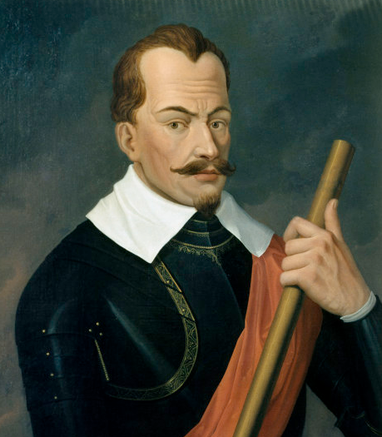
Albrecht von Wallenstein

Slide 14
30YW – France Can Help too, right?
Louis XIII and Richelieu (and three musketeers)
Although Catholic, they detest the Hapsburg family (competitors)
Decide to support the Swedes and the German Protestants (remember they’re Catholic)
Defeated the Hapsburgs in 1648
Shifts focus of war from religion to politics
This becomes the trend for… well forever (for the most part)
All parties are just kind of tired of fighting and ready for peace

Slide 15
30YW - Peace of Westphalia (1648)
Weakened Spain
Strengthened France
Gave independence to German princes (from Holy Roman Empire)
Swiss Confederation recognized
Dutch gain independence, Catholic part stays with Spain, later becomes Belgium
Introduced idea of having all participants of a war meet to negotiate peace treaties

Slide 16
30YW – Major Impacts
Much of German lands destroyed
Lost 15%-20% of their population
Economy ruined
War main reason Germany not unified until 1870
Biggest result: Europe was a group of independent, equal states – no religious empires
Secularism becomes the norm
HRE still exists but has no importance in Germany, becomes a Hapsburg—Austrian— rubber stamp
Starts to define ruling families that will play a large role in WWI, eventually impacting WWII as well (this will reveal itself over the course of the next few units)

Slide 17
30YW – Major Impacts
Some empires in eastern Europe were very weak
Poland’s system requiring 100% agreement on all decisions
Inefficient and they struggle
Ottoman Empire (Turks) was too big and not able to control land it ruled over (Hungary, Romania, Bulgaria)
Holy Roman Empire loses its political authority

Slide 18
Journal Entry 10/3/18
Discuss the articles regarding the social impacts of the war (what you did for me on Monday night)
As a table write a thesis arguing the following prompt –
What is the single greatest social impact of the 30 Years War?
You can all write the same thesis or you can write your own, just make sure you talk with your table before you write your thesis

