Slide 1
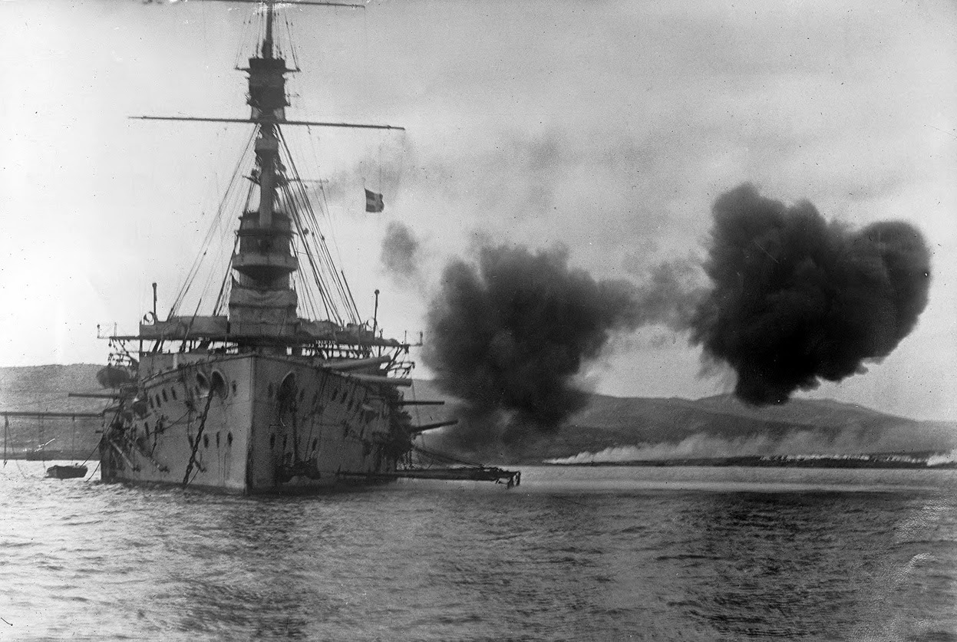
Battle of Gallipoli
Shiksha A., Jenna J., Isha J., Shirley H., Emma L.
Notes:
https://www.youtube.com/watch?v=8dJH_2SzVK8…
If u want to see the ppt...it might clarify the war’s plan: http://www.mrdoran.net/uploads/3/1/6/7/3167511/gallipoli_-_max.pptx

Slide 2
Thesis
The Battle of Gallipoli led to the first major loss for the Allied Forces due to lack of foresight that caused heavy casualties, provoking weakened enthusiasm for war around the globe.

Slide 3
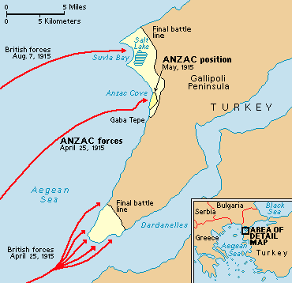
Map of gallipoli war
Where
When
Fought on the Gallipoli Peninsula, in modern day Turkey
Took place in the ottoman empire
Peninsula formed northern part of dardanelles - a strait with a direct route to the Russian Empire
The gallipoli war began on April 25th, 1915
The gallipoli war ended on January 9th, 1916
LAsted for 8 months, 2 weeks, and 1 day

Slide 4
Who won and Why?
The Ottoman Empire won with only 87,000 men dead
Allied Forces retreated when trying to seize Constantinople*
the fleets of the Allied Forces sustained heavy damage due to bad weather
Lack of Reinforcements of the Allied Forces led to Ottomans fortifying their defenses
Ottomans sank three Ships of Allied Powers and Damaged Three more ships
Notes:
http://www.telegraph.co.uk/sponsored/culture/water-diviner/11464437/battle-of-gallipoli-timeline.html
https://nzhistory.govt.nz/war/the-gallipoli-campaign/gallipoli-in-brief

Slide 5
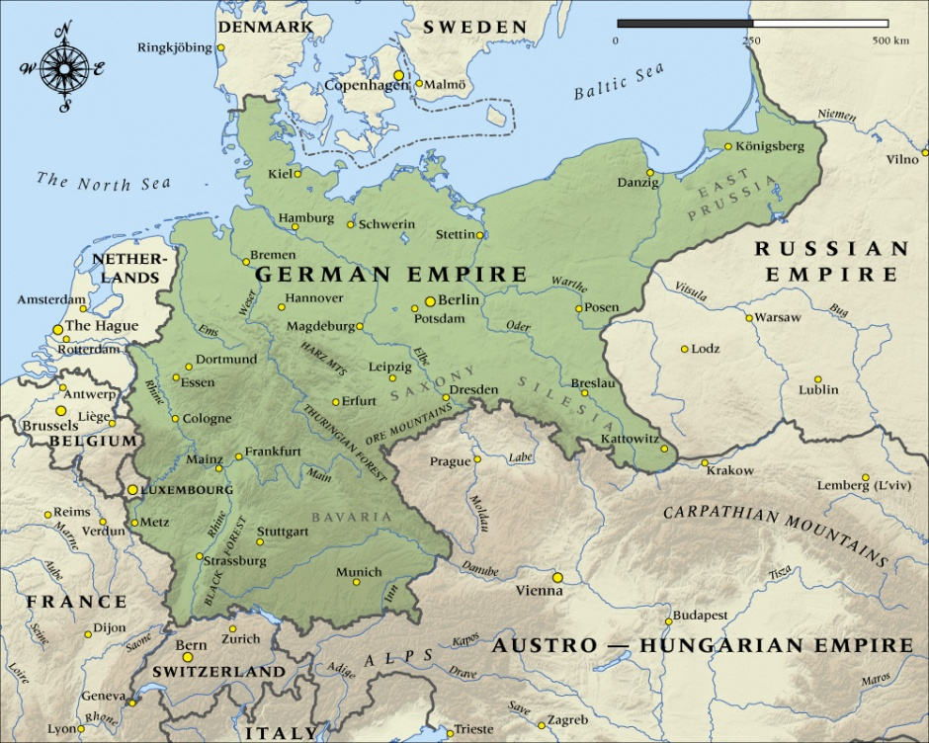
Strategy for Central Powers
Good Geographic position with each other
‘Operating on interior lines’
Example: Germany can move 10 infantry divisions from EAST THROUGH WEST QUICKLY THROUGH THE COUNTRY

Slide 6
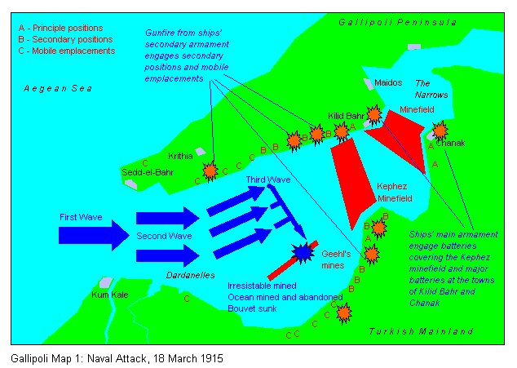
Strategy for allied forces
Lloyd George
Attack Austria-Hungary
Cut off Turkish army in the vicinity of Suez Canal
Lieutenant-Colonel Maurice Hankey
“Weave a web around turkey”
Occupy Constantinople, capital
Lord Fisher
Land on Gallipoli Peninsula
Use battle ships to force dardanelles open
Notes:
Taking Dardanelles could cut Turkey off from its ally, Germany and give Russia access to the waterway for their navy
Create alliance with balkan states
https://nzhistory.govt.nz/war/the-gallipoli-campaign/gallipoli-in-brief
https://www.aspistrategist.org.au/the-strategic-case-for-gallipoli/

Slide 7
Who Was Involved
Great Britain
Turkey/ Ottoman Empire
Australia/ New Zealand (ANZACS)
Blue is the Central Powers, Red is the Allies

Slide 8
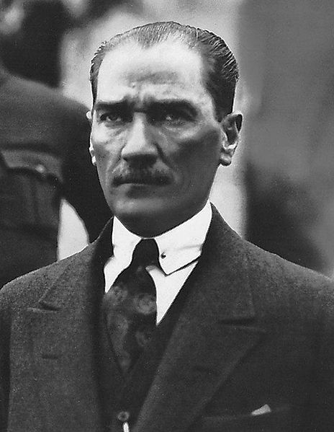
Turkish Commander:Mustafa Kemal Ataturk
Turkey’s most distinguished soldier in World War I
Refused to surrender to Greece in 1919
Was elected President in 1920
Negotiated treaties well
Head of the Republican People’s Party

Slide 9
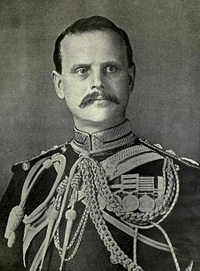
Anzac Commander: General William Birdwood
Developed the ANZAC acronym
Named the 1st landing place at Gallipoli Anzac Cove
Appointed Australians to command positions

Slide 10
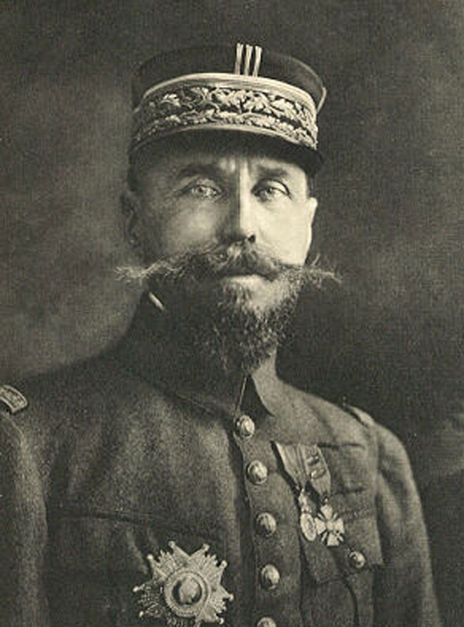
French Commander: Henri Gouraud
Born in Paris, but served in Morocco
Commander-in-chief of the army
High commissioner in Syria

Slide 11
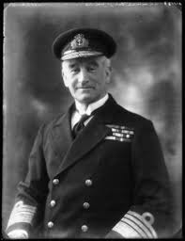
British Commander: John de Robeck
Commanded naval sources
Commander in Chief of the Mediterranean
High Commissioner at Constantinople
Knighted and made a full admiral

Slide 12
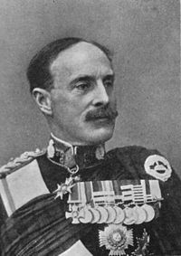
British Commander: Sir Ian Hamilton
Deputy to British Lord Kitchener
Directed land operations at Gallipoli

Slide 13
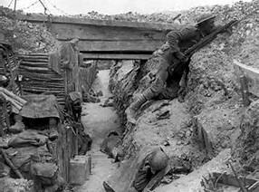
Impacts on Europe
Impacts on Government:
Socialist views became more apparent due to the many unneeded casualties during the Battle of Gallipoli (around 552,0000 casualties).
The view on war and heroism slightly changed over the course of battle. the illusion of heroism faded as men waited in trenches hoping not to get blown up.
New Zealand and Australia’s first major battle
Impacts on Future war:
The Ottoman victory over the Allies at Gallipoli renewed Turkey's visions for the empire.
Many structures were destroyed, such as hospitals.
Governments started to use Attritional warfare, where they win by wearing down the enemy with continuous losses
Military improved in combat

Slide 14
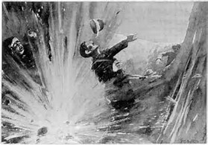
Impacts on Society and Soldiers
Impacts on Soldiers :
The Battle of Gallipoli had multitudes of rats in the trenches and on the peninsula of Gallipoli. As a result, the conditions spread dengue fever and dysentery by late 1915, causing one in three soldiers unscathed by battle of disease.
Most soldiers had long lasting psychological “wounds”.
Ex: Many soldiers were impacted by “Shell Shock”, a condition where soldiers constantly believed they were being fired at.
Impacts on Society:
The high death count caused a population decrease on men in most countries
The pro-war view most soldiers possessed before the war drastically changed after the Battle of Gallipoli. Many were left with the impression that war was not the answer.

Slide 15
Works Cited
"Battle of Gallipoli." World History: The Modern Era, ABC-CLIO, 2017, worldhistory.abc-clio.com. Accessed 8 Feb. 2017.
"Birdwood, William Riddell." The Oxford Companion to Australian History, 2001. History Study Center, .
"Central Powers." Central Powers - Central Powers | NZHistory, New Zealand History Online. N.p., n.d. Web. 9 Feb. 2017.
"De Robeck, John Michael (1862–1928)." Helicon Encyclopedia of World History, 2010. History Study Center, .
“General Sir Ian Standish Monteith Hamilton GCB GCMG DSO TD.” geni_family_tree, 30 Nov. 2016.
"Gouraud, Henri Joseph Etienne (1867–1946)." Helicon Encyclopedia of World History, 2010. History Study Center, .
"Hamilton, Ian Standish Monteith (1853–1947)." Helicon Encyclopedia of World History, 2010. History Study Center, .

Slide 16
Works Cited (cont..)
“Henri Gouraud (General) - Alchetron, The Free Social Encyclopedia.” Alchetron.com, 18 Jan. 2014.
Hughes, Matthew. "The French Army at Gallipoli." RUSI Journal, 2005., pp. 64-67 History Study Center, .
“John Michael De Robeck, First Baronet.” John Michael De Robeck, First Baronet - The Dreadnought Project.
“Lieutenant-General Sir William Birdwood, Commander of ANZACs in Great War (World War 1, WWI, European War) to
1918.” HubPages, HubPages.
"Maps of Gallipoli - The Gallipoli Association." Maps of Gallipoli - The Gallipoli Association. University of Toronto, 2015.
Web. 09 Feb. 2017.
"Mustafa Kemal Ataturk - Facts and Quotes by Founder of Turkey." Turkish Travel Blog : Travelling the Country of Turkey.
N.p., 27 Dec. 2016. Web. 08 Feb. 2017.

Slide 17
Works Cited (cont..X2)
Prior, Robin. "The Strategic Case for Gallipoli." The Strategist. Australian Strategic Policy Institute, 13 May 2015. Web. 8 Feb.
2017.
Sauers, Richard. "Australian and New Zealand Army Corps." World History: The Modern Era, ABC-CLIO, 2017,
worldhistory.abc-clio.com/Search/Display/311730. Accessed 8 Feb. 2017.
Smith, Philippa Mein. “Journal of British Studies.” Journal of British Studies, vol. 45, no. 2, 2006, pp. 458
–459. www.jstor.org/stable/10.1086/504230.
"Turkey, 1908-1938." History Study Center, .

Slide 18
The End
Thanks For listening!

