Slide 1
Daily Agenda/Goals 10/26/15
Agenda:
Death of Abraham Lincoln
Start Reconstruction
Goals:
Content:
Understand the impact of the death of Abraham Lincoln
Understand the initial issues with Reconstructing the south
Skills
Discussion
Analysis

Slide 2
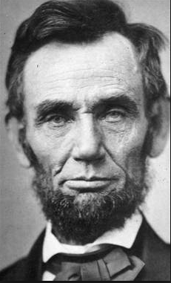
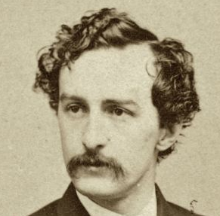
The Death of Honest Abe
What do we know about the death of Abraham Lincoln?
Discuss as a table

Slide 3
The Facts…
Lincoln and his wife Mary Todd went to a play (Our American Cousin) on the evening of April 14, 1865
Our American Cousin was showing at Ford’s Theater in Washington DC
Show starts at about 10:15 pm
At about 10:25 John Wilkes Booth walks in and shoots Lincoln in the head

Slide 4
Immediately after Booth shoots Lincoln Booth Yells, “Sic semper tyrannis!”
Virginia motto which means - Thus always to tyrants in Latin
Booth also yells – “The South is Avenged!”
After this Booth flees the theater
Lincoln is barely alive and treated through the night at a near by house, news of the shooting spread rapidly through the streets
Lincoln officially dies at 7:22 am on April 15th
Andrew Johnson replaces Lincoln after his death as president.

Slide 5
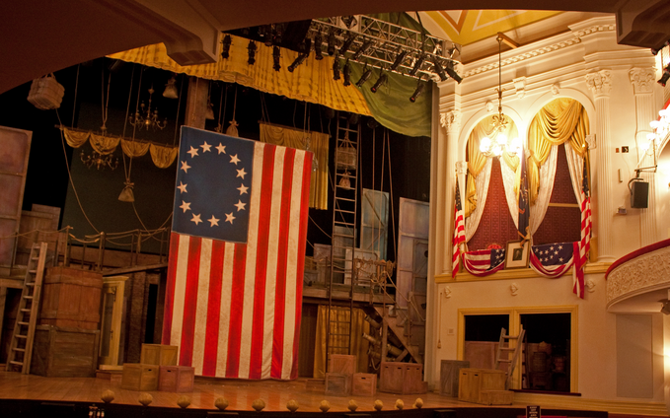

Slide 6
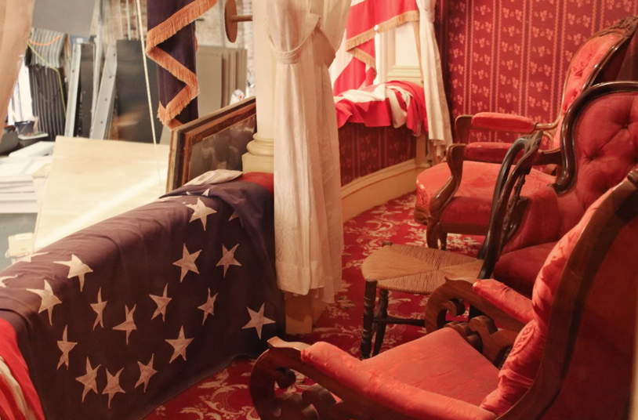

Slide 7
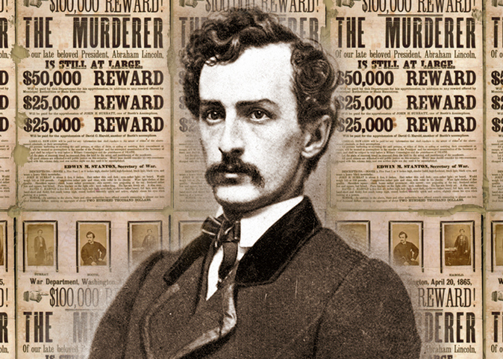
Who was Booth?
Born in Maryland, in a family
of 10 siblings
Heavy drinker, actor, and
Eccentric
Dies soon after the assassination of Lincoln on April 26, 1865
He is shot and killed in a barn after he refused to surrender
Abraham Lincoln’s Assassination

Slide 8
Journal Entry 10/27/15
What do your remember about reconstruction, was it initially successful, was it well received, what consequences did it have on African Americans?
Predict what the major issues with reconstruction will be.

Slide 9
Journal Entry 10/27/15
Read the article titled “Devastation in the South”
Answer the following question:
What issues did the government have when preparing to reconstruct the south?

Slide 10
Major Reconstruction Issues
Northern sentiment that “the south dragged us into this”
Southern sentiment that “The North is full of elitist bullies, and selfish politicians”
General idea that each side is responsible for killing family members from the other side
How will southern states be re-admitted to legislature?

Slide 11
More Issues
Who should be allowed to serve in public office from the south?
Who should be allowed to vote, in the south?
What do you do with the new Freedmen?
-Jobs -Education
-Housing -Voting
How do southern farmers re-populate their workforce?

Slide 12
Lesson Debrief
Who is responsible for the death of Abraham Lincoln?
Who replaced Lincoln after his death?
What are three major issues that will cause problems with reconstruction?

Slide 13
Homework 10/27/15
Read Rival Plans for Reconstruction.
Complete the questions that are connected to the assignment.
Both are on the website.
I will stamp your Causes of the Civil War sheet tomorrow, make sure you have it filled out

Slide 14
In your table groups answer the following questions…
Using your notes/knowledge/cell phones
Citizenship: How do confederates regain citizenship and who is not allowed?
Unity: how do the states re-enter the union?
Freedman: how do we try to help the Freedmen and create more equality in The South?
Rebuilding: How do we rebuild the infrastructure and cities destroyed during the war?

Slide 15
Journal Entry 10/28/15
Which Reconstruction plan was used, why do you think this is the case?

Slide 16
Daily Agenda/Goals – 10/28/15
Agenda:
Reconstruction
Goals
Wade-Davis
Lincoln Plan
Freedman’s Bureau
Black Codes
14th Amendment

Slide 17
Reading Debrief
How does Lincoln intend to re-introduce the south back into the Union?
How does congresses plan differ from Lincoln’s plan?
Which plan would you choose?

Slide 18
Lincoln v Wade-Davis
Lincoln | Wade-Davis
Oath of loyalty pledging to not take up arms against the Union and obey anti-slavery laws Confederate officials and military leaders were not allowed to exercise rights of citizenship, but were still counted as citizens When 10% of population pre-war take the oath, they can create a new gov’t Slavery must be abolished | Anyone who voluntarily participated in the confederate government or army is unable to participate in new government New Governors in former Confederate states will be appointed by the President of the USA 50% of white men in pre-war numbers must swear an oath loyalty before the state gets recognized

Slide 19
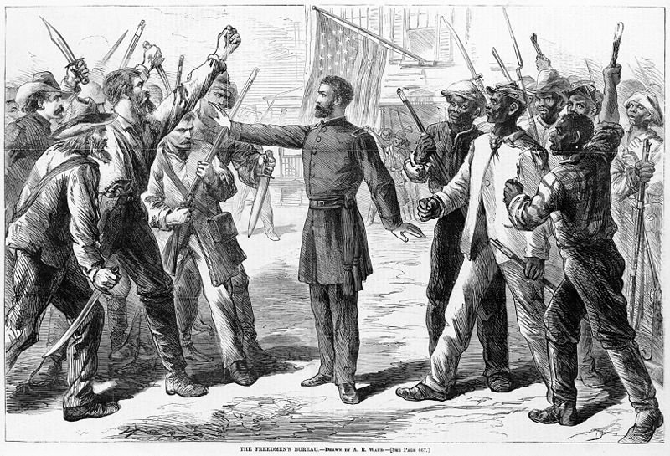
Freedman’s Bureau
The Bureau’s intention was to help solve everyday problems of the newly freed slaves, such as clothing, food, water, health care, communication with family members, education and jobs. It distributed 15 million rations of food to African Americans and set up a system where (primarily white) planters could borrow rations in order to feed freedmen they employed. (Wikipedia)

Slide 20
Black Codes: Passed 1865/66
Black Codes restricted black people's right to own property, conduct business, buy and lease land, and move freely through public spaces. A central element of the Black Codes were vagrancy laws, in which states classified not working as criminal behavior. Failure to pay a certain tax, or to comply with other laws, could also be construed as vagrancy
Strict punishments against theft also served to ensnare many people in the legal system. Previously, Blacks had been part of the domestic economy on a plantation, and were more or less able to use supplies that were available. After emancipation, the same act performed by someone working the same land might be labeled as theft, leading to arrest and involuntary labor.
Some states explicitly curtailed Black people's right to bear arms, justifying these laws with claims of imminent insurrection.
Samuel McCall commented in 1899 that the Black Codes had "established a condition but little better than that of slavery, and in one important respect far worse": by severing the property relationship, they had diminished the incentive for property owners to ensure the relative health and survival of their workers. (Wikipedia)

Slide 21
14th Amendment Ratified 1868
In your table groups go through and look at the 14th amendment and see if/how it applies to each on of these issues…
What should be done with the rebel leaders?
What should Southern states be required to do to be re-admitted into the Union?
Who is responsible for paying for the destruction of the south?
Does the 14th Amendment deal with Black Codes?
Electing state representation in the government?
You have 10 minutes to complete this exercise

Slide 22
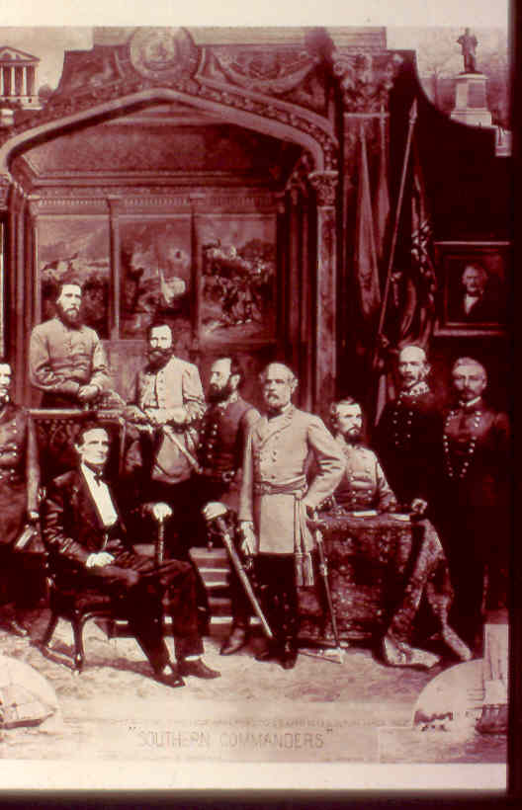
Reconstruction Issue #1: What should be done with the rebel leaders?
Which article addresses this?
How?
Which plan does this reflect?

Slide 23
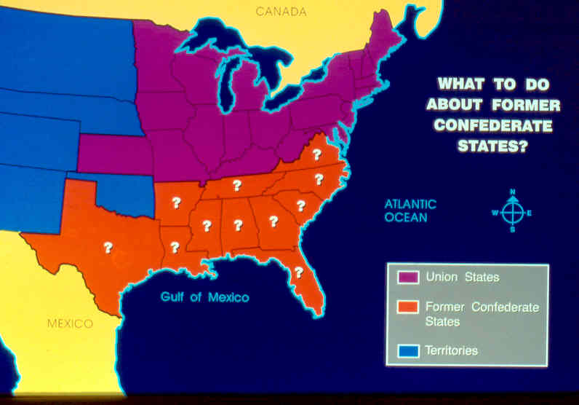
Reconstruction Issue #2: What should Southern states be required to do to be re-admitted into the Union?
Where in the 14th amendment is this addressed?
Why?
Which plan does this reflect?

Slide 24
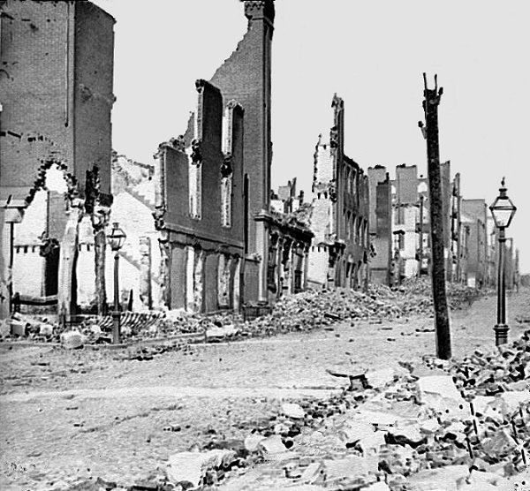
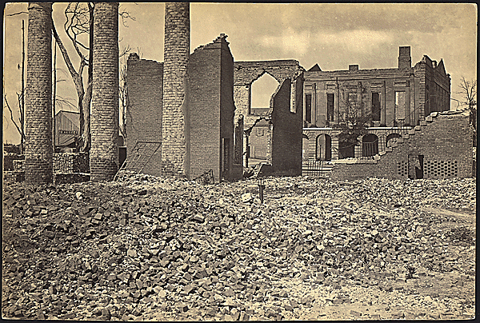
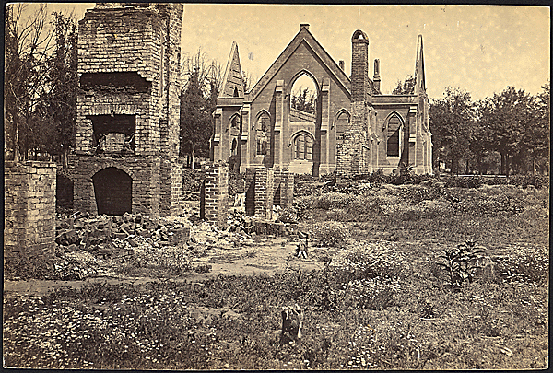
Reconstruction Issue #3: Who’s buying?
Does it talk about this issue in the 14th amendment?
Where?
Who is going to pay for damages?
Which plan does it reflect?

Slide 25
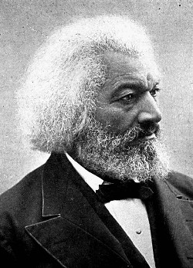
Reconstruction Issue #4: Black Codes?
How does the 14th amendment deal with Black Codes?
What section?
Which plan does it reflect?
“Though slavery was abolished, the
wrongs of my people were not ended.
Though they were not slaves, they
were not yet quite free. No man
can be truly free whose liberty is
dependent upon the thought,
feeling, and action of others.”
Douglas

Slide 26
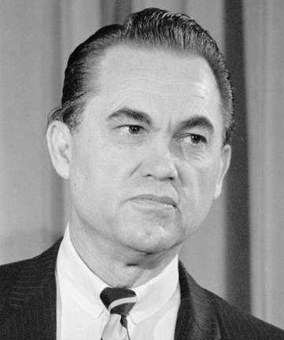
Reconstruction Issue #5: Government Officials?
Alabama Governor George
Wallace, during MLK’s Birmingham Campaign.
Where in the 14th Amendment does it address southern government officials?
Which sections?
Why is this important?
Does it reflect the Lincoln or Wade-Davis Plan?

Slide 27
14th Amendment Answers all of these problems, no more problems in the south right?

Slide 28
Homework
Print Southern Social Changes – Both the reading and the assignment (don’t do it we are starting it in class tomorrow)
Print the DBQ North or South: Who Killed Reconstruction?

Slide 29
Agenda/Goals 10/29/15
Agenda:
14th Amendment
Southern Social Changes
Goals:
Content
Understand how the 14th Amendment addresses Reconstruction issues
Understand issues that occurred socially during Reconstruction in the south
Skills
Reading
Analysis
Writing

Slide 30
Journal Entry 10/30/15
Read and answer the questions from 15th Amendment

Slide 31
Agenda/Goals – 10/30/15
Agenda:
North or South: Who killed Reconstruction?
Goals:
Content:
Understand who is responsible for the failure of Reconstruction
Skills:
Analysis
Discussion
Note – No journal entry for today

Slide 32
Homework
Put together your journal entries – they are due on Monday 11/2/15
You can have one 3X5 notecard on the exam
This must be completed by Monday
It must be hand written, if it is not I will not accept it
It must have my stamp on it to be used on the exam
DBQ is due Monday too

Slide 33
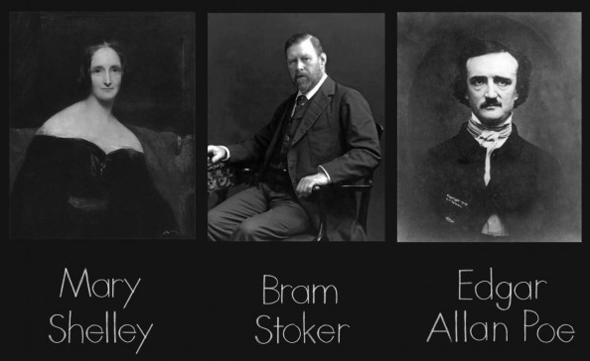
Other stuff – History of Horror in Film (Brief)
1700s – Gothic horror:
Edgar Allan Poe
Mary Shelley
Bram Stoker

Slide 34
Other stuff – History of Horror in Film (Brief)
https://www.youtube.com/watch?v=uNReoA8BV_Y
Silent Era
Films were made in Europe and in the US that highlighted death and the macabre
Attempts at making two films
Frankenstein
Dante's Inferno

Slide 35
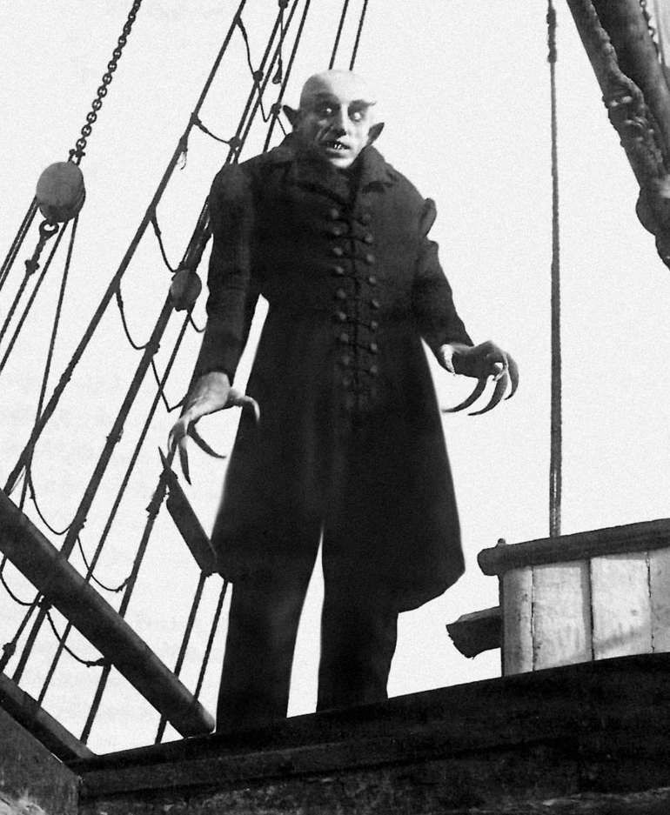
Other stuff – History of Horror in Film (Brief)
The Gollum
First attempt to make a vampire
German Expressionism
https://www.youtube.com/watch?v=-b8_ElkrRNY

Slide 36
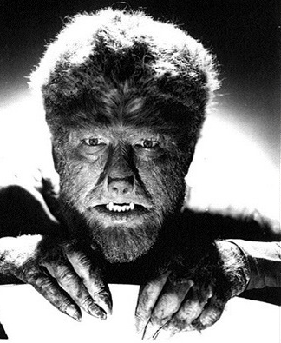
Other stuff – History of Horror in Film (Brief)
1920s-50s – The Golden Age of Horror
Wolfman
Hunchback of Notre dame
Mummy
Dracula
Campy horror
Abbot and Costello
https://www.youtube.com/watch?v=x0YLLkr7VfU
https://www.youtube.com/watch?v=7Nfmh178L98

Slide 37
Other stuff – History of Horror in Film (Brief)
1950s and beyond
Multiple themes within the genre begin to emerge
Monster movies
Sci-fi
Psychological thriller
Gore
Zombie (1968 – Night of the Living Dead)
Slasher

Slide 38
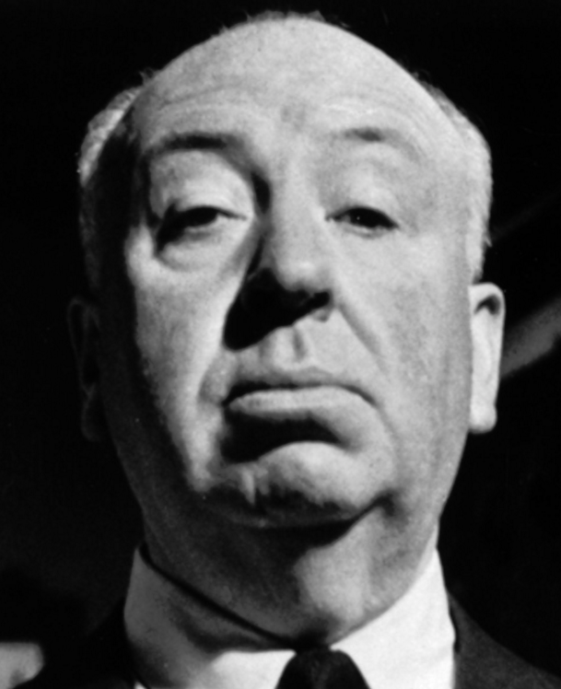
Other stuff – History of Horror in Film (Brief)
Alfred Hitchcock
Known for suspense and thriller
Creator of many classics
The Birds
Psycho
Rear Window
North by Northwest
Vertigo
Dial M for Murder

Slide 39
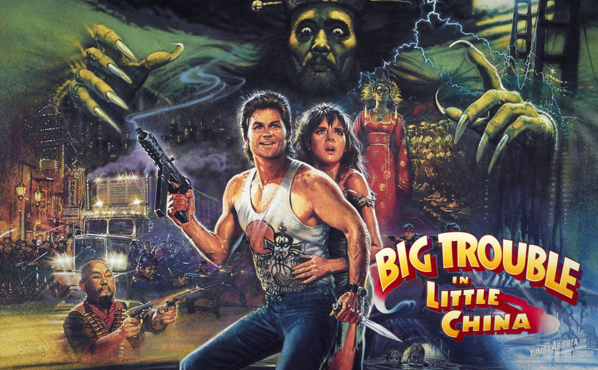
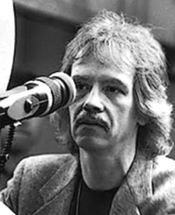
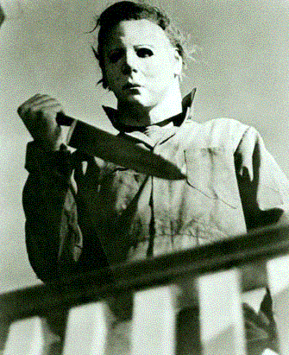
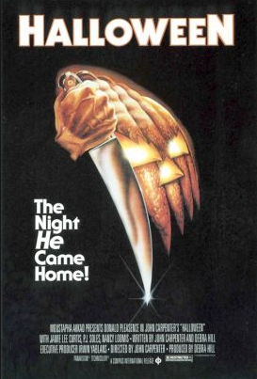
Other stuff – History of Horror in Film (Brief)
John Carpenter
Slasher films
Halloween (Michael Myers)
The Thing
Christine
Big Trouble in Little China

Slide 40
Other stuff – History of Horror in Film (Brief)
Wes Craven
Slasher movies
Last House on the Left
Hills Have Eyes
Swamp Thing
A Nightmare on Elm Street (entire franchise)
The Twilight Zone (movie not show)
People Under the Stairs
Vampire In Brooklyn
Scream (entire franchise)

Slide 41
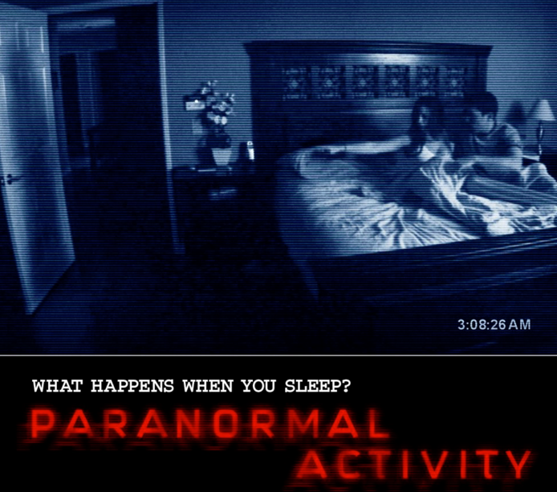
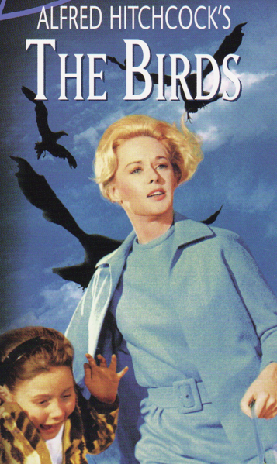
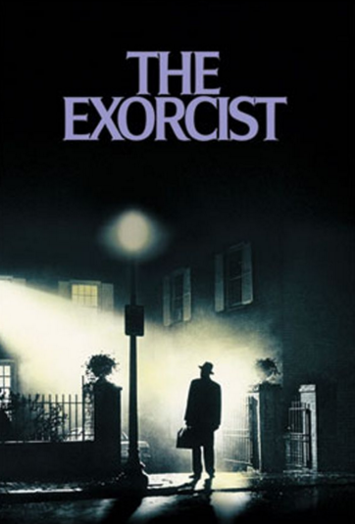
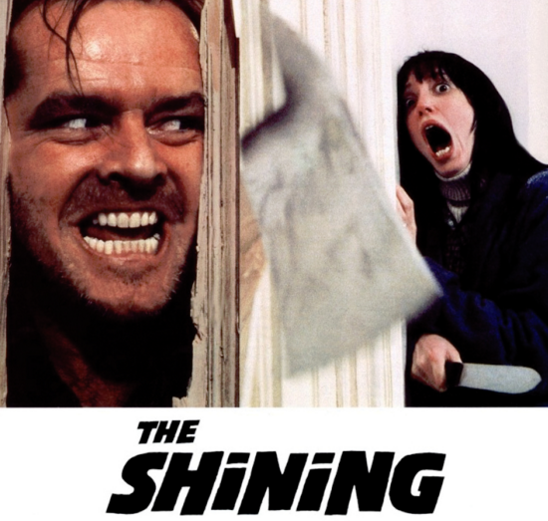
Guess which one of these movies is ranked the scariest movie of all time?

Slide 42
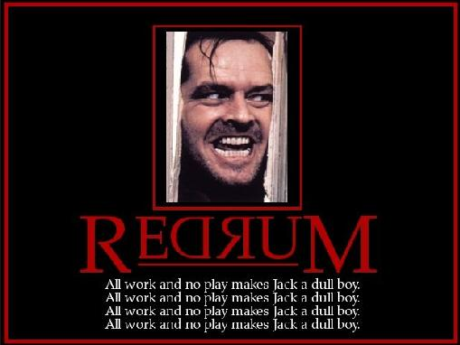
What’s your favorite scary movie?
If you don’t like scary movies what is your favorite movie?

Slide 43
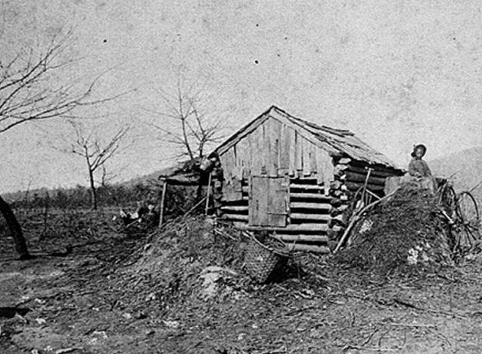
HW Debrief

Slide 44
Problems Moving Forward…
Jim Crowe
Corruption
Greed
How will we answer these problems?
MINI DBQ

Slide 45
Background Essay
Read the DBQ essay, you have 10 minutes…
Complete the background essay questions while you read the essay
Take your homework out to be stamped

Slide 46
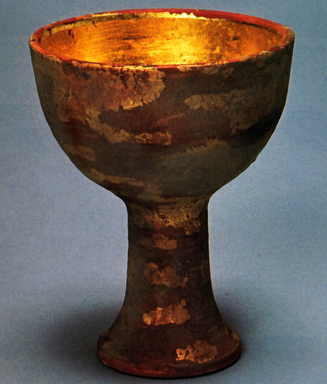
Choices…
In order to complete the DBQ you must fill out the questionnaire
You can complete the questionnaire CHOOSING one of the two following ways…
You can use on of the DBQ books and work on your own
You can use the posted documents and do a gallery walk
The choice is yours… choose wisely…

Slide 47
Homework
The DBQ packet is due tomorrow at the beginning of the period.

Slide 48
Agenda – 11/18/14
15 Minutes finish DBQ
20 Minutes Review DBQ
Remainder of Period
Prep for Exam
Go over homework list

Slide 49
Assessment
The assessment will be on the following information…
The Generals/Leaders of the Civil War
The battles of the Civil War
Battles/Figures Assignment
Social Issues of the Civil War
Reconstruction
DBQ North or South: Who Killed Reconstruction
Study your notes, power points, and the DBQ in order to prepare for the assessment
You can use ONE 3X5 notecard (front and back) on the assessment.
It must be handwritten

Slide 50
Warm up Complete the Hook Exercise with a partner at your table
For each of the answers put one of the following letters…
H = Happy
U = Unhappy
M = Mixed
You have 8 Minutes to complete this exercise

