Slide 1
Journal Entry 10/20/15
Write a thesis statement that answers the following prompt
What two things give the Union an advantage over the Confederates, why?
Make sure your homework is out

Slide 2
Daily Agenda/Goals
Agenda:
Civil War
Civil War figures/battles assignment
Goals:
Content
Discuss figures of the Civil War, and their relevance to the Civil War
Skills
Note taking
Analysis

Slide 3
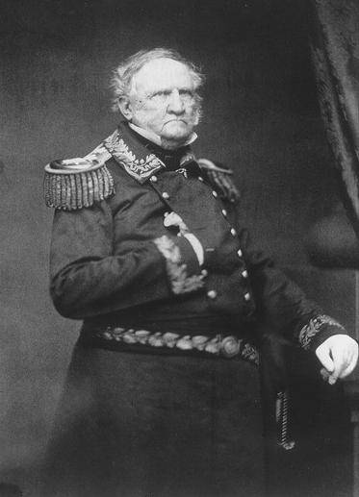
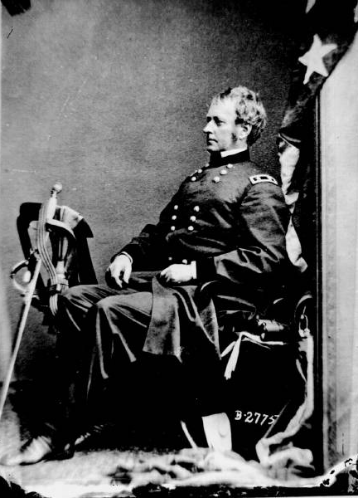
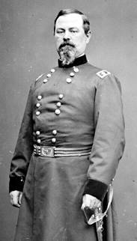
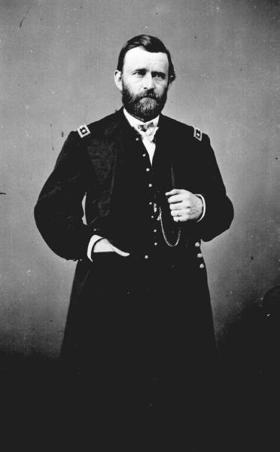
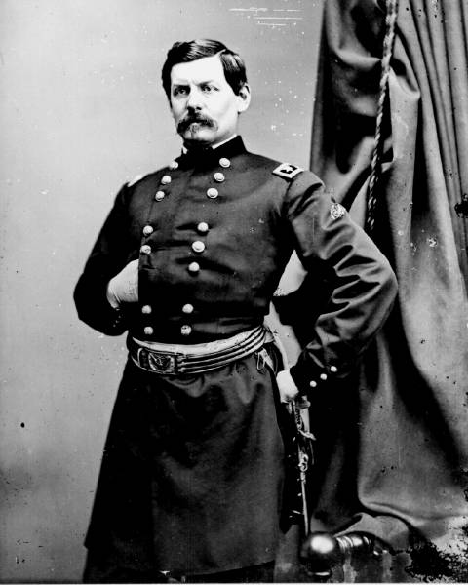
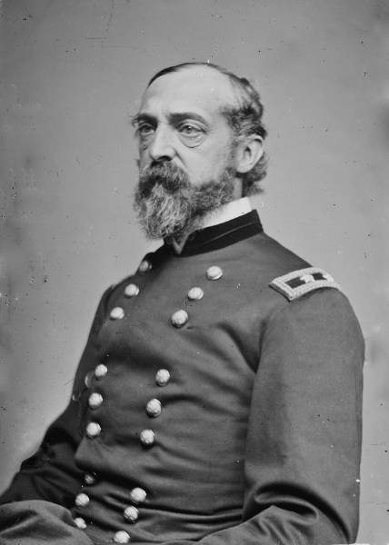
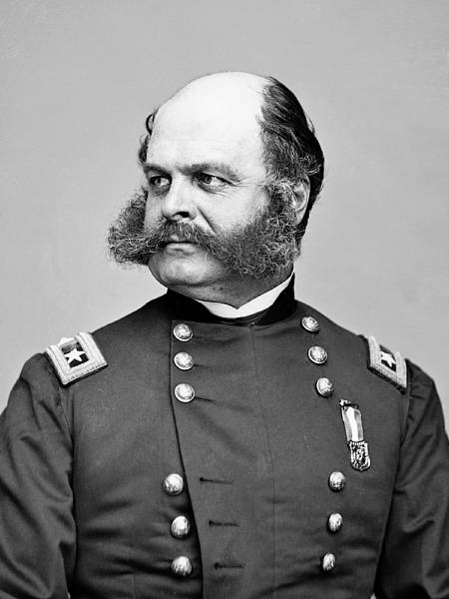
Union Leaders
Old
Too Hopeful
Hooker?
Bingo!
Defiant
Not political
Oops
Too Political
Winfield Scott
Joseph Hooker
Ulysses S. Grant
Irwin McDowell
George McClellan
George Meade
Ambrose Burnside
George McClellan, Again!

Slide 4
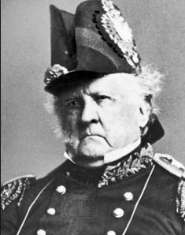
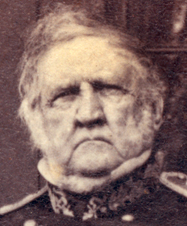
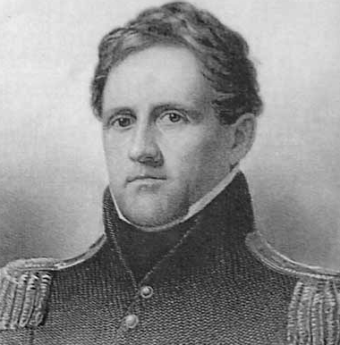
Winfield Scott
Longest tenured commander in US history
Had the nicknames “Old Fuss N Feathers,” and “Old Fat N Feeble”
Old and out of shape, couldn’t even mount his horse
Came up with the “Anaconda Plan”
Offered control of the army to Robert E Lee, Lee refused because he would have fought against his home state and switched to the Confederates
Ran the military in the Civil War from Spring 1861-November 1861

Slide 5
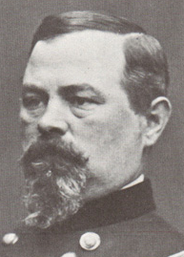
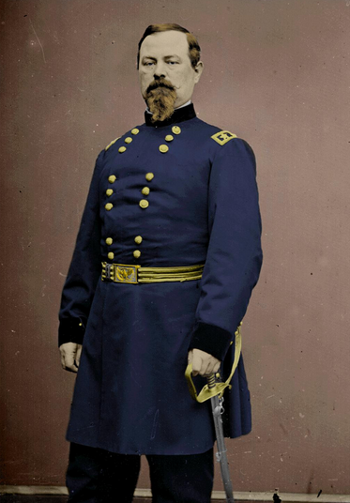
Irvin McDowell
Commander of the Army of Northeastern Virginia
Did not have experience commanding in battle
Was forced into leading his troops into battle at the 1st Bull Run before he/they were ready
Blamed for the failure at 2nd Bull Run
Not a great general

Slide 6
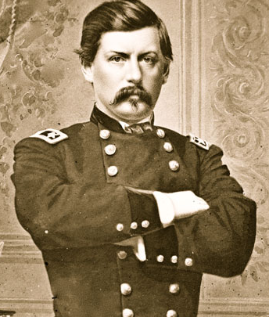
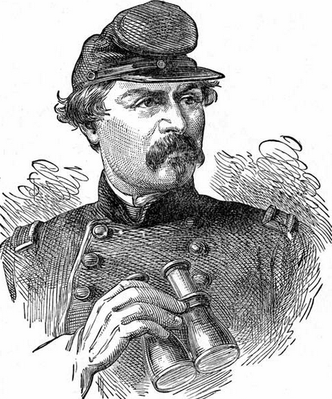
George McLellan
On and off military man
Had money outside of the military (other business ventures)
Wanted to be involved in politics
Took over for General Scott in November 1861
Did not get along with Lincoln, called him a “Baboon”

Slide 7
George McLellan Cont.
Lost his post as Chief General in March 1862 because he did not attack/use the military and refused to communicate with Lincoln
After the army is defeated at the 2nd Bull Run McLellan is reinstated as Chief General
In charge during Antietam and is removed from his command a second time after be refuses to pursue Robert E Lee post battle

Slide 8
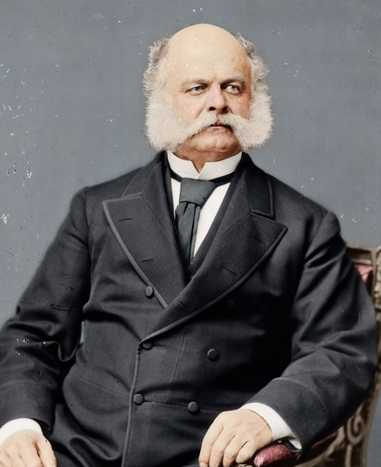
Ambrose Burnside
Commanded army after McLellan’s second time
Not experienced as military commander during wartime
Was beaten in multiple battles because of tactical mistakes
Multiple officers court marshalled because of their actions
Offered to resign otherwise he would have been court marshalled
Lincoln accepts his resignation
Commands smaller portions of the army throughout the rest of the war
Sideburns are named after him

Slide 9
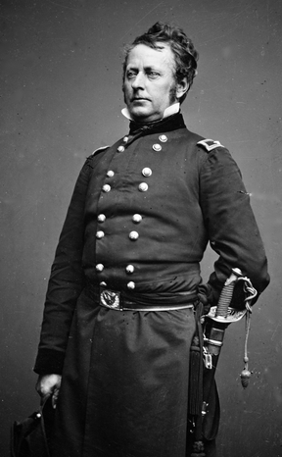
Joseph Hooker
Took over after Burnside in January 1863
Party animal, after battles he would drink and have girls come party with him
Makes poor command decisions at Chancellorsville, and his officers start to lose confidence in him
Gets into a dispute with Lincoln after Lincoln starts to lose confidence with him
Offers resignation, Lincoln accepts
Loses his command in June 1863

Slide 10
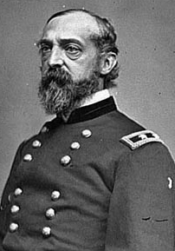
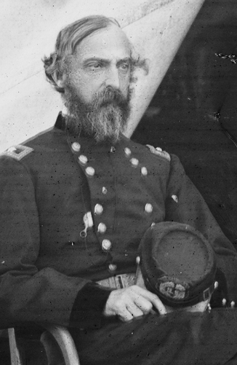
George Meade
Takes over for Hooker in June 1863
Wins at Gettysburg, turning point in war
His major downfall is he is not a politician, and he couldn’t handle his commanding officers left over from Hooker
Offers to resign, in early 1864
He and Grant did not have a great relationship

Slide 11
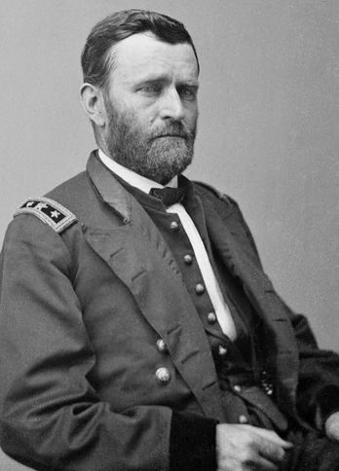
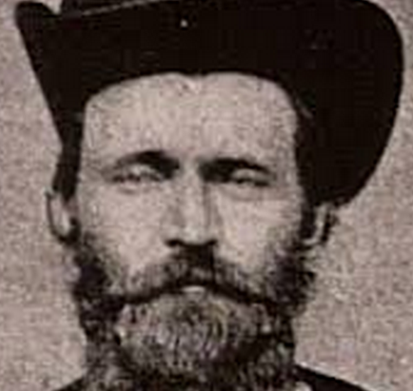
Ulysses S Grant
Doing work on in the Western Theater of the war pre-command of the army (Tennessee)
Takes over for Meade in March 1864
Leads Overland Campaign and attacks Lee (this is what Lincoln wanted all along)
Sends General Sherman on his “March to the Sea” also known as the Savanah Campaign
Grant struggles to take cities in Virginia (specifically Petersburg and Richmond), until Sherman works from the south and aids Grant
Negotiates peace in April 1865

Slide 12
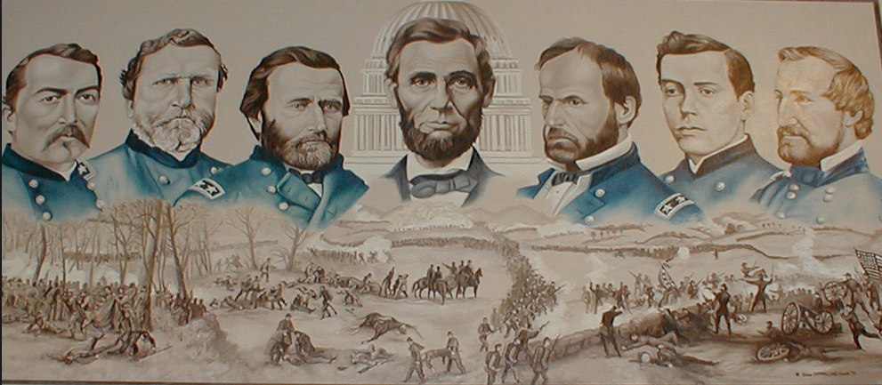
Why did Union leadership struggle early in the war?
What other wars have we studied had similar issues with leadership in US history?
Why didn’t the North just dominate the south?

Slide 13
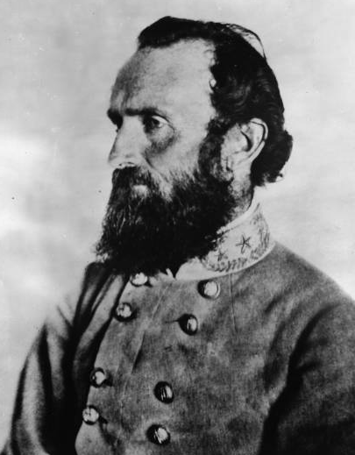
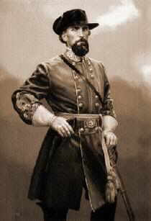
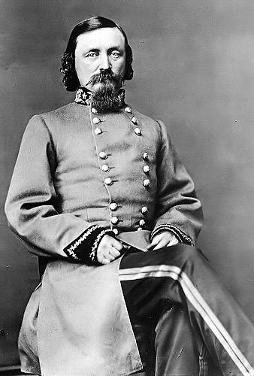
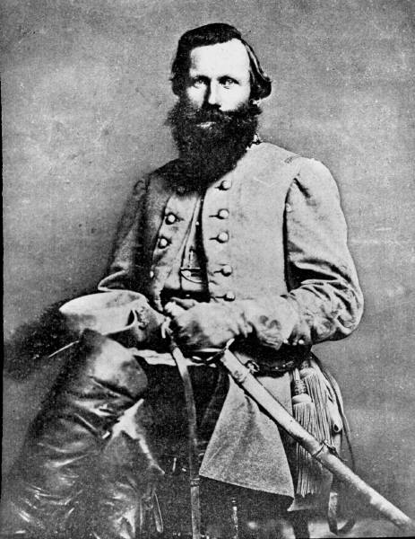
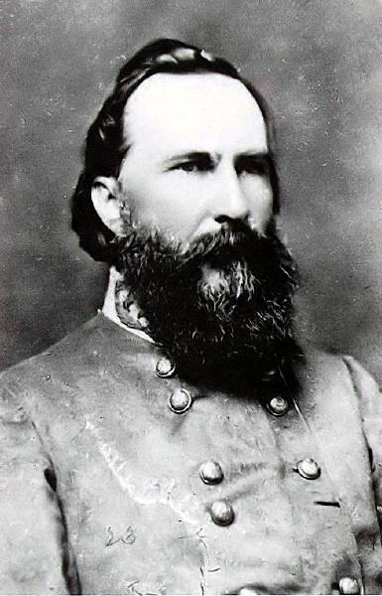
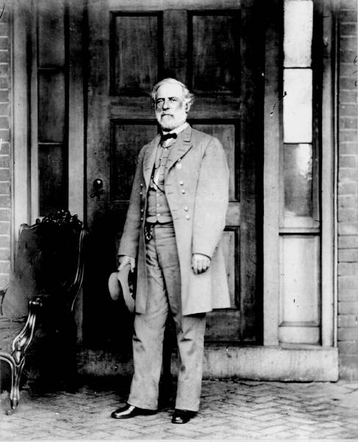
Confederate Leaders
“Stonewall” Jackson
Nathan Bedford Forrest
"Give General Jackson my affectionate regards, and say to him: he has lost his left arm but I my right."
George Pickett
Jeb Stuart
James Longstreet
Robert E. Lee

Slide 14
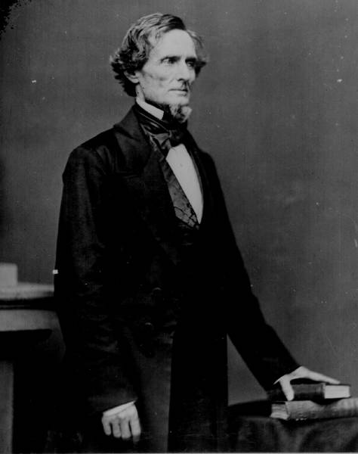
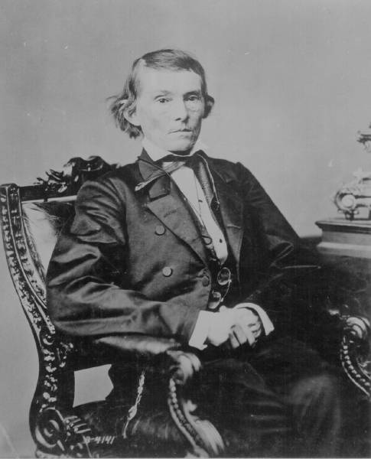
The Leaders of the Confederacy
Pres. Jefferson Davis
VP Alexander Stevens

Slide 15
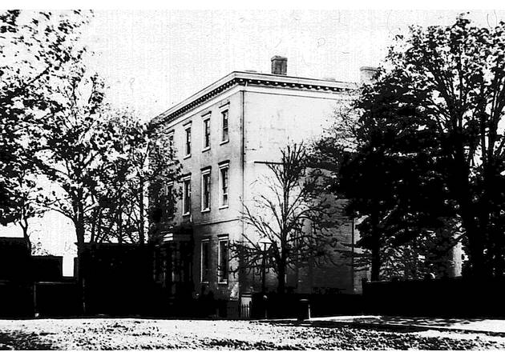
The Confederate “White House”
Richmond, VA

Slide 16
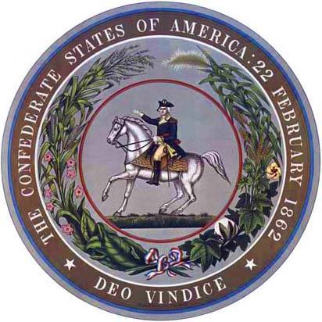
The Confederate Seal
MOTTO → “With God As Our Vindicator”

Slide 17
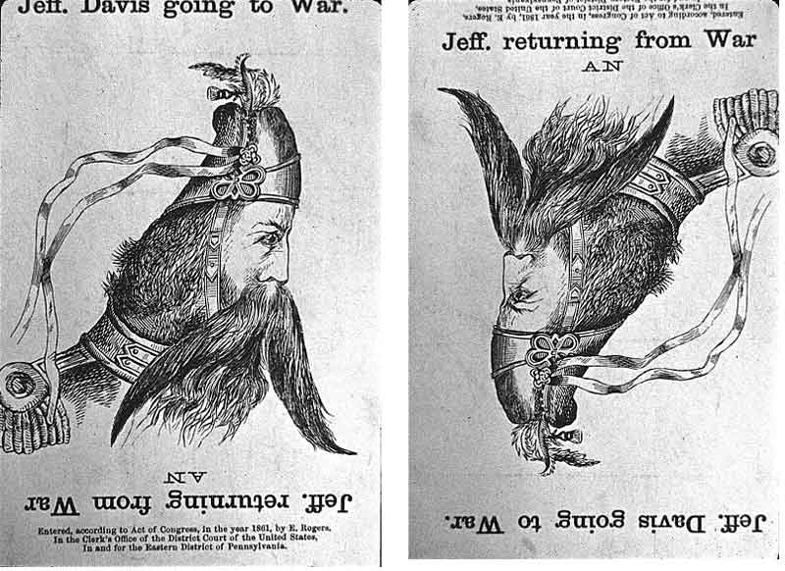
A Northern View of Jeff Davis

Slide 18
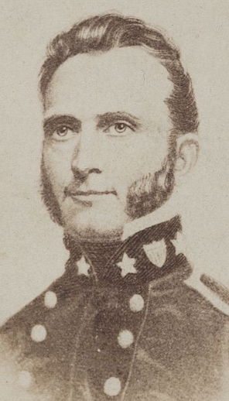
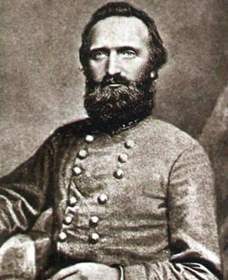
Stonewall Jackson
Highly decorated in the US military
Considered one of the top military minds pre Civil War
From West Virginia
Extremely decisive leader, Lee trusted him to create and deliver plans

Slide 19
Stonewall Jackson
Led the Confederate army to victories at 1st & 2nd Bull Run, Valley Campaign, Peninsula Campaign, Fredericksburg, and Chancellorsville
Loses arm in an a shooting at Chancellorsville, from someone who shot him while hiding in the woods
Dies as a result of the shooting
When he dies Lee is quoted as saying “I have lost my right arm… and I am bleeding at the heart”

Slide 20
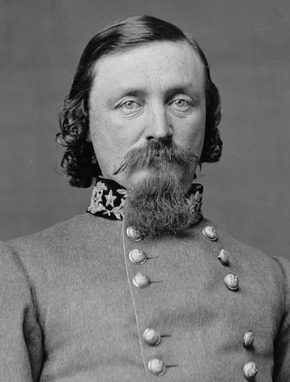
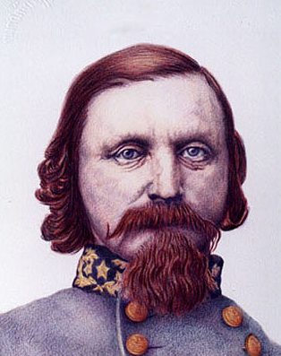
George Pickett
Fought in the Mexican American War
Served in Bellingham Washington!
Made Brigadier General in 1862
Wounded during the Peninsula Campaign, had to sit out for 3 months
Comes back in time for the Gettysburg Campaign
Leads the infamous “Pickett’s Charge” at Gettysburg
Continued to command men for Lee after Gettysburg

Slide 21
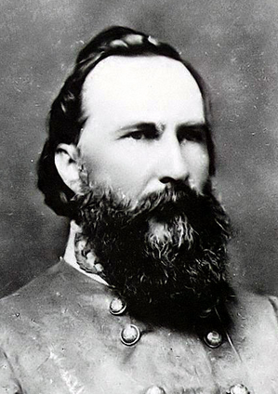
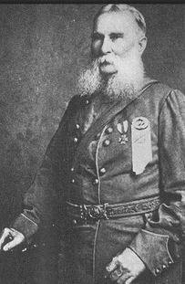
James Longstreet
High ranking General for Lee
Nicknamed “Old War Horse”
Fought in Mexican American War
From S. Carolina
Had early success at the 1st/2nd Bull Runs
Struggled later in the war (after Gettysburg)
Became a “Reconstructed Rebel” after the war, supported African American Rights

Slide 22
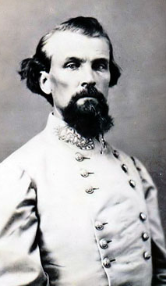
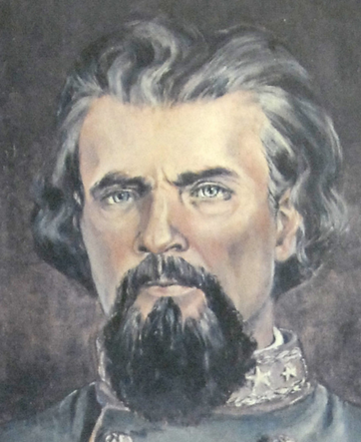
Nathan Forest
From Tennessee
Nicknamed “Devil Forrest,” and “Wizard of the Saddle”
Was not in the military pre Civil War
Eventually tried for war crimes for his massacre at Fort Pillow, responsible for massacring soldiers that surrendered at Fort Pillow, mostly African Americans, but white soldiers as well
Post war he was one of the founding members of the KKK
He is who Forrest Gump was named after

Slide 23
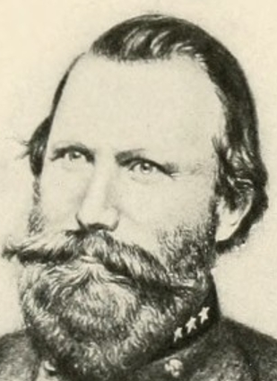
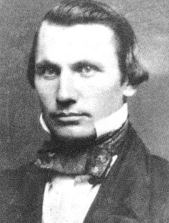
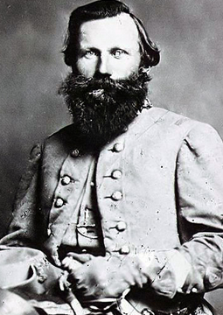
Jeb Stuart
From Virginia
Went to West Point Military
Academy
Fought for US in Mexican American
War
Died at the Battle of Yellow Tavern
Fought in multiple battles include Gettysburg,
and Chancellorsville
Helped lead in the Overland Campaign

Slide 24
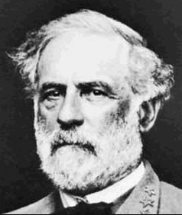
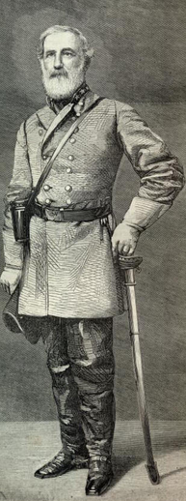
Robert E Lee
Born and raised in Virginia
Fought in the Mexican American War
Ran the school at West Point
Was not pro slavery
Opposed secession
Early in the war was opposed to the confederacy, but fought to support it because he was from Virginia
Led the confederate army for the entire war
Was not tried for war crimes post Civil War, did lose some property and the right to vote

Slide 25
Homework
Read about the early war strategies on the website
Answer questions found in the graphic organizer

Slide 26
Warm Up
Answer the following questions…
Which strategy is better, the Union or the Confederacy, why?
Predict who you think will have early battle success, the Union or Confederacy, why?
Make sure your homework is out so I can stamp it

Slide 27
Journal Entry 10/22/15
Review – Why did the Union struggle early in the war?

Slide 28
Agenda/Goals 10/22
Agenda:
Gallery Walk
Finish Civil War
Social Issues
Goals:
Understand the different battles of the Civil War
Begin discussing the social issues of the Civil War

Slide 29
Gallery Walk
Set up your battle or figure somewhere around the classroom.
You can hang it on the wall or set it on a desk
You will have 15 minutes to study the different battles
I suggest you take notes

Slide 30
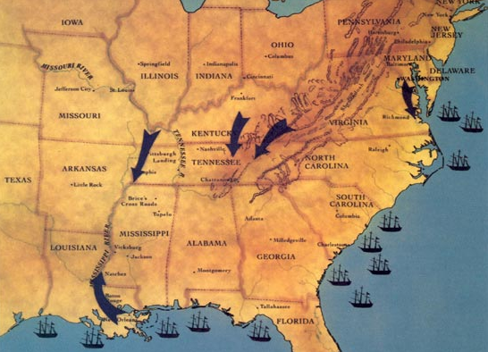
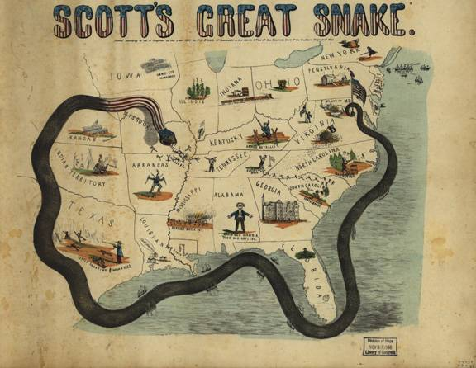
Anaconda Plan
The goal of the plan was to blockade the Confederacy on all sides
Term coined by Winfield Scott
Is this a good plan?

Slide 31
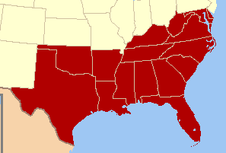
Confederate Plan
Did not want to attack the north
“Don’t die, and don’t lose” Mr. McCormick
Did not have the resources that the north did so they looked to other countries for help
Went to Great Britain and France
Hoping that Great Britain would align with them for their need of cotton
Do you remember where GB went for cotton instead?

Slide 32
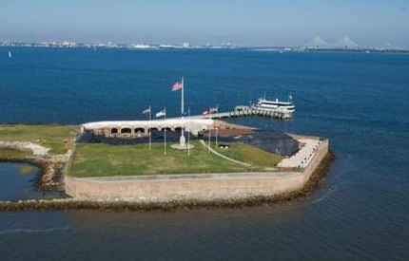
Battle at Fort Sumter
Date: April 12-14, 1861
Location: Charleston Harbor (South Carolina)
Leaders:
Union: Anderson
Confederate: Beauregard
Casualties: 1
Victor: Confederates
Significance: First battle of the war

Slide 33
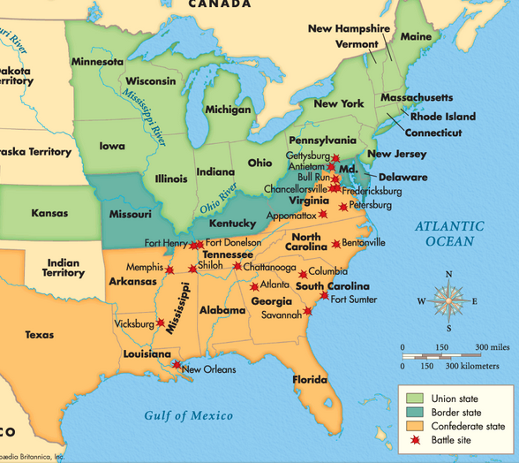

Slide 34
Battle of Bull Run (1st Manassas)
Date: July, 1861
Location: Fairfax Virginia
Leaders:
Union: McDowell
Confederacy: Beauregard
Casualties: ~ 4,900
Victor: Confederate
Significance:
1st true bloodshed
McDowell Replaced with McClellan
Established Confederate Advantage
Emergence of Stonewall Jackson as great leader

Slide 36
Battle 2nd Bull Run (2nd Manassas
Date: Aug. 1862
Location: essentially the same as Bull Run
Leaders:
Union: Pope
Confederacy: Jackson
Casualties: 22,180
Victor: Confederate
Significance: Showed weakness of Union leadership

Slide 39
Battle Antietam
Date: September, 16-18 1862
Location: Sharpsburg, Maryland (Western
Maryland)
Leaders:
Union: McClellan
Confederacy: Lee
Casualties: 23,000 on the 17th alone (bulk of the casualties)
Victor: Draw, but a Union advantage
Significance:
17th is the single bloodiest day in the history of US battle
Showed McClellan’s poor leadership because it should have easily been a Union victory.
Could possibly have ended war if McClellan had followed Confederate retreat
.

Slide 42
Battle Chancellorsville
Date: April 3- May 3, 1863
Location: Spotsylvania County VA
Leaders:
Union: Hooker
Confederacy: Lee/Jackson
Casualties: about 28,000
Victor: Confederacy
Significance:
Jackson killed in battle by his own men!
Confederacy out numbered and still win the battle
Single greatest Confederate victory

Slide 45
Battle Vicksburg
Date: May 18 – July 4, 1863
Location: Warren County Mississippi
Leaders:
Union: Grant
Confederacy: Pemberton
Casualties: 35,000
Victor: Union
Significance:
Split Confederate forces entirely in half
Considered turning point of war

Slide 48
Homework
Begin working on your battles/figures assignment with your partner

Slide 49
Warm Up
Answer the following questions:
At this point in the war which battle has had the greatest effect on the Union?
At this point in the war which battle has had the greatest effect on the Confederacy?

Slide 50
Battle Gettysburg
Date: July 3-4, 1863
Location: Gettysburg Pennsylvania
Leaders:
Union: Meade
Confederacy: Lee
Casualties: 51,000 casualties, the highest single-battle casualties in US history
Victor: Union
Significance:
Showed that confederacy was SIMPLY running out of men
Union’s superiority was based on numbers

Slide 54
Sherman’s march to the sea
Date: Nov 1864 – Jan 1865
Location: The South
Leaders:
Union: Tecumseh Sherman
Confederacy: None
Casualties:
Victor: Union
Significance:
Destroyed most of Georgia (literally burnt it to the ground)
Made post war relations very difficult between south and north
Showed a dark side to Sherman

Slide 57
Battle (Siege at) Petersburg
Date: June 1864 – April 1865
Location: Virginia
Leaders:
Union: Grant
Confederacy: Lee
Casualties:
Victor: Union
Significance:
Last major battle of the war

Slide 59
War Ends
Lee surrenders at Appomattox on April 9, 1865
This is the bulk of the confederate army
After this point is only a short time before the rest of the Confederate surrender

Slide 60
Casualties on Both Sides

Slide 61
Civil War Casualties in Comparison to Other Wars

