Slide 1
Journal Entry 10/15/15
Answer each of the following questions…
Explain how the Wilmot Proviso is a cause of the Civil War
Explain how Popular Sovereignty is a cause of the Civil War
Consider Sectionalism and Nationalism

Slide 2
Agenda/Goals 10/15/15
Agenda:
Causes of the Civil War
Goals:
Content Goals:
Understand the following causes of the Civil War and how the connect
Wilmot Proviso & Popular Sovereignty
Missouri Compromise
Compromise of 1850
Skills Goals:
Analysis of content
Note taking
Discussion

Slide 3
Cause of the Civil War - Missouri Compromise
Take a few minutes and read your chosen article on the Missouri Compromise
Consider the following…
The rhetorical situation
What is it
How can I use it
How does the Missouri Compromise connect to previous causes that we have discussed?
Is this sectionalist, or nationalist, why?
How is the Missouri Compromise a cause the Civil War?

Slide 4
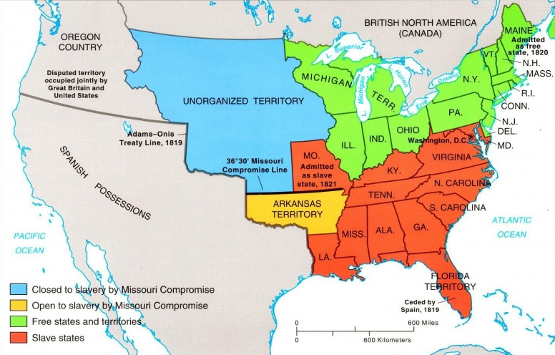

Slide 5
Cause of the Civil - War Compromise of 1850
Take a few minutes and read your chosen article on the Compromise of 1850
Consider the following…
The rhetorical situation
What is it
How can I use it
How does the Compromise of 1850 connect to previous causes that we have discussed?
Is this sectionalist, or nationalist, why?
How is the Compromise of 1850 a cause the Civil War?

Slide 6
Homework
Two parts…
Critically read an article on Uncle Tom’s Cabin (select an article on the website)
Print and bring to class an article on John Brown’s Raid (select an article on the website)
Print and bring to class an article on the Election of 1860

Slide 7
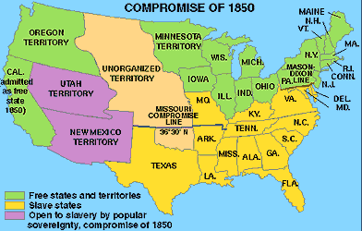
Journal Entry 10/16/15
How was the Compromise of 1850 a cause of the Civil War?
Explain using details.

Slide 8
Agenda/Goals 10/16/15
Agenda:
Causes of the Civil War
Content Goals:
Understand how each of the following items were a cause of the Civil War
Uncle Tom’s Cabin
Kansas/Nebraska Act & Bleeding Kansas
Dred Scott
Skills Goals:
Reading
Note Taking
Discussion
Analysis

Slide 9
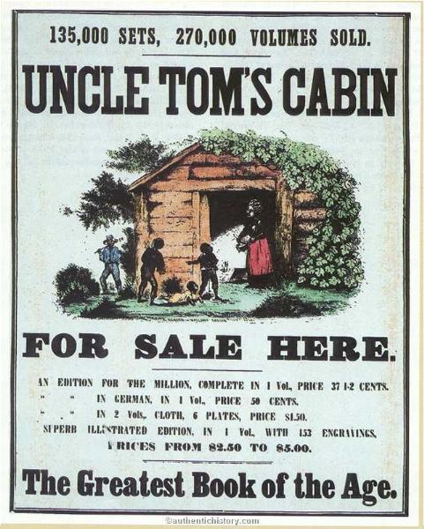
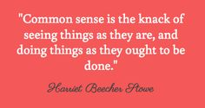
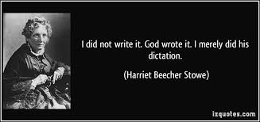
Uncle Tom’s Cabin- 1852
Harriet Beecher Stowe
Humanized Slaves
Banned in the South

Slide 10
Cause of the Civil War - Kansas Nebraska Act & Bleeding Kansas
Kansas Nebraska Act…
Background –
The idea of creating Kansas/Nebraska into territories and eventually states stems from the creation of the continental railroad
Multiple routes considered
Northern – Milwaukee to the Columbia River
2 Central –
St. Louis to San Francisco
Memphis to Los Angeles
Southern – Houston to Los Angeles via the Gadsen Purchase
Two schools of thought
Use the southern because it avoids territory awarded to Native Americans & it promoted the Gadsen Purchase
Supported by Jefferson Davis, Secretary of War
Use a central or northern because it would usher in new territories and states
Supported by Stephen Douglas, Illinois Senator

Slide 11
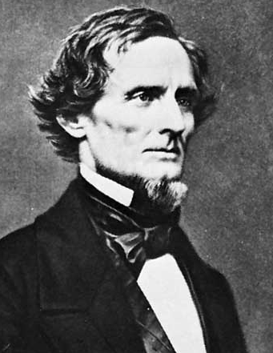
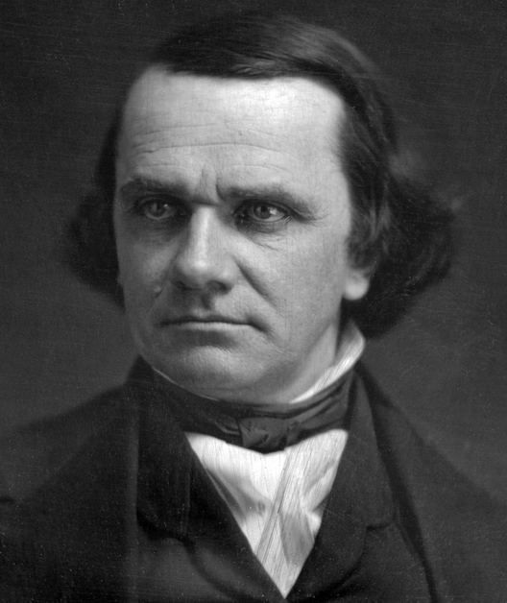
Jefferson Davis
Stephen Douglas

Slide 12
Cause of the Civil War - Kansas Nebraska Act & Bleeding Kansas
Kansas Nebraska Act – What happened?
Douglas pushes hard to use central line where the eastern terminus is in Chicago
This would create a new territory – Nebraska
Douglas begins to push the Kansas Nebraska Act which did the following…
Gives Nebraska & Kansas territorial status
Uses Popular Sovereignty in order to obtain the southern vote
Undoes the Missouri Compromise because the territorial government would have to make a decision regarding slavery
Ultimately the act is passed on May 30, 1854

Slide 13
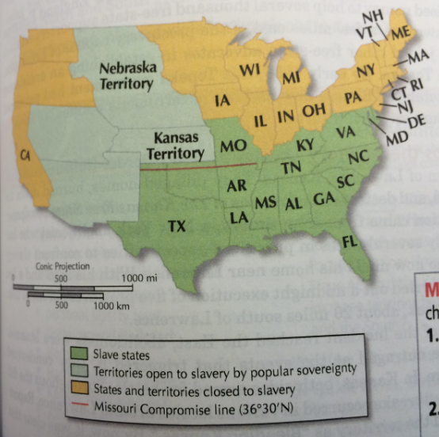

Slide 14
Cause of the Civil War - Kansas Nebraska Act & Bleeding Kansas
Bleeding Kansas – The issues
Early in territorial hood Kansas settlers did not want blacks, freed or slaves
In 1860 there were only 627 African Americans in the territory
Remember that when granted statehood the state is able to choose whether or not it is a free state or slave state (popular sovereignty
There are ultimately two different attempted governments
One free
One slave

Slide 15
Cause of the Civil War - Kansas Nebraska Act & Bleeding Kansas
Tensions are high between citizens, because there are two illegal governments running in the territory of Kansas, neither side can gain enough control to declare statehood
This blows up and causes two major problems
Lawrence Kansas
Free Kansas Capitol
May 1856 a pro slavery mob enters, and eventually burns down most of the town including the free states governors home
Results in only one casualty, but causes outrage among citizens who support a free state

Slide 16
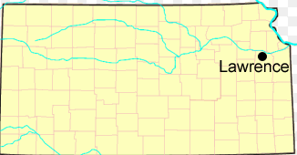

Slide 17
Cause of the Civil War - Kansas Nebraska Act & Bleeding Kansas
John Brown (first encounter, there will be another)
May 24-25, 1856
Furious over the “Sack of Lawrence”
Sets out with four of his sons for Pottawatomie – a pro slavery settlement
Drag 5 men out of their houses and murder them
Later John Brown’s son is killed by members of a pro slave movement called the Missouri Ruffians
This sets in motion guerilla warfare in Kansas that lasts through the fall until the military has to step in and control the territory
By the end of 1856 200 settlers had been killed and over 2 million dollars in property damage had been done

Slide 19
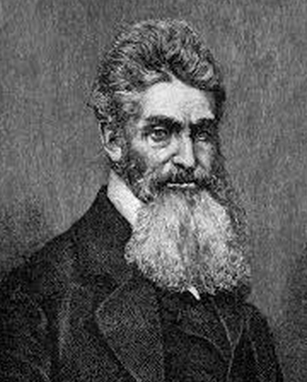
John Brown

Slide 20
Cause of the Civil War - Kansas Nebraska Act & Bleeding Kansas
Connecting Questions…
How does the Kansas Nebraska Act bring up slavery issues?
Consider other things that we have discussed regarding Causes of the Civil War
Is the Kansas Nebraska Act sectionalist or nationalist, why?
How does the Kansas Nebraska Act & Bleeding Kansas create problems that could lead to the Civil War?

Slide 21
Cause of the Civil War – Dred Scott
Background – Who, and what?
Dred Scott – Born around 1800
Bought in 1830 by an army surgeon in St. Louis
Taken to Wisconsin and Illinois territories
Master dies in 1843, he returns to St. Louis with his wife and children where he attempts to buy his freedom
He is unable to buy his freedom because Missouri is a slave state
1846 Scott’s wife persuades him to file a suit in Missouri Courts claiming that his residence in Illinois and Wisconsin made him free
Jury rules in his favor, but state supreme court rules against him

Slide 22
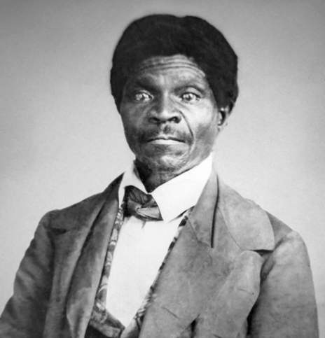
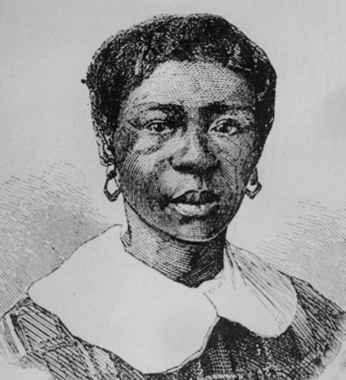
Dred Scott
Harriet Scott

Slide 23
Cause of the Civil War – Dred Scott
Scott appeals the case all the way to the Supreme Court
Chief Justice Roger B. Taney wrote the majority opinion of the 9 justices that oversaw the case, here is what they decided…
Scott lacked citizenship, therefore he had no legal standing
Taney argued that you became a citizen by birth or naturalization, both methods ruled out a slave
Taney also declared that Scott’s residency in a free state had not freed him
This was because the case was not brought in a free state
Taney then argues that the Missouri Compromise was unconstitutional because it deprived citizens of property by prohibiting slavery
Due process clause of the 5th Amendment
“No person shall…e deprived of life, liberty, or property, without due process of law; nor shall private property be taken for public use, without just compensation.”
Congress had an obligation to protect the property of slaveholders

Slide 24
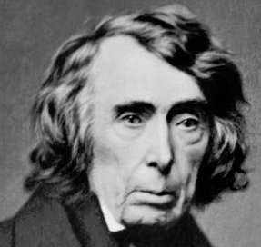

Slide 25
Cause of the Civil War – Dred Scott
Connecting Questions…
How does the Dred Scott case promote or denounce slavery issues?
Is the Dred Scott case sectionalist or nationalist, does it matter in this case?
How could the Dred Scott case be perceived as a cause of the Civil War?

Slide 26
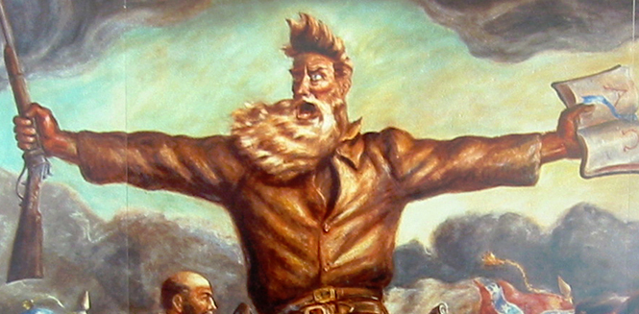
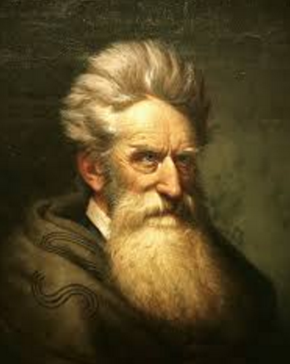
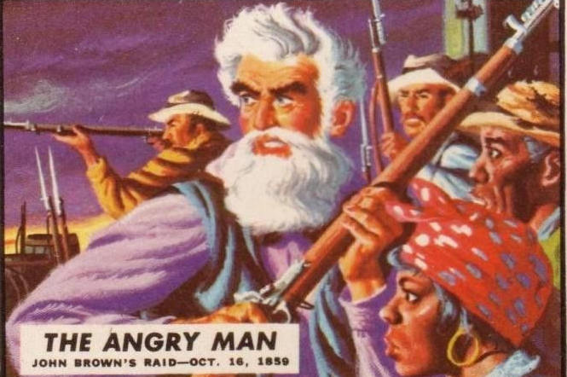
Cause of the Civil War – John Brown’s Raid
Remember John Brown from Bleeding Kansas? Well he’s back, he’s pissed off, and he’s lookin to give a case of the face hurts to slavery with a vengeance!!!!!!!!!!!!!

Slide 27
Cause of the Civil War – John Brown’s Raid
Brown who is still angry from the death of his son and the events that occurred in Kansas (Bleeding Kansas) feels the need to take action
Believed himself to be an angel of God avenging the evil of slavery
Felt that violence was the best way to reach this goal
Between 1857 & 1859 Brown crisscrossed the US in search of people to join his cause
In the fall of 1859 Brown rallies his men to respond to the evils of slavery
21 men

Slide 28
Cause of the Civil War – John Brown’s Raid
Brings his men together at Harpers Ferry
Weapons depot
Hub for transportation
In West Virginia (was Virginia at the time)
Hoped to inspire a revolution destroying slavery
Brown is unable to rally anyone else, loses to local citizens
Is ultimately hung, the members of his regime who escaped flee to Canada

Slide 29
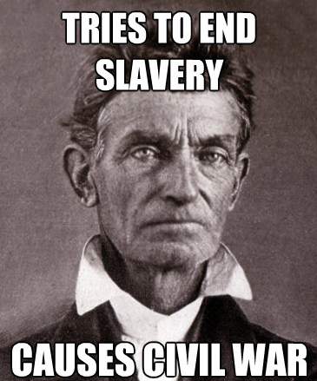
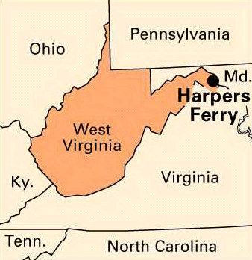

Slide 30
Cause of the Civil War – John Brown’s Raid
Connecting Questions…
How does John Brown’s intensity and fanaticism represent the nation?
Does it represent the south, north, or both sides?
Is Brown a representation of sectionalism or nationalism, why or why not?
How is John Brown’s raid on Harpers Ferry a cause of the Civil War?

Slide 31
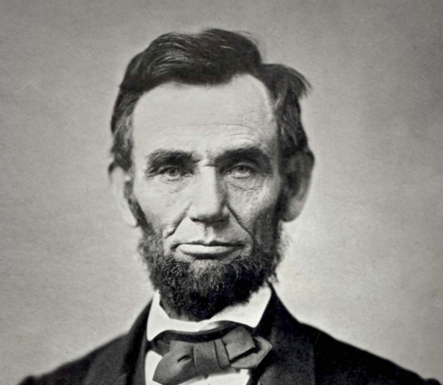
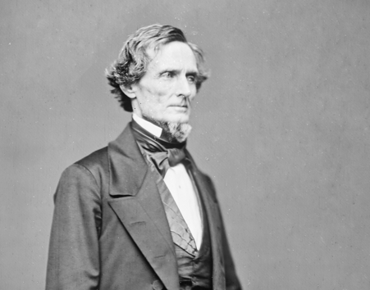
Journal Entry 10/19/15
Explain the impact of the Election of 1860.
How could the Election of 1860 cause the Civil War?

Slide 32
Weekly Agenda
Monday:
Complete causes of the Civil War
South secedes
Tuesday:
Start Civil War
Wednesday:
Civil War
Thursday:
Wrap up Civil War
Start Civil War Social Issues
Friday:
Civil War Social Issues

Slide 33
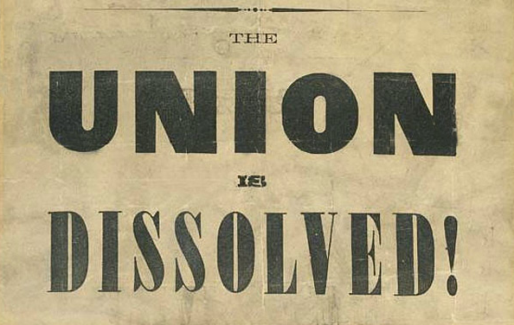
The South Secedes
Discuss in your groups why you think after the election of Lincoln the south finally secedes?

Slide 34
Secession
Lincoln is elected November 6 1860, by December south was already on its way out.
South Carolina holds a special election to choose delegates on December 20, 1860
Convention unanimously decides to secede (only for SC)
Ordinance of Secession – Dissolves relationship with union
By February 1, 1861 Mississippi, Florida, Alabama, Georgia, Louisiana, and Texas all secede
Elect Mississippi’s Jefferson Davis as President of the Confederate States of America
Within a week they draft and adopt a new constitution
All of this occurs before Lincoln officially takes office

Slide 35
Secession
Prior to the start of the Civil War there were multiple attempts to bring the Confederate States back into the union
Even went so far as to guarantee slavery in a new Amendment (would have been the 13th)
Ultimately they cannot agree over slavery in the territories which leads to the Civil War

